Slide 1
Case Studies
A selection of tailored solutions

Slide 2
Python
Open files the correct way

Slide 3
About me
A selection of tailored solutions

Slide 4
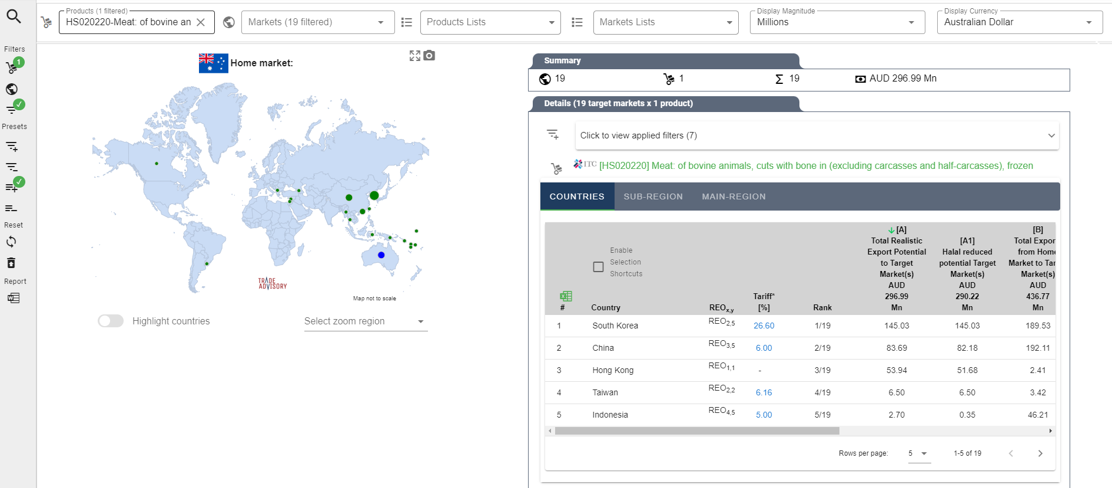
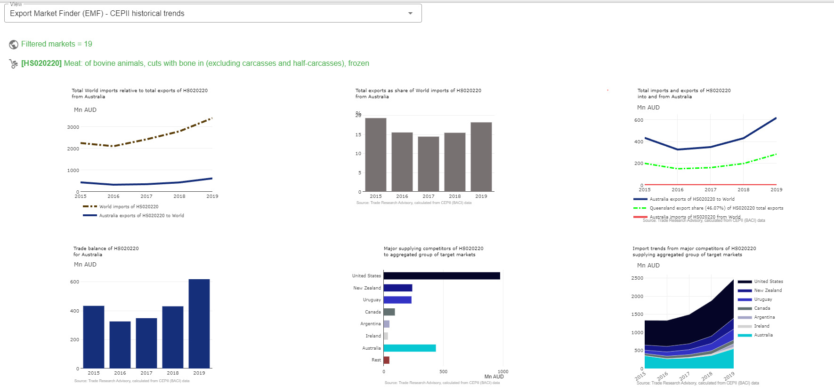
Case Study | International trade application

Slide 5
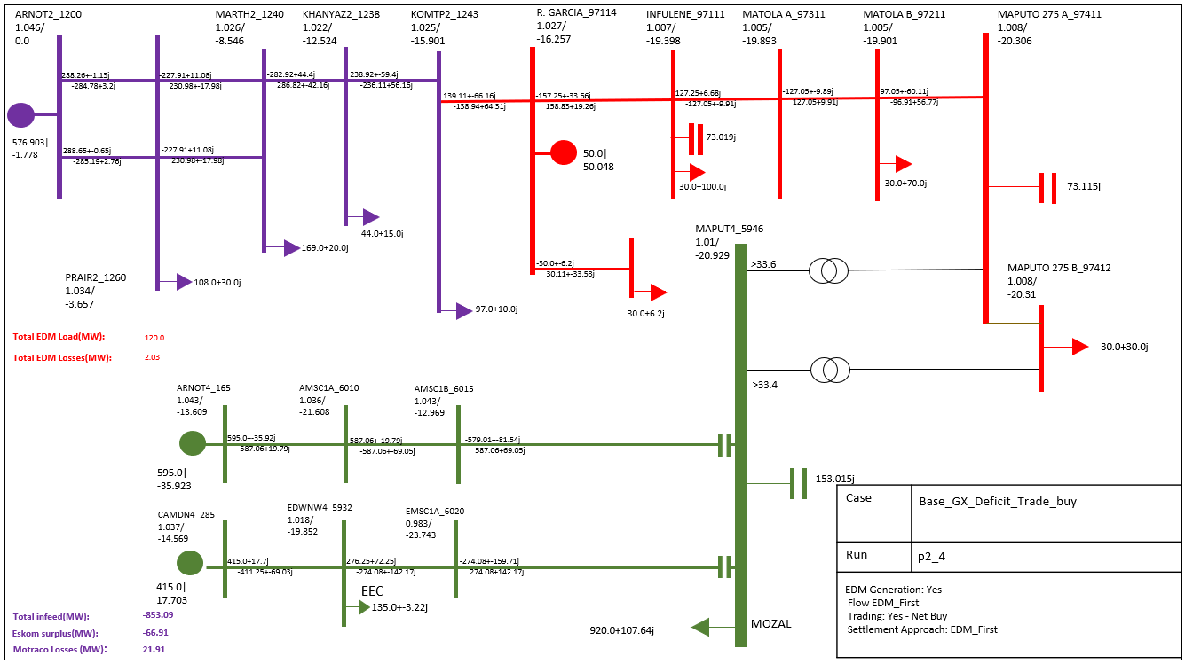
Case Study | Tailored electrical engineering

Slide 6
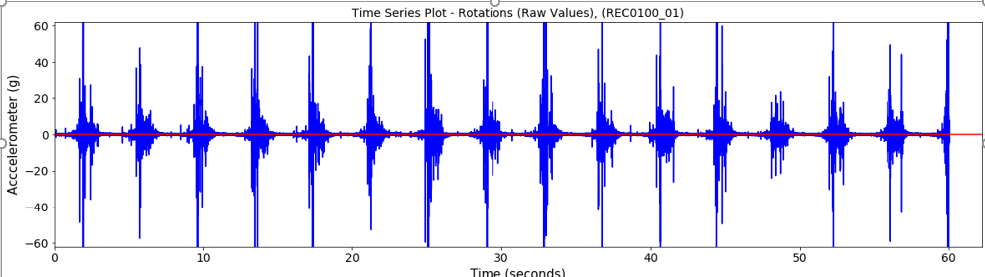
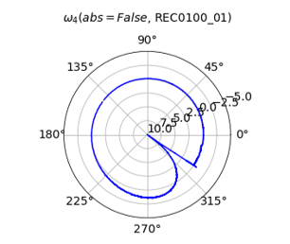
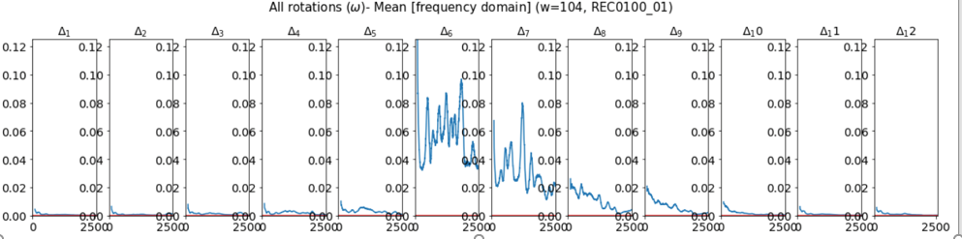
Case Study | Industrial Scientific Analysis
Time series
Rotational energy
Frequency domain

Slide 7
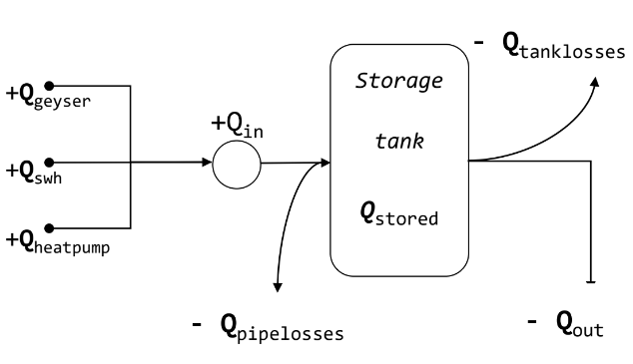
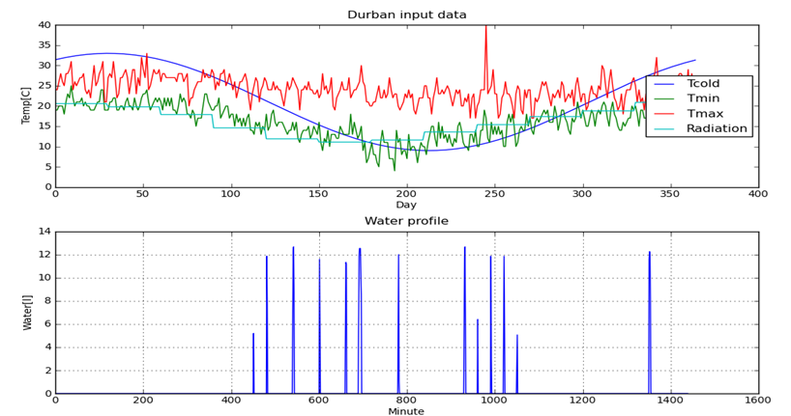
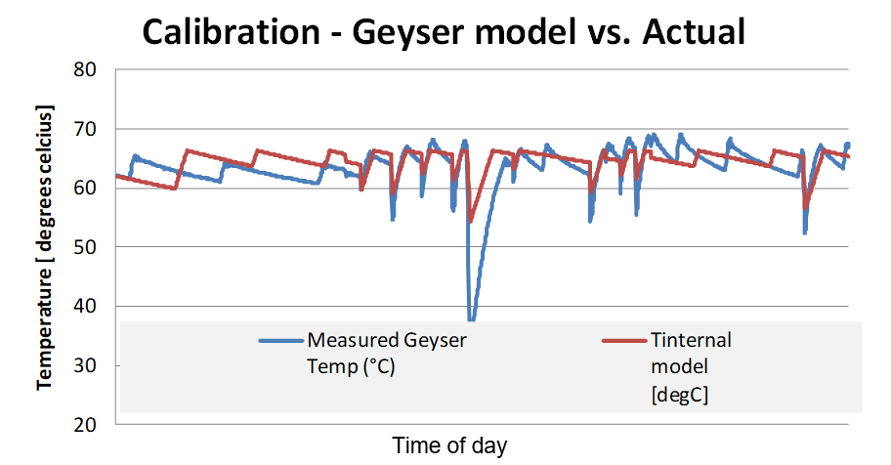
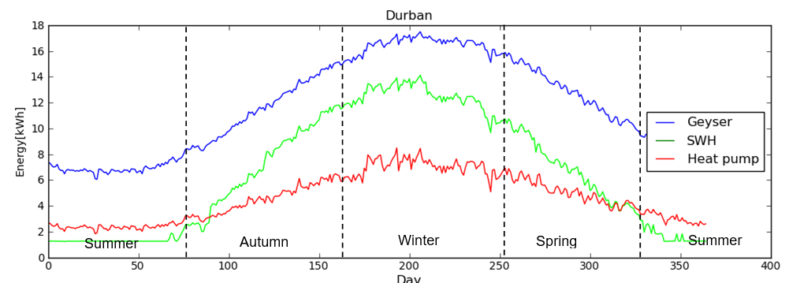
Case Study | Water heating research
Model
Results
Calibration
Results

Slide 8
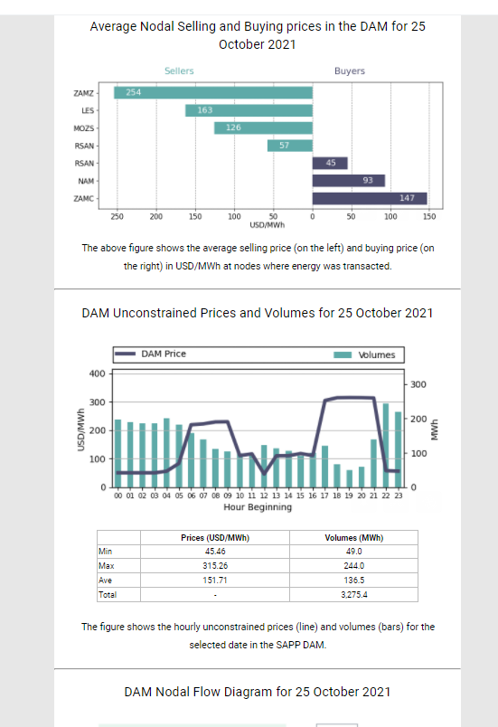
Case Study | Specialised Automated Email
Full responsive design
Variable sending frequency
Automatic processing and email generation

Slide 9
Case Study | Automated social meda

Slide 10
Case Study | Social post automation

Slide 11
Case Study | Specialized mailing lists

Slide 12
Case Study | Tailor made analysis tools

Slide 13
Case Study | Engineering automation

Slide 14
Case Study | Large data sets analysis

Slide 15
Case Study | Automated presentations

Slide 16
Case Study | Automated PDF reports

