Slide 1
Case Studies
A selection of tailored solutions

Slide 2
Python
Open files the correct way

Slide 3
About me

Slide 4
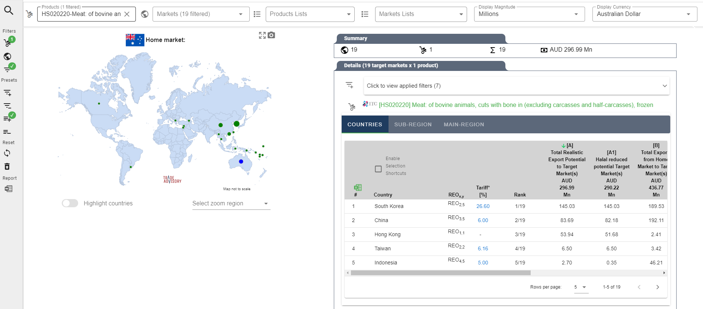
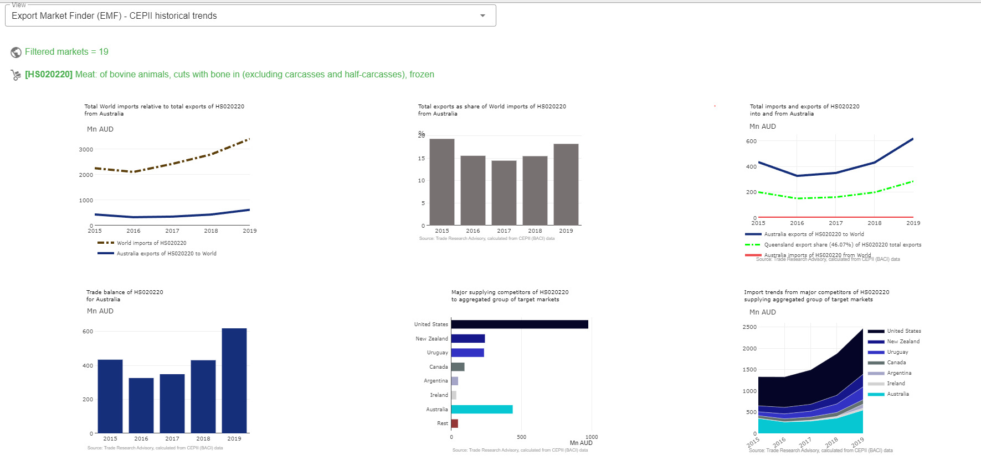
Case Study | International trade application

Slide 5
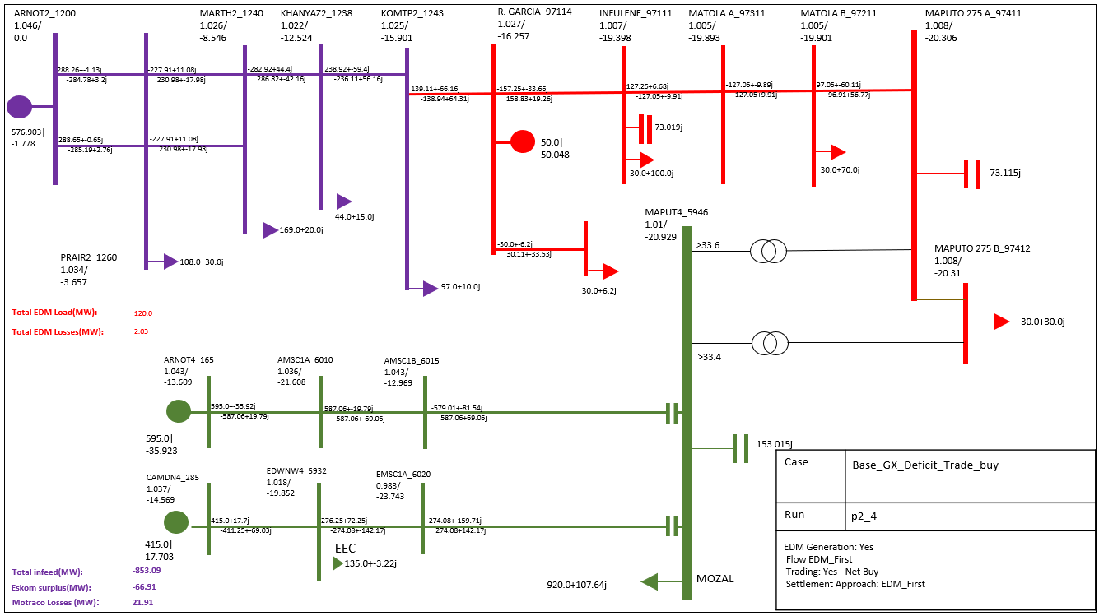
Case Study | Tailored electrical engineering

Slide 6
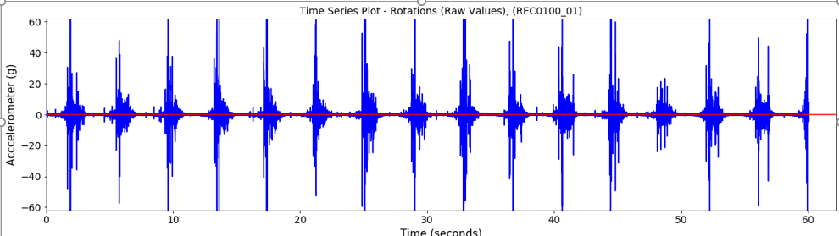
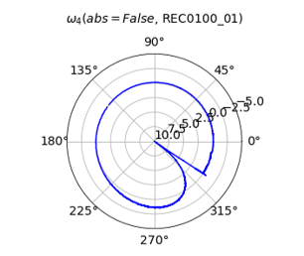
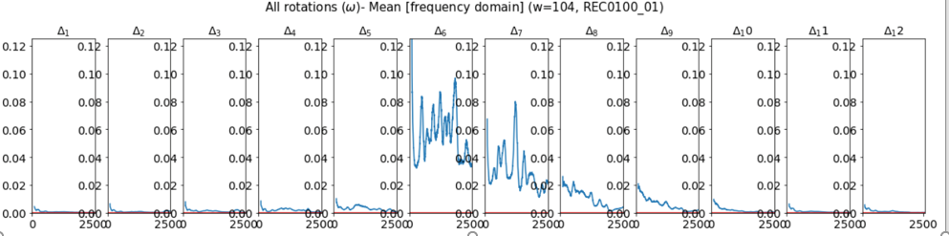
Case Study | Industrial Scientific Analysis
Time series
Rotational energy
Frequency domain

Slide 7
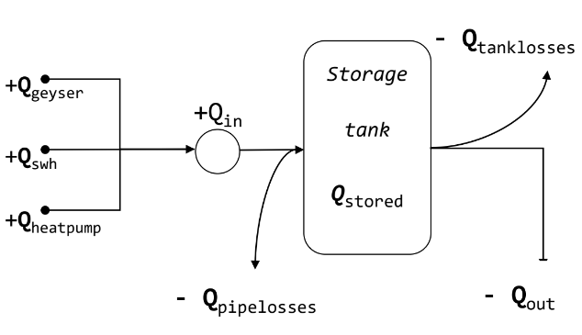
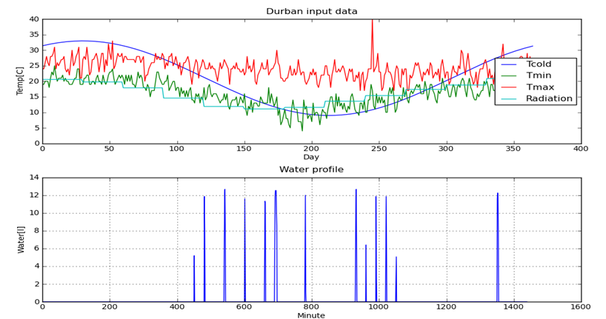
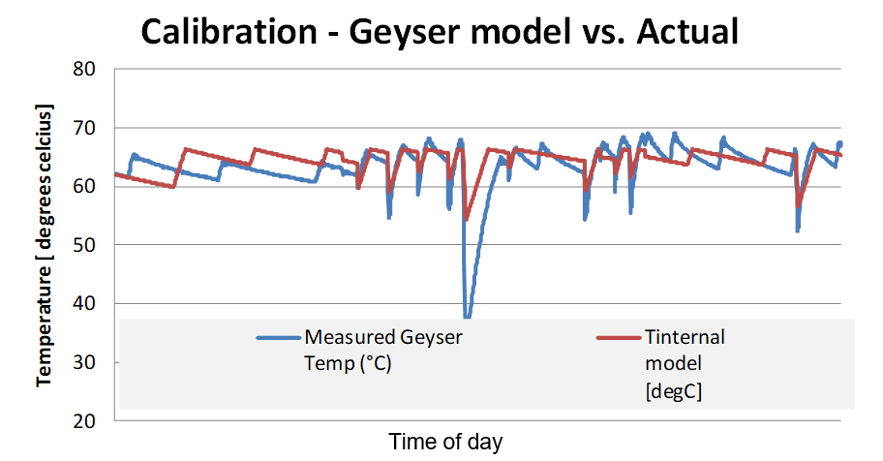
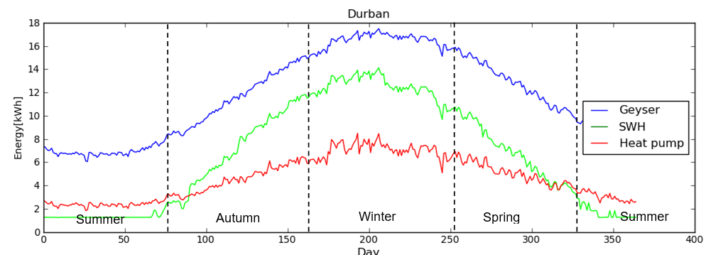
Case Study | Water heating research
Model
Results
Calibration
Results

Slide 8
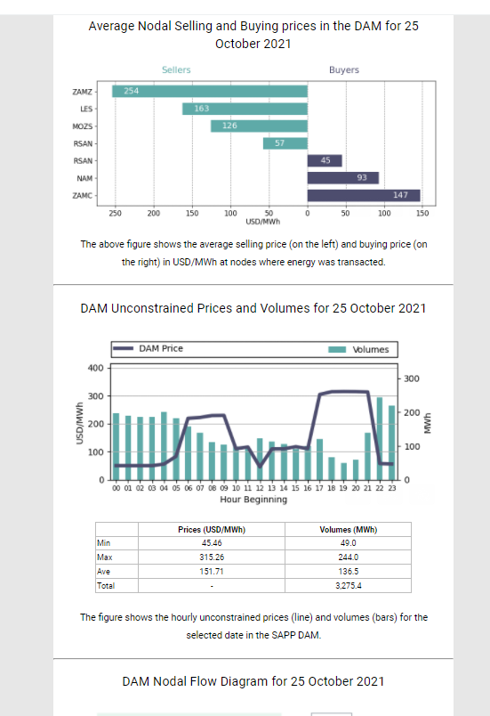
Case Study | Specialised Automated Email
Full responsive design
Variable sending frequency
Automatic processing and email generation

Slide 9
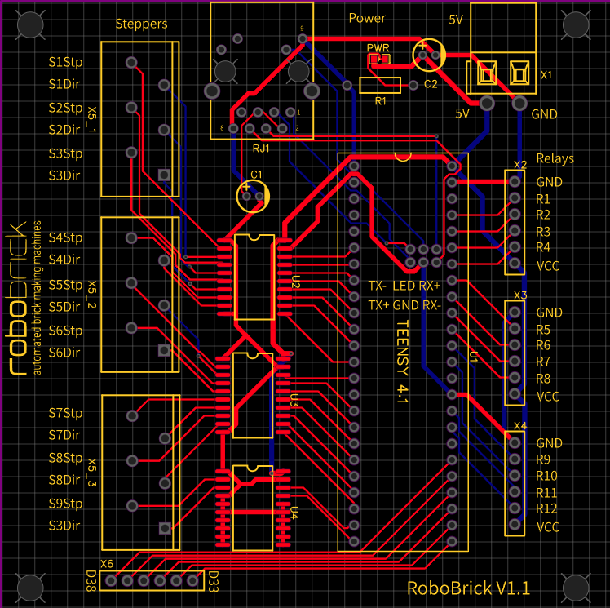
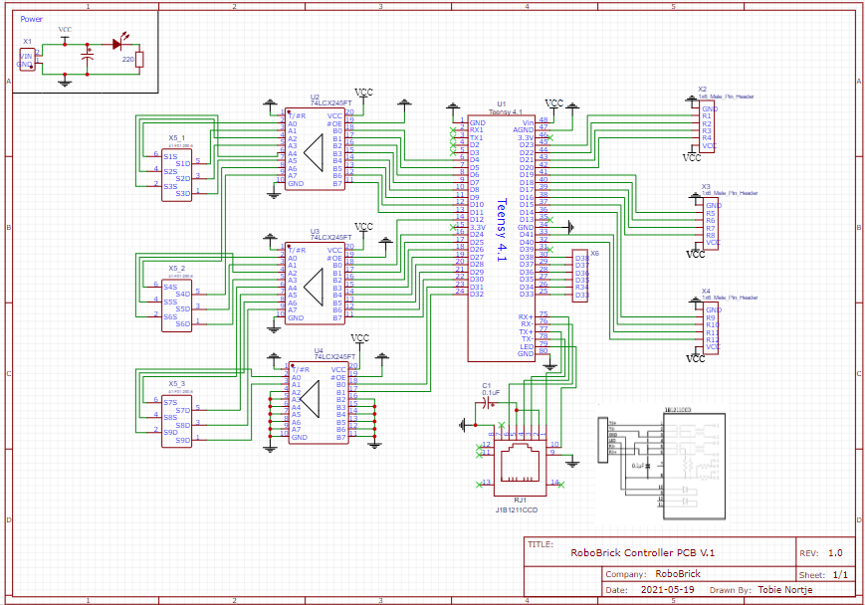
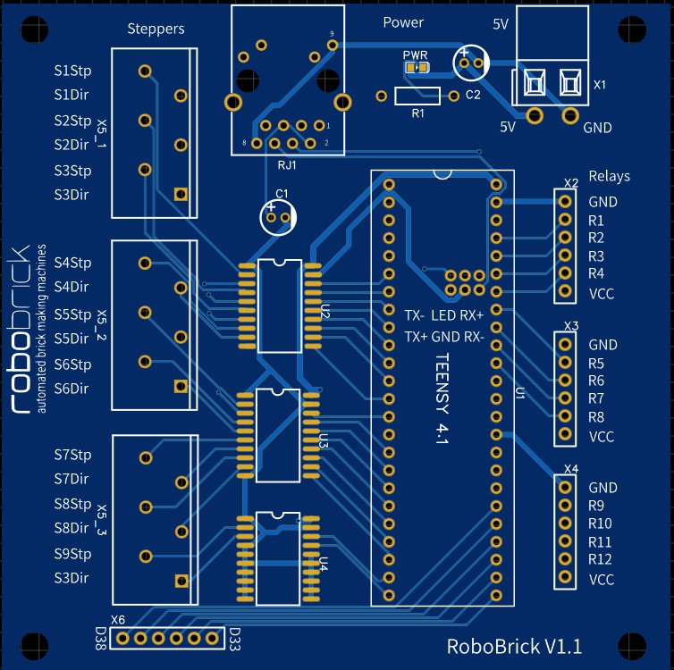
Case Study | Printed Circuit Board
PCB Layout
Schematic
PCB

Slide 10
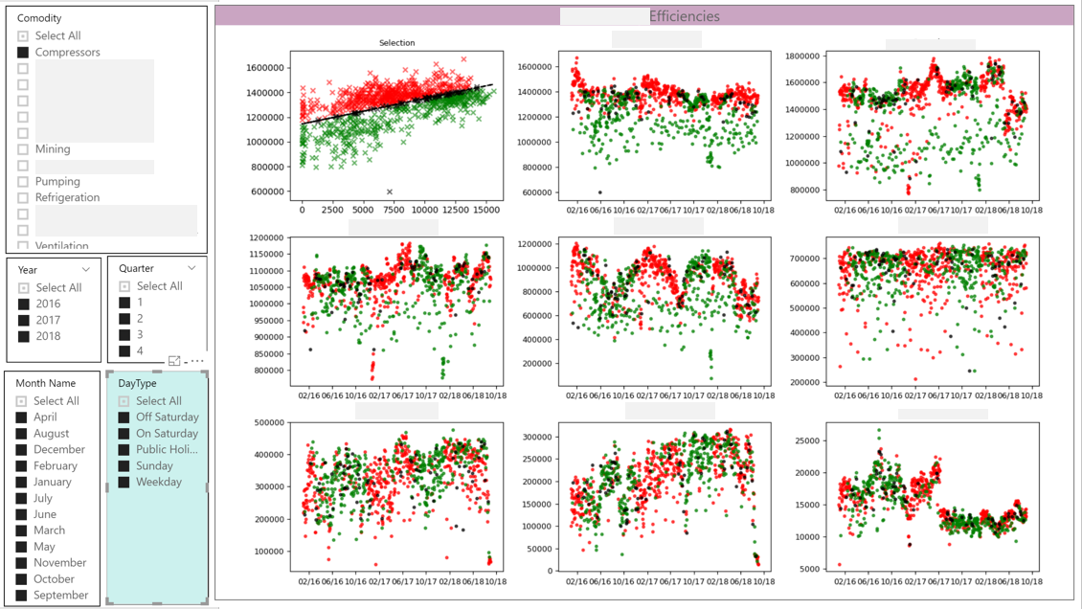
Case Study |Engineering Energy Analysis

Slide 11
Case Study | Social post automation

Slide 12
Case Study | Specialized mailing lists

Slide 13
Case Study | Tailor made analysis tools

Slide 14
Case Study | Engineering automation

Slide 15
Case Study | Large data sets analysis

Slide 16
Case Study | Automated presentations

Slide 17
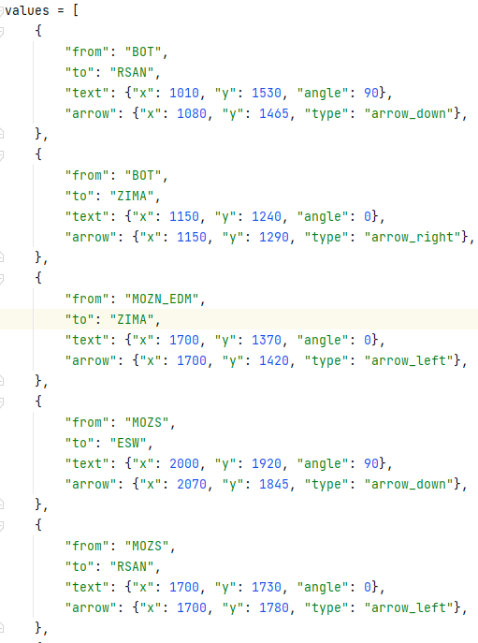
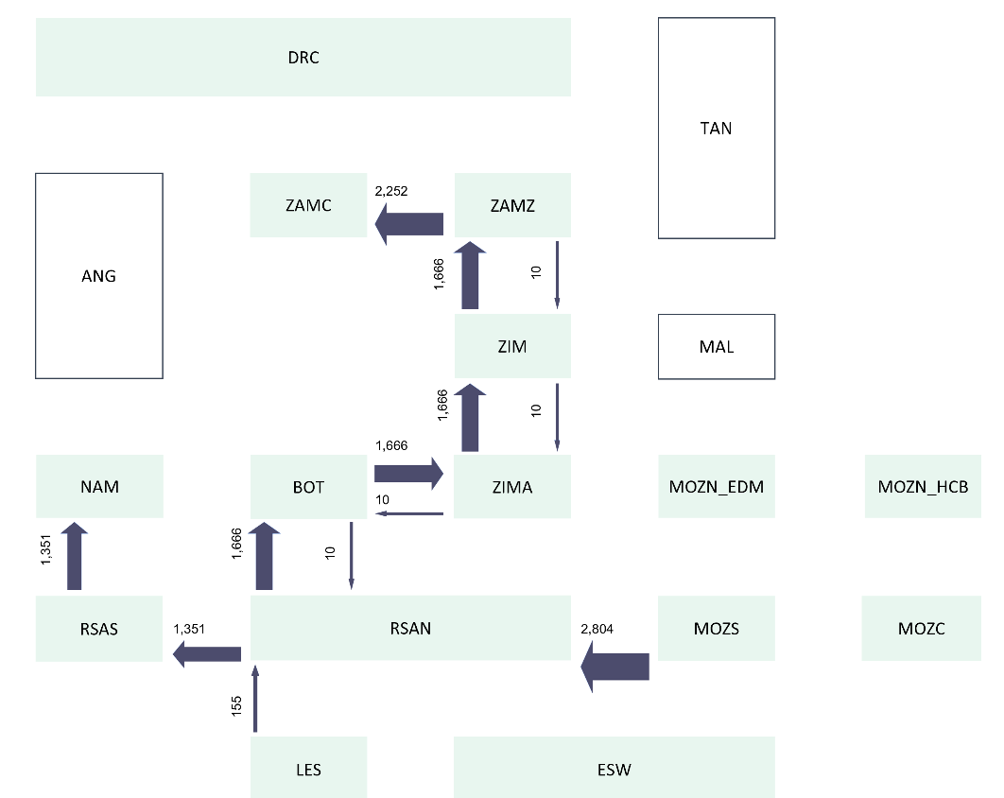
Case Study | Automated Diagrams / Flow Charts

