Slide 1

MULTI-DIMENSIONAL (2d) ARRAY
CCE 103/L

Slide 2
objective
To understand the concept of multi-dimensional array.
Learn how to declare and initialize multi-dimensional array.
Write Java program implementing multi-dimensional array.
Learn the concept of Nested For Loop and to access element of a 2D array.

Slide 3
Multi-dimensional array (2d aRRAY)
An array of arrays. Basically looks like a table with rows and columns.
It can only store one datatype at a time.
It useful when you want to store data as a tabular form, like a table with rows and columns.

Slide 4
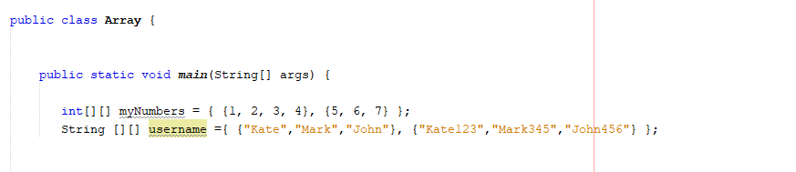
SYNTAX
Add each array within its own set of curly brace.
data_type [][] array_name;
datatype identifier [][] = new datatype [row][cols];
Example:

Slide 5
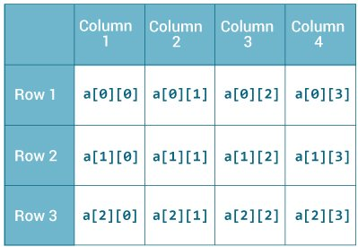

Slide 6
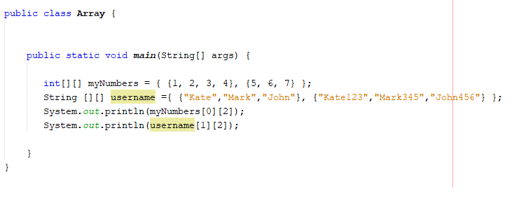
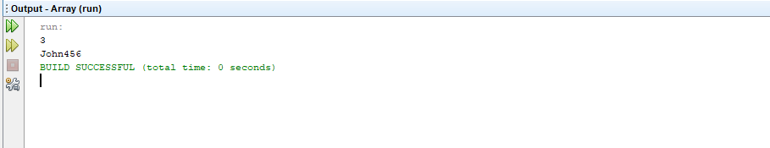
Accessing 2d array
To access the elements of 2D-Array, specify two indexes:
One for the array.
One for the element inside that array.

Slide 7

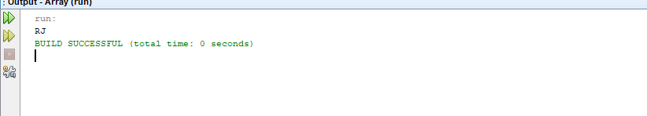
ASSIGNing VALUE IN 2D ARRAY
Syntax:
Identifier [row][col] = value;

Slide 8
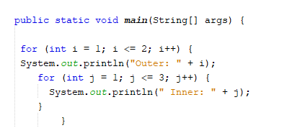
Nested for loop
A for loop inside another for loop.

Slide 9
Nested FOR LOOP SYNTAX IN ITERATING 2D ARRAY
for (int row =0; row<identifier.length;row++){
for (int col =0; col<identifier[row].length; col++){
System.out.println(identifier[row][col]);
}
}

Slide 10
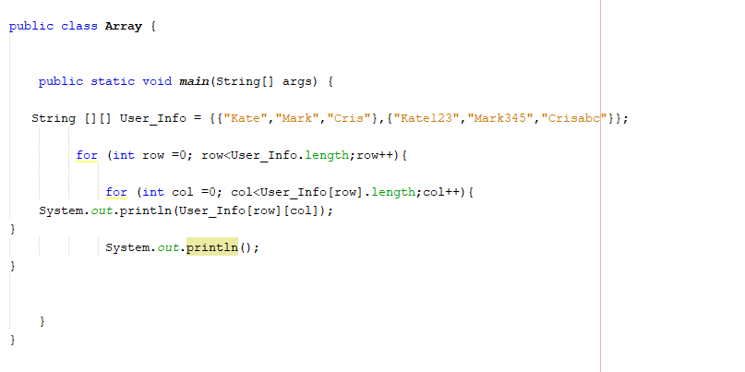
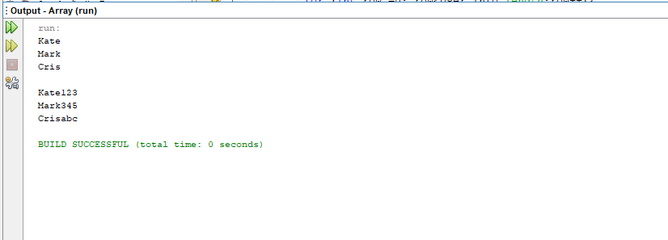
ITERATING 2D ARRAY using nested for loop
Notes:
If fixed array length then do not use .length()

Slide 11
For each loop in iterating 2d array
Are used to iterate through collections like arrays easily without knowing the size of the collection.
SYNTAX:
For(datatype identifier:collection) {
//to do code
}

Slide 12
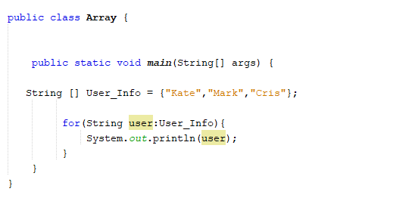
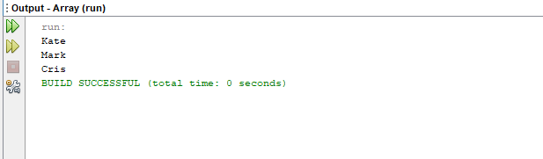
For each loop iterating array

Slide 13
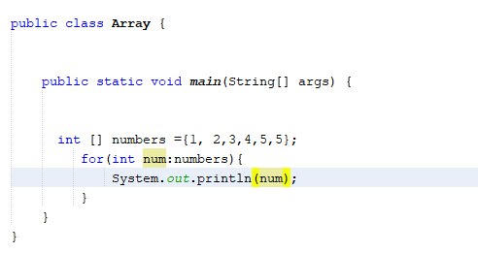
For each loop iterating array

Slide 14
Nested FOR each LOOP SYNTAX IN ITERATING 2D ARRAY
For(String [] Var_name :Array_identifier){ - holds the array
For(String NewVar_name: Var_name){ - holds the value of each array
}
}

Slide 15
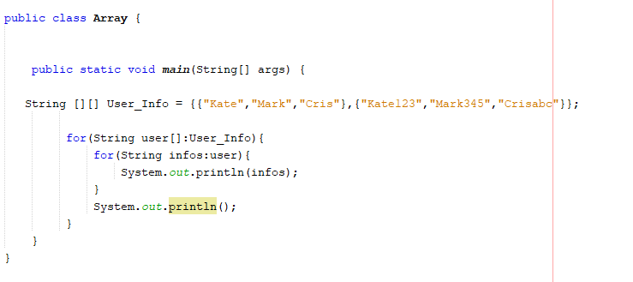
IN ITERATING 2D ARRAY using nested for each loop

