Slide 1
PROBABILITY & STATISTICS MATH 103 – LESSON 1

Slide 2
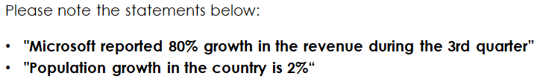
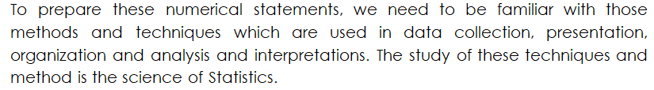
INTRODUCTION

Slide 3
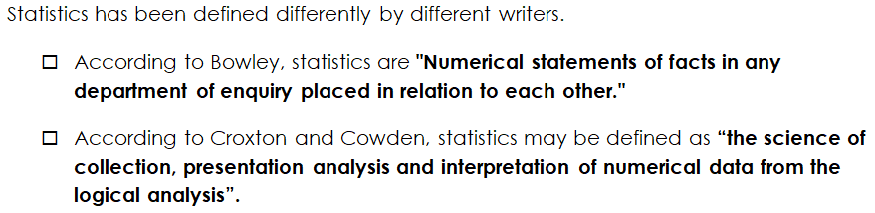
INTRODUCTION

Slide 4
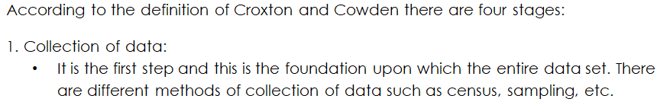
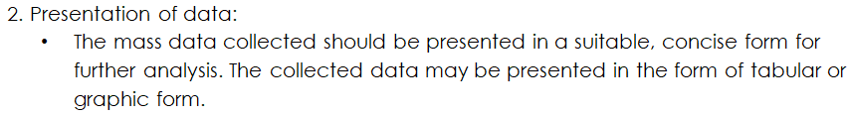

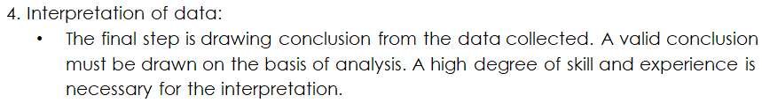
INTRODUCTION

Slide 5
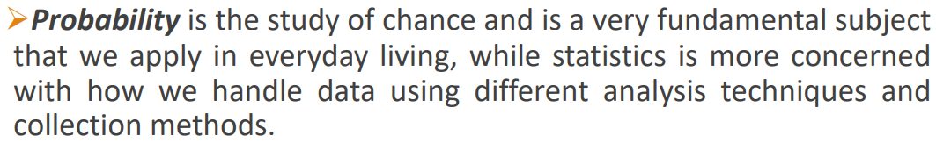
INTRODUCTION

Slide 6
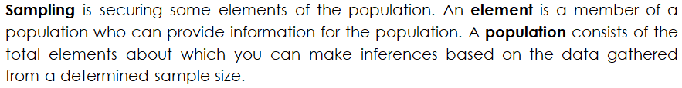
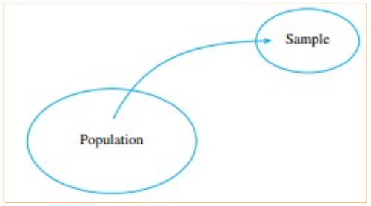
INTRODUCTION THE POPULATION AND THE SAMPLE

Slide 7
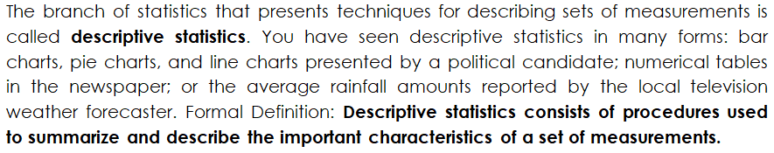
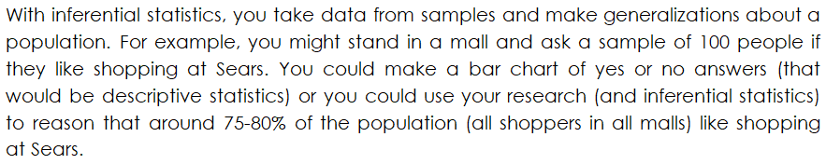
INTRODUCTION DESCRIPTIVE AND INFERENTIAL STATISCTIS

Slide 8
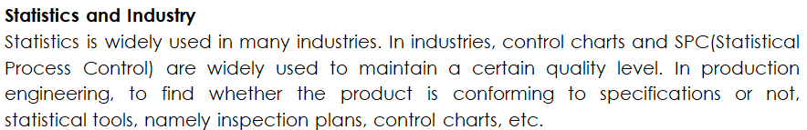

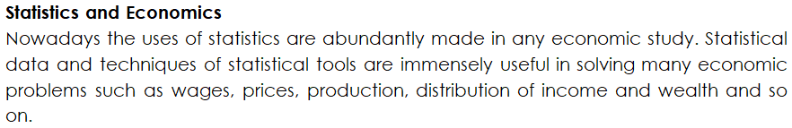
INTRODUCTION APPLICATION OF STATISCTIS

Slide 9
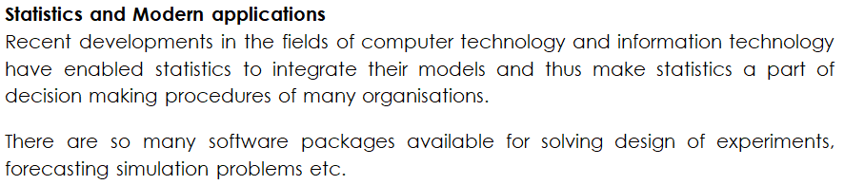
INTRODUCTION APPLICATION OF STATISCTIS

Slide 10
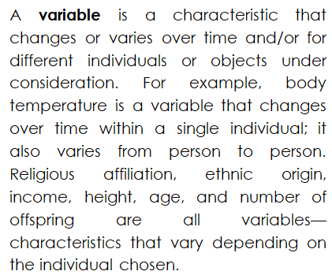
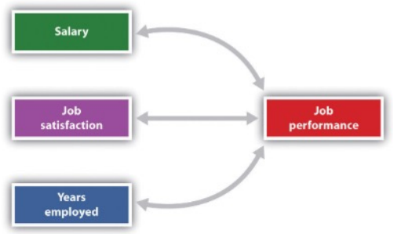
INTRODUCTION VARIABLES AND DATA

Slide 11
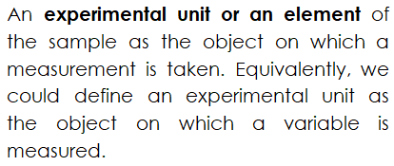
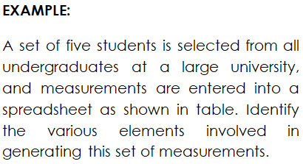
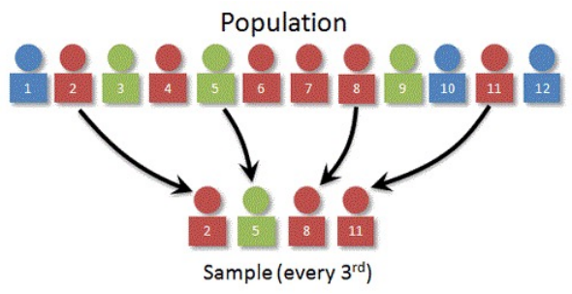
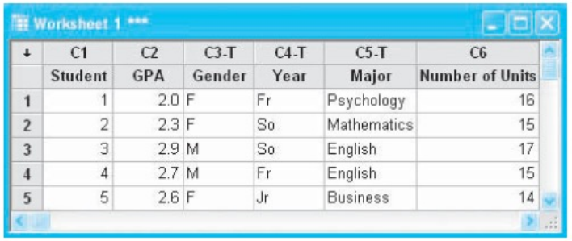
INTRODUCTION VARIABLES AND DATA

Slide 12
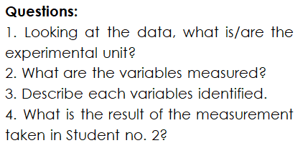
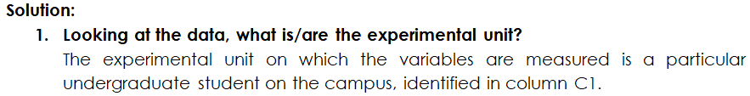
INTRODUCTION VARIABLES AND DATA

Slide 13
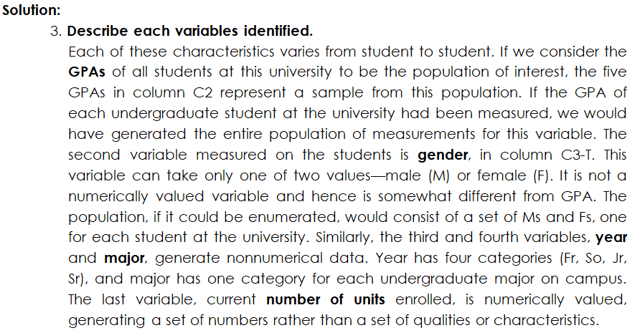
INTRODUCTION VARIABLES AND DATA

Slide 14
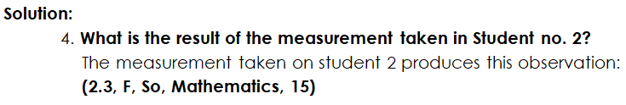
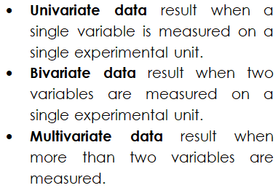
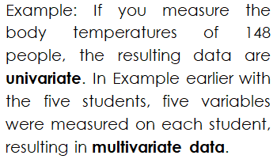
INTRODUCTION VARIABLES AND DATA

Slide 15
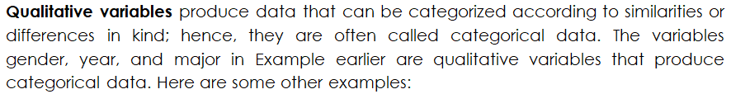

INTRODUCTION TYPES OF VARIABLES

Slide 16
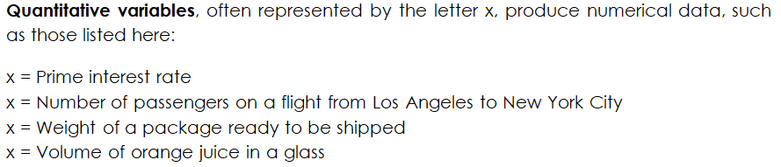

INTRODUCTION TYPES OF ARIABLES

Slide 17
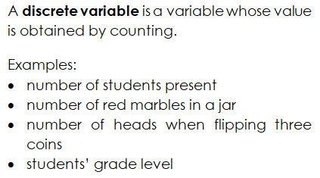
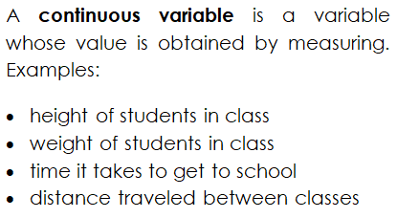
INTRODUCTION TYPES OF ARIABLES

Slide 18
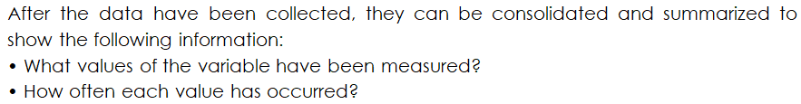

INTRODUCTION GRAPHS FOR CATEGORICAL DATA

Slide 19
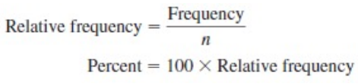
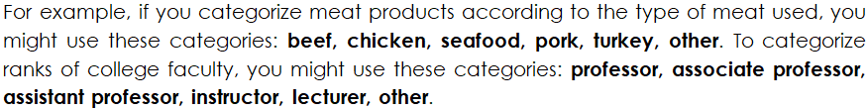
INTRODUCTION GRAPHS FOR CATEGORICAL DATA

Slide 20
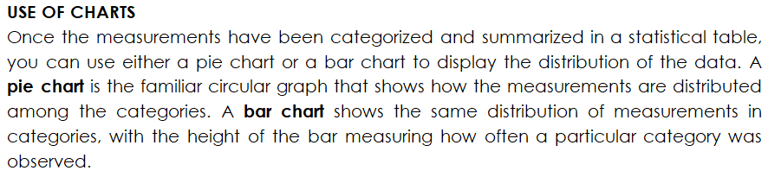
INTRODUCTION GRAPHS FOR CATEGORICAL DATA

Slide 21
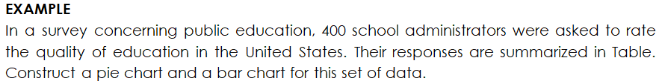
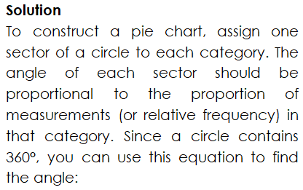
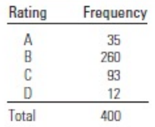
INTRODUCTION GRAPHS FOR CATEGORICAL DATA

Slide 22
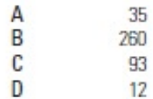
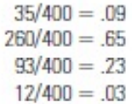

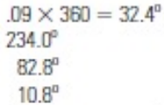


INTRODUCTION GRAPHS FOR CATEGORICAL DATA

Slide 23
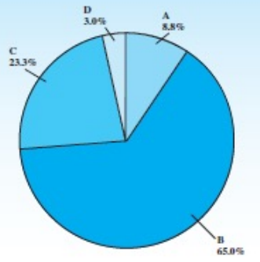
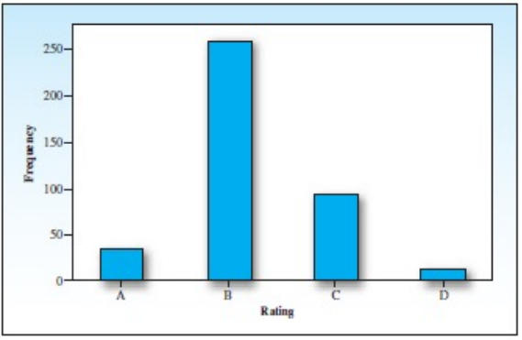
INTRODUCTION GRAPHS FOR CATEGORICAL DATA

Slide 24
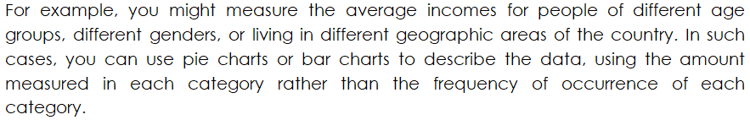
INTRODUCTION GRAPHS FOR QUANTITATIVE DATA

Slide 25
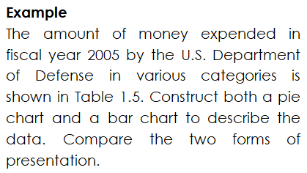
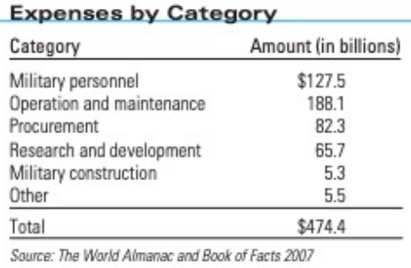
INTRODUCTION GRAPHS FOR QUANTITATIVE DATA

Slide 26
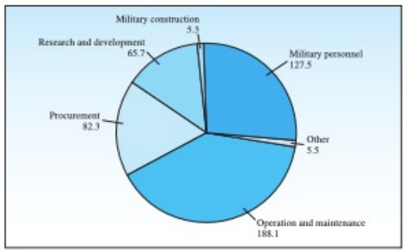
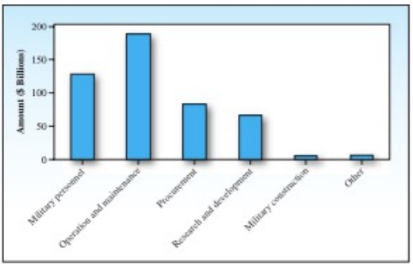
INTRODUCTION GRAPHS FOR QUANTITATIVE DATA

Slide 27
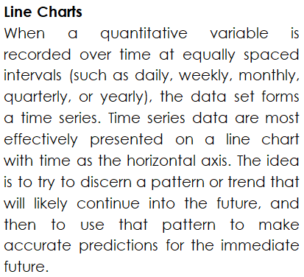
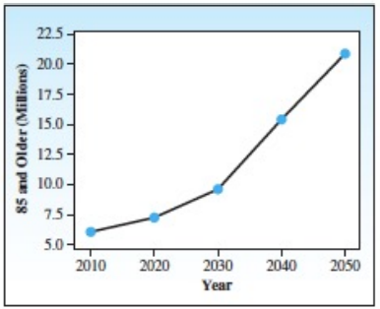
INTRODUCTION GRAPHS FOR QUANTITATIVE DATA

Slide 28
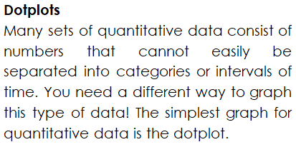

INTRODUCTION GRAPHS FOR QUANTITATIVE DATA

