Slide 1
IT8 CALCULUS 2

Slide 2
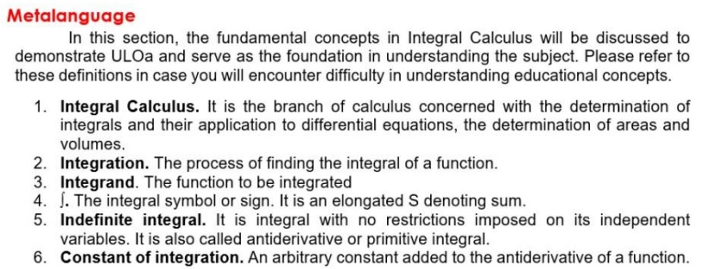
IT8– Calculus 2

Slide 3





IT8– CALCULUS 2 APPLICATIONS OF INTEGRAL CACLULUS

Slide 4
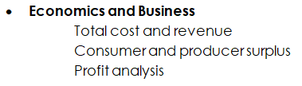
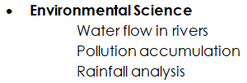
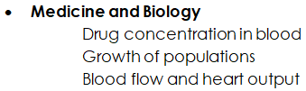



IT8– CALCULUS 2 APPLICATIONS OF INTEGRAL CACLULUS

Slide 5
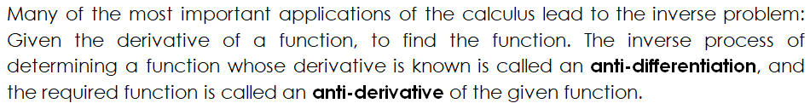
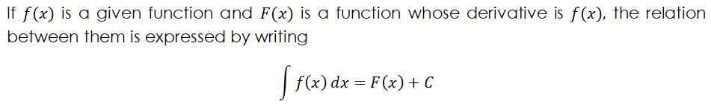
IT8– Calculus 2

Slide 6
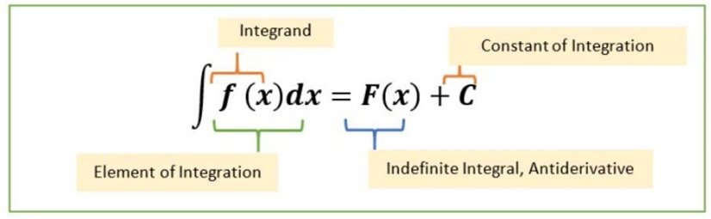
IT8– Calculus 2

Slide 7




IT8– Calculus 2

Slide 8

IT8– Calculus 2

Slide 9
















IT8– Calculus 2

Slide 10




IT8– Calculus 2

