Slide 1
IT8 CALCULUS 2 LESSON 5

Slide 2
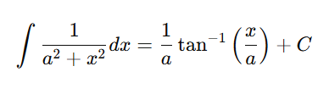
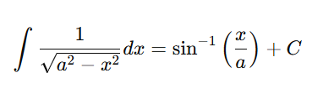
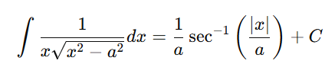
IT8 CALCULUS 2 Inverse Trigonometric Functions
Arctan
Arcsin
Arcsec

Slide 3

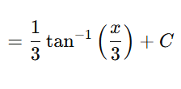
IT8 CALCULUS 2 Inverse Trigonometric Functions
Example

Slide 4
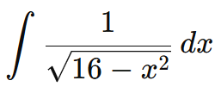

IT8 CALCULUS 2 Inverse Trigonometric Functions
Example

Slide 5
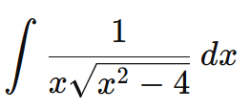
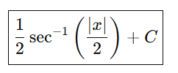
IT8 CALCULUS 2 Inverse Trigonometric Functions
Example

Slide 6




IT8 CALCULUS 2 Inverse Trigonometric Functions

