Slide 1

Lesson 6 - HYPERBOLIC FUNCTIONS
INTEGRAL CALCULUS

Slide 2


INTEGRATION OF HYPERBOLIC FUNCTIONS
The following formulas are direct consequences of the differentiation formulas of hyperbolic functions.
$$\int{\sinh{u}}du=\cosh{u}+C$$
$$\int{\cosh{u}}du=\sinh{u}+C$$
$$\int{\tanh{u}}dx=\ln{\cosh{u}}+C$$

Slide 3

INTEGRATION OF HYPERBOLIC FUNCTIONS
$$\int{\coth{u}}du=\ln{\sinh{u}}+C=\ln\left|\sinh{u}\right|+C$$
$$\int{{sech}^{2}{u}}du=\tanh{u}+C$$
$$\int{{csch}^{2}{u}}du=−\coth{u}+C$$
$$\int{\operatorname{sech}{u}}\tanh{u}du=−\operatorname{sech}{u}+C$$

Slide 4

INTEGRATION OF HYPERBOLIC FUNCTIONS
$$\int{\operatorname{csch}{u}\coth{u}}du=−\operatorname{csch}{u}+C$$
$$\int{\frac{du}{\sqrt{u^{2}+a^{2}}}}=\sinh^{−1}\left(\frac{u}{a}\right)+C$$
$$\int{\frac{du}{\sqrt{u^{2}−a^{2}}}}=\cosh^{−1}\left(\frac{u}{a}\right)+C, u>a>0$$
$$\int{\frac{du}{a^{2}−u^{2}}}=\frac{1}{a}\tanh^{−1}\left(\frac{u}{a}\right)+C, u^{2}<a^{2}$$

Slide 5

INTEGRATION OF HYPERBOLIC FUNCTIONS
$$\int{\frac{du}{u^{2}−a^{2}}}=−\frac{1}{a}\coth^{−1}\left(\frac{u}{a}\right)+C, u^{2}>a^{2}$$

Slide 6

INTEGRATION OF HYPERBOLIC FUNCTIONS
Review that the hyperbolic functions are defined as
$$\sinh{x}=\frac{e^{x}−e^{−x}}{2}$$
$$\cosh{x}=\frac{e^{x}+e^{−x}}{2}$$
$$\tanh{x}=\frac{\sinh{x}}{\cosh{x}}=\frac{e^{x}−e^{−x}}{e^{x}+e^{−x}}$$
$$\coth{x}=\frac{\cosh{x}}{\sinh{x}}=\frac{e^{x}+e^{−x}}{e^{x}−e^{−x}}, x≠0$$

Slide 7

INTEGRATION OF HYPERBOLIC FUNCTIONS
$$\operatorname{sech}{x}=\frac{1}{\cosh{x}}=\frac{2}{e^{x}+e^{−x}}$$
$$\operatorname{csch}{x}=\frac{1}{\sinh{x}}=\frac{2}{e^{x}−e^{−x}}, x≠0$$

Slide 8

IDENTITIES OF HYPERBOLIC FUNCTIONS (REVIEW)
$$\cosh^{2}{x}−\sinh^{2}{x}=1$$
$$1−\tanh^{2}{x}={sech}^{2}{x}$$
$$\coth^{2}{x}−1={csch}^{2}{x}$$
$$\sinh\left(x±y\right)=\sinh{x}\cosh{y}±\cosh{x}\sinh{y}$$
$$\cosh\left(x±y\right)=\cosh{x}\sinh{y}±\sinh{x}\cosh{y}$$
$$\sinh{2x}=2\sinh{x}\cosh{x}$$
$$\cosh{2x}=\cosh^{2}{x}+\sinh^{2}{x}$$
$$\cosh^{2}{x}=\frac{\cosh{2x}+1}{2}$$
$$\sinh^{2}{x}=\frac{\cosh{2x}−1}{2}$$

Slide 9

EXAMPLE PROBLEM
Evaluate the following integrals.
a.) $\int{\sinh{\frac{1}{2}x}}dx$
b.) $\int{{sech}^{2}\left(2x−1\right)}dx$
c.) $\int{e^{x}\cosh{x}}dx$
d.) $\int{\frac{dx}{\sqrt{4x^{2}−9}}}$
e.) $\int{\frac{dx}{9x^{2}−25}}$

Slide 10

EXAMPLE PROBLEM
Solution:
a.) $\int{\sinh{\frac{1}{2}x}}dx$
$$\int{\sinh{\frac{1}{2}x}}dx=\int{\sinh{\frac{1}{2}x}}dx⋅\frac{\frac{1}{2}}{\frac{1}{2}}=2\int{\frac{1}{2}\sinh{\frac{1}{2}x}}dx$$
$$2\cosh{\frac{1}{2}x}+C$$

Slide 11
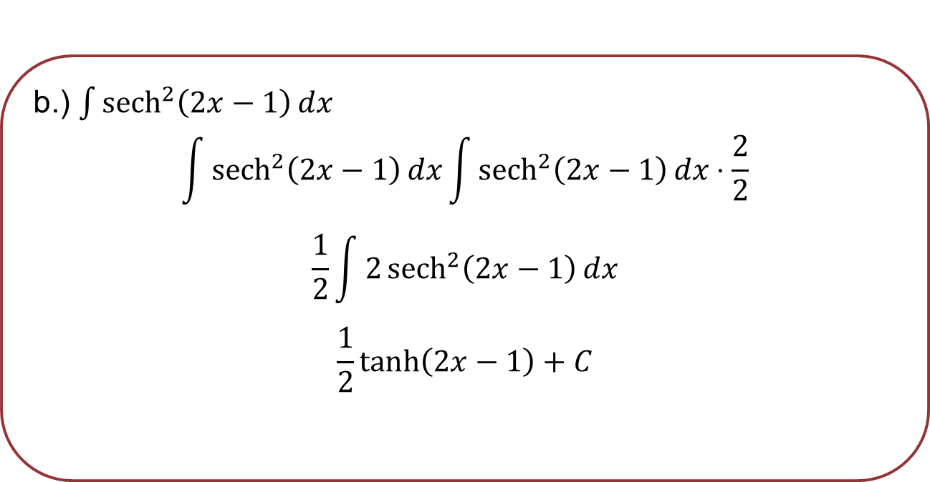
EXAMPLE PROBLEM
b.) $\int{{sech}^{2}\left(2x−1\right)}dx$
$$\int{{sech}^{2}\left(2x−1\right)}dx\int{{sech}^{2}\left(2x−1\right)}dx⋅\frac{2}{2}$$
$$\frac{1}{2}\int{2{sech}^{2}\left(2x−1\right)}dx$$
$$\frac{1}{2}\tanh\left(2x−1\right)+C$$

Slide 12
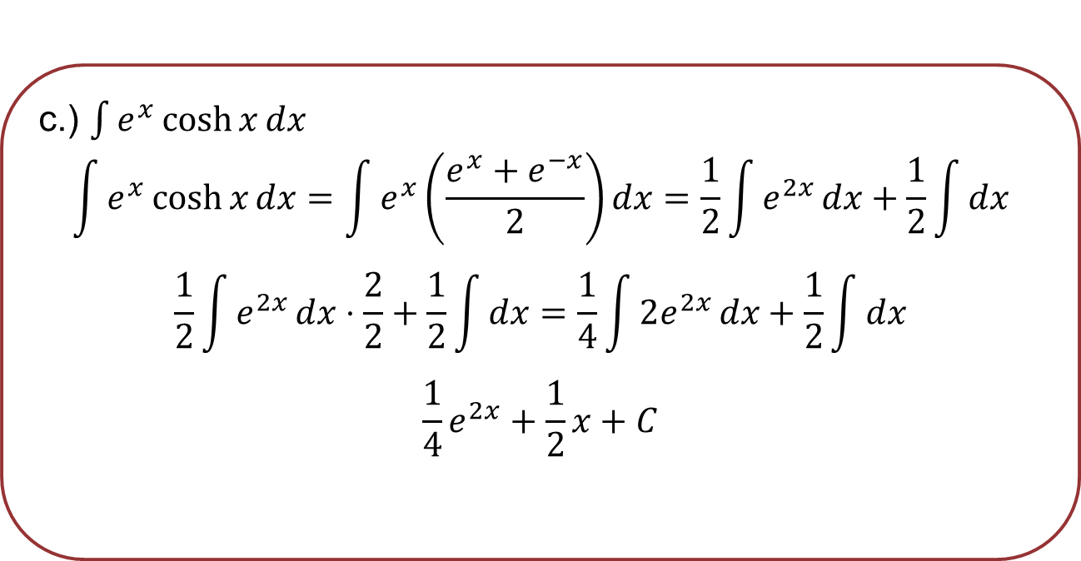
EXAMPLE PROBLEM
c.) $\int{e^{x}\cosh{x}}dx$
$$\int{e^{x}\cosh{x}}dx=\int{e^{x}\left(\frac{e^{x}+e^{−x}}{2}\right)}dx=\frac{1}{2}\int{e^{2x}}dx+\frac{1}{2}\int{dx}$$
$$\frac{1}{2}\int{e^{2x}}dx⋅\frac{2}{2}+\frac{1}{2}\int{dx}=\frac{1}{4}\int{2e^{2x}}dx+\frac{1}{2}\int{dx}$$
$$\frac{1}{4}e^{2x}+\frac{1}{2}x+C$$

Slide 13

EXAMPLE PROBLEM
d.) $\int{\frac{dx}{\sqrt{4x^{2}−9}}}$
$$\int{\frac{dx}{\sqrt{4x^{2}−9}}}=\int{\frac{dx}{\sqrt{{\left(2x\right)}^{2}−{\left(3\right)}^{2}}}}⋅\frac{2}{2}=\frac{1}{2}\int{\frac{2 dx}{\sqrt{{\left(2x\right)}^{2}−{\left(3\right)}^{2}}}}$$
$$\frac{1}{2}\cosh^{−1}\left(\frac{2x}{3}\right)+C$$

Slide 14

EXAMPLE PROBLEM
e.) $\int{\frac{dx}{9x^{2}−25}}$
$$\int{\frac{dx}{9x^{2}−25}}=\int{\frac{dx}{{\left(3x\right)}^{2}−{\left(5\right)}^{2}}}⋅\frac{3}{3}=\frac{1}{3}\int{\frac{3 dx}{{\left(3x\right)}^{2}−{\left(5\right)}^{2}}}$$
$$−\frac{1}{3}\left(\frac{1}{5}\right)\coth^{−1}\left(\frac{3x}{5}\right)+C$$
$$−\frac{1}{15}\coth^{−1}\left(\frac{3x}{5}\right)+C$$

Slide 15

ASSIGNMENT PROBLEM
Evaluate the integrals below.
a.) $\int{\coth{\frac{3}{2}x}}dx$ g.) $\int{\frac{dx}{\sqrt{x^{2}−25}}}$
b.) $\int{\sinh^{3}{x}}dx$ h.) $\int{\frac{dx}{4x^{2}+12x+5}}$
c.) $\int{{csch}^{2}\left(1+3x\right)}dx$
d.) $\int{\sinh^{3}{x}\cosh^{2}{x}}dx$
e.) $\int{\frac{dx}{\sqrt{x^{2}−2x+17}}}$
f.) $\int{\frac{dx}{4−9x^{2}}}$

