Slide 1
IT8 CALCULUS 2 LESSON 6

Slide 2
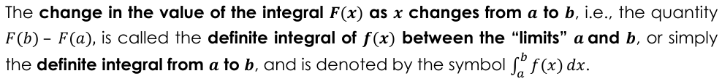


IT8 CALCULUS 2 DEFINITE INTEGRALS

Slide 3







IT8 CALCULUS 2 DEFINITE INTEGRALS

Slide 4
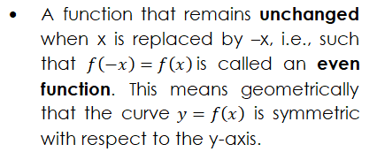
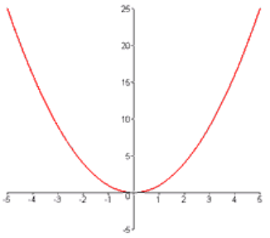
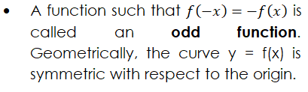
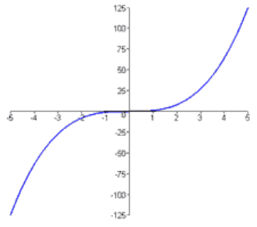
IT8 CALCULUS 2 DEFINITE INTEGRALS

Slide 5














IT8 CALCULUS 2 DEFINITE INTEGRALS

Slide 6





IT8 CALCULUS 2 DEFINITE INTEGRALS

