Slide 1

BUILD YOUR BHARAT HACKATHON 2026
Team Submission Deck
Team: Team FieldForge • Project: MandiMate • Theme: Agriculture
MandiMate — better deals, shared logistics, more money in the farmer’s hand.

Slide 2






Choose Your Theme
Agriculture: raising farmers’ income by fixing how small farmers sell (farm-to-market).
Agriculture
Gig Economy
Rural Healthcare
Increasing farmers’ income
Improving the livelihood of gig workers
Solving healthcare problems in small towns and rural areas
Help smallholder farmers earn more: better prices and market access, lower input costs, affordable credit and insurance, and climate-resilient practices.
It takes less than ten minutes to order something for convenience. But what does the day of the person delivering it look like? Riders, domestic workers, security guards and construction workers in Mumbai and Bangalore told us about exhaustion that never switches off, loneliness far from home, and shrinking earnings against rising costs. No safety, no shelter security, not even clean water. Build solutions that genuinely improve the lives of millions of gig and migrant workers.
Reimagine healthcare beyond the metros, for villages and small towns still waiting for care that arrives on time and within reach. Focus areas: last-mile care and ASHA/CHW tools; AI-enabled diagnostics and triage; telehealth and specialist access in Tier 2.
This is our theme
This is our theme
This is our theme

Slide 3




01 Problem Research Statement
Small farmers don’t just lose on price. They lose on everything that happens after it.
PROBLEM IN ONE SENTENCE
A small farmer selling a few hundred kilos alone has no volume, no buyer links and no shared truck — so transport, commission and rejections eat into every sale, and a better quoted price rarely means more money in hand.
Who is the user?
How do they cope today?
How big is the pain?
Persona (illustrative, built from public data): Ravi, a 2-acre tomato farmer near Madanapalle, Andhra Pradesh. Harvests 300–500 kg every few days in season. Basic Android phone, speaks Telugu, reads little English. Sells through a commission agent at the local mandi.
Sells alone to the nearest commission agent or trader, who sets the price that morning.
Hires a whole vehicle for one small load.
Learns the real deductions — commission, unloading, weighing, rejected crates — only after the sale, and may wait days to be paid.
86% of India’s farm holdings are small or marginal — about 12.6 crore farms (Agriculture Census 2015-16).
~33% of the consumer’s rupee reaches tomato farmers (RBI working paper, 2024).
₹1.5 lakh crore of produce is lost after harvest every year (NABCONS study, 2022).

Slide 4

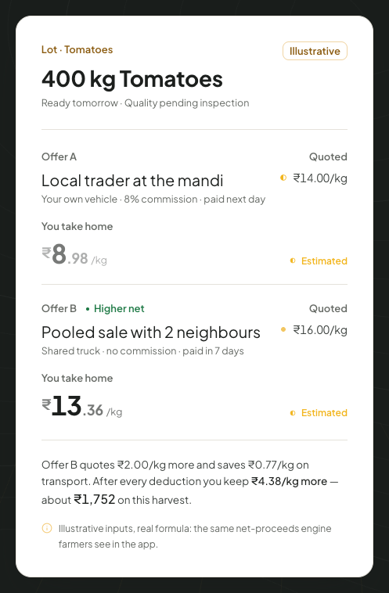
01 Evidence From the Ground
Desk research and our cost model so far. Farmer and trader interviews are milestone 1 of the pilot.
+₹4.38
From the working prototype
more per kg in hand than selling alone (our model)
A ₹2/kg better quote became ₹4.38/kg more in hand — ₹1,752 on 400 kg — once shared transport and no commission were counted.
−29%
— MandiMate net-earnings model, 400 kg tomato example
Shows: the quoted price hides the real take-home
transport per kg when neighbours share one truck
1,050 kg
Three neighbours (200 + 350 + 500 kg) in one 1,050 kg lot: transport drops from ₹2.63/kg alone to ₹1.86/kg shared.
one buyer-ready lot from 3 small farms
— MandiMate pooling model, published vehicle rates
Shows: pooling turns small lots into a buyer’s order

Slide 5

Insights: What Others Might Not Know
What decides a small farmer’s income is not the quoted price.
INSIGHT 1
INSIGHT 2
INSIGHT 3
The insight
Most people assume farmers need a better price. We found what decides income is what is left after the sale.
How we know
Our cost model: a ₹2/kg higher quote kept ₹4.38/kg more once transport, commission and rejection were counted.
So what?
Rank every offer by net take-home and show every deduction before the farmer says yes.
How big?
Every sale by India’s 12.6 crore small and marginal farms.
The insight
Most people assume small farms can’t supply big buyers. We found neighbours together can: 200 + 350 + 500 kg = one 1,050 kg lot.
How we know
A retailer’s 1,000 kg order no single farm can fill; one pooled lot fills it with one truck.
So what?
Match compatible harvests (crop, grade, timing, place) while each farmer keeps their own price and consent.
How big?
Average holding is just 1.08 ha (Agriculture Census 2015-16).
The insight
Most people assume marketplaces fail at finding buyers. We found deals break after that: transport, rejections and late payment.
How we know
₹1.5 lakh crore is lost after harvest each year (NABCONS 2022); deductions appear only after the sale.
So what?
Stay with the deal to settlement: pickup, delivery check, deductions and payment tracking.
How big?
Every perishable crop; tomato farmers get ~33% of the consumer rupee (RBI 2024).
Bottom line: MandiMate is judged by one number — extra net rupees per kg in the farmer’s hand versus selling alone.

Slide 6

02 Solution / Idea
One app from harvest to payment: the farmer speaks, MandiMate pools, compares and coordinates.
MandiMate helps small farmers earn more from every harvest by pooling neighbours’ produce into buyer-ready lots, ranking offers by net take-home, and coordinating transport through to payment.
ONE-LINE PITCH
1
User does
2
System does
3
User gets
Speaks the harvest in Telugu, Hindi, Kannada, Urdu or English — “400 kilos of tomatoes, ready tomorrow” — or a coordinator lists it.
Pools compatible harvests into one lot, collects buyer offers and works out each farmer’s net after every cost.
The best offer by money in hand, explained in plain words, and a yes/no — then one shared pickup and tracked payment.
Built for real constraints
Where tech is used, and why
Built for a 55-year-old first-time smartphone user: voice-first in Telugu, Hindi, Kannada, Urdu and English, big numbers, few words. Field coordinators can list for a farmer. Free for farmers; nothing is sold without consent.
AI to understand: speech and messy descriptions → a structured listing, and plain-language deal advice (DeepSeek via LangChain agents).
Rules to decide: lot matching, transport cost and net earnings are arithmetic, so prices are never AI guesses.

Slide 7




03 Why Now?
A farmer-family founder, a working product, and the rails (UPI, cheap phones, FPOs) are finally in place.
Why this challenge
Why you’ll keep going
A small farmer sells a few hundred kilos alone. A trader quotes a price per kg, but transport, commission, wastage and late payment cut what actually reaches the farmer, and no one shows that final number. Too small to fill a truck or bargain, they take the first offer. Shivansh, our team lead, grew up seeing this in a farming family.
We have a working end-to-end product and want it proven with real farmers. A measured 90-day pilot (slide 07) decides whether it earns its place.
Market timing and Macro factors
What limits you?
UPI makes fast, traceable payouts normal; cheap Android phones and Indian-language voice AI let farmers list by speaking; the 10,000 FPO scheme is creating ready aggregation partners; e-NAM has made digital trade familiar.
Verified buyer demand, reliable transport quotes, grading at pickup and working capital for faster payouts. To unblock: one FPO partner and 2–3 anchor buyers for a pilot.

Slide 8

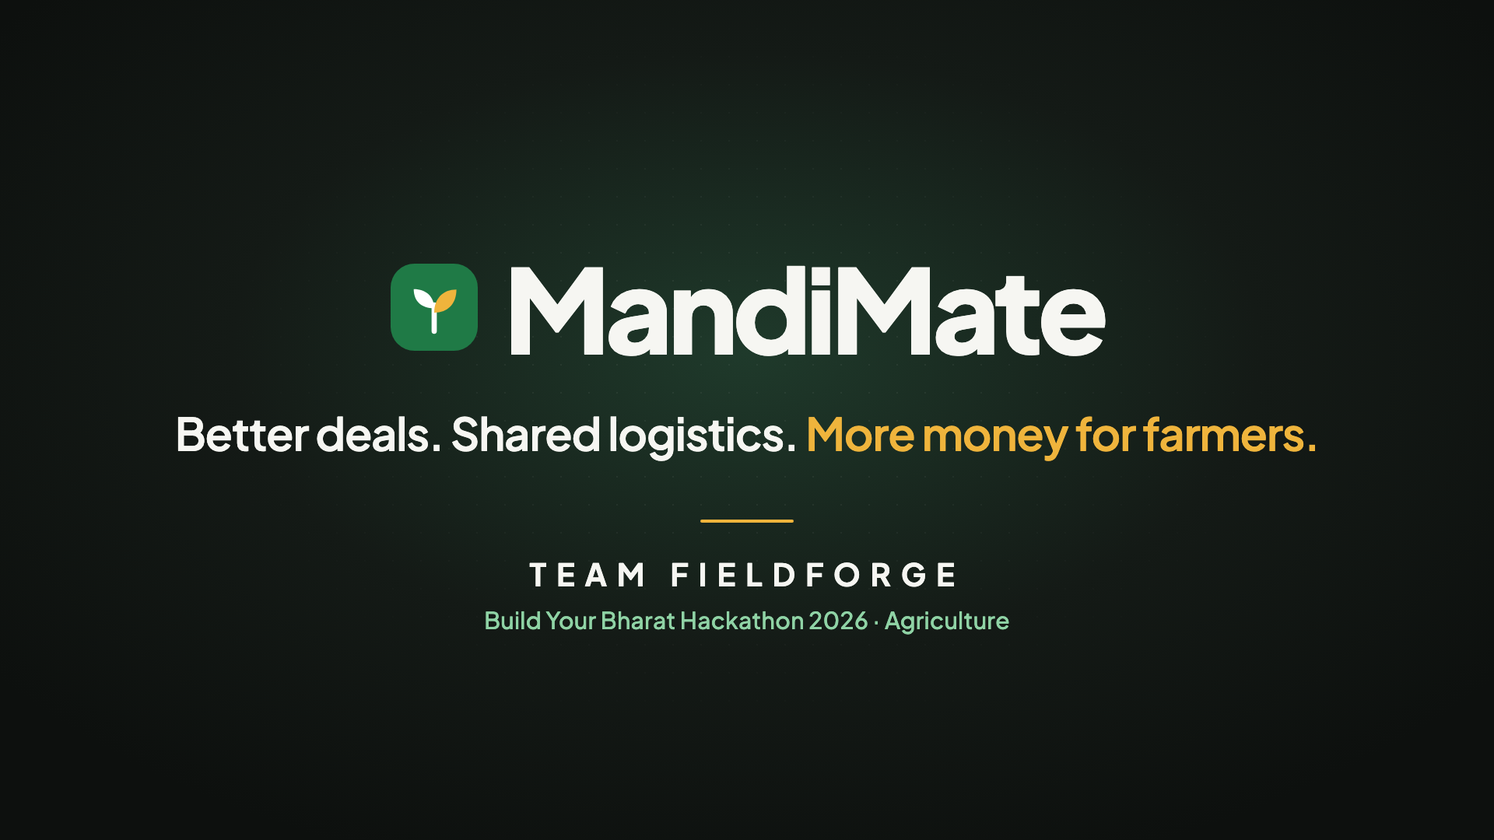



04 Prototype & Demo
Working end to end today: five roles, real flows, demo data.
Demo link
Watch on YouTube: youtu.be/pZn4KXhrFbk
What works today
5 roles, voice listing, pooling, offers, net-earnings compare, consent, transport, settlement
What is mocked / next
Demo data and simulated payments; AI in free rule mode (live DeepSeek wired in). Next: UPI payouts
Tested with
Our team, end to end, plus 1,460+ automated tests. Not yet with farmers
Full 2:48 walkthrough, also on YouTube: youtu.be/pZn4KXhrFbk
Assumption
A coordinator helps first-time users; pooled produce is graded consistently

Slide 9

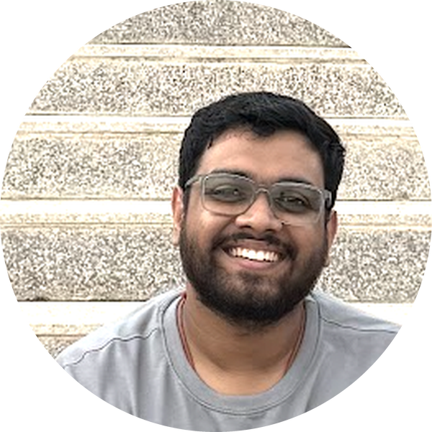
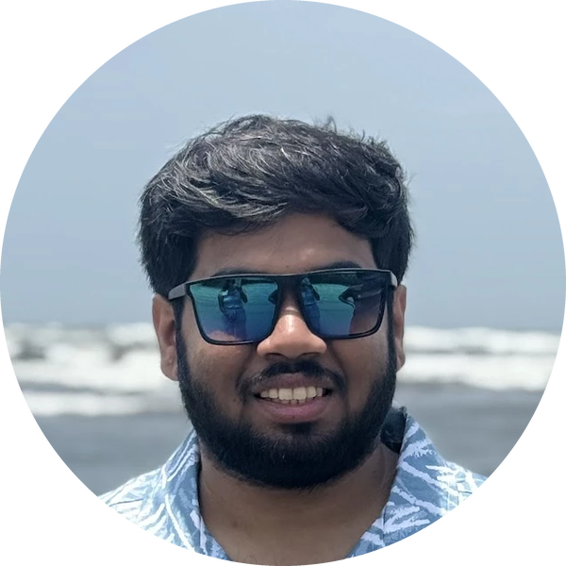



05 Team
A farmer-family lead and two engineers who built the whole product.
Shivansh Agarwal
Ambuj Raj
Lav Joshi
Team Lead
Team Member
Team Member
Background
Background
Background
Pursuing M.Tech in CSE at IIT Hyderabad. Worked at Intel Labs, Intel Corporation India.
B.Tech CSE, IIIT Nagpur. Software Engineer at Microsoft India.
B.Tech CSE, IIIT Lucknow. Software Engineer at Meta, London.
Edge on this problem
Edge on this problem
Edge on this problem
From a farmer’s family: knows first-hand what small-land farmers lose for lack of resources. Brings research and systems experience from Intel Labs.
Co-built MandiMate end to end: backend, multilingual web app, database and AI agents. Ships large-scale production software at Microsoft.
Co-built MandiMate end to end: backend, multilingual web app, database and AI agents. Ships large-scale production software at Meta.
Shortfalls
Shortfalls
Shortfalls
Limited experience taking a product from prototype to large-scale rural deployment.
No farming background; relies on field research and the team lead for ground truth.
Limited exposure to mandi operations and agri supply chains; still building field-research experience.
linkedin.com/in/shivansha
linkedin.com/in/raj-ambuj
linkedin.com/in/lavjoshi

Slide 10

06 Competitors & Benchmark
Others show a price. MandiMate shows what the farmer actually takes home.
 | MandiMate (ours) | Agri supply-chain platforms (e.g. Ninjacart, DeHaat) | e-NAM (government online mandi) | Status quo: commission agent
Who it serves | Small farmers selling together; buyers who need steady volume | Farmers and retailers through the platform’s own network | Farmers and traders at integrated APMC mandis | Every farmer, close to home
Edge over competition | Offers ranked by net take-home; neighbours pooled into one lot | Scale, own logistics, inputs and advisory | Nationwide price discovery, official | Trust, cash advances, instant sale
Key gap | New — needs a buyer network and pilot proof | Farmer sees one buy price, not every option side by side | Farmer still arranges transport alone | Opaque deductions; weak bargaining for small lots
Net earnings before a yes | Yes, every deduction shown | Price shown; full net not the focus | Price only | Known after the sale
Transport & settlement | Shared pickup to payment, tracked | Within its own network | Left to the farmer | Partly, informal
Our edge in one line: the only option judged by money in the farmer’s hand — pooling, transport and every deduction shown before a yes, in one workflow.

Slide 11
07 Pilot Plan & Business Model
What the ₹5 lakh pilot grant would prove in 90 days, and how MandiMate earns.
Business model
90-day pilot
Free for farmers. Buyers pay a coordination fee per lot sourced; FPOs subscribe for lot, buyer and settlement tools; a transparent logistics fee per pickup.
Illustration: 100 lots a month × ₹500 = ₹50,000 gross.
One cluster: Madanapalle tomatoes. 10–20 farmers, 2–3 verified buyers, one transporter, one FPO partner and a field coordinator who helps farmers list and confirm.
Milestones and how we measure
Risks and how we handle them
Day 30: 20 farmer and 5 trader interviews; FPO partner and 2–3 buyers signed.
Day 60: first 5 pooled lots picked up, delivered and settled.
Day 90: 20+ lots; report extra net ₹/kg vs mandi, % sold, transport ₹/kg, days to payment.
Too few buyers: sign anchor buyers before onboarding farmers.
Uneven quality: pool only produce that meets the agreed grade.
Transport eats the margin: cost every pickup before recommending a deal.
Distrust: every fee shown up front; farmers can always say no.

Slide 12
Thank You
TEAM FIELDFORGE

