Slide 1

What are you Navigating Towards?
Program Outcomes
Partnership between Academic Affairs,
Office of Institutional Effectiveness, and
Online Studies
ALLPPT.com _ Free PowerPoint Templates, Diagrams and Charts

Slide 2

Outcomes for this Workshop Series
Participants will:
Identify what constitutes a measurable outcome.
Write or revise student learning outcomes, so that they are measurable.
Identify a key assignment in their course for assessment.
Create their own rubric to measure learning outcomes.
Gather assessment data.
Explain whether the assessment data is relevant.
Create a plan to improve assessment results through easy and measurable steps.

Slide 3
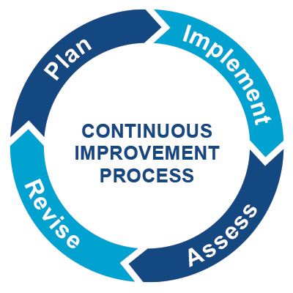
What is academic assessment? Assessment is the process of collecting information about a program or course’s performance. Data is used to make decisions to improve the program.
Plan: Create a plan for collecting information about how students are learning (e.g., identify a key assignment).
Implement: Collect information about student performance on achieving an outcome using a key assignment.
Assess: Reflect on the collected assessment data. Where are students performing well and not so well?
Revise (“Closing the loop”): Make changes to your program to improve student learning.

Slide 4

Assessment is like a Doctor’s Check Up.
Notes:
Side notes:
Goals: Larger aim of the course or program (e.g, critical thinking or other).
Objectives: Objectives state what the instructor will provide and what will be done to achieve the broader goals.
Outcomes: describe what students will specifically do in the course. Outcomes are the most important feature because they are used to guide assessment.

Slide 5
Everything is Connected
Institutional Learning Outcomes
Program Learning Outcomes
Course Learning Outcomes
Notes:
* Amy

Slide 6
What will students learn at Goodwin University?
At Goodwin University, we believe that every student who graduates should possess certain abilities regardless of their academic program.
We call these core abilities Institutional Outcomes:
Communication: Students will be able to effectively express and exchange ideas through various modes of communication including written, oral, and digital.
Information Literacy: Students will be able to identify relevant information, evaluate alternatives, synthesize findings, and apply solutions.
Career Readiness: Students will be able to apply their knowledge, skills, and abilities in their chosen field of study.
Notes:
* Amy

Slide 7
Assessment Process at Goodwin University
One of the most powerful tools that we use in terms of holding ourselves accountable with student learning outcomes and assessment is the curriculum map. Program Directors create these maps.
Here is an example of what a simplified map looks like:
Core Courses | Outcomes from Curriculum Map | Key Assignment
Basket Weaving 101 | 8 | Paper: Basket Weaving Basics
Basket Weaving 110 | 2 | Paper: History of Basket Weaving
Basket Weaving 210 | 1,3,5 | Presentation: Ethics of Selling Baskets
Basket Weaving 250 | 1,2,5,6 | Group Project: What makes an effective basket?
Basket Weaving 300 | 1,3,5 | Weave a Basket Pattern
Basket Weaving 310 | 2, 3 | Weave Your Own Basket
Basket Weaving 400 | 2, 7 | Weave Your Own Basket with original pattern and unorthodox materials
Notes:
**Courses could fall under two buckets:
Core course that falls under an academic program.
May not have a map if elective

Slide 8
Assessment Process at Goodwin University as of 2020
The Office of Institutional Effectiveness enforces and consults on assessment.
The members on University Committee on Assessment (UCA) provide advice on updating the process of assessment on campus.
Instructors
Program Directors
Instructors should identify assessment opportunities in their course and discuss with their supervisor.
Instructors are encouraged to collect assessment data within their course.
Instructors are encouraged to discuss and evaluate potential changes with their supervisor within their course.
In October, program directors submit a plan to assess 2-3 outcomes.
Data is collected about student achievement of the outcomes.
Program directors reflect on the results of their assessment in a report due to the Office of Institutional Effectiveness in August.
Notes:
*Amy
- Every course/ department does revisions differently. Every course does differently things. Don’t want to stifle anybody, just don’t want to step on anyone’s foot.
Work smarter, not harder to save some work.
Add bullet—instructors should identify assessment opportunities in their course and discuss with their supervisor.

Slide 9

What is your Program?
Is much like asking….

Slide 10
How do you know?
Student Learning Outcomes:
Usually, we have student learning outcomes in our courses because they are required and because we are asked to write them.
Sometimes, they aren’t given a second thought.
However, student learning outcomes define your course.
You can use student learning outcomes as a tool to determine whether or not students are learning in your classroom.

Slide 11
Activity: What is a effective versus an ineffective outcome?
Let’s do a Pre-Test!
Live Poll!
Let’s see if we can identify the difference between measurable and non-measurable outcomes.

Slide 12
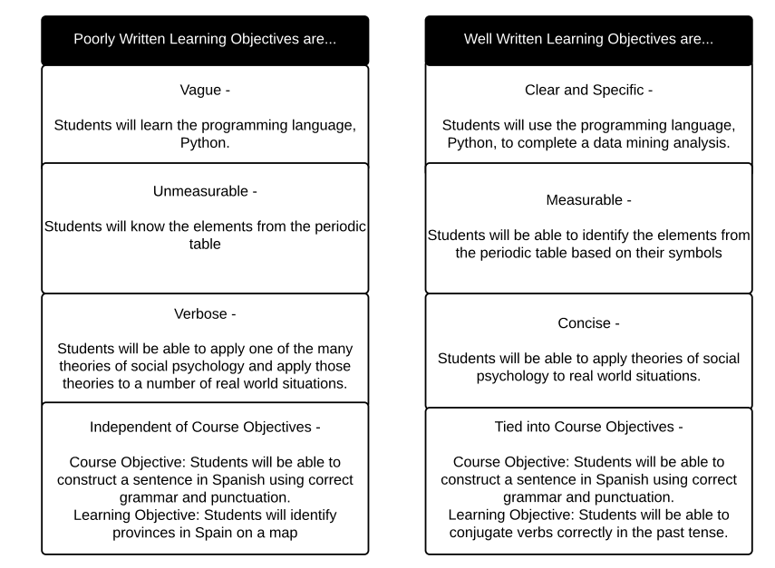
Effective vs. Ineffectual Program Outcomes
Credit: Illinois Center for Innovation in Teaching & Learning

Slide 13
Examples of Measurable vs. Ineffectual Program Outcomes
Ineffective Outcomes | Measurable Outcomes
Students will understand history and policy related to cooking and serving dinner. | 1. Students will describe the history of policy related to cooking and serving dinner.
2. Become familiar with the elements of baking cookies. | 2. Identify the steps needed to bake a cookie.
3. Complete the assignment on cakes. | 3. Bake a cake to meet their client’s expectations.
4. Explain the benefits of various diets. | 5. Determine the most appropriate diet for an individual based off of their preferences and health determ- inents.
5. Formulate a recipe from above. | 5. Develop an original recipe for a cookie, cake, and a dinner.
Notes:
https://tips.uark.edu/learning-objectives-before-and-after-examples/
https://tips.uark.edu/learning-objectives-before-and-after-examples/

Slide 14
How to Write Quality Learning Outcomes
By the end of the assignment/course, students will be able to….
Insert a Measurable Action Verb…
Insert Skill, Knowledge, Value, Attitude, or Ability.
Notes:
*Amy

Slide 15
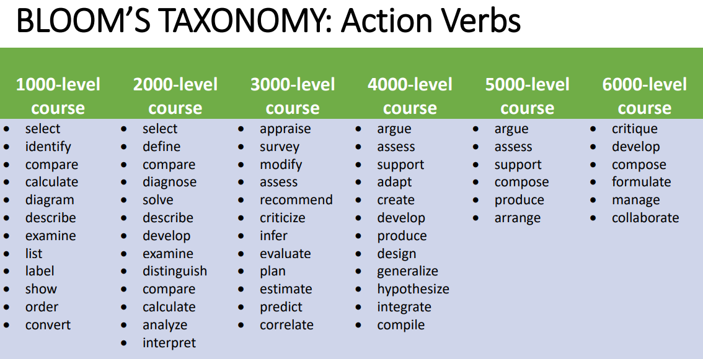
How to Pick Your Action Verbs
University of New Mexico also has a great handout.
Notes:
*Amy
Pros: Widely accepted in Higher Ed . Other resource: http://ccoe.rbhs.rutgers.edu/forms/pdf/EffectiveUseofLearningObjectives.pdf
Con: written in 1956. https://www.arjonline.org/papers/arjel/v2-i1/14.pdf; https://www.teachthought.com/critical-thinking/5-alternatives-to-blooms-taxonomy/

Slide 16
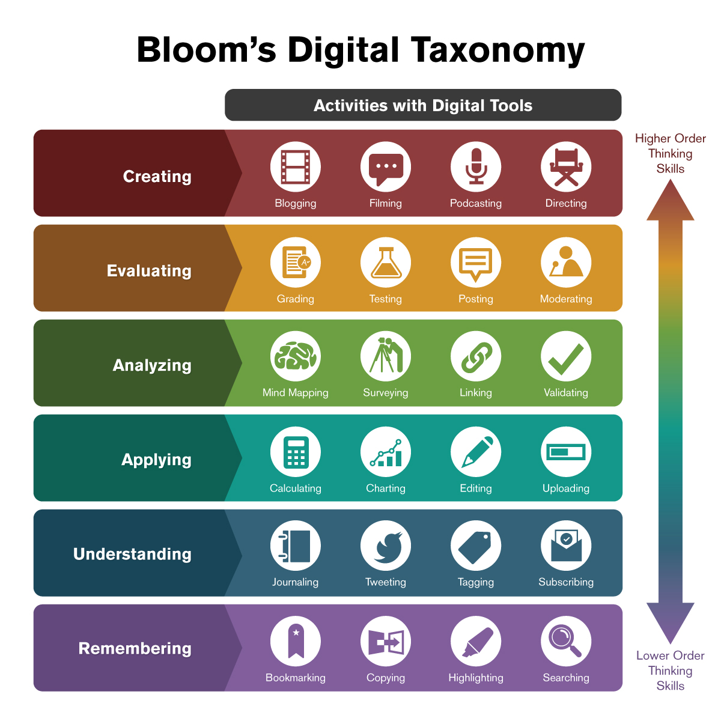
Writing Outcomes for Online Courses
Arizona State University Bloom’s Digital Taxonomy has a great resource for online courses and programs!

Slide 17

How to Update Outcomes at Goodwin University
Rescript your Outcomes and Review with Faculty
Have your Outcomes Approved by Academic Affairs
Publish Outcomes
Notes:
AMY
Group of people modify and approve
Go to Academic Affairs in consent agenda for review and essentially approval
SLO’s go into an updated master Syllabus and program outcomes go into Catalog, program’s website or wherever else appropriate.
Update all syllabi if PLO’s are included.
Course or Program Outcomes

Slide 18
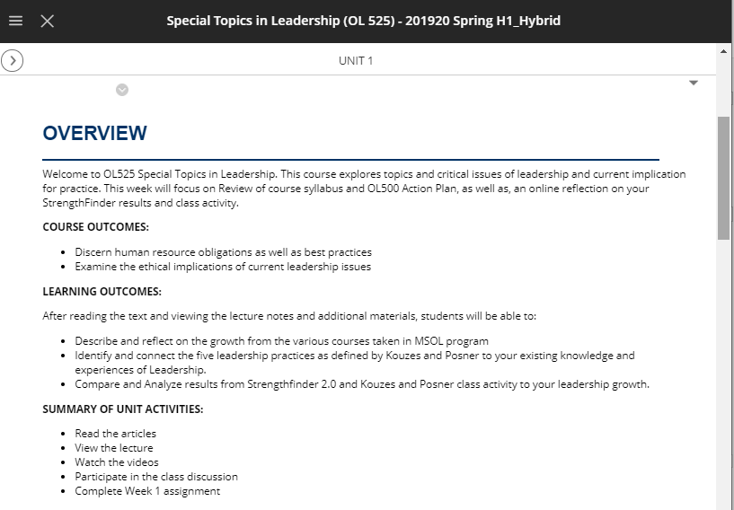
Example: OL 525 Special Topics in Leadership
Notes:
Lisa
https://goodwin.blackboard.com/ultra/courses/_12839_1/cl/outline

Slide 19
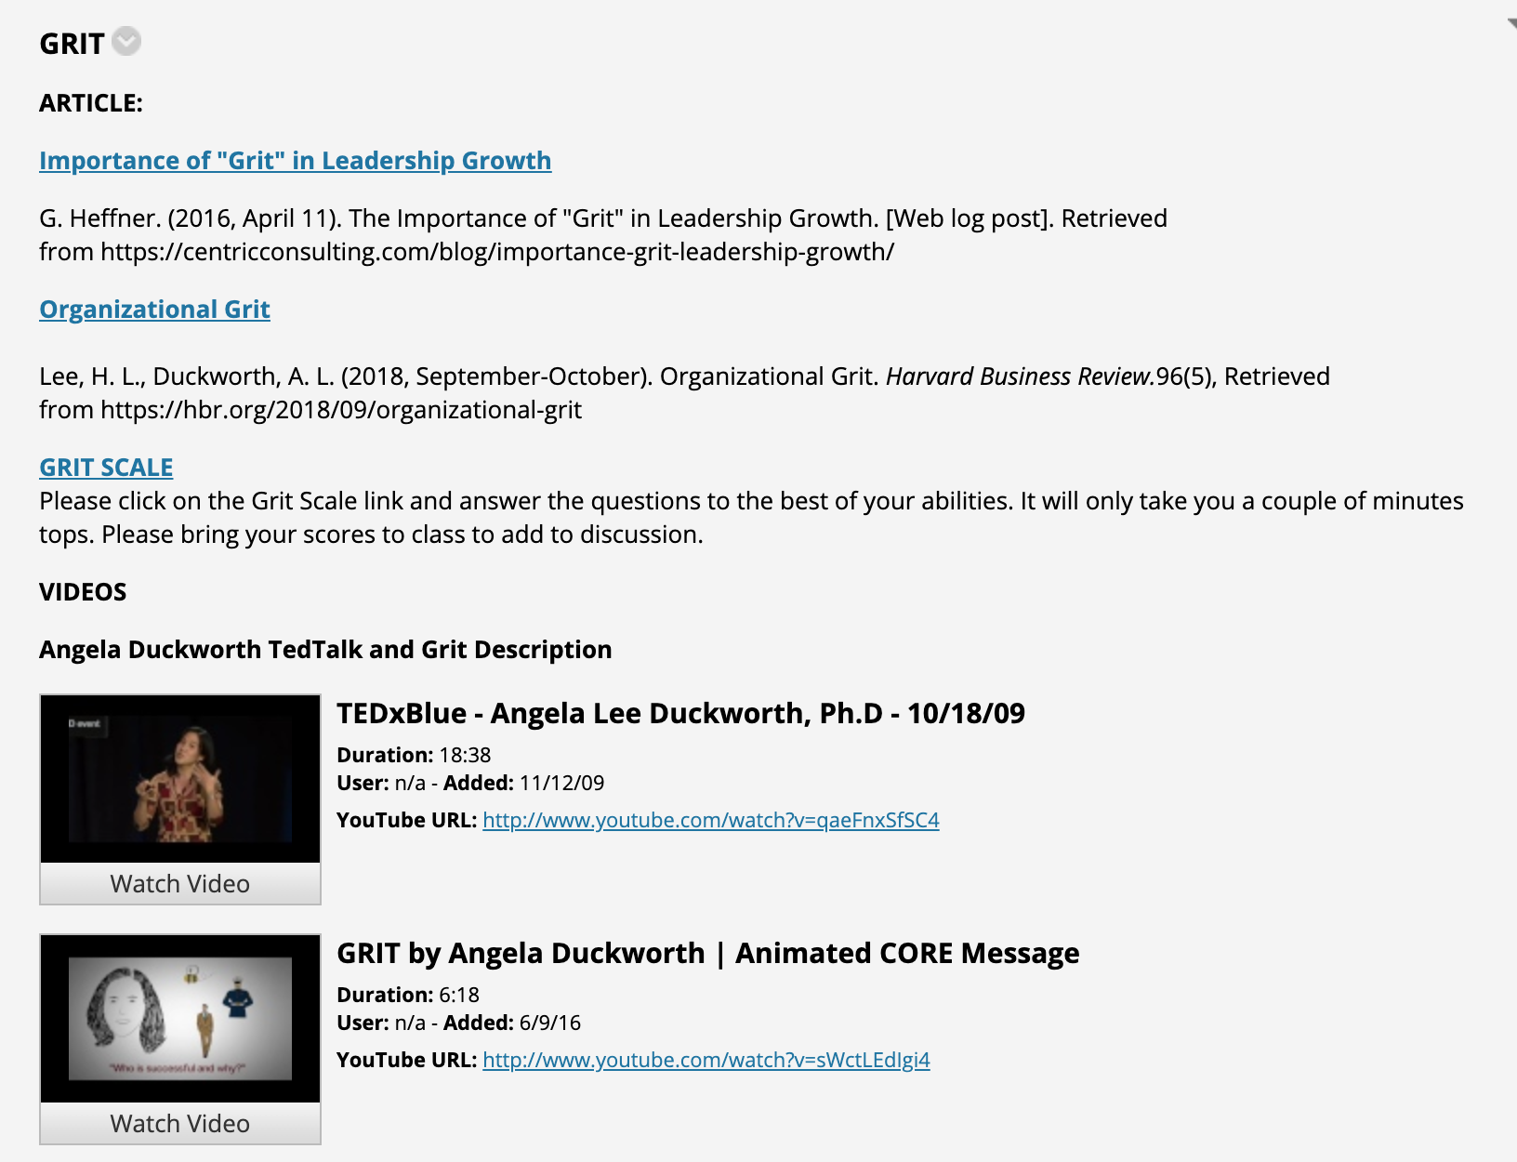

Slide 20
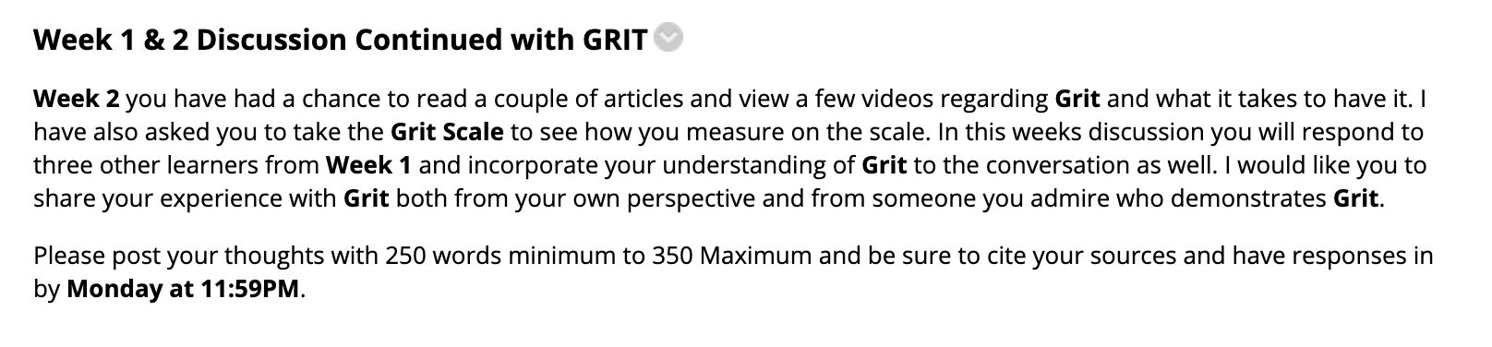
Example Weekly Assessment

Slide 21
Student Learning Outcome Activity
Homework: Student Learning Outcomes Activity:
First, look at your existing student learning outcomes. Are they measurable?
Do the student learning outcomes tie into your course learning outcomes?
Are your any of your student learning outcomes tied with the Institutional Learning Outcomes (Communication, Information Literacy, & Lifelong Learning)?
Now, let’s look at one of your key assignments.
Does the key assignment have anything to do with the student learning outcomes?
How many program outcomes are not assessed in the key assignments?
Notes:
*Lisa
Within Blackboard, Syllabus has course outcomes and that within the week, there are weekly outcomes.
Sometimes weekly outcome and course outcome is the same.
Explain: This is how it’s supposed to be. You’re supposed to have at the ILO→ Program Learning Outcome→ Course Outcome→ Weekly Outcome (5-6 outcomes, customized to the week)
Look at course outcomes and align with the weekly outcome
Pick a student learning outcome to align it to.
ILO’s in courses—maybe in the future

Slide 22
Homework
Revisit a weekly student learning outcome in your Blackboard Shell.
Review the student learning outcome and rewrite it.
Make sure that the outcome aligns with the course outcomes.
Make sure that it has some connection with the program learning outcomes and institutional learning outcomes.
What’s coming up: You will submit your revised student learning outcome before the next workshop so that we can provide feedback.
Submit your student learning outcome to the nzagula@goodwin.edu. The subject should be Homework: Assessment Spectacular.
Next workshop: We will create a rubric to measure the assessment we are creating.

Slide 23

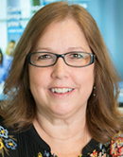


We’ve got your back!
Questions about
Assessment Methods and Process?
Natalia Zagula
Learning Assessment Coordinator Institutional Effectiveness 860-727-6795 NZagula@goodwin.edu
Lisa Manley
Director of Online Studies & CTE
860-913-2078 LManley@goodwin.edu
Questions about Assessment using Blackboard and Taskstream?
William Kenyon
Instructional Tech and Data Support Developer
860-913-2225
WKenyon@goodwin.edu
Questions about a Faculty’s Perspective on Assessment?
Amy Beauchemin
Chair of Academic Affairs
Associate Professor School of Applied Liberal Arts & Social Sciences 860-913-2127 ABeauchemin@goodwin.edu

