Slide 1

The Mysterious World of Rubrics!
Partnership between Academic Affairs,
Office of Institutional Effectiveness, and
Online Studies
ALLPPT.com _ Free PowerPoint Templates, Diagrams and Charts

Slide 2

Outcomes for this Workshop Series
Participants will:
Identify measurable outcomes.
Write or revise student learning outcomes so that they are measurable.
Identify a key assignment in their course for assessment.
Create their own rubric to measure learning outcomes.
Gather assessment data.
Explain whether the assessment data is relevant.
Create a plan to improve assessment results through easy and measurable steps.
Notes:
Natalia

Slide 3
Let’s talk Homework!
Let’s review your revised weekly outcome (homework from last session).
What outcome did you choose to revise?
Why did you choose this outcome?
What changes did you make to the outcome?
Notes:
Lisa
Have participants discuss and talk more. Goal.
Revise for Fall. More activity,

Slide 4
Step 1. Determining your Assessment Project
Why Are You Assessing?
Who are the audiences for your results?
Why?
What do they need to know?
What decisions will your results inform?
Define what it means for a student to success-fully meet an outcome.
Notes:
Natalia
https://assessmentinstitute.iupui.edu/overview/institute-files/2011-institute/monday-2011/suskie.pdf

Slide 5
Step 2. Create a Rubric for Assessment
The rubric’s purpose is to assess student performance in mastering a specific learning outcome.
It should:
1. Have criteria that should be present in the student’s work.
2. Descriptions of different levels of performance.
3. Be written in such a way where scorers have a similar understanding of the rubric’s scale and criteria (inter-rater reliability).
Notes:
Amy

Slide 6
Refresher: Writing Outcomes to Measure in Your Rubrics
By the end of the assignment/program, students will be able to….
Insert Action Verb…
Insert Skill, Knowledge, Value, Attitude, or Ability.
Notes:
BJ

Slide 7
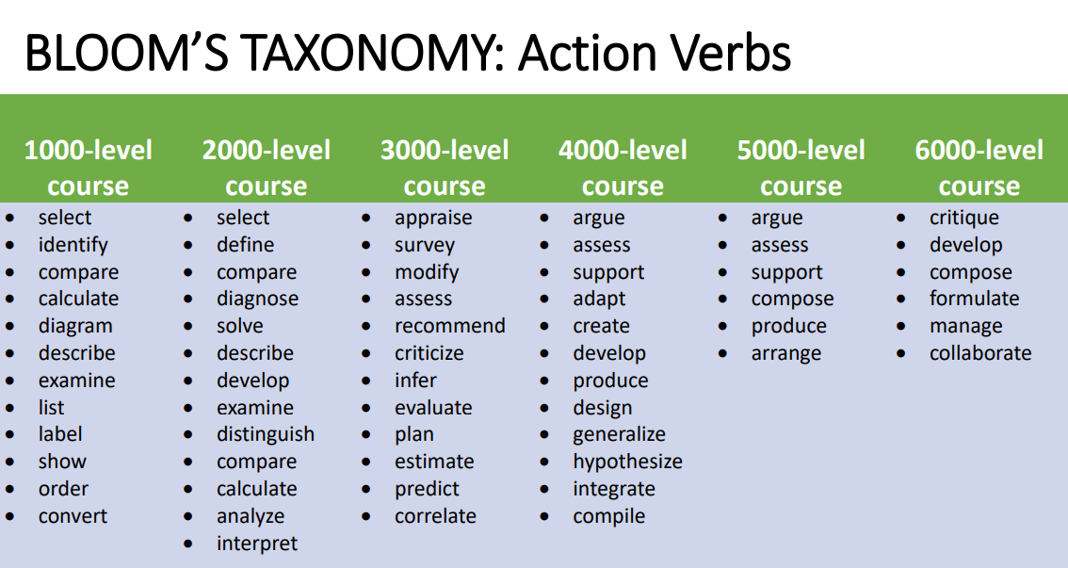
Action Verb Refresher
Bloom’s Digital Taxonomy is a great resource!
Notes:
BJ

Slide 8
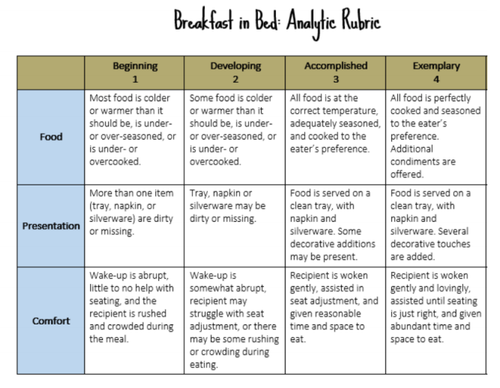
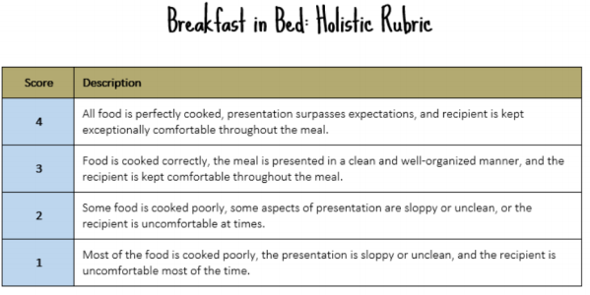
Analytic versus Holistic Rubric (Pros and Cons)
We have a winner!
Notes:
Amy (AAC&U)
Pros and Cons
More helpful in some ways than others. How to use the rubric but not be confined to hours grading. Students don’t always look at their breakdown.
How can students use the rubric for their own improvement? Tie into conversation of Starfish and student engagement. If your grade goes down, Starfish will flagthe student. The rubrics are going to be needed for a tool for students to see where they are strong and weaker. First mod of Fall 2020. Second mod will be completely rolled out.
Analytic Rubrics: Assesses student work by evaluating the essential features or individual elements of the assignment. ✓Standard matrix format ✓Make explicit the standards for grading or assessing ✓Provides detailed feedback.
Holistic Rubrics: Assesses student work by evaluating the overall impression of the whole product rather than individual elements of the assignment. ✓The essential features are all lumped together so all criteria are evaluated simultaneously. ✓You look over the assignment and give one holistic score to the whole thing.
✓ Used when there’s no time for specific feedback. ✓Lists three to five levels of performance. ✓The levels can be labeled with numbers (e.g., 1 through 4), letters (e.g., A through F) or words (e.g., Beginning through Exemplary).
Analytic Rubrics-- Pros: It gives students a clear picture of why they received a particular score. • Identifies areas of student strengths and areas in need of improvement. • It gives the professor the ability to justify a score without having to explain everything in a later conversation. Cons: Takes time to create and score. • Students won’t necessarily read the whole thing.
Holistic Rubrics-- Pros: Takes less time to develop and to assess. • Good for summative assessment Cons: Does not provide targeted feedback to students. • Not intended to improve student learning. Does not provide clear identification of student strengths or weaknesses. • Justifying the score to a student may require a lengthy conversation.

Slide 9
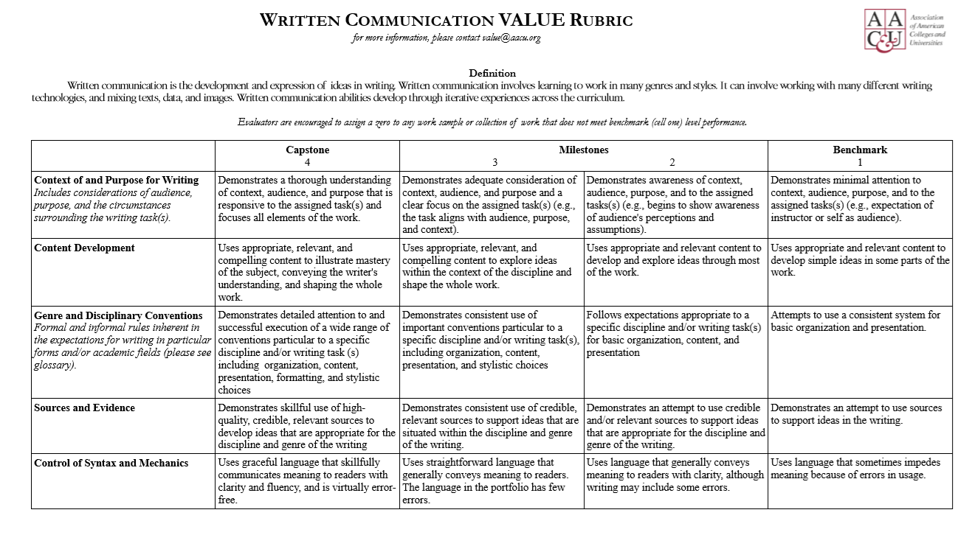
Resources for Assessment: AAC&U VALUE Rubrics
10 years ago, volunteers from 100 colleges developed rubrics for the Association of American Colleges & Universities (AAC&U).
16 VALUE rubrics were created and tested for validity.
They are inter-disciplinary and inter-institutional.
Each rubric was tested by faculty with their students’ work at 100 college campuses.
The rubrics are intended to be modified at campus-level.
There are Different Methods for Different Purposes:
Grading - Assessment - Scoring
Notes:
Amy

Slide 10
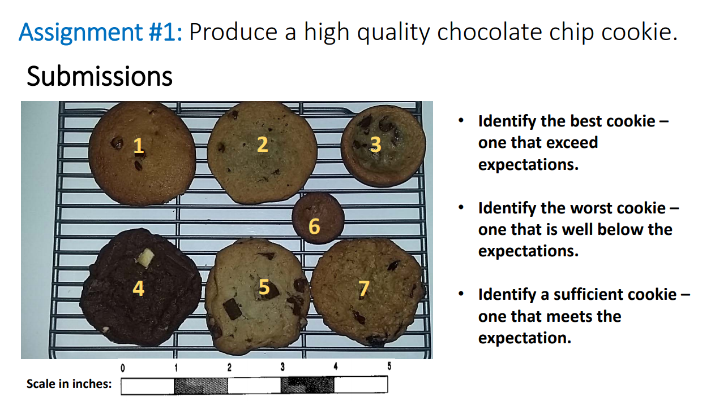
Discussion: What makes a cookie high quality?
Credit: Vera Mauk Cookie, Director of Institutional Research & Assess-ment, Becker College
Notes:
Natalia

Slide 11
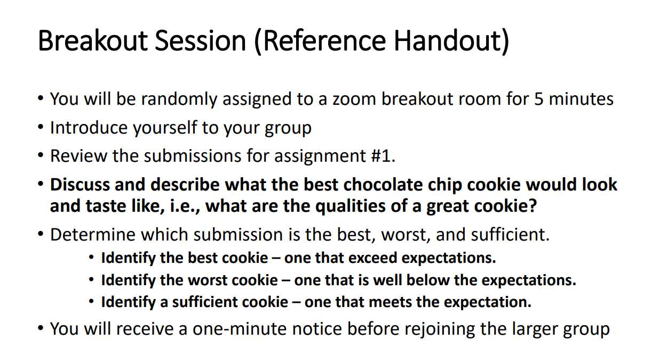
Communicating our Expectations
Notes:
Natalia

Slide 12
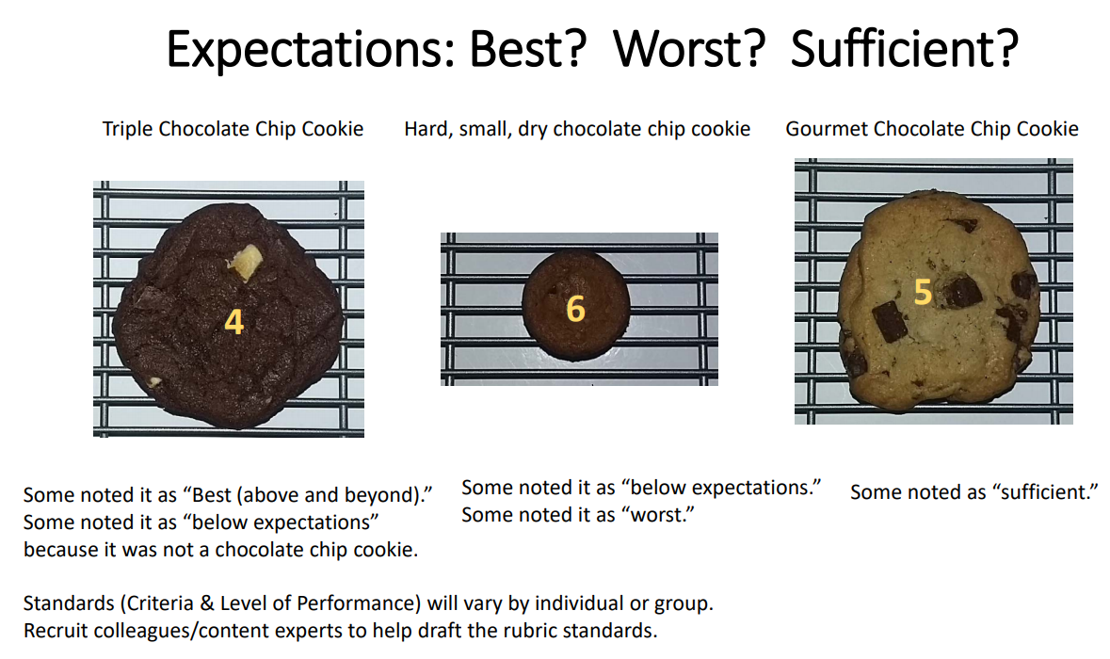
Subjectivity of Rubrics
Notes:
Natalia

Slide 13
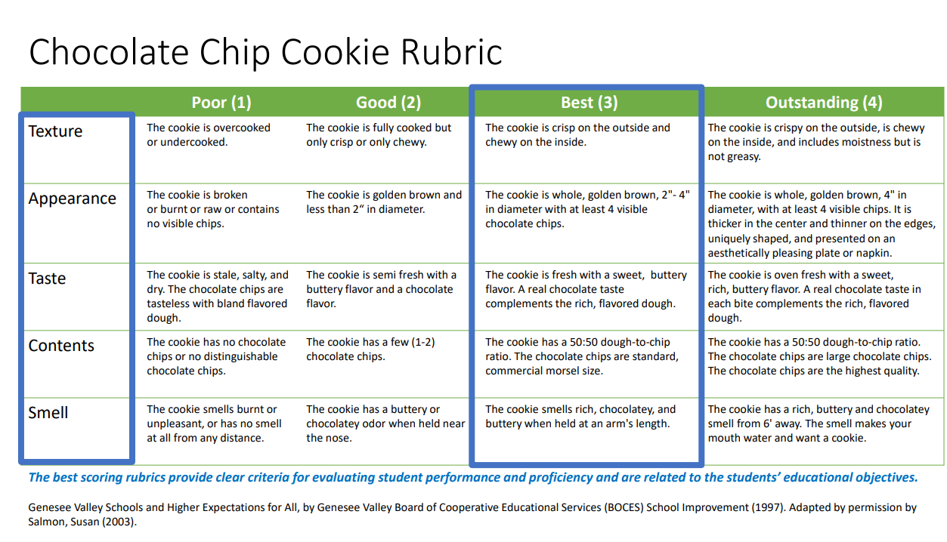
Example of Creating a Rubric for Our Exercise
Notes:
Score the cookies again using cookies.
Natalia

Slide 14
Ensuring your Rubric is Reliable through Norming
INTER-RATER RELIABILITY!
Now, we need to make sure that everyone scoring students understands the rubric the same way. This process is called norming.
Steps to Norming:
Schedule a set meeting time and place.
Distribute and review the prompt, rubric, and student work samples.
Individually score sample student work using the rubric.
Present scores individually and identify common discrepancies as a group.
Discuss the grey areas that led to discrepancies in scoring.
As a group, come to a consensus on how to apply the rubric to student work to ensure consistency.
If available, compare your scoring to an expert’s scoring to calibrate.
Credit: The Graide Network
Notes:
Natalia

Slide 15
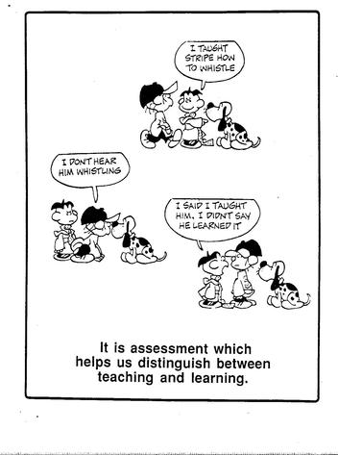
Grading Rubrics versus Assessment Rubrics
Generally, the goal of grading is to evaluate individual students’ learning and performance.
Although grades are sometimes treated as a proxy for student learning, they are not always a reliable measure. Moreover, they may incorporate criteria – such as attendance, participation, and effort – that are not direct measures of learning.
The goal of assessment is to improve student learning.
Although grading can play a role in assessment, assessment goes beyond grading by systematically examining patterns of student learning across courses and programs and using this information to improve educational practices.

Slide 16
Creating an Analytic Rubric
Anatomy of a Rubric!
Performance Indicators
 | Proficient | Competent | Developing | Poor
Content Develop-ment
Critical Thinking
Information Literacy
Criteria
Performance Descriptors
Notes:
Amy

Slide 17
Tips and Tricks to Help when writing your rubric!
Avoid using vague words that confuse the meaning of the performance criteria.
Use language that describes observations.
Use the action verb from the objective in your descriptors. For example:
Proper citations vs. APA citations
Many sources vs. 5 or more sources
Good vs. 2 or fewer grammatical mistakes
Task specific (Assignments) vs. More general descriptors (Institution/Dept.)
Avoid double negatives in your rubric!
Keep your scale between 2-4 for greater validity.
Notes:
Natalia

Slide 18
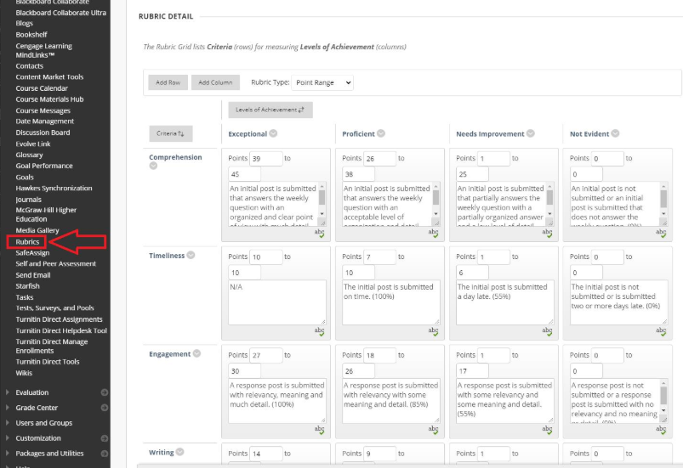
Making a Rubric through Blackboard
Notes:
Lisa
Screenshot—show how it looks like
Set up appointment with faculty
Show screen of creating the rubric → Training about setting up rubrics in Blackboard. Link to Faculty Resources.

Slide 19
Activity (Manual Homework)
Let’s Create a Rubric Together!
Identify the outcome you want to assess.
What would the ‘highly proficient’ student work look like? What characteristics would it have?
What would ‘poor’ student work look like? What characteristics would it have?
Think about these same questions for the categories of ‘developing’ and ‘competent’.
Use action verbs to describe what the students will produce.
Be specific in what they will produce (e.g., if one criteria is Information Literacy, how many data sources would they need to use to have “mastered” that outcome?
Notes:
Lisa
How does this all tie together?
Tips to easily assess my data
Formative Assessment? -- Looking at students who failed the assignments—was there a pattern of where the student was struggling?
Tables in Word

Slide 20
After Completing Your Homework
Take your students work and assess whether they met the weekly outcome.
How well did you meet the outcome?
What factors led you to either meet or not meet the outcome?
What do we need to do differently?
What do you need to change to improve the results?

Slide 21
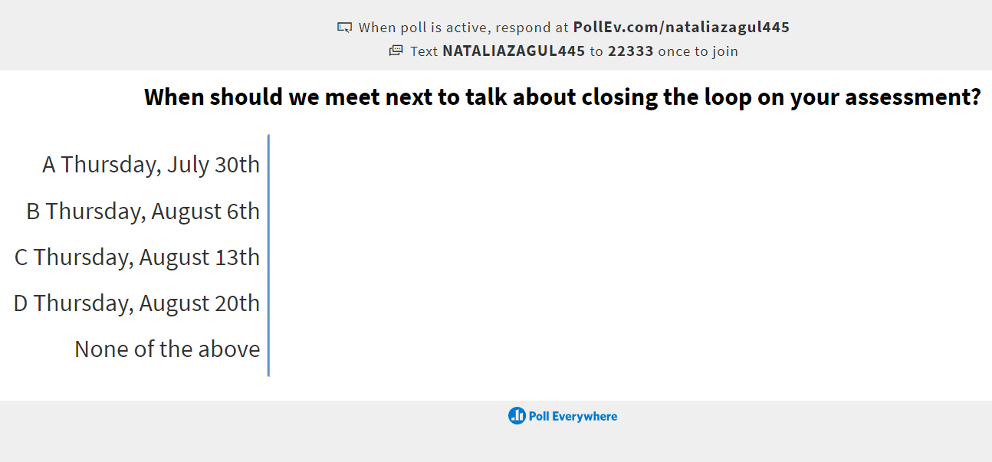
Live Poll: When should we meet next?
PollEV.com/nataliazagul445
Notes:
PollEV.com/nataliazagul445

Slide 22

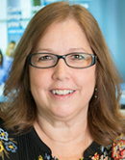


We’ve got your back!
Questions about
Assessment Methods and Process?
Natalia Zagula
Learning Assessment Coordinator Institutional Effectiveness 860-727-6795 NZagula@goodwin.edu
Lisa Manley
Director of Online Studies & CTE
860-913-2078 LManley@goodwin.edu
Questions about Assessment using Blackboard and Taskstream?
William Kenyon
Instructional Tech and Data Support Developer
860-913-2225
WKenyon@goodwin.edu
Questions about a Faculty’s Perspective on Assessment?
Amy Beauchemin
Chair of Academic Affairs
Associate Professor School of Applied Liberal Arts & Social Sciences 860-913-2127 ABeauchemin@goodwin.edu

