Slide 1


Universal Synthetic Image Detection
Tanvir Mahmud Prince, Eshan Agarwal

Slide 2
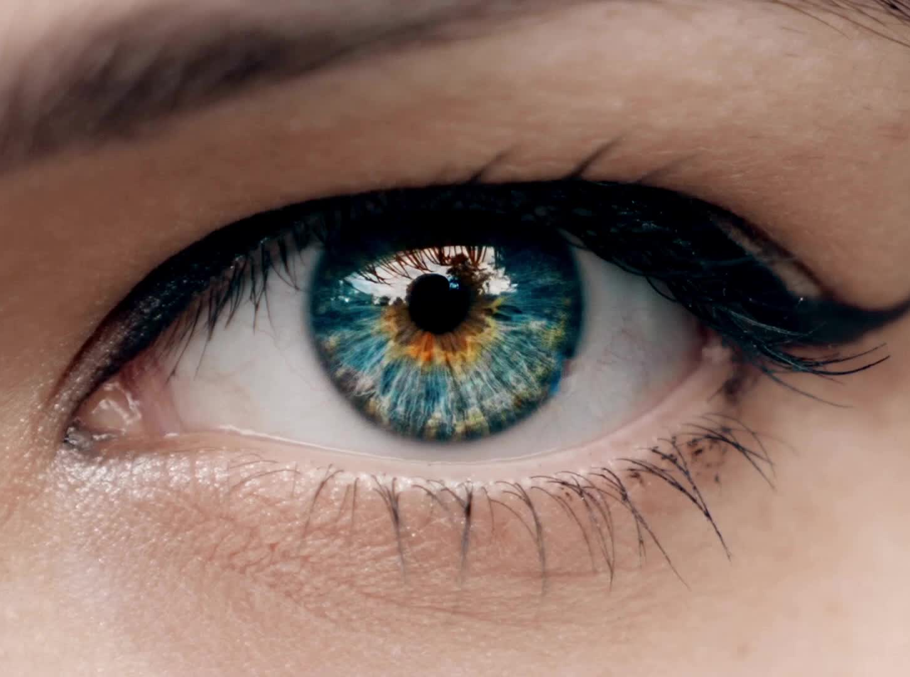
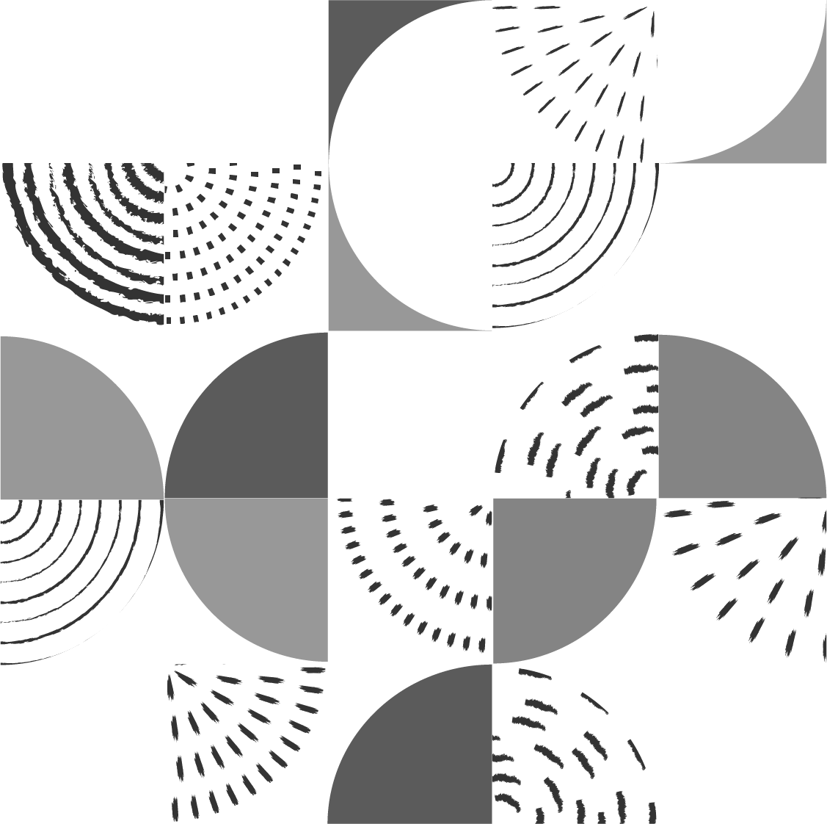
Generative AI is Everywhere
Generative AI has improved with technologies such as:
- Stable Diffusion, StyleGAN, face-swapping pipelines
- Photorealistic outputs at scale, indistinguishable to the human eye
Significant societal harms:
- Misinformation
- Identity fraud and deepfake
- Political manipulation

Slide 3
Three Critical Gaps in Current Detectors
Poor Generalization
- Models trained on one generator fail on unseen generators
Manipulation-Specific Fingerprints
- Detectors learn generator fingerprints, not universal forgery cues
No Explainability
Virtually all detectors output a single binary label
No transparency into which regions drove the decision

Slide 4
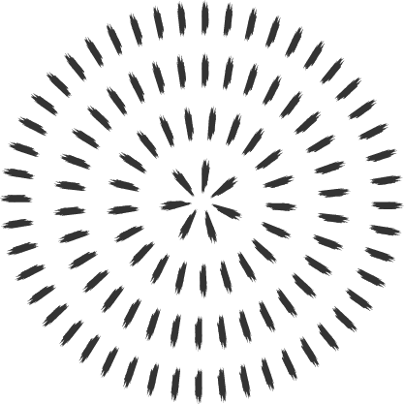
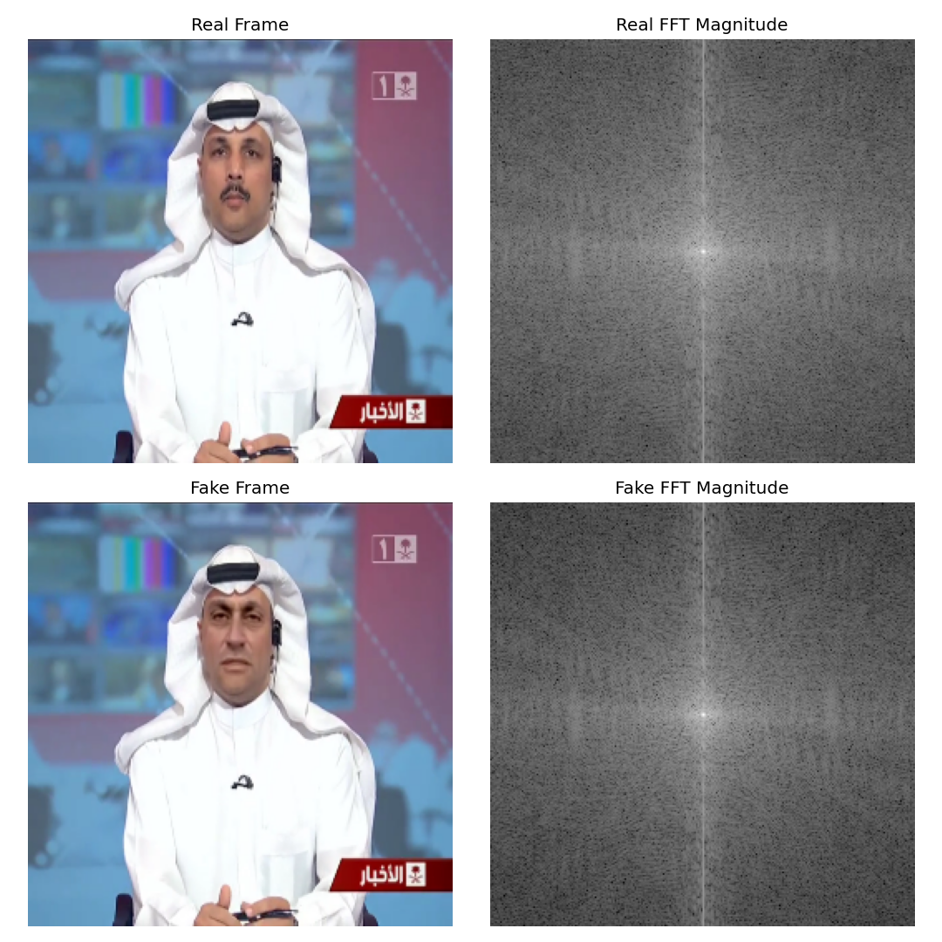
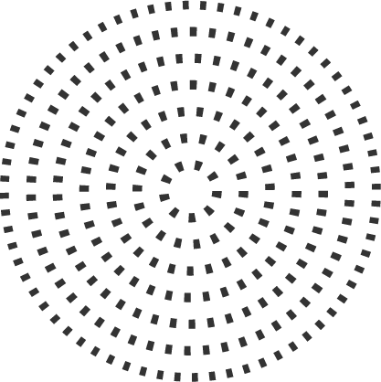
Solution: Multi-Domain Fusion
Forgeries leave traces in BOTH spatial and frequency domains
Spatial domain: RGB pixel patterns, texture inconsistencies
Frequency domain: FFT log-magnitude reveals spectral artifacts
Cross-shaped energy spikes at DC component
Periodic high-frequency peaks from upsampling layers
Checkerboard patterns from transposed convolutions
Our framework processes both domains in parallel

Slide 5
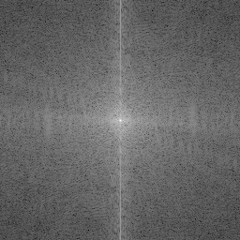
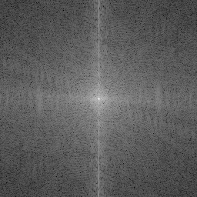
What the Frequency Domain Reveals
We convert each frame to grayscale and compute 2D FFT
Formula: M(u,v) = log(|FFTShift(FFT2(gray))| + epsilon)
Result: single-channel 128x128 log-magnitude spectrum
Real and fake spectra show measurable differences:
Energy distribution patterns around DC component
High-frequency tail characteristics
These differences are invisible in the spatial domain alone

Slide 6
Data Flow
Input: one video frame (128x128 RGB)
Two parallel preprocessing paths:
Path A: RGB → Spatial CNN branch (3 channels)
Path B: Grayscale → FFT → Frequency CNN branch (1 channel)
Feature extraction:
Spatial branch: 3-block CNN (16→32→64 filters, ReLU, MaxPool)
Frequency branch: identical 3-block CNN
Fusion strategies:
Option 1: Concatenation → MLP classifier
Option 2: Attention gate → weighted sum → MLP classifier
Output: single logit → sigmoid → Fake/Real probability

Slide 7
Four Model Variants Compared
Attention gate learns alpha = Softmax(MLP([f_s; f_f]))
Fused = alpha_s * f_s + alpha_f * f_f
Model can dynamically emphasize the informative domain per sample
Model | Inputs | Fusion | Params | Key Property
Spatial CNN | RGB only | None | ~530K | Single-domain baseline
Frequency CNN | FFT only | None | ~530K | Single-domain baseline
Fusion (concat) | RGB + FFT | Concat → MLP | ~560K | Naive dual-domain
Attention Fusion | RGB + FFT | Softmax gate | ~2.1M | Learned per-sample weighting

Slide 8
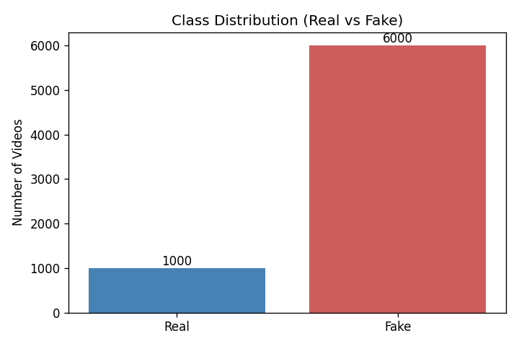
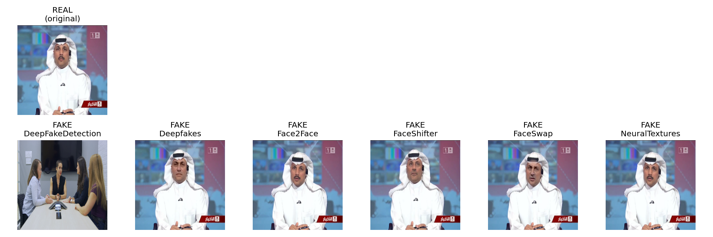
Dataset: FaceForensics++ Subset
FaceForensics++ (C23 compressed, H.264), hosted on Hugging Face
Original (real) + 6 manipulation methods (DeepFakeDetection, Deepfakes, Face2Face, FaceShifter, FaceSwap, NeuralTextures)
Two experiment tracks:
Video subset: middle frame per video (~132 total, imbalanced 1:3.4 real:fake)
Image split: 2000 REAL + 2000 FAKE per train/test (perfectly balanced)

Slide 9
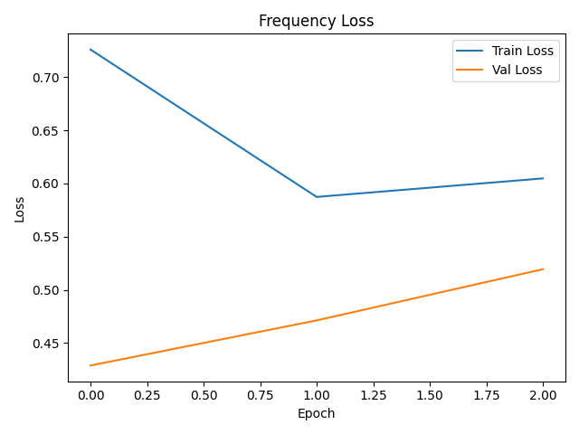
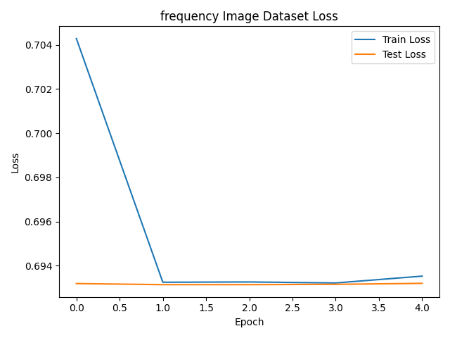
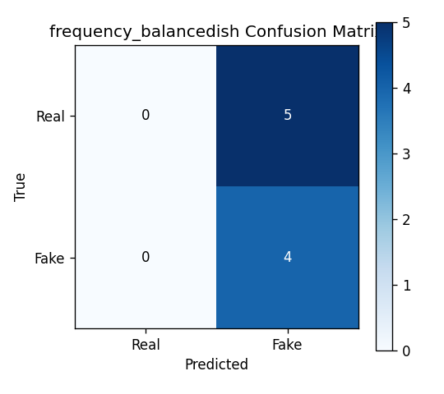
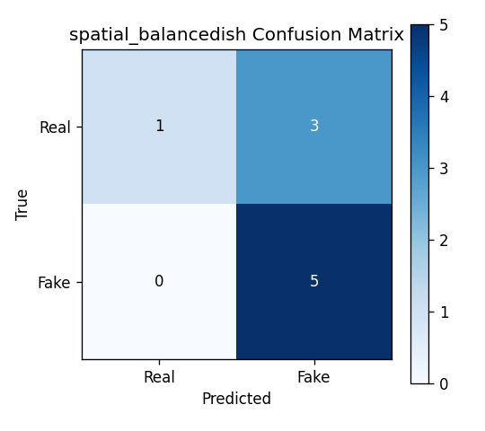
Video Subset: Ablation Study
Tested imbalance impact: max_fake_per_csv = 8 vs 3
With 8 fake per CSV (68 fake, 20 real): 3.4:1 ratio
- Both models predict ALL samples as Fake → 88.2% acc, 100% recall
- Precision = accuracy → degenerate solution
With 3 fake per CSV (38 fake, 20 real): 1.9:1 ratio
- Spatial: 66.7% acc, F1=0.769
- Frequency: 44.4% acc, F1=0.615 — below random
Key insight: balanced datasets are essential for meaningful architecture comparison

Slide 10
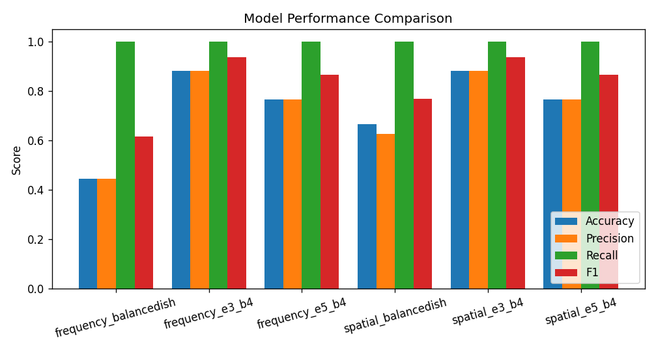
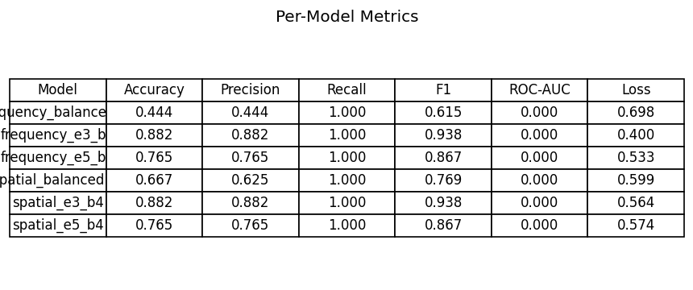
Main Results
Attention fusion beats spatial by +7.4% accuracy, +10.8 F1
Attention fusion beats naive concat by +19.2% accuracy
Frequency near random (hypothesis: C23 compression masks FFT artifacts)
Naive concat hurts performance vs spatial alone

Slide 11
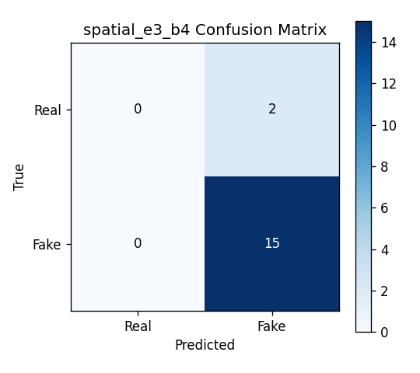

Confusion Matrix: Spatial vs Frequency
Spatial CNN (80.7% acc on image, 88.2% on video):
- On image data: 1886/2000 real correct, 658 fakes missed
- High precision (92%) means: when it says Fake, it's almost always right
- Low recall (67%) means: it misses 1 in 3 fakes
Frequency FFT-CNN (46.5% on image):
Near random performance
Confusion matrix shows balanced errors on image data
On video with imbalance: degenerate all-fake prediction

Slide 12
Confusion Matrix: Spatial vs Attention Fusion
Attention Fusion (88.1% acc)
True Real -> Pred Real: 1,703 | True Real -> Pred Fake: 297
True Fake -> Pred Real: 178 | True Fake -> Pred Fake: 1,822
Catches 480 MORE fakes than spatial
Only 178 false negatives vs 658 — 73% reduction
Tradeoff: 183 more false positives (acceptable in forensics)
Spatial CNN(80.7% acc)
True Real -> Pred Real: 1,886 | True Real -> Pred Fake: 114
True Fake -> Pred Real: 658 | True Fake -> Pred Fake: 1,342
Conservative: misses 658 fakes (33% miss rate)

Slide 13
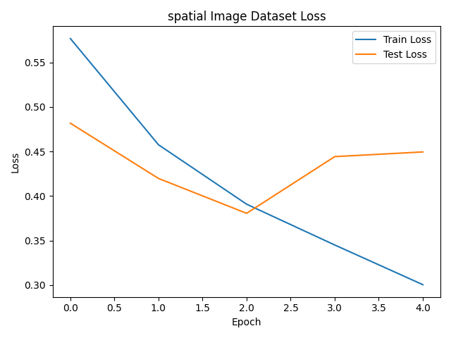
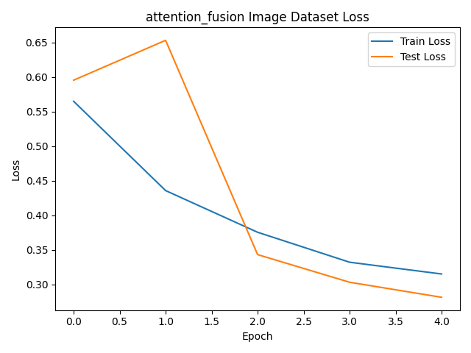
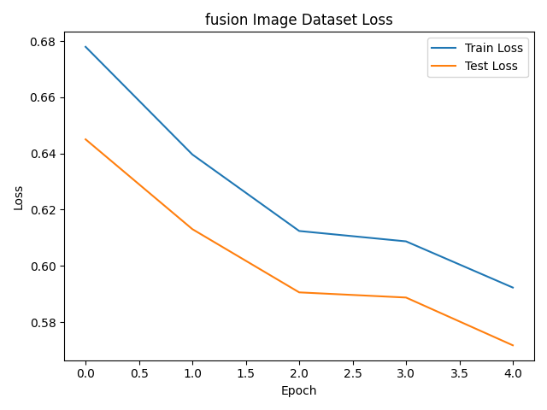
Training Loss Curves
Spatial CNN: validation loss bottoms at epoch 3, climbs — classic overfitting
Fusion (concat): slow convergence, final val loss 0.57 — noisy features dilute signal
Attention Fusion: smooth, stable convergence to 0.28 — best generalization
The frequency branch acts as a regularizer when combined through attention
Without the gate, the noisy frequency features hurt; with the gate, they help

Slide 14
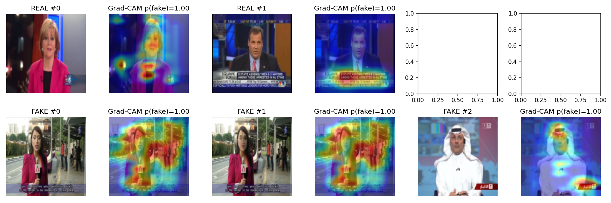
Grad-CAM
Grad-CAM over the attention model's final spatial conv layer
Three consistent attention regions:
Facial boundaries: blending artifacts from face-swapping pipelines
Eye & mouth regions: morphological inconsistencies (asymmetrical pupils, unnatural teeth)
Hair & clothing edges: high-frequency texture patches, GAN checkerboard patterns
Heatmaps align with known synthesis artifacts from literature
Evidence the model learned genuine forgery cues, not correlations

Slide 15
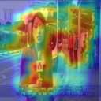
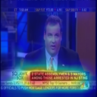
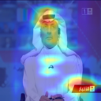
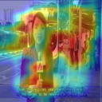
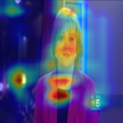
Grad-CAM: Individual Examples

Slide 16

Key Insights
Attention gating is essential, not optional
Naive concat fusion (68.9%) < spatial alone (80.7%)
Attention fusion (88.1%) > spatial alone (80.7%)
Without a gate, adding the frequency domain hurts performance
FFT-only detection fails on compressed media
C23 compression masks spectral artifacts
Important practical insight for real-world deployment
Explainability works and aligns with forensic knowledge
Grad-CAM heatmaps highlight meaningful regions
Bridges the gap between prediction and trust

Slide 17
Unexpected Findings
Surprise 1: Frequency model near-random (46.5%)
Contradicts common assumption that FFT is universally informative
Hypothesis: C23 compression quantizes frequency domain, masking artifacts
Prediction: would perform much better on uncompressed/lightly compressed media
Surprise 2: Concat fusion < spatial baseline
Counterintuitive: why does adding information hurt?
Explanation: 128-dim vector with 64 dims of noise dilutes classifier capacity
Attention gate solves this by learning to suppress uninformative branch
Implication: domain fusion must be paired with gating; naive approaches backfire

Slide 18
Conclusion
Bottom line:
Learned attention weighting between spatial and frequency domains
Consistently outperforms single-domain and naive fusion approaches
Built-in explainability through Grad-CAM
Immediate next steps:
Cross-generator evaluation (train FF++ → test on diffusion models)
Multi-frame fusion using 3D CNNs or LSTMs
Robustness testing: JPEG compression, resizing, adversarial attacks

