Slide 1
An Introduction to Natural Language Processing
Motaz Saad
September 2020

Slide 2
Outline
What is NLP?
Why NLP is hard?
Applications

Slide 3
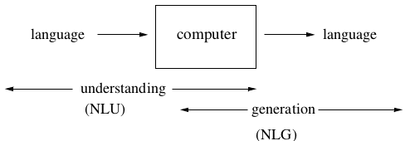
What is Natural Language Processing?
computers using natural language as input and/or output

Slide 4
NLP tasks
Machine Translation (MT)
Information Extraction (IE)
Text Summarization (TS)
Tagging (POS, NER)
Text Classification (TC)
Information Retrieval (IR)
Language Modelling (LM)
….

Slide 5
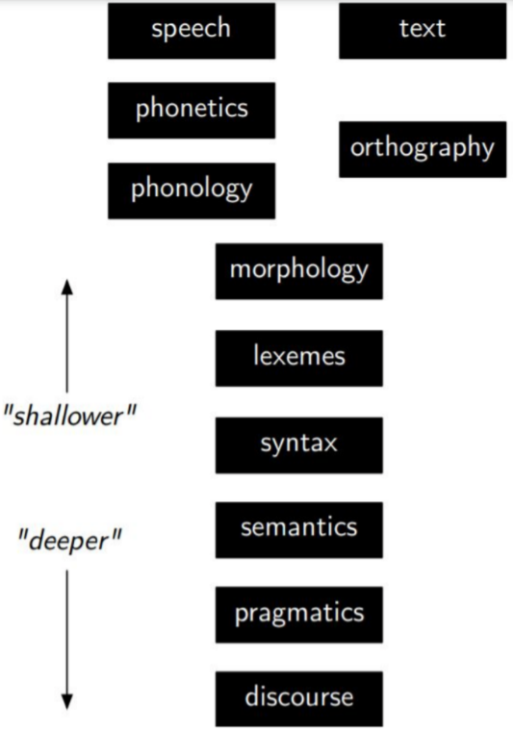
Level Of Linguistic Knowledge

Slide 6
Tagging
Example 1: Part-of-speech tagging
Profits/N soared/V at/P Boeing/N Co./N ,/, easily/ADV topping/V forecasts/N on/P Wall/N Street/N ./.
Example 2: Named Entity Recognition
Profits/NA soared/NA at/NA Boeing/SC Co./CC ,/NA easily/NA topping/NA forecasts/NA on/NA Wall/SL Street/CL ./.

Slide 7
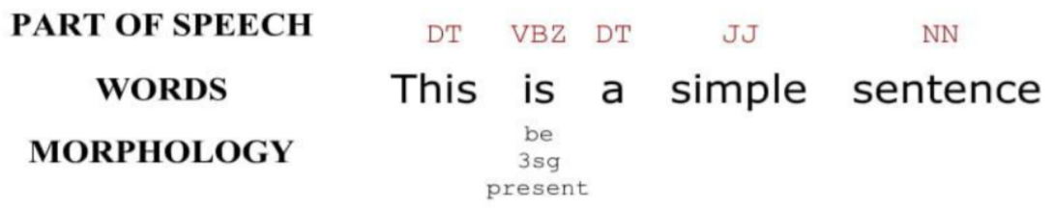
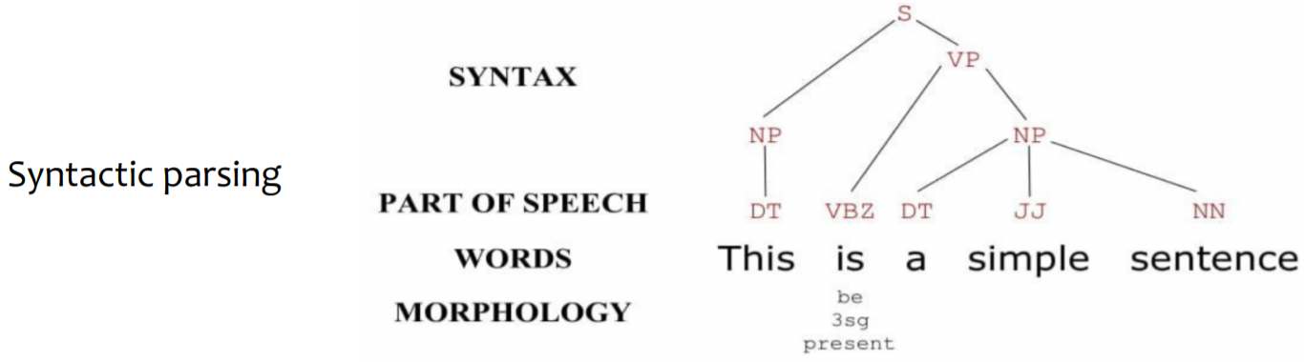
POS Tagging, Syntax

Slide 8
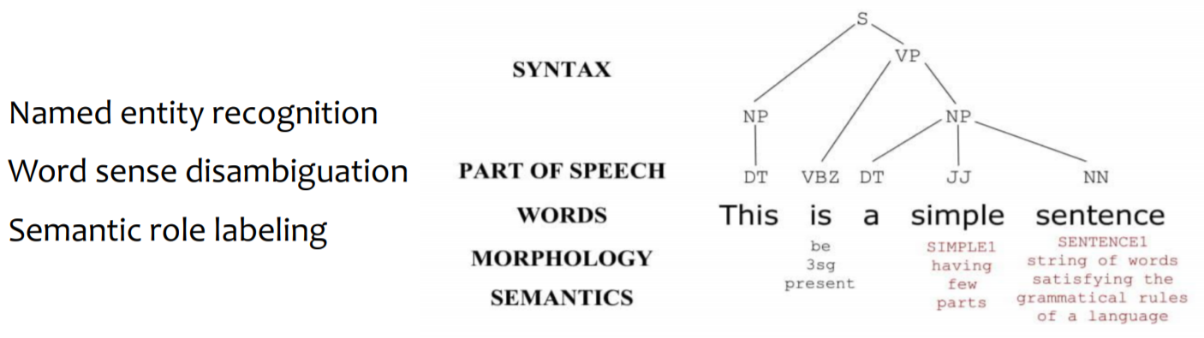
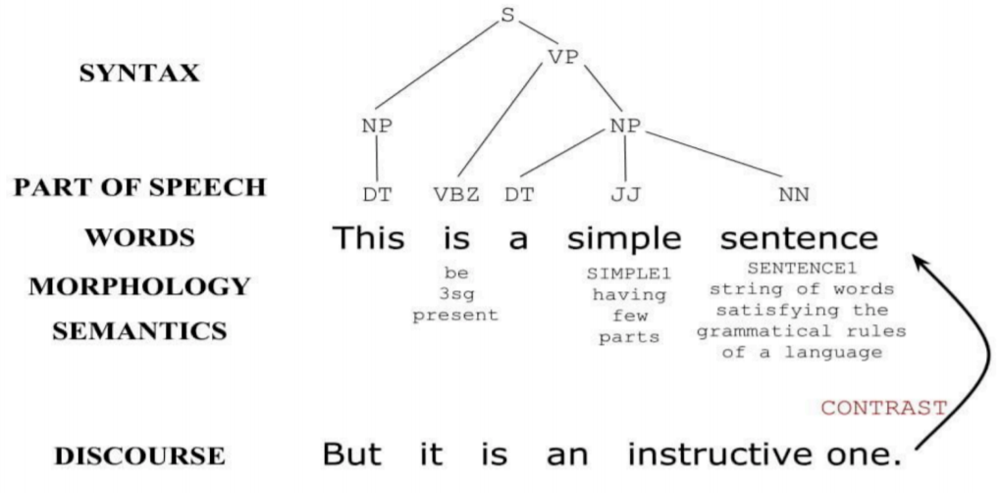
Semantics and Discourse

Slide 9
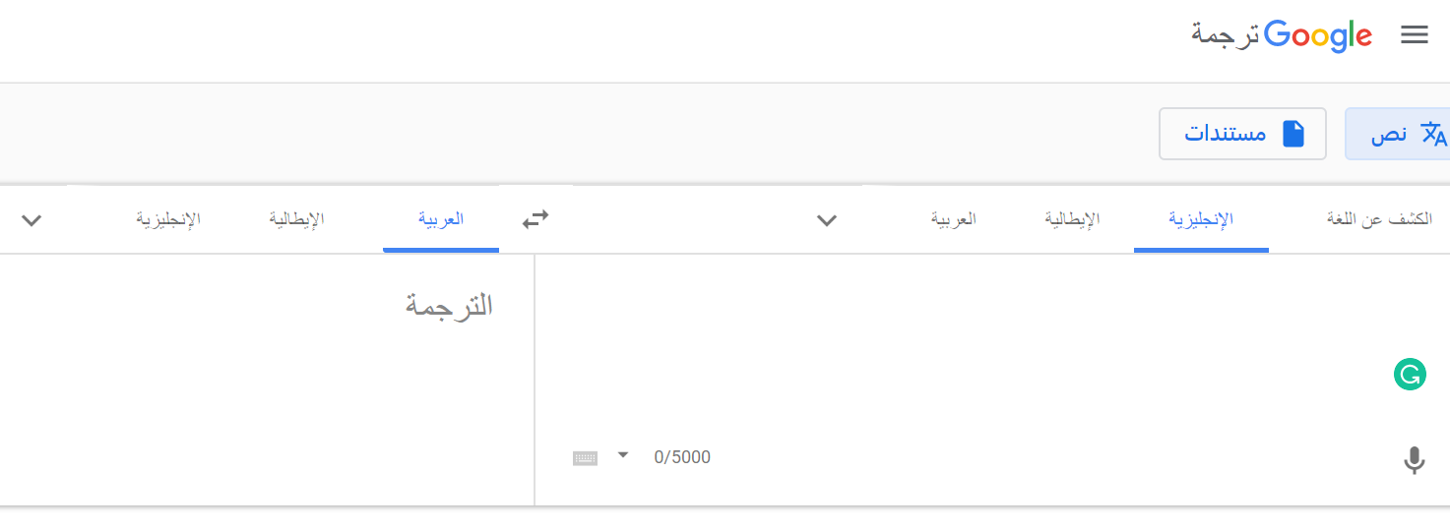

Machine Translation (MT)
A sub-field of computational linguistics that investigates the use of software to translate text or speech from one language to another. (Wikipedia)
Statistical Machine Translation (SMT)
Neural Machine Translation (NMT)

Slide 10
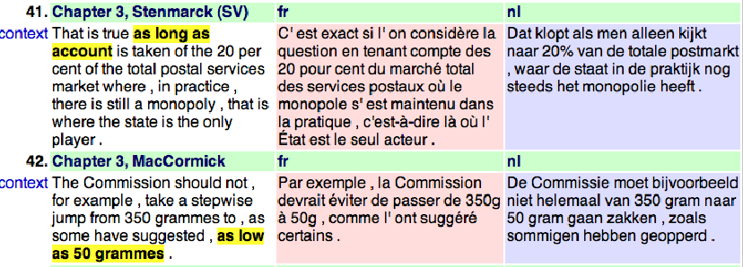
Parallel coprus

Slide 11

Information Extraction (IE)
Information extraction (IE) is the task of automatically extracting structured information from unstructured documents. (Wikipedia)

Slide 12
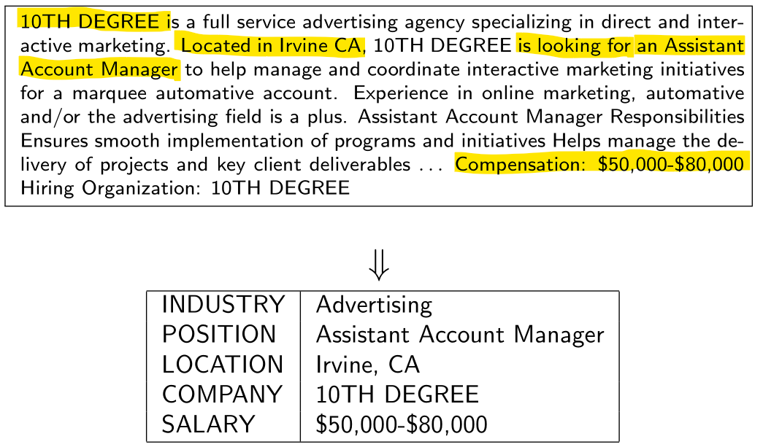
Information Extraction Example

Slide 13
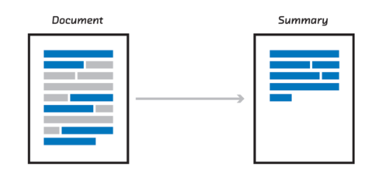
Text Summarization

Slide 14
Information Extraction
Goal: Map a document collection to structured database
Motivation:
Complex searches (“Find me all the jobs in advertising paying at least $50,000 in Boston”)
Statistical queries (“How has the number of jobs in accounting changed over the years?”)

Slide 15
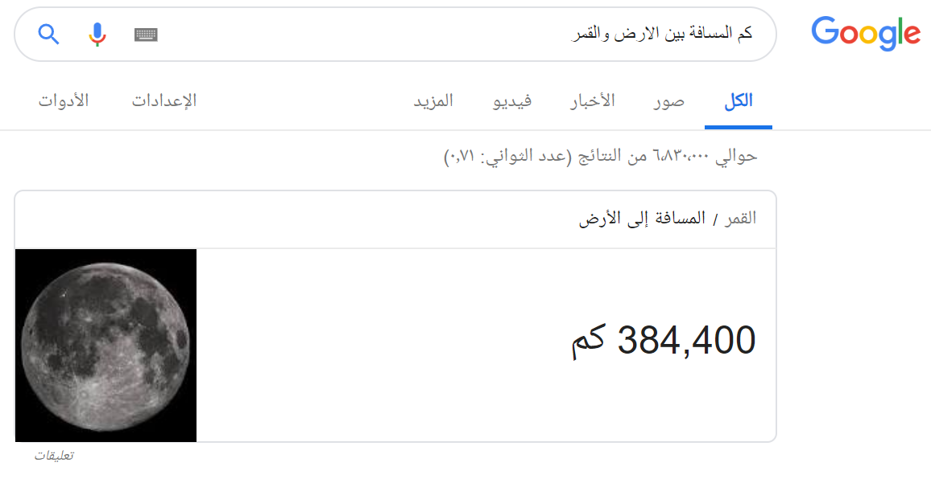

Slide 16

Chatbots (text understanding and generation)
is a computer program which conducts a conversation via auditory or textual methods

Slide 17

Why is NLP Hard?

Slide 18
Ambiguity
“At last, a computer that understands you like your mother”
1. (*) It understands you as well as your mother understands you
2. It understands (that) you like your mother
3. It understands you as well as it understands your mother
1 and 3: Does this mean well, or poorly?

Slide 19
Ambiguity At the acoustic level (speech recognition)
I’m eight or duck
Eye maid; her duck
I maid her duck
I’m aid her duck
I’m ate her duck
I’m ate or duck

Slide 20
Ambiguity at the semantic (meaning) level
Two definitions of “mother”
I a woman who has given birth to a child
I a stringy slimy substance consisting of yeast cells and bacteria; is added to cider or wine to produce vinegar
This is an instance of word sense ambiguity

Slide 21
More Word Sense Ambiguity semantic (meaning) level
I They put money in the bank = = buried in mud?
I saw her duck with a telescope

Slide 22

Thanks ☺

