Slide 1

Node JS
Interview Questions

Slide 2
What is Node.js and how it works?
Node.js is an open-source, cross-platform JavaScript runtime environment that executes JavaScript code outside of a browser.
Node.js is built on Chrome's V8 JavaScript engine and uses an event-driven, non-blocking I/O model that makes it lightweight and efficient.
Node.js is commonly used for developing server-side applications, but it can also be used for developing desktop and mobile applications.

Slide 3
What is a first-class function in JavaScript?
When functions can be treated like any other variable then those functions are first-class functions.
1
function can be passed as a param to another function(callback)
2
function can return another function(higher-order function).
3
map() and filter() are higher-order functions that are popularly used.
4

Slide 4
How do you manage packages in your node.js project?
It can be managed by several package installers and their configuration file accordingly.
Out of them mostly use npm or yarn.
To maintain versions of libs being installed in a project we use package.json

Slide 5
How is Node.js better than other frameworks most popularly used?
Node.js provides simplicity in development because of its non-blocking I/O and even-based model results in short response time and concurrent processing, unlike other frameworks where developers must use thread management.

Slide 6
Explain the steps how “Control Flow” controls the functions calls?
Control the order of execution
Collect data
Limit concurrency
Call the following step in the program.

Slide 7
What are some commonly used timing features of Node.js?
setTimeout/clearTimeout – This is used to implement delays in code execution.
setInterval/clearInterval – This is used to run a code block multiple times.

Slide 8
What are the advantages of using promises instead of callbacks?
The main advantage of using promise is you get an object to decide the action that needs to be taken after the async task completes.
This gives more manageable code and avoids callback hell.

Slide 9
What is fork in node JS?
A fork in general is used to spawn child processes.
In node it is used to create a new instance of v8 engine to run multiple workers to execute the code.

Slide 10
Why is Node.js single-threaded?
Node.js was created explicitly as an experiment in async processing. This was to try a new theory of doing async processing on a single thread over the existing thread-based implementation of scaling via different frameworks.

Slide 11
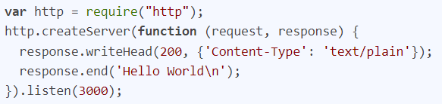
How do you create a simple server in Node.js that returns Hello World?

Slide 12
How many types of API functions are there in Node.js?
Asynchronous, non-blocking functions - mostly I/O operations which can be fork out of the main loop.
Synchronous, blocking functions - mostly operations that influence the process running in the main loop.
// Requiring inbuilt module
const fs = require('fs');
// Asynchronous function
fs.readFile('data.json', 'utf8', function (err,data) {
if (err) {
return console.log(err);
}
console.log("Below is the Data from Asynchronous function call")
console.log(data);
});
// Synchronous function
var data = fs.readFileSync('data.json','utf8');
console.log("Below is the Data from Synchronous function call")
console.log(data);

Slide 13
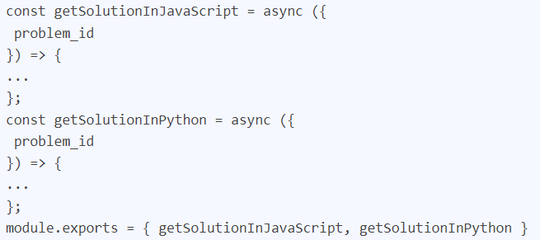
What is the purpose of module.exports?
This is used to expose functions of a particular module or file to be used elsewhere in the project.

Slide 14
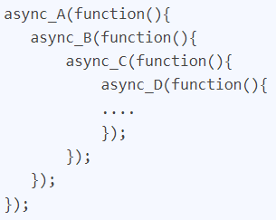
What do you understand by callback hell?
Pyramid of doom.
Non structured code.

Slide 15
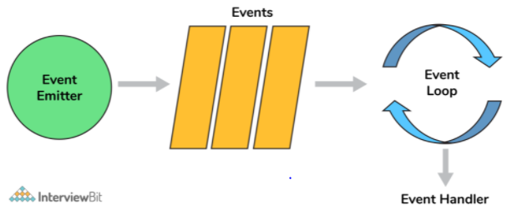
What is an event-loop in Node JS?
So, when an async function needs to be executed(or I/O) the main thread sends it to a different thread allowing v8 to keep executing the main code. Event loop involves different phases with specific tasks such as timers, pending callbacks, idle or prepare, poll, check, close callbacks with different FIFO queues. Also in between iterations it checks for async I/O or timers and shuts down cleanly if there aren't any.

Slide 16
What is node.js streams?
Streams are instances of EventEmitter which can be used to work with streaming data in Node.js.
Writable: streams to which data can be written (for example, fs.createWriteStream()).
Readable: streams from which data can be read (for example, fs.createReadStream()).
Duplex: streams that are both Readable and Writable (for example, net.Socket).
Transform: Duplex streams that can modify or transform the data as it is written and read (for example, zlib.createDeflate()).

Slide 17
What are node.js buffers?
In general, buffers is a temporary memory that is mainly used by stream to hold on to some data until consumed.
Buffers are introduced with additional use cases than JavaScript’s Unit8Array and are mainly used to represent a fixed-length sequence of bytes.

Slide 18
Why should you separate Express app and server?
The server is responsible for initializing the routes, middleware, and other application logic whereas the app has all the business logic which will be served by the routes initiated by the server.

Slide 19
Describe the exit codes of Node.js?
Uncaught fatal exception - (code - 1) - There has been an exception that is not handled
Unused - (code - 2) - This is reserved by bash
Fatal Error - (code - 5) - There has been an error in V8 with stderr output of the description
Internal Exception handler Run-time failure - (code - 7) - There has been an exception when bootstrapping function was called
Internal JavaScript Evaluation Failure - (code - 4) - There has been an exception when the bootstrapping process failed to return function value when evaluated.

Slide 20
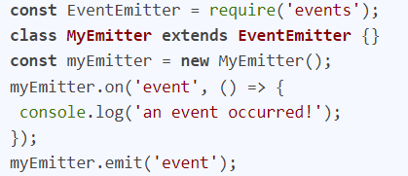
What is an Event Emitter in Node.js?
EventEmitter is a Node.js class that includes all the objects that are basically capable of emitting events. This can be done by attaching named events that are emitted by the object using an eventEmitter.on() function. Thus, whenever this object throws an even the attached functions are invoked synchronously

Slide 21
Enhancing Node.js performance through clustering.
Node.js applications run on a single processor, which means that by default they don’t take advantage of a multiple-core system.
Cluster mode is used to start up multiple node.js processes thereby having multiple instances of the event loop.
When we start using cluster in a NodeJS app behind the scene multiple node.js processes are created but there is also a parent process called the cluster manager which is responsible for monitoring the health of the individual instances of our application.

Slide 22
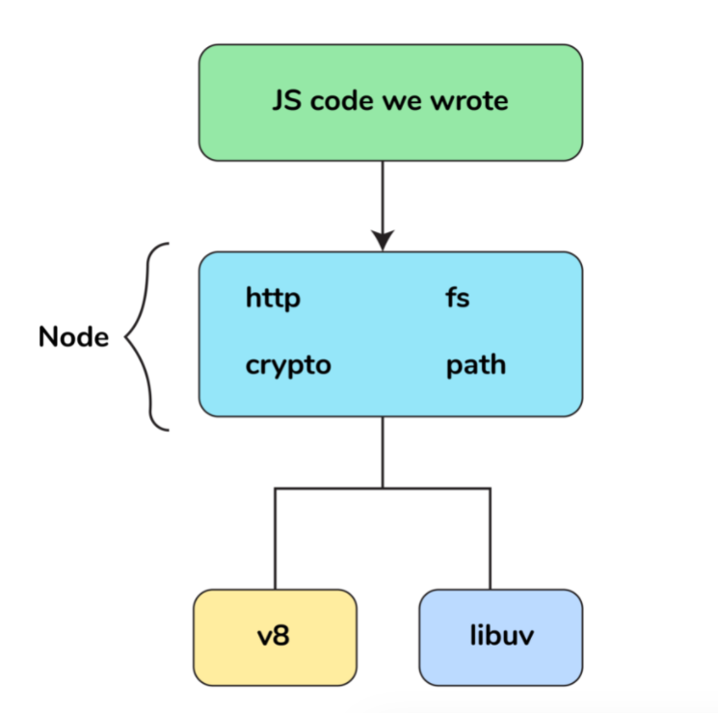
What is a thread pool and which library handles it in Node.js
The Thread pool is handled by the libuv library. libuv is a multi-platform C library that provides support for asynchronous I/O-based operations such as file systems, networking, and concurrency.

Slide 23
What is piping in Node.js?
Piping is a mechanism used to connect the output of one stream to another stream. It is normally used to retrieve data from one stream and pass output to another stream

Slide 24
Node.js is an open-source server side runtime environment built on Chrome's V8 JavaScript engine. It provides an event driven, non-blocking (asynchronous) I/O and cross-platform runtime environment for building highly scalable server-side application using JavaScript.
Node.js can be used to build different types of applications such as command line application, web application, real-time chat application, REST API server etc. However, it is mainly used to build network programs like web servers, similar to PHP, Java, or ASP.NET.
Node.js was written and introduced by Ryan Dahl in 2009. Visit Wikipedia to know the history of Node.js.
Node.js official web site: https://nodejs.org
https://nodejs.dev/en/learn/
Node.js on github: https://github.com/nodejs/node
Node.js community conference http://nodeconf.com
What is Node.js?

Slide 25
Advantages of Node.js
Node.js is an open-source framework under MIT license. (MIT license is a free software license originating at the Massachusetts Institute of Technology (MIT).)
Uses JavaScript to build entire server side application.
Lightweight framework that includes bare minimum modules. Other modules can be included as per the need of an application.
Asynchronous by default. So it performs faster than other frameworks.
Cross-platform framework that runs on Windows, MAC or Linux

Slide 26
Disadvantages\Limitations of Node.js
There are following limitations of Node.js:
It doesn’t support multi-threaded programming.
It doesn’t support very high computational intensive tasks. When it executes long running task, it will queue all the incoming requests to wait for execution, since it follows JavaScript event loop which is single threaded.
Node good for executing synchronous and CPU intensive tasks.

Slide 27
Why Node js is single thread?
Node.js is based on single threaded architecture due to the reason that it runs on Google’s V8 engine which is a single threaded architecture.

Slide 28
Types of APIs
Synchronous API:- These are blocking functions that wait for the response to come back.
Asynchronous API:- These are non-blocking functions that keep on processing in the background.

Slide 29
Node.js Core Modules
Core Module | Description
http | http module includes classes, methods and events to create Node.js http server.
url | url module includes methods for URL resolution and parsing.
querystring | querystring module includes methods to deal with query string.
path | path module includes methods to deal with file paths.
fs | fs module includes classes, methods, and events to work with file I/O.
util | util module includes utility functions useful for programmers.

Slide 30
call back return value
This is impossible as you cannot return from an asynchronous call inside a synchronous method.
In this case you need to pass a callback to foo that will receive the return value

Slide 31
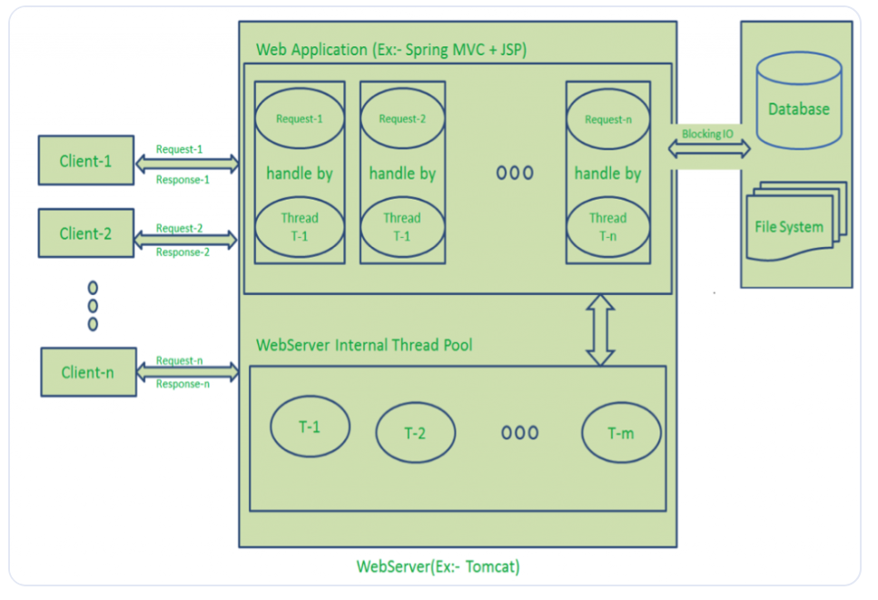
Node js architecture

Slide 32
Return value from nested callback instead of the parent function?
Have addNewUser accept a callback as its last argument and have the innermost function call the callback with the value.
Alternatively, you could look into having addNewUser return a promise. RSVP or Q are implementations of the Promises/A :
function addNewUser(hash,name,number,time,syncTime) {
var deferred = Q.defer();
connection.query("SELECT ...", function(err, rows, fields) {
if(err) { deferred.reject(err); }
if(rows[0]) { deferred.reject("some reason"); }
connection.query("INSERT INTO ...", function(err, rows, fields) {
if(err) { deferred.reject(err); }
deferred.resolve(rows[0]); // Whatever addNewUser would return normally
});
});
return deferred.promise;
}
Then the caller would use it like this:
addNewUser(...).then(function(newUserAdded) {
// Do something with newUserAdded here
}, function(err) {
// Do something with the error here
});

Slide 33
Difference between Json.Parse() and Json.Stringify()?
a.Json.Stringify() is used for convert Json to String. ==>Json.Stringify(null)//'null';
Json.Parse is used for converting string to json. ==>Json.Parse('null')//null;

Slide 34
what is error first call back?
. passing error as first argument to the function is known as error first call here error will check first after that data checks.

Slide 35
Two types of function creation will be there
1. functionName (parameter){
new promise((resolve,reject)=>{
try{}
catch(error){
reject error;
}
});
return value;
}
2. const functionName=parameters=>{
return value;
}

Slide 36
How can you reduce consistency?
using tools like eslint and standard.

Slide 37
How does Node.js support multi-processor platforms, and does it fully utilize all processor resources?
using cluster module which is one of module in node js, it can support to run multiple worker processors in node js

Slide 38
benefits of node js
-->Asynchronous
-->Single Threading
-->No Buffer
-->Very Fast
-->No Blocking

Slide 39
Node package installation
->node packages can be installed in two ways global installation and local installation here globally installed files are stored in
user<directory> these are no need to require and locally installed packages are stored in our api package.json we need to use require statement to get the local package.
-->package.json represent the root directory of any node modules.

Slide 40
what is blocking code?
. blocking code is nothing, but synchronous calling means second block not executes until first block code is executed
Example:-

Slide 41
Blocking Code | Non-Blocking Code
var data=fs.readFile('input.txt'); console.log(data); console.log('code completed'); Output: reading text file code completed | fs.readFile('input.txt',function(err,data){ if(err){ console.log(err.message); } console.log(data); }); console.log('code completed'); Output: code completed reading text file

Slide 42
what is event emitter?
. It is nothing but fire the event whenever it is required.
const event=require('event');
const event_instance=new event.EventEmitter();
-->Through above event instance we can fire the respective event which supports event.on etc....

Slide 43
How many types of streams are present in node?
a. 1. Readable 2. Writable 3. Duplex 4. Transform.
--->fs.open(path,flags[,mode],callback);

Slide 44
How can you avoid callback hell?
callback hell is avoided by using promises, modularization, asyn/await function calling.

Slide 45
What is event Looping?
To Process the external events and convert them into callback invocations we use event loops.

Slide 46
Pros and cons of node js?

Slide 47
what is module in node js?
module is a simple or complex functionality organized in single or multiple file which can be used in throughout the application.
Example:-

Slide 48
Diff b/w general and arrow functions?
this behavior is changes in both arrow and general functions'
-->Named expression functions.

Slide 49
For js event loop properties
1.Heap
2.Stack
3.Web Api
4.Queue
5.Event Loop.

Slide 50
For Node js Architecture
client req ===>
client request =====> event queue ==> event loop ===>[]==>thread pool==>D.B

Slide 51
What is event loop?
Event loop can perform non blocking i/o operations.
setTimeout(()=>{
console.log('');
})

Slide 52
what is object destructuring?

Slide 53
ES6 or ES2015 additional features:
Object destructuring
-->arrow functions
-->template literals(`${err}` stringify in our snr)
-->classes
-->Spread Operator
-->Types of object declaration.
Difference:
var a = Object.create(null); is not the same as var a = {};
var a = Object.create(null); sets the prototype of a as null where as
var a = {}; sets the prototype of a as the Object object

Slide 54
Event Loop Internal Properties
1.Timers-->Used for setTimeOut() and setInterval()
2.Pending CallBacks-->I/O executions will be perform here.
3.Ideal--->Internal Operations are performed here.
4.poll-->Get the new I/O operations and executions performed here and timer can be set here.
5.check-->it will check the setTimeout threshold period.
6.close callback-->callbacks can close here.

Slide 55
exporting module
So, there are two types of exporting module will be there.

Slide 56
'use strict'

Slide 57
variable using without declaration
Delete a function or object
Deleting an undeletable property
Duplicating a parameter name
Octal numeric literals/escape are not allowed
Writing to a read-only property
Writing to a get-only property
The string "eval" cannot be used as a variable

Slide 58
Spread Operator
var mid=[3,4];
var st=[1,2,mid,5,6]
console.log(st);
o/p:[ 1, 2, [ 3, 4 ], 5, 6 ]//Not expected o/p
var mid=[3,4];
var st=[1,2,...mid,5,6]
console.log(st);
o/p:[ 1, 2, 3, 4,5, 6 ]//expected o/p
var arr=[1,2,3,4,5]; function math(arr) { return Math.max.apply(null,arr); } console.log(math(arr)) o/p:5 | var arr=[1,2,3,4]; console.log(Math.max(...arr)); o/p:

Slide 59
What is variable Hoisting?
-->The variables and functions declarations are moved to top of their scope before code execution.

Slide 60
Session maintenance
--->Session maintenance is not there in javascript. only cookies are worked in js because js can work on current page. if we want to transfer value
from one page to another page then we can use dotnet, java, php, etc...

Slide 61
maintain cookie in js :
-->When we enter a site(fb, gmail) with username and password browser ask us to save user data that is cookie.
Creating coockie:document.cookie = "username=John Doe; expires=Thu, 18 Dec 2013 12:00:00 UTC; path=/";

Slide 62
Template Literal:
Template literals is a additional way to create and handle dynamic strings/string templates
usages:
1.MultiLIne Strings
-->console.log('First Line\n'+'second Line') //Normal syntax
-->console.log(`First Line
second Line`); //Template literal syntax

Slide 63
Expression Interpolation
var a=10;
var b=20;
var c=b?(a+b):a; //Normal ternary operator
var c=`{b?a+b:a}` //Template literal syntax

Slide 64
Object Literals:
https://blog.kevinchisholm.com/javascript/difference-between-object-literal-and-instance-object/
-->If the object declared with properties and methods known as object literal and that properties and methods are public. the function declared inside object capable of private scope.
var obj={
name:'gopi',
Class:'first',
subjects:function(){
return {lang1:'telugu',lang2:'english'}
}
}
var {lang1,lang2}=obj.subjects();
console.log(lang1)//telugu

Slide 65
Instance Object:
Here instance object in the sense creating instance for the function and the properties, methods declared inside the function are private only.
by using 'this' keyword we make them as public see below code.
var fun=function(){
color='blue';
this.getcolor=function(){
return color;
}
this.setcolor=function(newcolor){
color=newcolor;
}
}
var inst_obj=new fun();
console.log(inst_obj.getcolor());//blue
inst_obj.setcolor('yellow');
console.log(inst_obj.getcolor());//yellow
console.log(inst_obj.color);//o/p is undefined but we access color by put it as this keyword.

Slide 66
Rest parameters:
https://javascript.info/rest-parameters-spread-operator
function sum(...args)
{
var sum=0;
for(let arg of args)
{
sum+=arg;
}
return `Total Sum is ${sum} and passing arguments lengthis ${args.length}`
}
sum(1,2,3,4,5,5);

Slide 67
-->call, apply, bind methods difference
bind | call | apply
bind: if a function needs to invoke later in certain events then we use bind. var obj={ name:'Gopi' } var sample=function(a,b,c){ console.log(this.name+' is '+ a +' and '+b +' and '+c); } var args=['sam','dom','ram']; var bound=sample.bind(obj) bound('sam','dom','ram’); ===>o/p Gopi is sam and dom and ram | If we want to invoke a function then we use call and apply but their usage is different see below example. var obj={ name:'Gopi' } var sample=function(a,b,c){ console.log(this.name+' is '+ a +' and '+b +' and '+c); } sample.call(obj,'sam','dom','ram’); ==>o/p Gopi is sam and dom and ram | var obj={ name:'Gopi' } var sample=function(a,b,c){ console.log(this.name+' is '+ a +' and '+b +' and '+c); } var args=['sam','dom','ram']; sample.apply(obj,args);==>o/p Gopi is sam and dom and ram

Slide 68
what is the use of clouser

Slide 69
regarding iife means selfinvoking function
(()=>{
console.log('hi')
})();

Slide 70
Remove duplicates from array.
-->var a=[1,2,2,3,4]--Remove duplicates from array.
var b=[...new Set(a)]--o/p-{1,2,3,4}

Slide 71
console.log(NaN===NaN)//o/p false
console.log(NaN===NaN)//o/p false

Slide 72
Object.freeze(obj) vs Object.seal(obj); vs Object.defineProperty
here it can restrict the insertion of new object properties. obj.age=26; console.log(obj); g var obj={ name:'gopi' } | //here it will not allow to add new properties but it will modify the existed properties. obj.name=26; console.log(obj); -->if we want to modify one object property and seaz another property use code like below. var obj={ name:'gopi' } | Object.defineProperty(obj,'age',{ value:26, writable:false }) obj.name='sam'; obj.age=27 console.log(obj);

Slide 73
-->what are javascript types?
-->Number, boolean, string, object, null, undefined
-->How do you create an object in js?
var obj={};var obj=new obj();
-->How do you assign object properties?
obj['age']=16;obj.age=16;
-->How to append value to an array?
arr[arr.length]=value;

Slide 74
Reverse String in js
var str='hi'
str = str.split("");
str = str.reverse();
str = str.join("");
console.log(str);

Slide 75
What is shallowcopy and deepcopy?
https://stackoverflow.com/questions/184710/what-is-the-difference-between-a-deep-copy-and-a-shallow-copy
-->shallocopy:
var a={1,2,4};
var b=a;
===>means a=b={1,2,3} here both a and b can reference to same memory location.
--->Deep copy:
var a={1,2,3};
var b=json.parse(Json.Stringify(a));
==>means a={1,2,3} and b={1,2,3} here both a and b can referencing to different memory location.

Slide 76
Callback function:
A function can passed as parameter to another function then it will be a callback function.
functionOne(err,daat=>{
if(err){
return err;}
console.log(data);
})
functionTwo(callback)
{
callback(null,'Hi')
}
functionTwo(functionOne);

Slide 77
-->Event Bubbling:
If two events are there event1 and event2 then firing will start from event2 to event1 nothing but bubbling up.
-->Event Capturing/Event delegation:
If two events are there event1 and event2 then firing will start from event1 to event2 nothing but capturing down.

Slide 78
Generators
-->Generators are used to pause and resume the block of code, here generators can have two methods which are yield() and next().
-->if we give run next method then code can run until first yield finding.
function* Add(x) {
console.log("first yield");//first next
yield x + 1;
console.log("second yield");//second next
var y = yield(null);
y = 6
console.log("third yield");//third next
return x + y;
}
var gen = Add(5);
gen.next();
gen.next();
gen.next();

Slide 79
Difference between local and session storage?
Here localstorage can be stored without any expiration time if we want to delete localstorage doen with javascript or clear cache
-->Session storage only available duration of browser session

Slide 80
Difference b/w http and http2

Slide 81
What is token authentication.

Slide 82
Difference b/w exports and module.export

Slide 83
Array Some()
some() method:
-->The return value of some method is true/false here it will check weather the item exist or not in the array if item will exist then return
true else return false.
var a=[1,2,3,4,5];
var b=[];
function ageCount(age){
b.push(age);
return age>4;
}
var some=a.some(ageCount);
console.log(b);
console.log(some);

Slide 84
create sample listener

Slide 85
What are exit codes in Node.js? List some exit codes?
Exit codes are specific codes that are used to end a “process” (a global object used to represent a node process).
ex:unused,Fatal Error

Slide 86
what is buffer class in Node js?
Node provides Buffer class which provides instances to store raw data similar to an array of integers but corresponds to a raw memory
allocation outside the V8 heap. Buffer class is a global class that can be accessed in an application without importing the buffer module.
-->buf = new Buffer(256);
len = buf.write("Simply");
console.log("Octets written : "+ len);

Slide 87
stdout and stderr
console.log("I will goto the STDOUT");
console.error("I will goto the STDERR");
process.stdout.write("I will goto the STDOUT")
process.stderr.write("I will goto the STDERR")

Slide 88
Array methods
--->Reduce():
https://developer.mozilla.org/en-US/docs/Web/JavaScript/Reference/Global_Objects/Array/Reduce
it is used to reduce the single value from an array.
--->shift():
https://www.w3schools.com/jsref/tryit.asp?filename=tryjsref_shift
--->It can remove the first element of an array.
-->unshift():
-->it is used to add the elements from beginning of array.
-->pop():
-->It is used to get the last element of an array.

Slide 89
CAP theorem

Slide 90
CAP -->COns

Slide 91
-->MongolClient.connect(url,function(err,db)=>{
dbo=db.db('myDb');
dbo.collection('collectionName').inserOne(myobj,(err,data)=>{
})

Slide 92
Object comparing

Slide 93
REST-->Representation state transfer

Slide 94
SOAP-->Simple Object Access Protocol

