Slide 1
Foundry Models
Top Burapacheep
3/5/2021

Slide 2
Hours
Wednesday: 1 hour
Thursday: 2 hour
Friday: 3 hour

Slide 3
Code
Github: https://github.com/Top34051/foundry-model

Slide 4
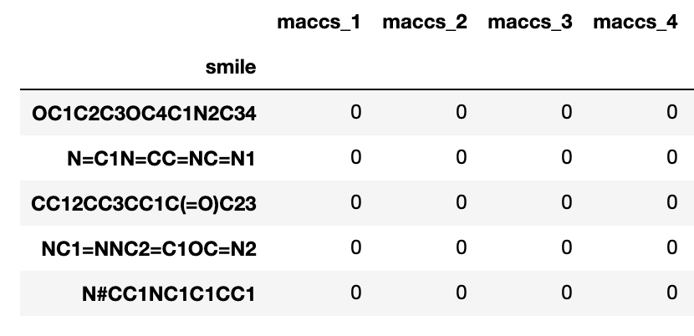
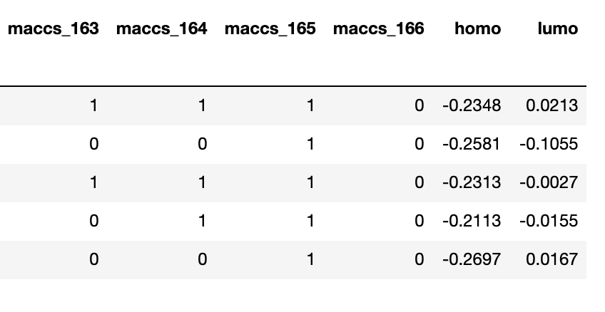
Data
Key-value-pair table → generate MACCS keys using RDKit
Homo and lumo values
Using only ~5000 molecules (takes around 5 mins to process the data)

Slide 5
Model
KRR (kernel ridge regression) → sklearn
Random Forest → sklearn
XGBoost
Train on the gap (lumo – homo) values

Slide 6
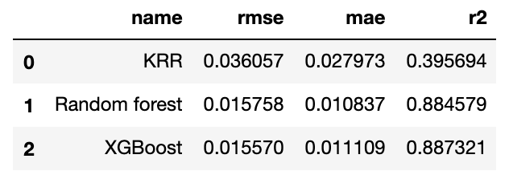
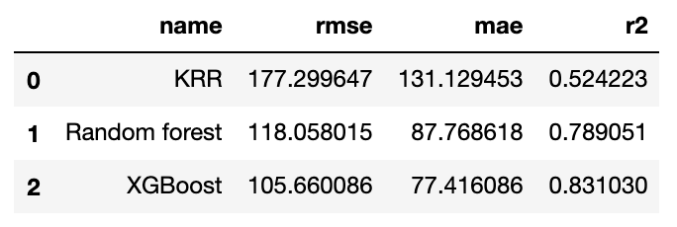
Scores
Homo-lumo gap
Evaluate using rmse, mae, and r2 score
AtomizationE

Slide 7
Conclusion
Random forest and XGBoost currently work significantly better than KRR
Hyperparameter tuning should be used if we want to work with KRR

