Slide 1


Slide 2
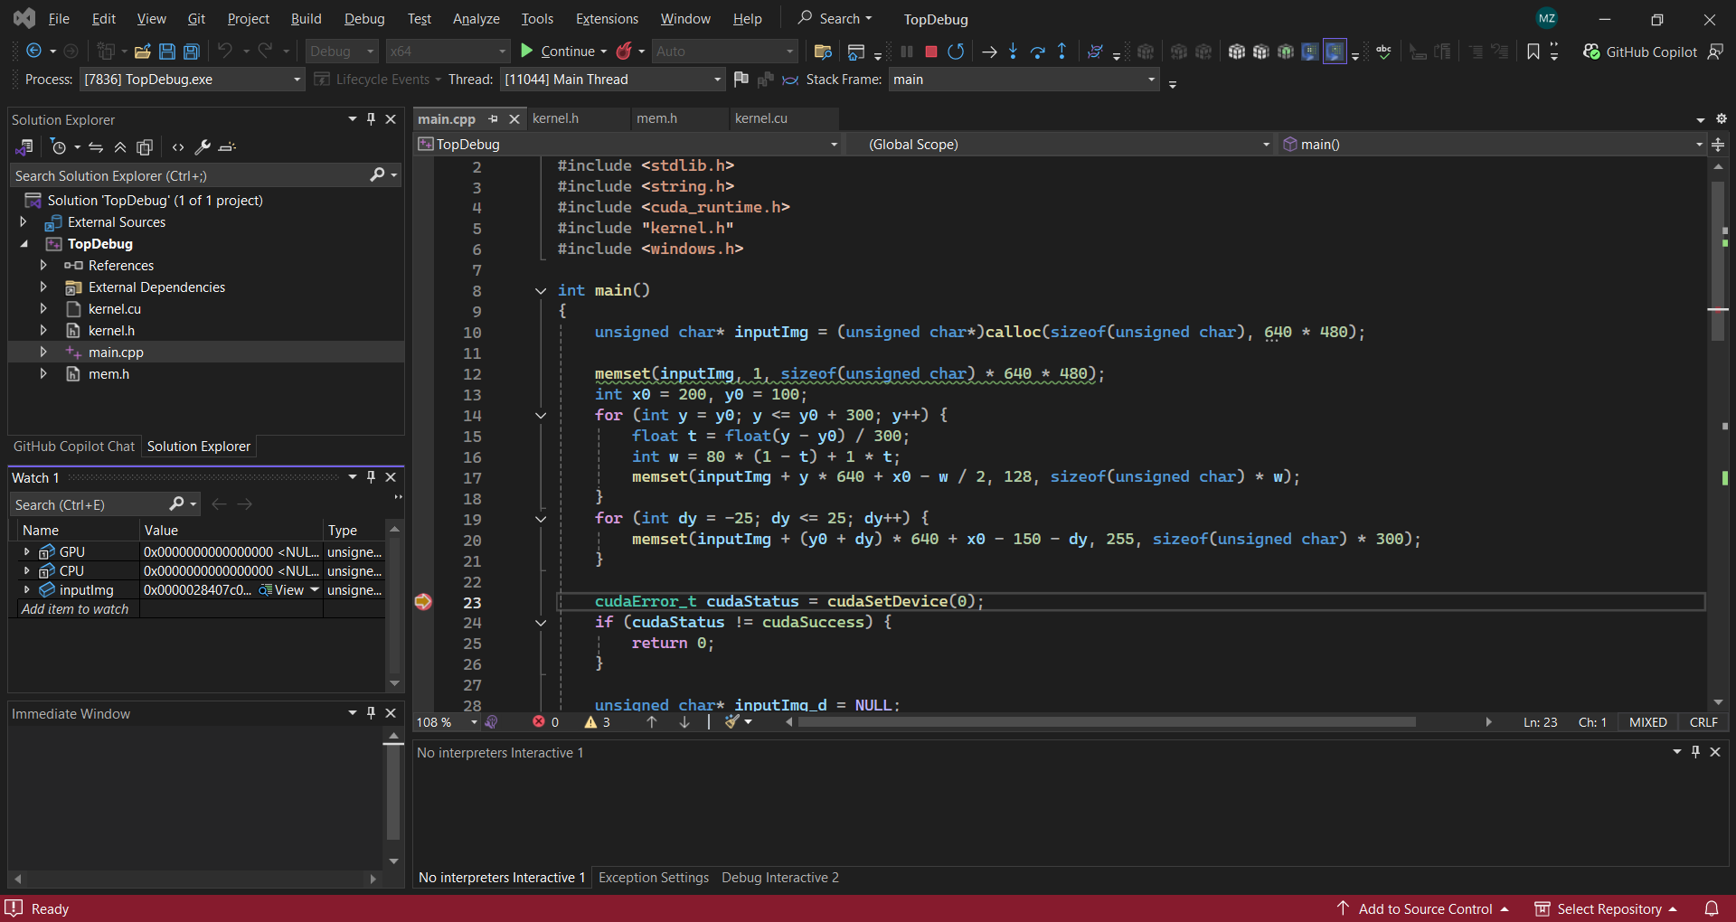
We first create the image data and then use MATLAB to read the C++ memory data.

Slide 3
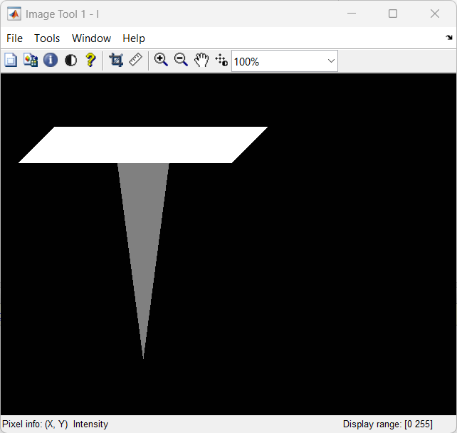
MATLAB displays the image data using the imtool method, as shown in this picture.

Slide 4
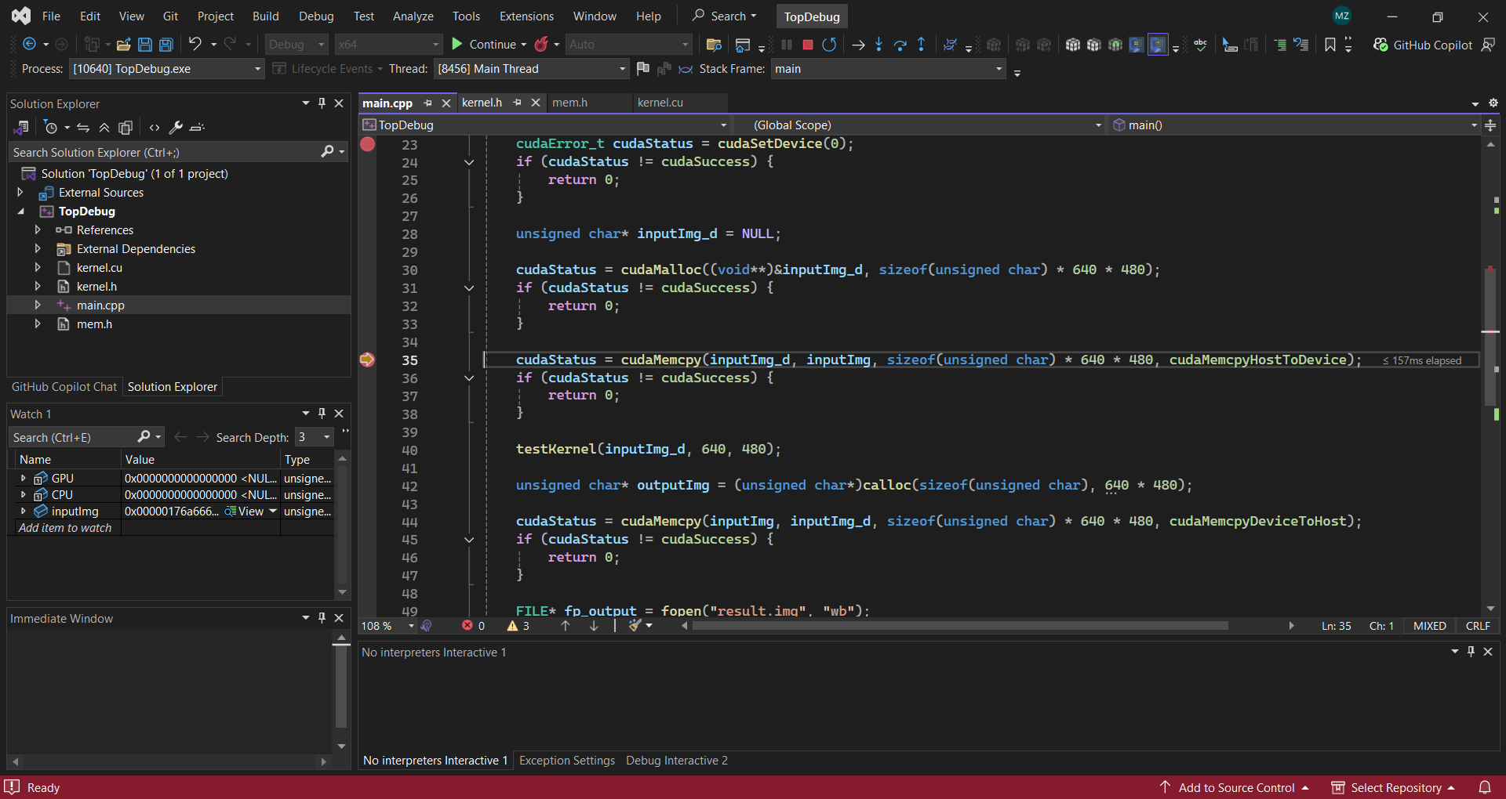
We copy the CPU image data to the GPU device using cudaMemcpy.
Then we call testKernel to test the GPU kernel function.

Slide 5
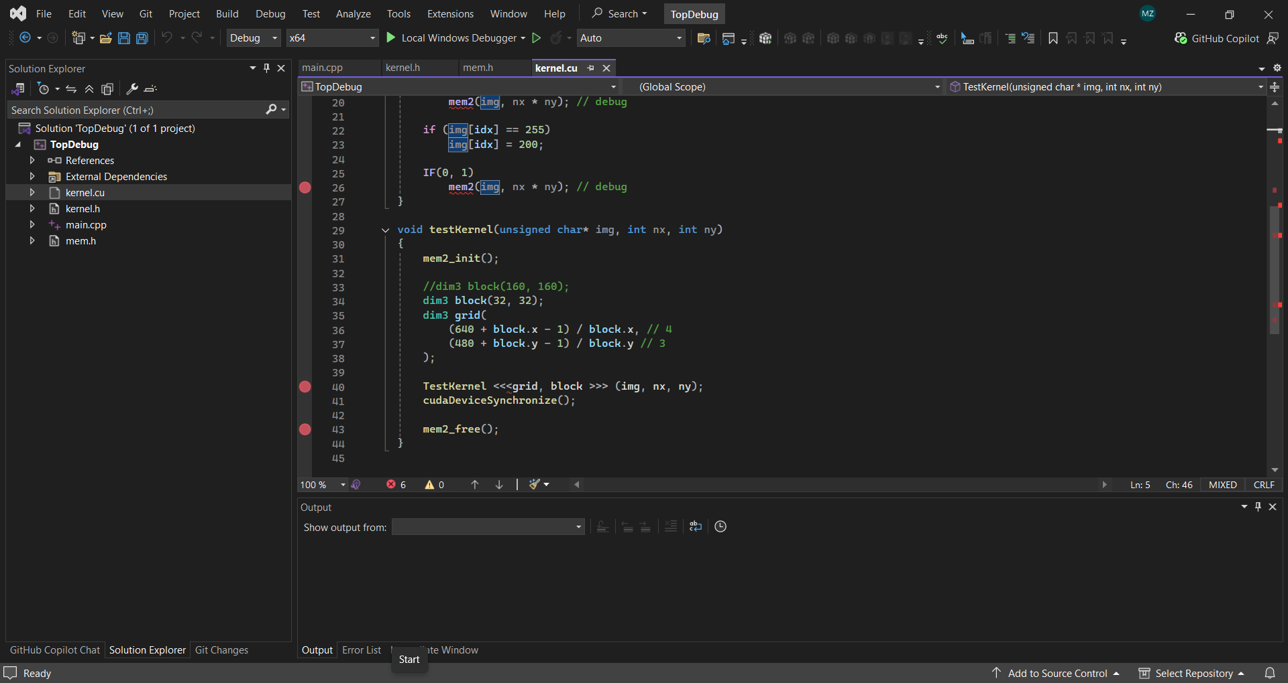
We should prepare the kernel function, as well as the grid and block sizes.
Then we call the TestKernel function.
The test kernel initialization function mem2_init() must be called.
mem2_free() is not required, but it is better to include it.

Slide 6
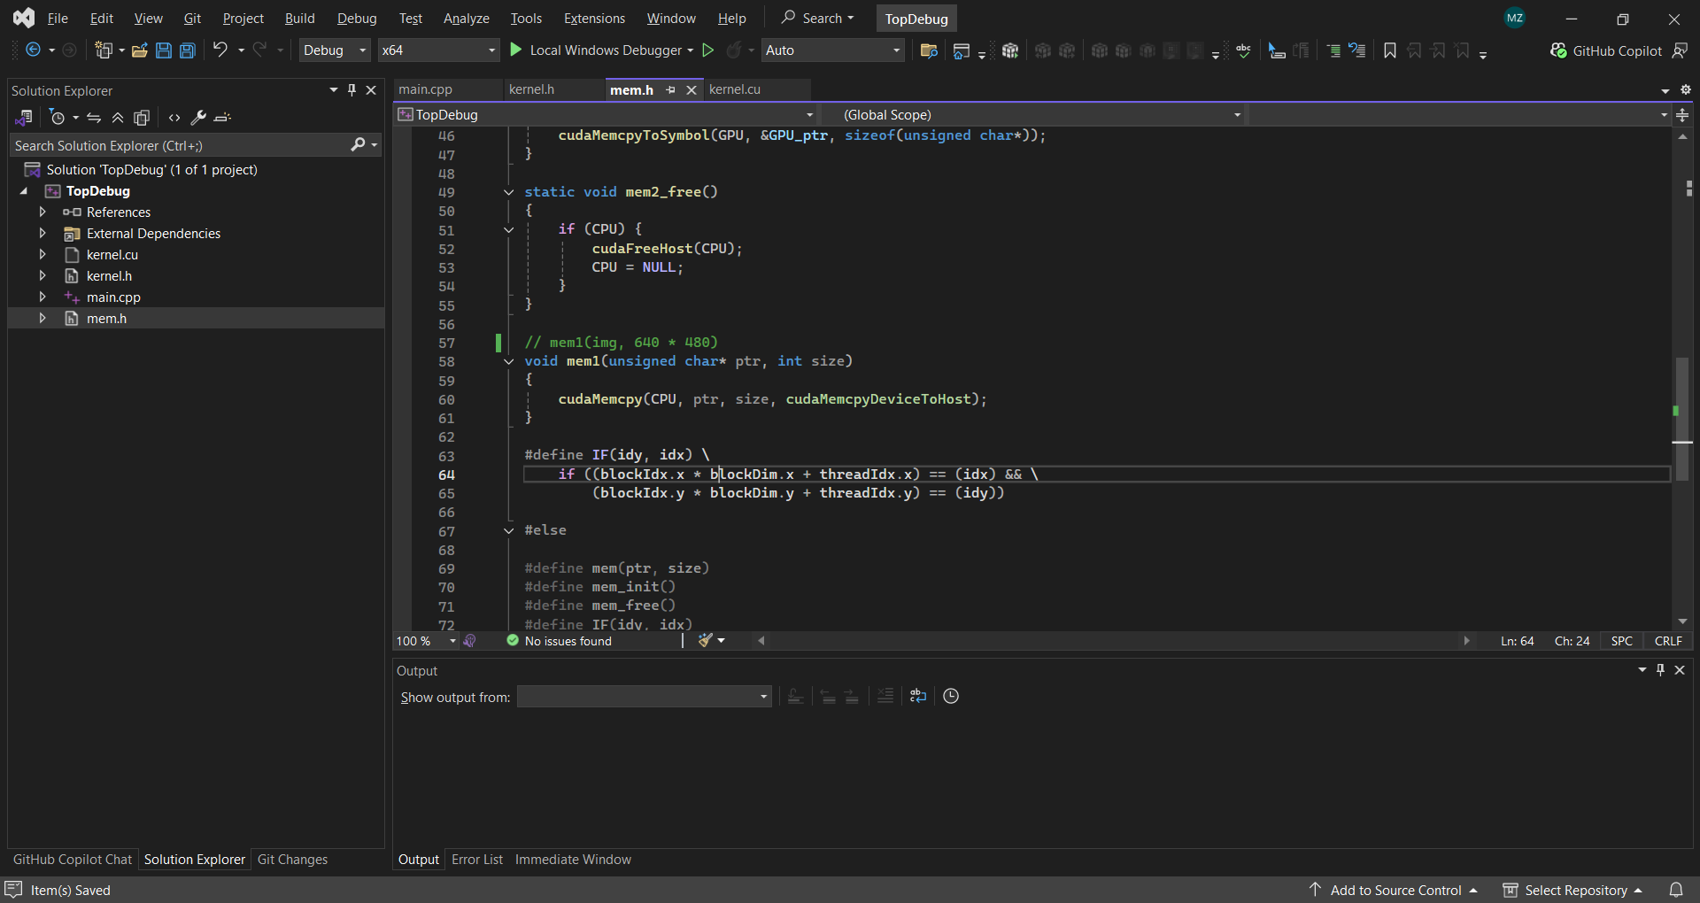
Out-of-kernel debugging:
First, we need to inject the function.

Slide 7
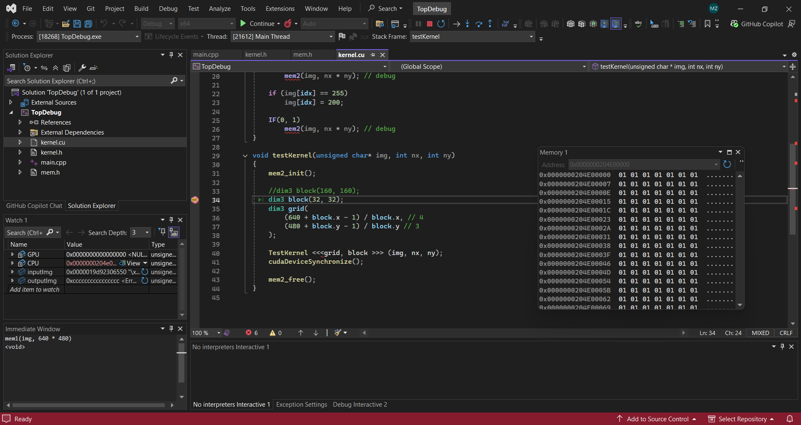


Out-of-kernel debugging:
Second, we use the Immediate Window to call the mem1 function.
Then we check the CPU memory using MATLAB.

Slide 8
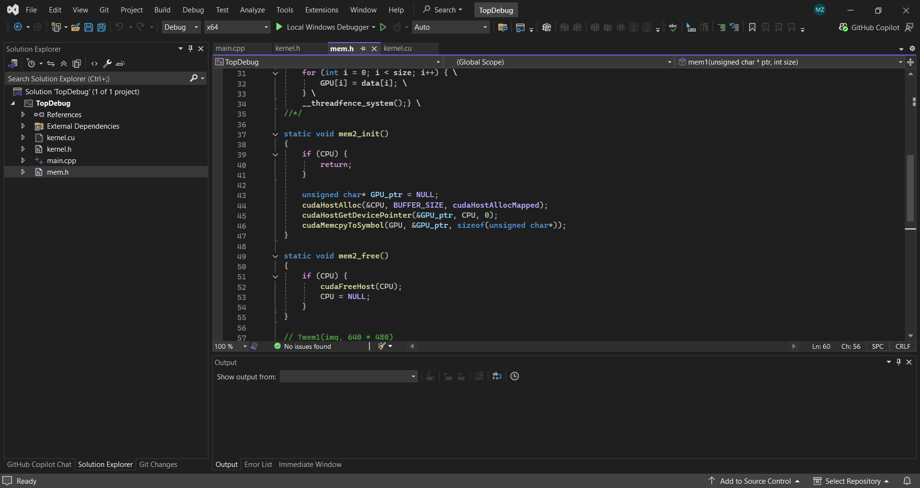
In-kernel debugging:
mem2_init() calls CUDA functions.
It maps CPU and GPU memory. Normally, CPU and GPU appear to have the same address,
but in fact they have different addresses: a CPU address and a GPU address.
However, the CPU and GPU pointers reference the same data.
Therefore, when we update GPU data, CUDA refreshes the CPU data.

Slide 9
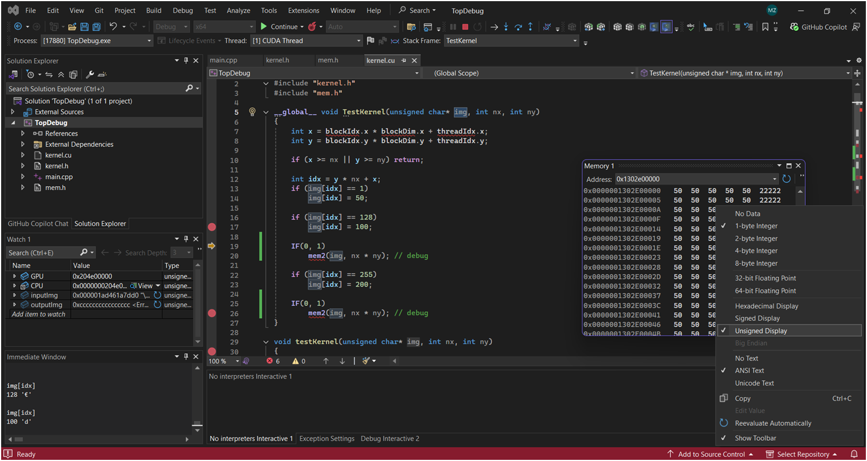


In-kernel debugging:
We set a breakpoint, and when we click “Start CUDA Debugging” (red circle),
we can see values in the Watch, Memory, and Immediate windows.
When we want to view the image buffer, we need to inject code, as shown by the red line.

Slide 10
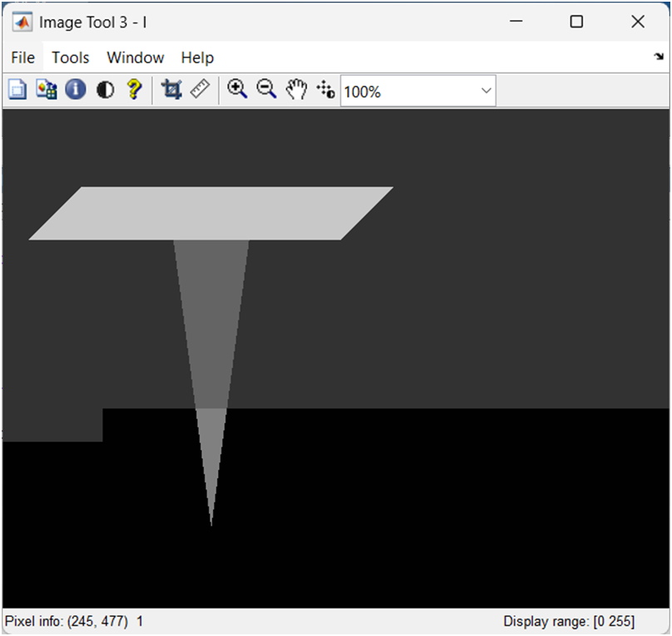
In-kernel debugging:
We check the GPU memory data.
The GPU address can be seen on the last page of the Watch window.
We can see that values 50, 100, and 200 have already been modified,
but 1 and 128 have not changed.

Slide 11
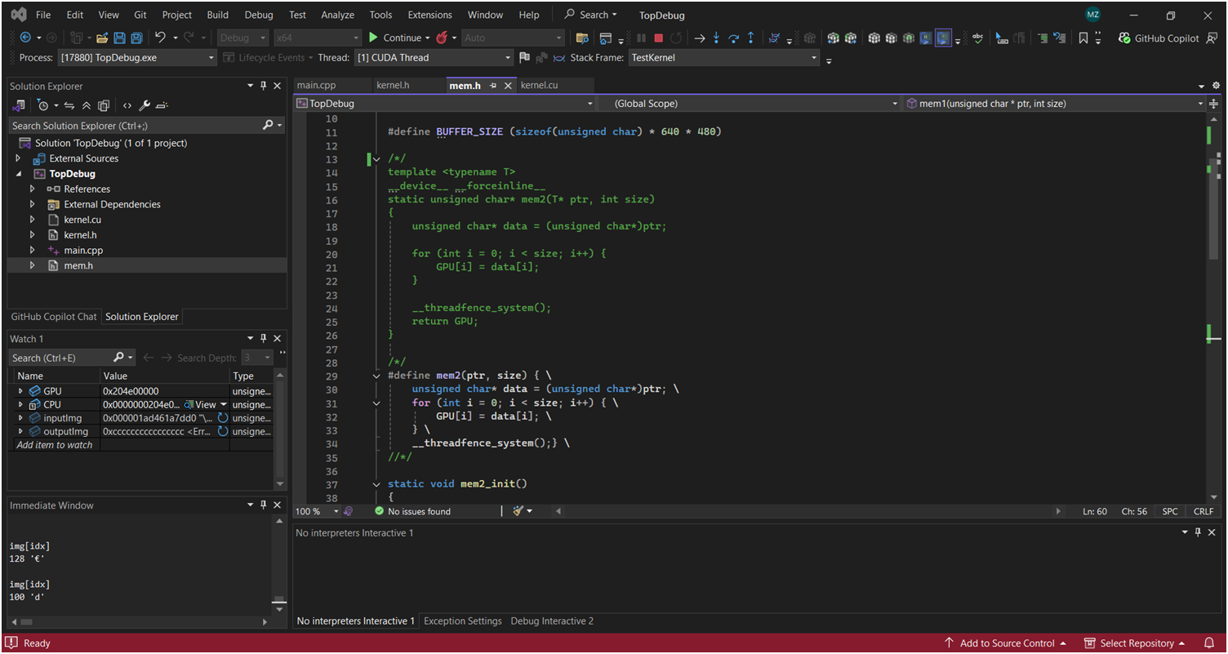
In-kernel debugging:
Sometimes stepping over functions at breakpoints is not good for GPU debugging.
The debugger may enter the mem2 function and get stuck in loops.
This is very bad, so using #define is a better approach.
Honestly, Linux debugging is much better than Windows Visual Studio debugging.

Slide 12
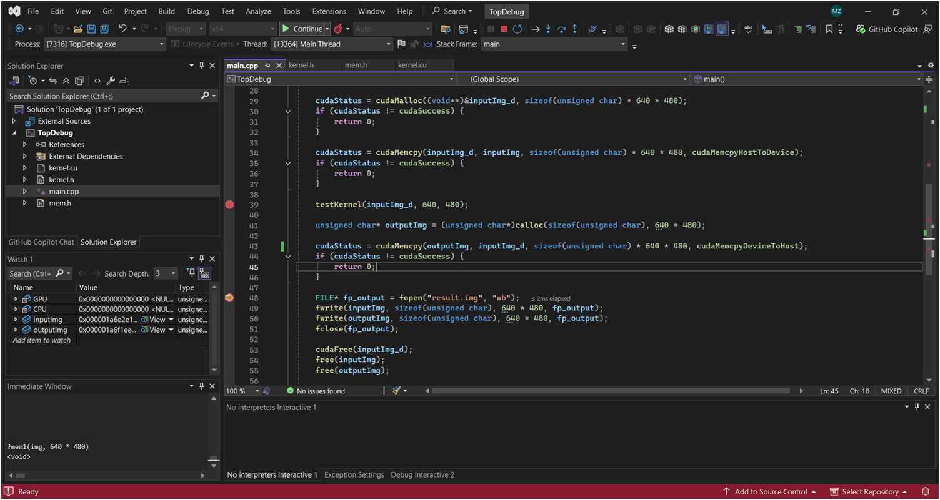
We copy the result from the GPU to the CPU
and save the input and output to files.
We can use MATLAB to read the outputImg memory.

Slide 13
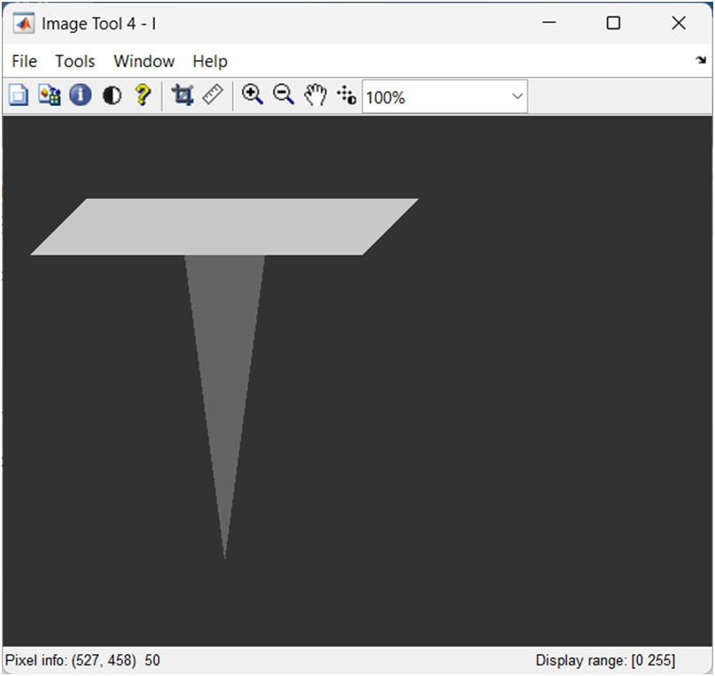
This is the program result.

Slide 14
Good:
We can check GPU memory and analyze GPU data inside the kernel function.
Bad:
We need to inject code into the kernel function.
SourceCode:
https://github.com/TopDebug/2601A-Debug-GPU-kernel-on-windows
Questions? mingjie2028@gmail.com

