Slide 1
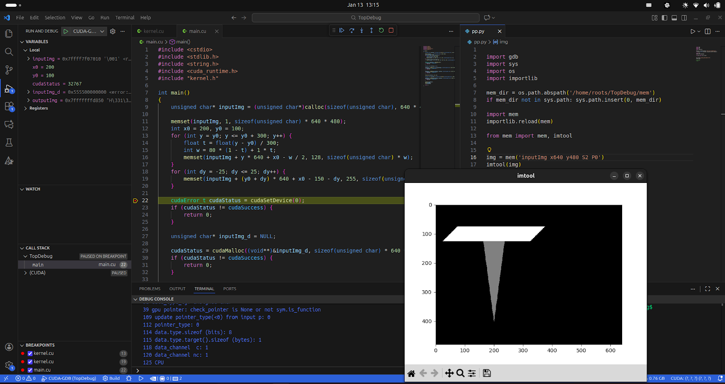
Python is used to read image data from CPU memory, and the data is visualized using the imtool function.

Slide 2
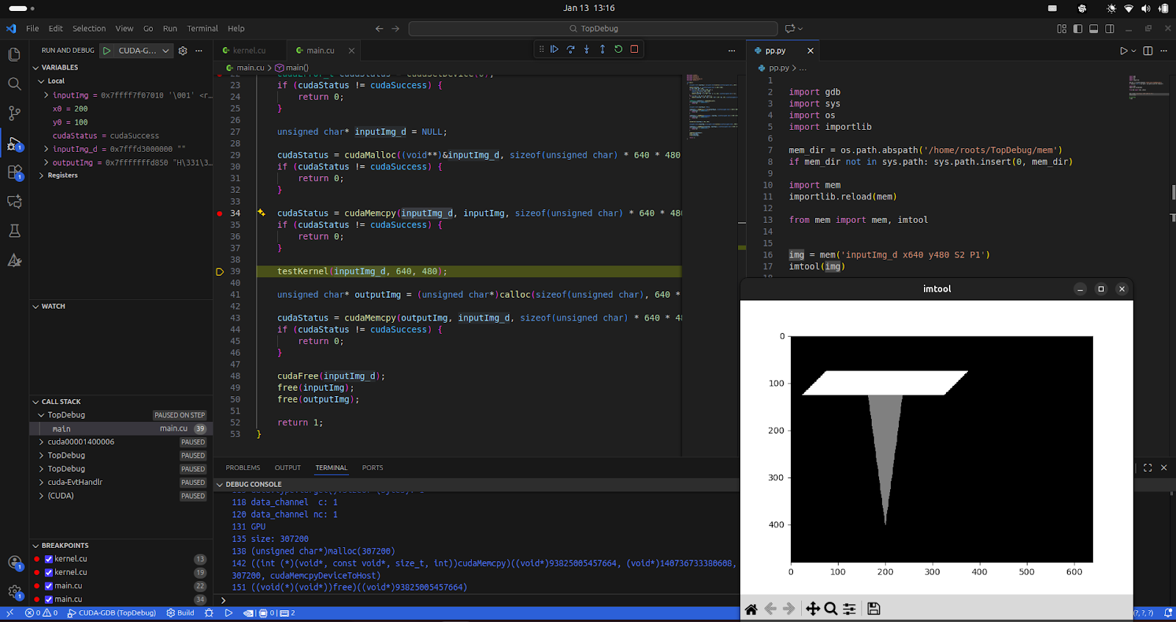
Python is used to access and read data stored in GPU device memory.

Slide 3
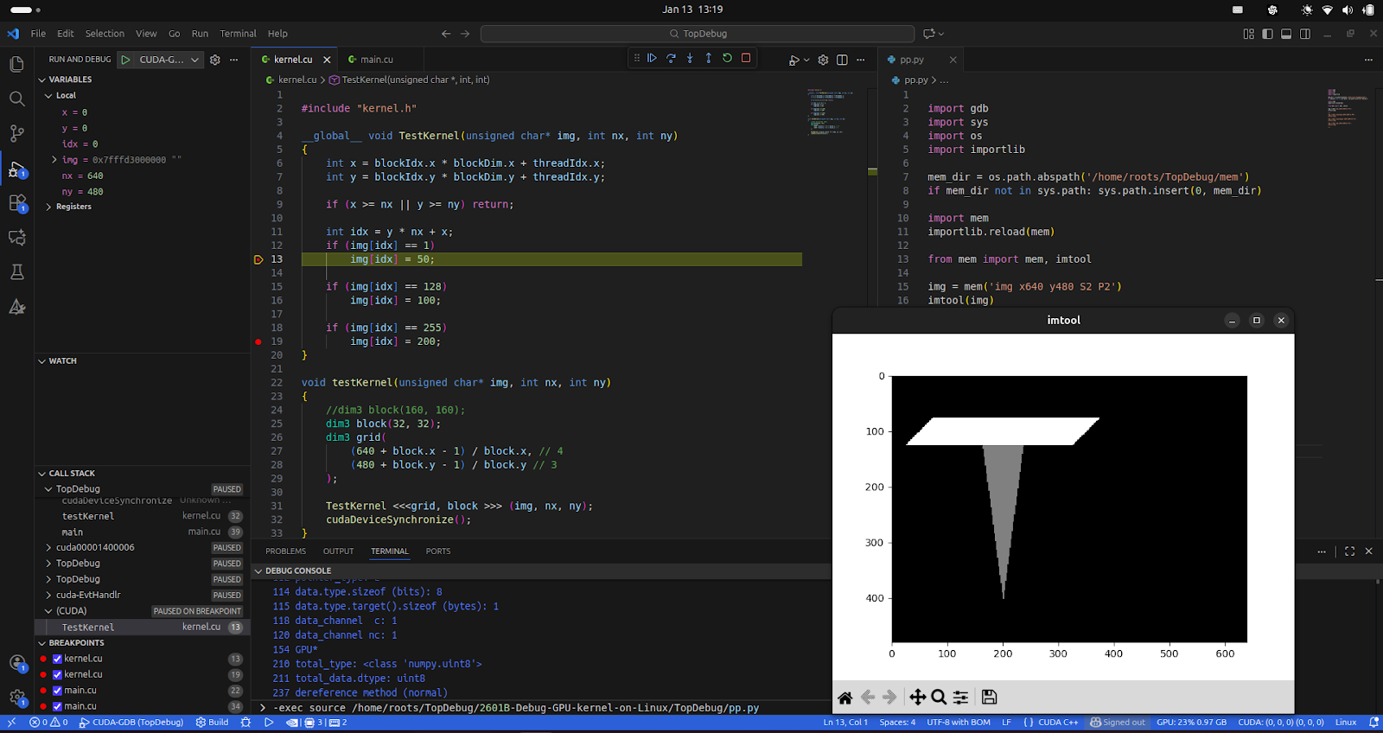

Python reads data produced by a GPU kernel function from GPU device memory.

Slide 4
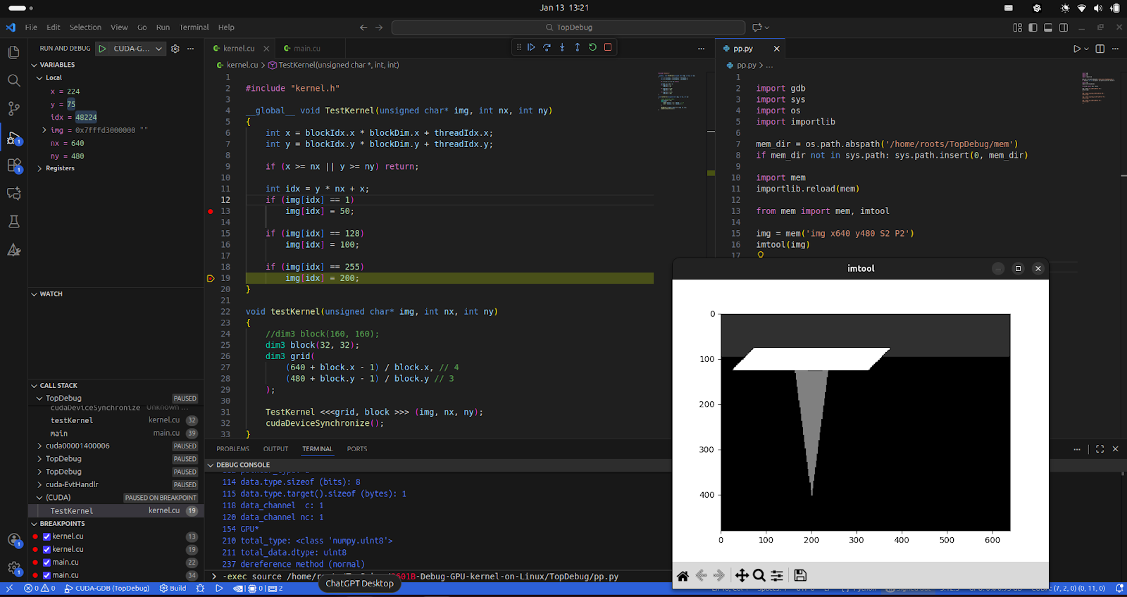
The GPU kernel modifies a portion of the device memory.

Slide 5
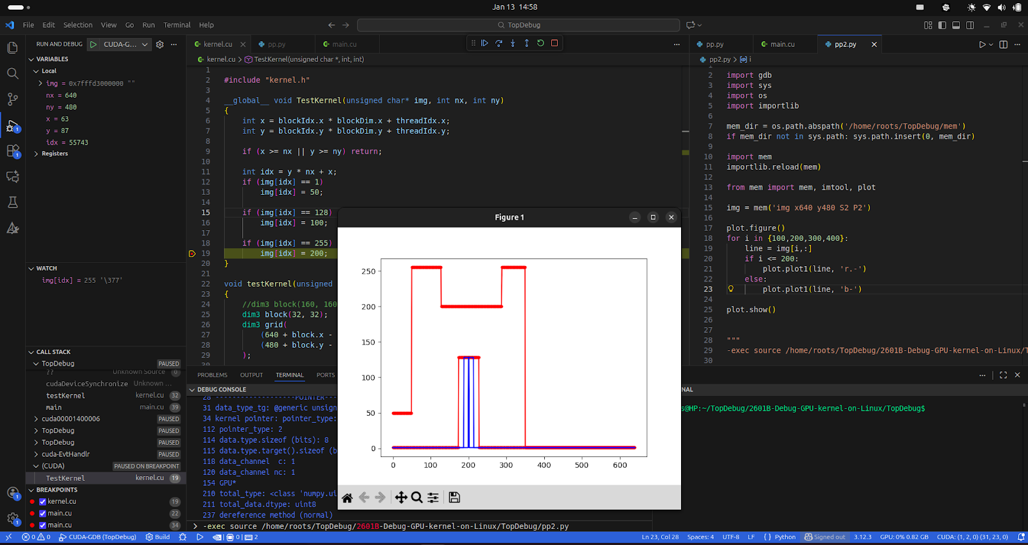
We display the image line data to analyze kernel output and memory modifications.

Slide 6
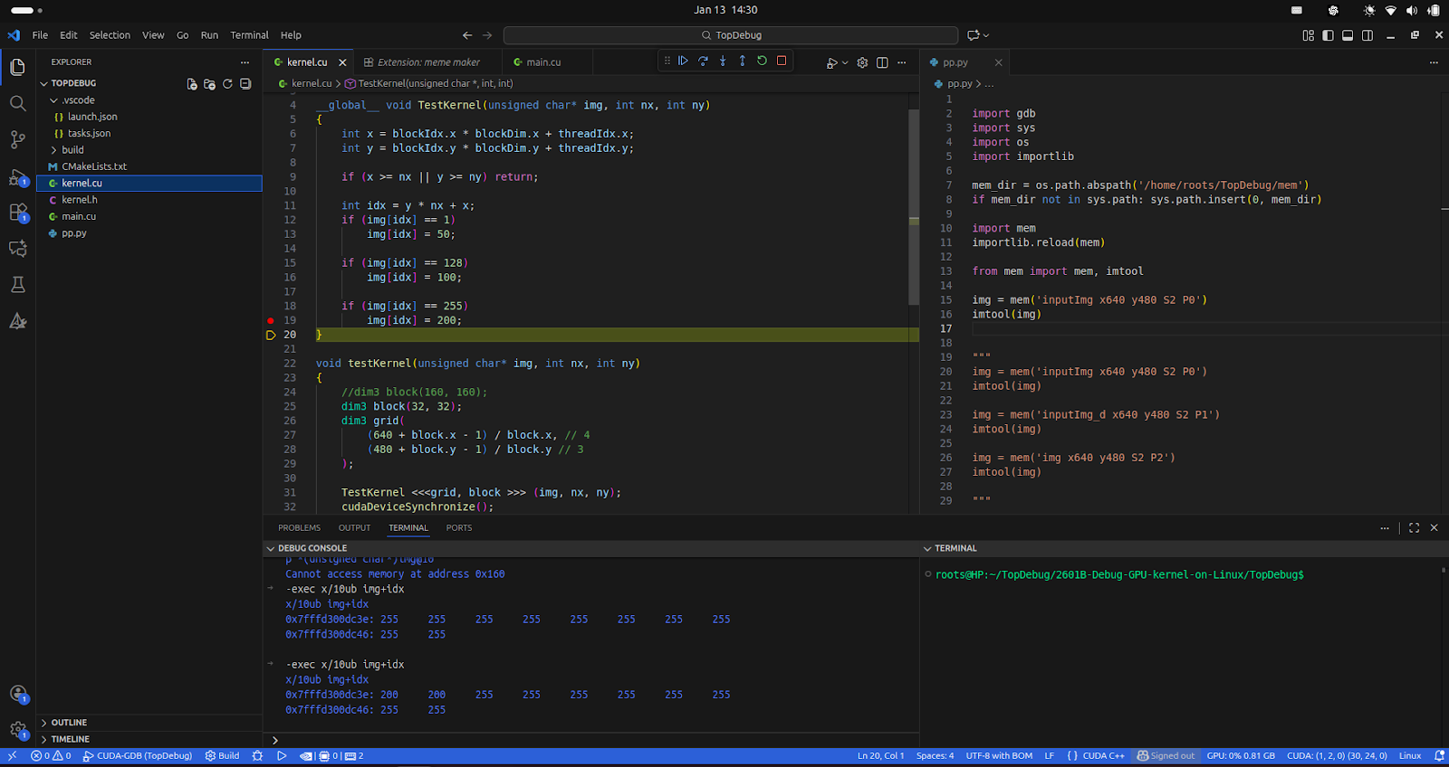
The x/10ub command is used to inspect and compare the modified data.

Slide 7
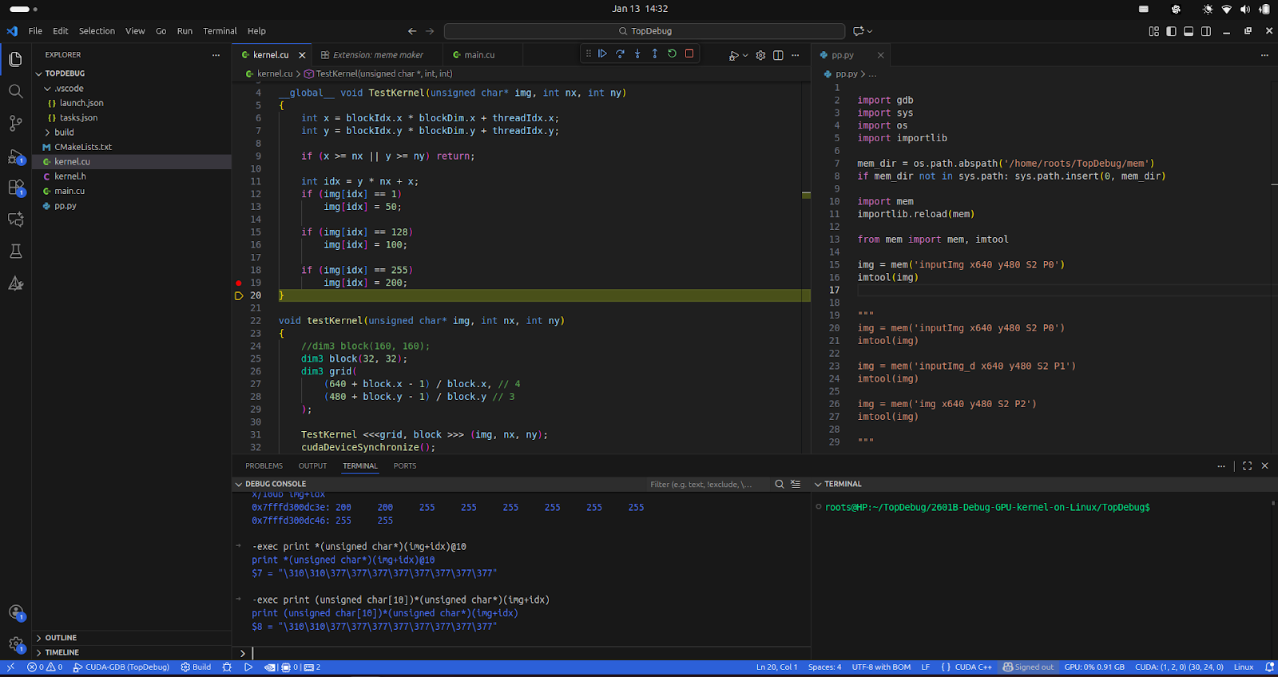
GDB’s print output does not always provide clear or intuitive visualization.

Slide 8
Questions? mingjie2028@gmail.com

