Slide 1


Freelancing Tips

Slide 2
(1. Account)
Account
Bid
Chatting
Perform
Relationship

Slide 3
Importance
Terms and conditions
No Project
Freelancer
Policy

Slide 4
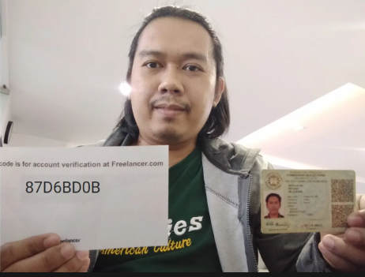
Suitable person
Old Client
Poor
Interesting

Slide 5
Country
US
Europe
Asia

Slide 6
Try one time using script
Doubt
Fear
Never
Disappear

Slide 7

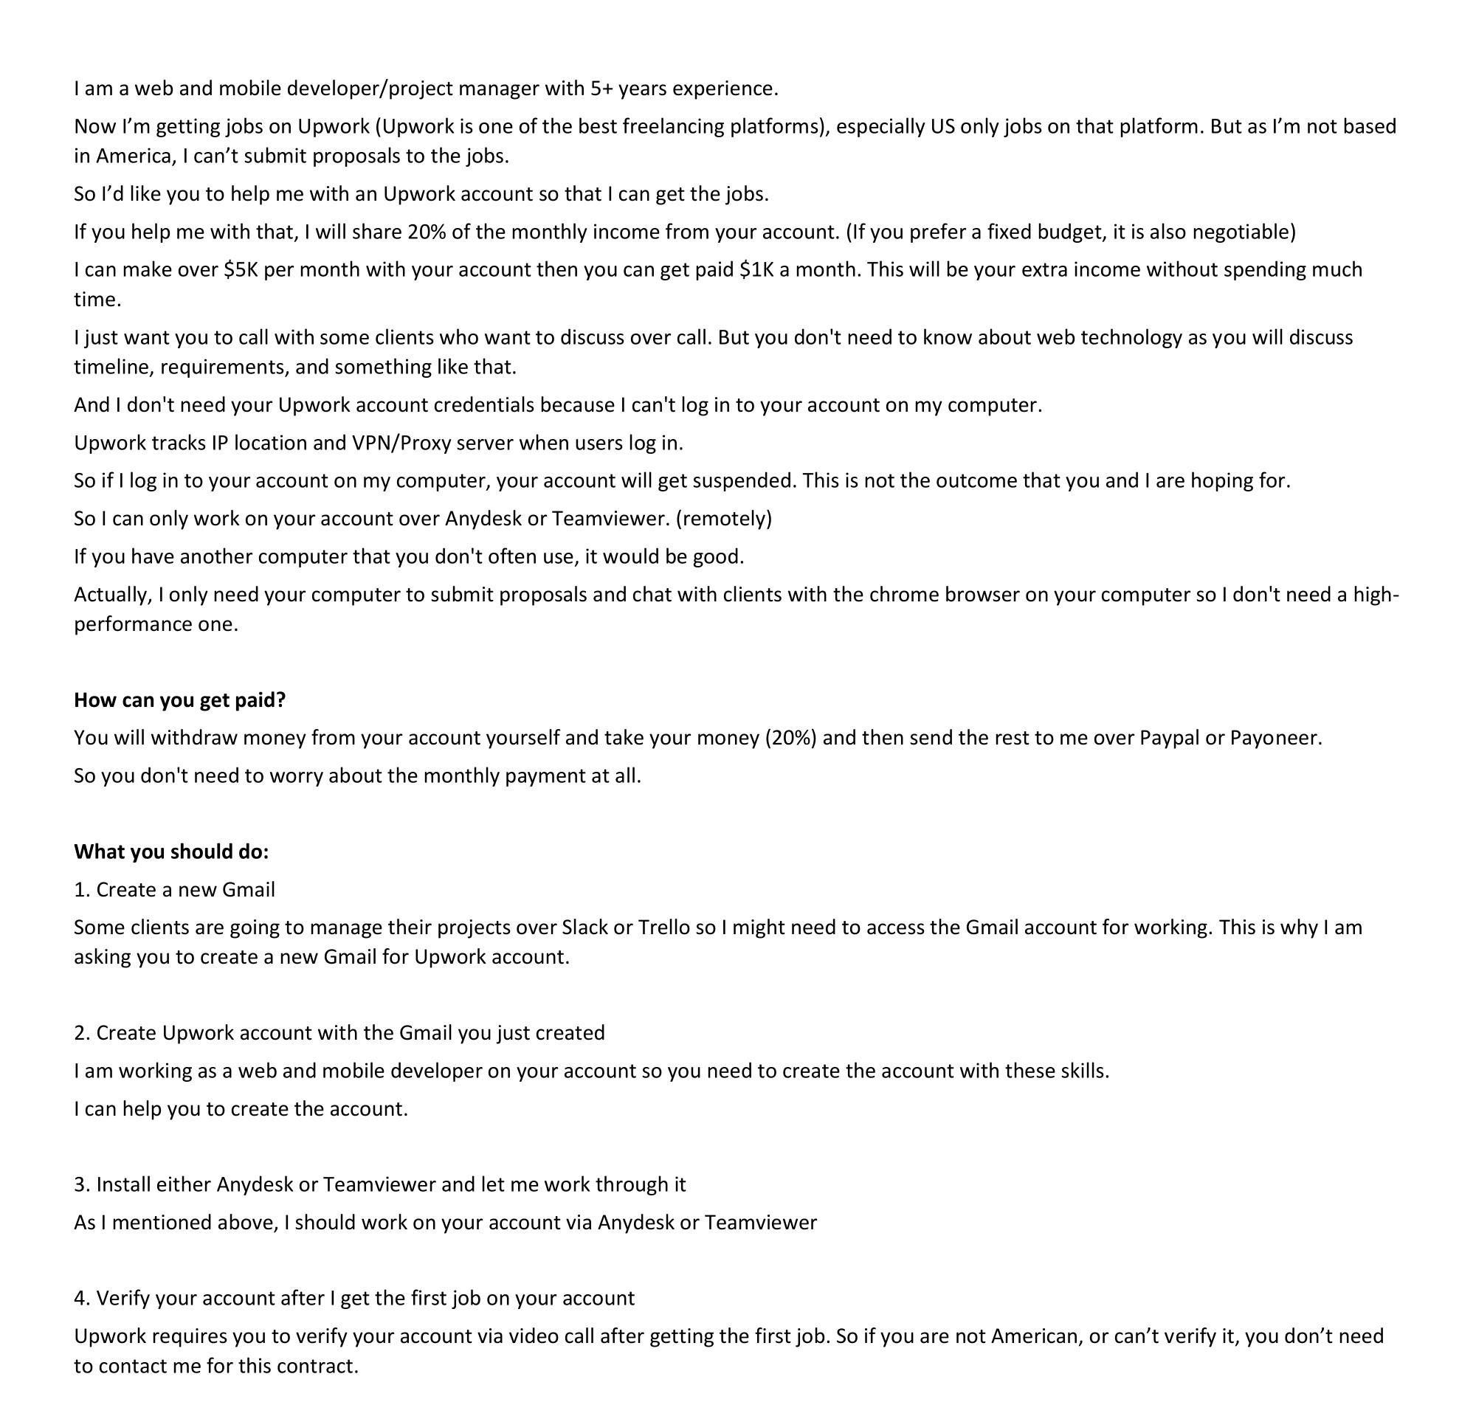




Distribute Script

Slide 8
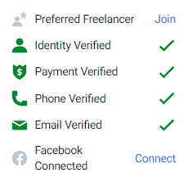
Verification

Slide 9
Sum up
Call to Action
Offer
Persuade
Profit
Relationship

