Slide 1
OSES Project
Emulating the NXP S32K3X8EVB board with Qemu
Authors:
Stefano Galati (342146)
Claudio Pio Perricone (333942)
Matteo Ruggeri (345046)
Gabriele Arcidiacono (343444)

Slide 2
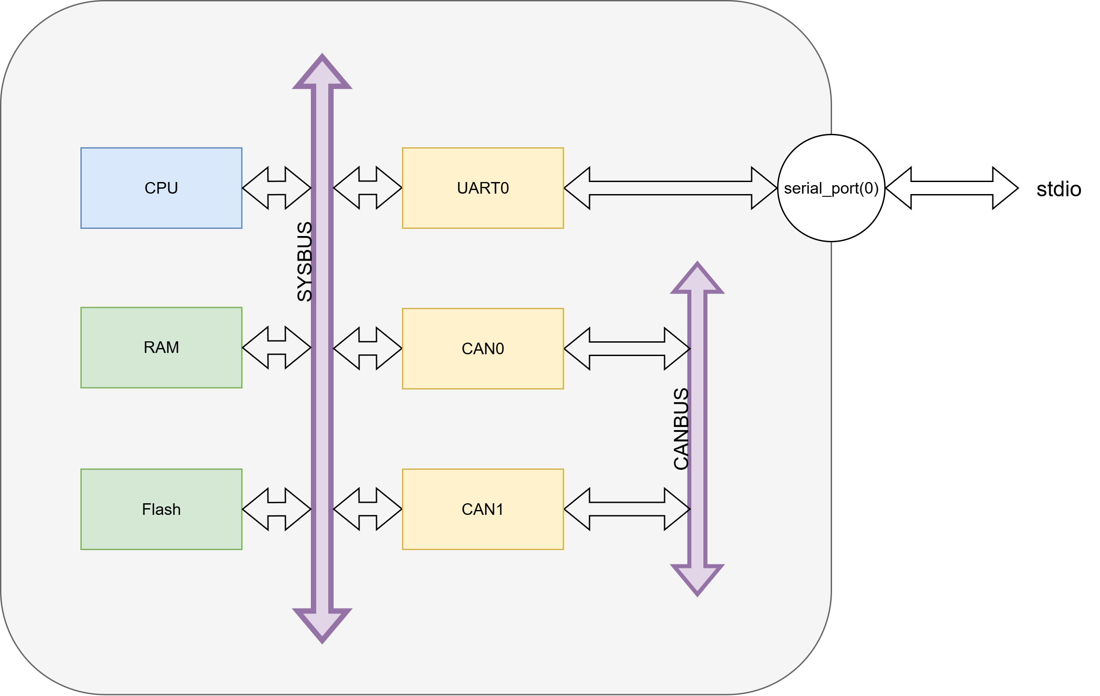
The Microcontroller

Slide 3
Part 1: Board Emulation
Introduction
The NXP S32K3X8EV is based on the microcontroller NXP SK358.
The microcontroller is based on ARMv7M, there are three Cortex M7 cores, with two configured in lockstep mode.

Slide 4
Defining a new board
The board is defined as a QEMU machine, composed by MachineClass and MachineState, which are structures defined by QEMU to emulate a complete system:
MachineClass abstracts and encapsulates the emulated platform
MachineState tracks the instance of a machine
The microcontroller and all the other peripherals are defined as QEMU devices and treated like objects, with the following structures:
DeviceClass and DeviceState: structures to emulate a particular device, such as a microcontroller

Slide 5
Microcontroller
The microcontroller is composed by:
A Sysbus : a generic virtual bus realized by QEMU used to interconnect all the devices
The Cortex-M7 and its instruction set
A MemoryRegion, an abstract way to represent the physical memory needed by the device
A MemoryRegion Alias, needed to correctly emulate the load of a kernel

Slide 6
Testing and FreeRTOS
Finally we had to test the functionalities of the board:
First we tried with a simple bare-metal application:
We developed a suitable linker to define all the memory sections of the board, and the entry point of the program;
We coded a startup file, with the correct interrupt vector table, and a reset and default handler;
We also wrote a new Makefile with option for debugging.
Then was the turn of FreeRTOS:
We modified the configuration files;
We wrote a new main file including the FreeRTOS functionalities.

Slide 7
Multicore
Last step for the board was to add the additional cores.
The major problems where:
Changing how the memories where define, and make some private for each core, and some shared
Understanding how the boot sequence would work
Making the interrupt working on the cores

Slide 8
Part 2: Peripherals emulation
In this part we discuss the emulation of UART and CAN peripherals.

Slide 9
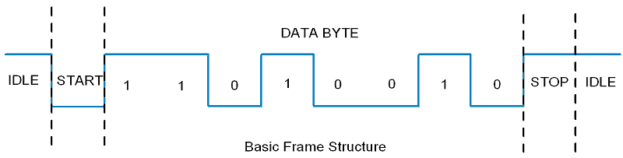
UART
UART (Universal Asynchronous Receiver Transmitter) is a device used for full duplex point-to-point serial communication.

Slide 10
Altera Nios II UART Peripheral
1 RX shift register + 1 TX shift register
No FIFOs
STATUS register:
PE
FE
BRK
ROE
TOE
TMT
TRDY
RRDY
E
Control register for interrupt activation
115200, 8E1 with configurable baudrate

Slide 11
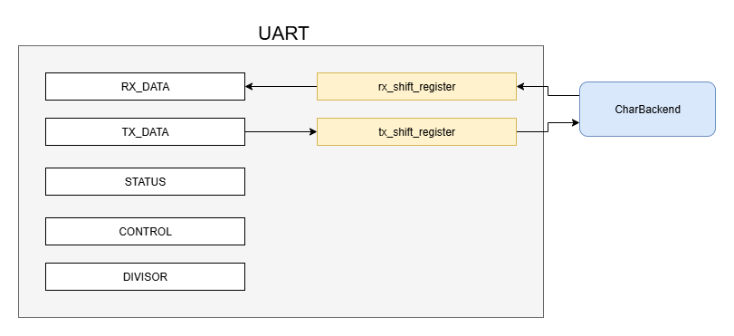
Schematic view of our UART

Slide 12
INSTANTIATING A UART DEVICE
Implementation requires creating uart.c and uart.h
Peripheral state includes registers, IRQ, and Character Backend
The UART device logic handles:
Transmission and reception from CharBackend
Changing transmission baudrate
Behaviour of STATUS register
Interrupt

Slide 13
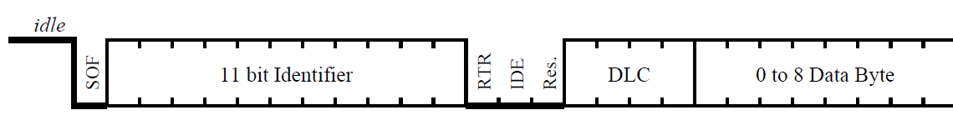
CAN
• CAN (Controller Area Network) is a shared bus protocol.
• Unlike UART (point-to-point), CAN uses a bus where all nodes receive frames.
• In Qemu, a CAN bus object is instantiated and CAN peripherals are connected to it.

Slide 14
LPC17xx CAN
• Based on NXP LPC17xx CAN controller (simplified).
• Registers: TX buffer (TFI, TID, TDA, TDB), RX buffer (RFI, RID, RDA, RDB), SR, CMR, IER.
• Transmission: data written to TX buffer, a bit in SR starts transmission.
• Reception: frames copied to RX buffer, interrupts optionally raised on events.

Slide 15
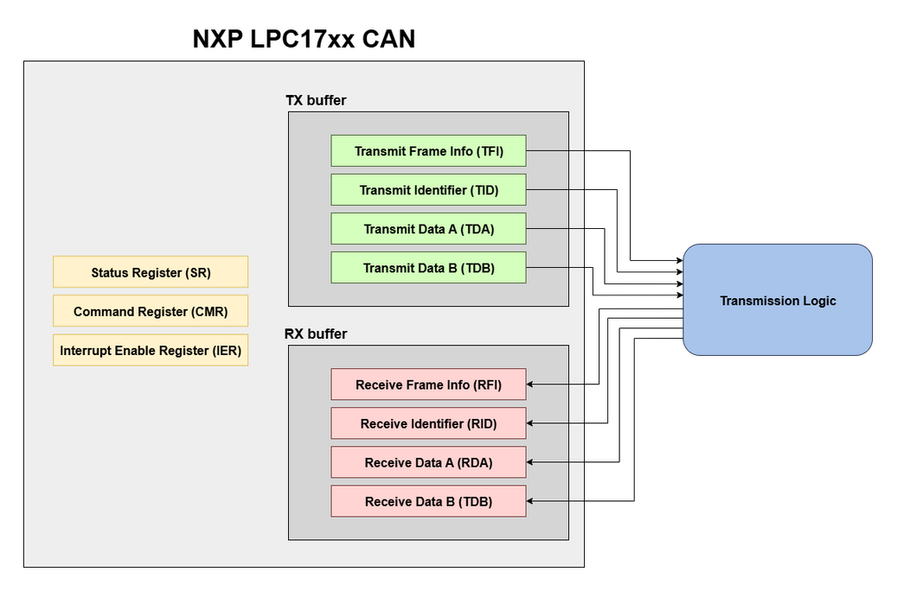
Schematic view of our CAN

Slide 16
INSTANTIATING A CAN DEVICE
• Implementation requires creating can.c and can.h.
• Peripheral state includes registers, IRQ, and CAN bus connection.
• The CAN device logic handles transmit, receive, interrupts, and bus connection.

Slide 17
Example application

