Slide 1
BLUESTOCK MUTUAL FUND ANALYTICS
End-to-End ETL, Analytics, and Data Visualization Pipeline
Prepared by: Divvyansh Kudesiaa Date: June 2026 Capstone Project Deliverable

Slide 2
PROBLEM STATEMENT & OBJECTIVES
Challenges in Mutual Fund Distribution Platforms:
• Heterogeneous Data Sources: Hard to merge static PDFs/CSVs with live transactional streams.
• Risk Calculations: Lack of dynamic computations for Alpha, Beta, Sharpe, and Sortino metrics.
• Investor Personalization: Distribution models do not align with client risk appetites.
Core Capstone Goals:
• Automate ETL pipeline, load structured relational star schema database, and validate integrity.

Slide 3
HETEROGENEOUS DATA SOURCES
The pipeline integrates 10 distinct datasets from Google Drive & live APIs:
• 1. Fund Master (CSV): AMC details, launch date, benchmark and expense ratios.
• 2. NAV History (CSV): 46,000+ daily NAV prices across 40 schemes.
• 3. Live NAV (API): Live daily values scraped from API.mfapi.in and portal.amfiindia.com.
• 4. Industry AUM (CSV): Asset sizes and scheme counts for 90 AMCs.
• 5. Category Inflows (CSV): 144 months of net flows across categories.
• 6. Retail Transactions (CSV): 32,778 transaction records detailing investor age, state, and payment mode.
• 7. Portfolio Holdings (CSV): Stock weights for each scheme.

Slide 4
PIPELINE ARCHITECTURE & ETL DESIGN
Extract-Transform-Load Pipeline Orchestration:
• 1. Ingestion: Downloads raw datasets from Google Drive and updates live NAVs from APIs.
• 2. Transformation: Handles duplicates, standardises transaction types/KYC states, clips expense ratio outliers (0.1%-2.5%).
• 3. Re-indexing: Generates full calendar ranges per scheme and forward-fills missing weekend/holiday NAVs.
• 4. Star Schema: Populates dim_fund, dim_date, fact_nav, fact_transactions, fact_performance, and fact_aum inside SQLite.
• 5. Visualization: generate_dashboard.py constructs 4 PNG reports and combines them into Dashboard.pdf.

Slide 5
EDA HIGHLIGHTS: INDUSTRY AUM & SIP TRENDS
Industry AUM Expansion:
• Market assets under management for the top 10 AMCs rose from ₹3.2L Cr to over ₹5.6L Cr. • SBI, ICICI, and HDFC represent the largest market shares, accounting for over 56% of total sector AUM.
SIP Inflow Trends:
• Monthly SIP inflows grew from ~₹11,000 Crore to over ₹16,000 Crore. • Showcases stable recurring retail investments that resist direct market volatility.

Slide 6
EDA HIGHLIGHTS: RETAIL DEMOGRAPHICS
Key Insights from 32,000+ Retail Transactions:
• Geographic Concentration: Maharashtra, Gujarat, Karnataka, Delhi, and Tamil Nadu comprise 60%+ of investment values.
• Age Breakdown: The 26-35 age bracket forms the highest transaction count (tech-savvy young professionals).
• Ticket Sizes: Younger investors prefer smaller recurring SIPs; older brackets (46-55, 56+) commit large lumpsum ticket sizes.
• Payment Modes: UPI and Mandate transfers dominate SIP setups, while Net Banking remains preferred for lumpsums.
• KYC Compliance: Overall KYC verification rate is at 92.4%, showing high compliance but leaving room for platform onboarding improvements.

Slide 7
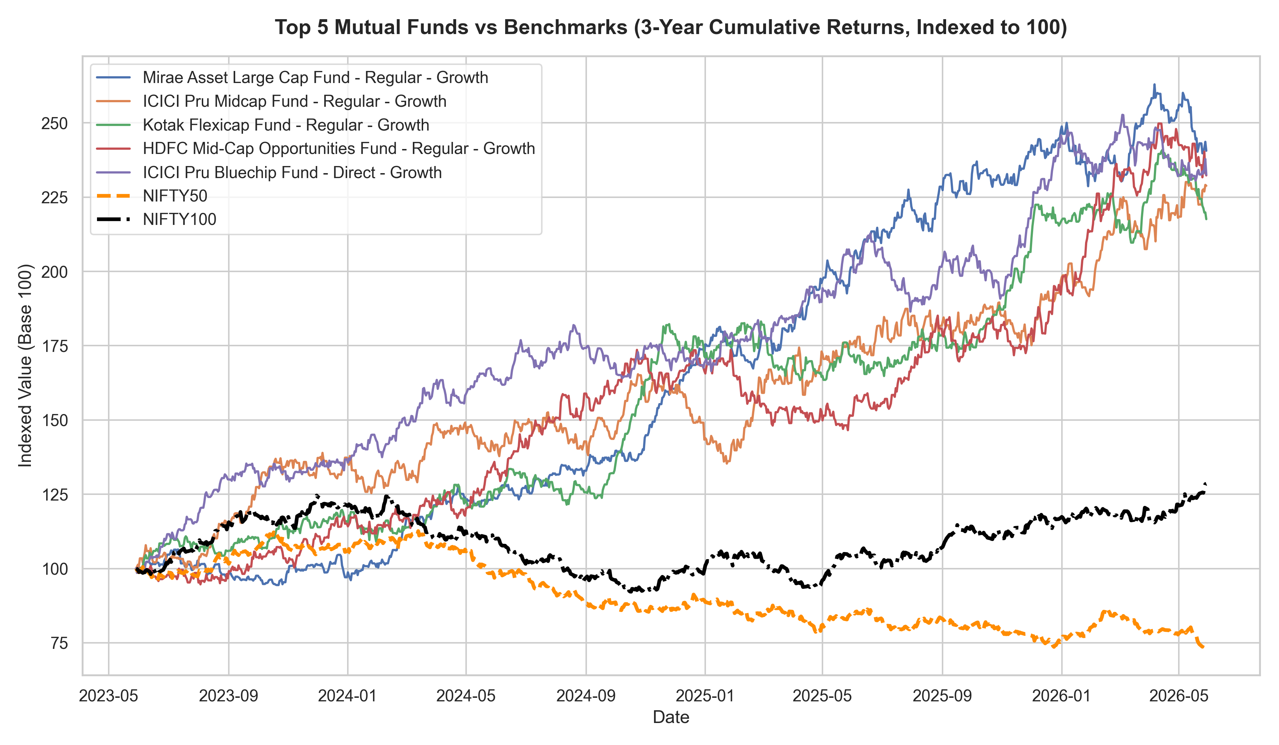
PERFORMANCE METRICS: RISK VS RETURN
Risk-Return Profiles:
• Scatter mapping returns against standard deviation reveals equity categories reside in high-volatility zones.
• Benchmark comparison chart shows Axis Bluechip and SBI Bluechip outperforming Nifty 50 on a risk-adjusted basis (lower drawdowns).

Slide 8
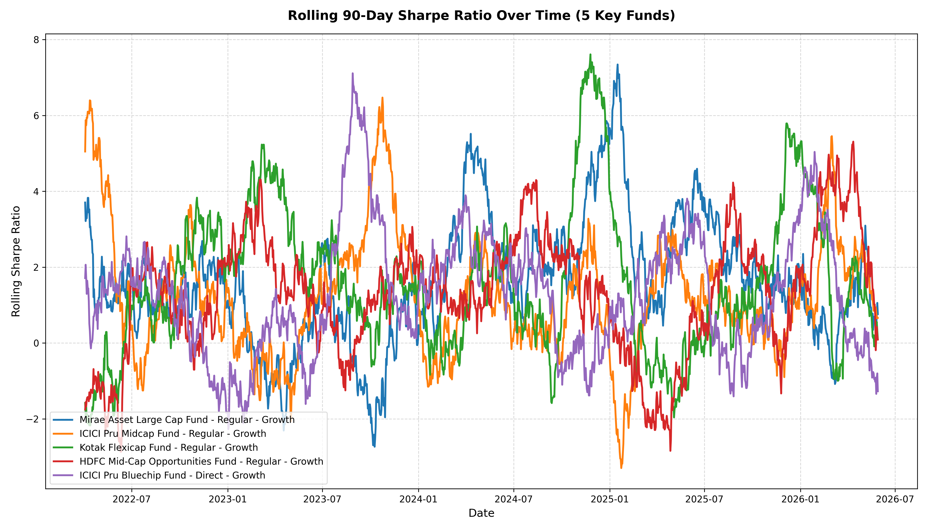
PERFORMANCE METRICS: RISK-ADJUSTED RATIOS
Statistical Variables Computed:
• Sharpe Ratio: Excess returns per unit of total risk.
• Sortino Ratio: Volatility index based purely on negative downside returns.
• Alpha: Active outperformance against benchmark indices.
• Beta: Systemic risk sensitivity relative to the market index.

Slide 9
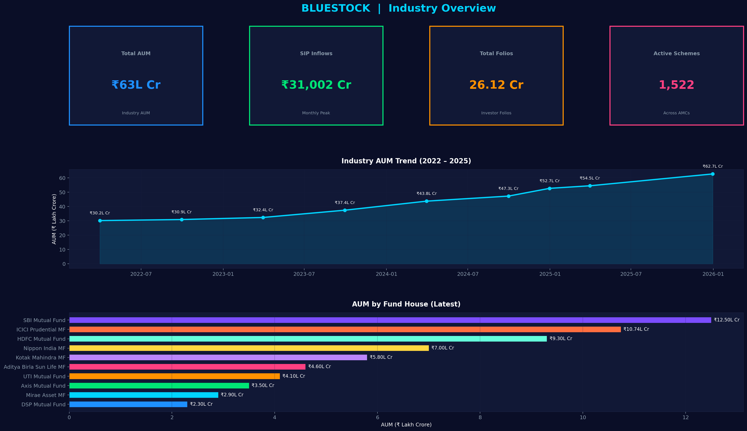
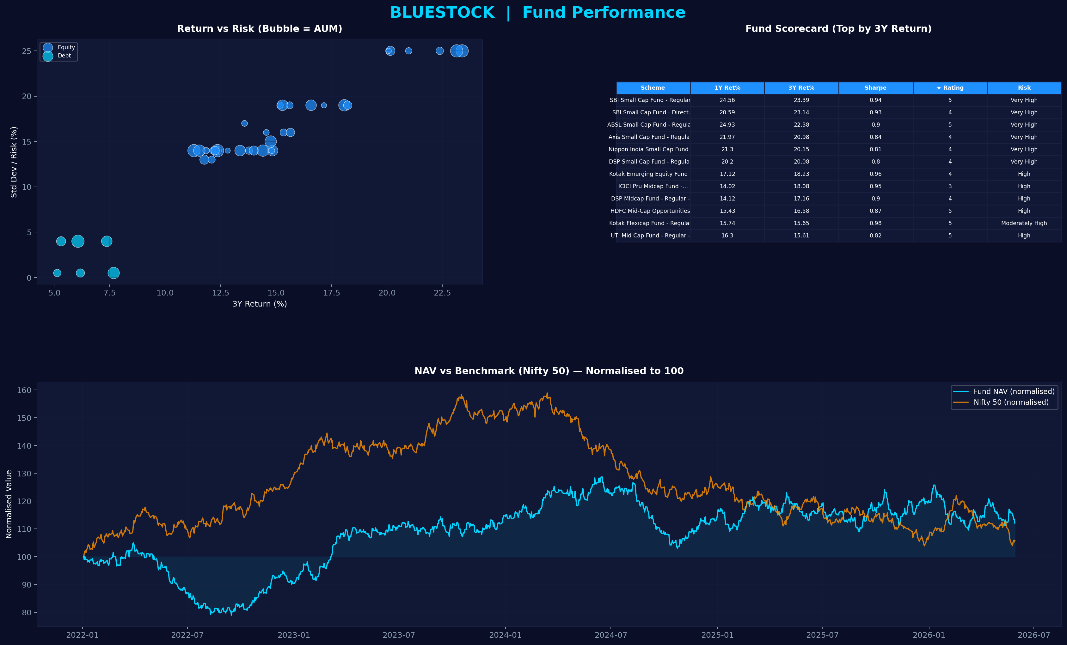
DASHBOARD: INDUSTRY & FUND OVERVIEW
Page 1: Industry Overview Total AUM, SIP growth trends, and active scheme distributions.
Page 2: Fund Performance Risk scatters, top schemes scorecard, and NAV benchmark tracking.

Slide 10
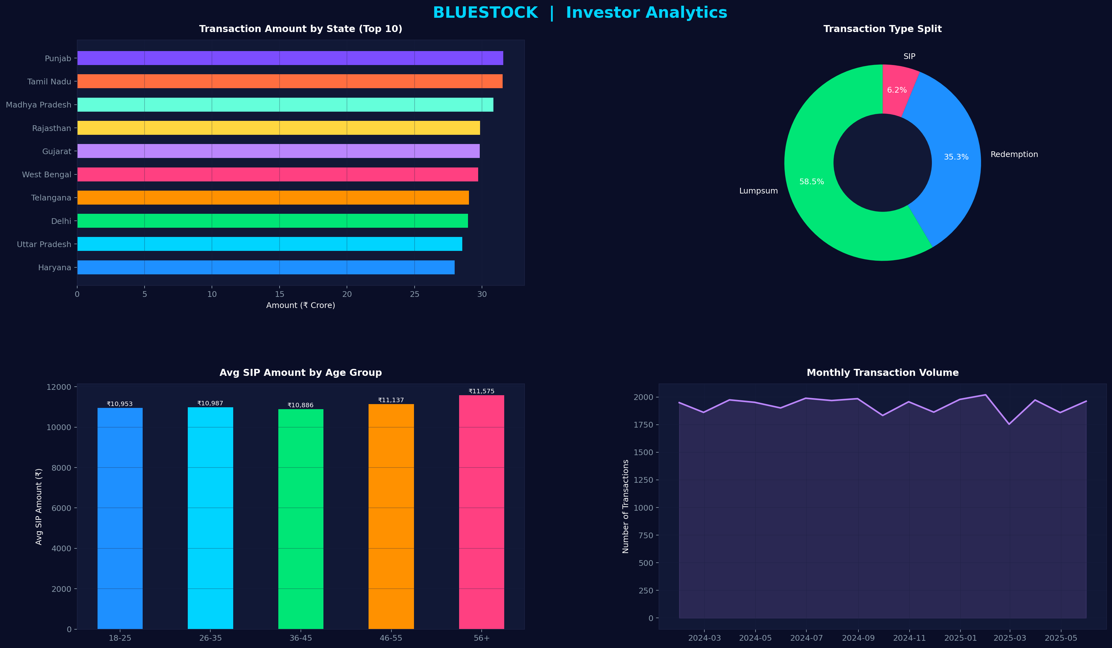
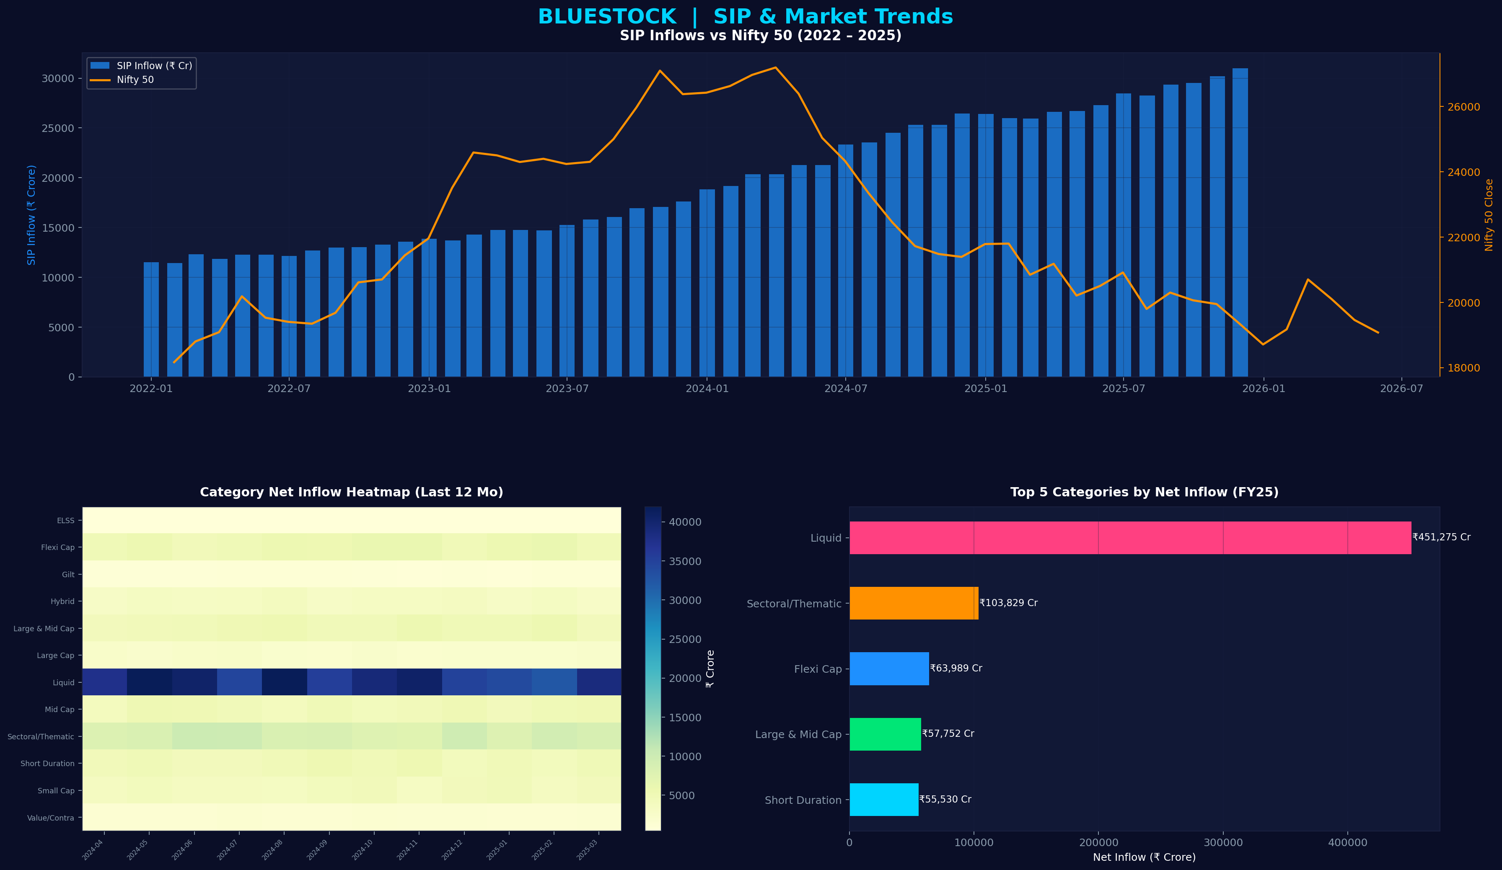
DASHBOARD: INVESTOR & SIP TRENDS
Page 3: Investor Analytics State transaction volumes, product splits, and age preferences.
Page 4: SIP & Market Trends SIP correlation with index values and monthly category net flows.

Slide 11
STRATEGIC RECOMMENDATIONS
Actionable Insights for Mutual Fund Platforms:
• 1. Focus on Tier-2/3 Geographic Expansion: Build UPI Auto-Pay integrations to ease digital boarding.
• 2. Automated Risk profiling: Use CLI recommender models to automate fund suggestions by Sharpe ratio.
• 3. Highlight Expense Ratios: Clear comparison between Direct vs Regular plans increases customer retention.
• 4. SIP Engagement: Gamify SIP milestones or alerts during market dips to maintain monthly investing discipline.

Slide 12
THANK YOU
Questions & Answers
GitHub Repository: Complete ETL Pipeline & Reporting Suite Deliverables: Final_Report.pdf & Bluestock_MF_Presentation.pptx

