Slide 1
BOM and DOM
BROWSER OBJECT MODEL AND DOCUMENT OBJECT MODEL

Slide 2
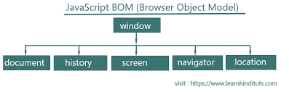
BOM(Browser Object Model)
The Browser Object Model (BOM) allows JavaScript to "talk to" the browser.
"BOM" stands for Browser Object Model. It represents the objects that a browser provides to JavaScript to interact with the browser itself.
The BOM includes objects like:

Slide 3
BOM
Window: The global object in a browser's environment. It represents the browser window or tab and contains properties like window. location (which gives information about the current URL), window. document (which refers to the DOM document in the current window), and many others.
Document: Represents the DOM (Document Object Model) of a web page. It provides methods and properties to interact with the contents of the page.
Location: Represents the current URL of the browser and allows you to interact with it.
Navigator: Provides information about the browser itself, such as its name, version, and capabilities.
Screen: Represents the user's screen. It provides information about the dimensions and pixel depth of the screen.
History: Allows manipulation of the browser's history (back, forward, etc.).

Slide 4
Window. Screen
The window.screen object contains information about the user's screen.
The window.screen object can be written without the window prefix
Properties:
  screen.width
  screen.height
  screen.availWidth
  screen.availHeight
  screen.colorDepth
  screen.pixelDepth

Slide 5
Window.location
The window.location object can be used to get the current page address (URL) and to redirect the browser to a new page.
Some examples:
  window.location.href returns the href (URL) of the current page
  window.location.hostname returns the domain name of the web host
  window.location.pathname returns the path and filename of the current page
  window.location.protocol returns the web protocol used (http: or https:)
  window.location.assign() loads a new document

Slide 6
Window.history and window.navigator
Window.history object contains the browser history.
Some methods:
  history.back() - same as clicking back in the browser
  history.forward() - same as clicking forward in the browser
Window.navigator object contains information about the visitor’s browser
Examples:
  navigator.cookieEnabled : property returns true if cookies are enabled, otherwise false.
  navigator.appCodeName :property returns the application code name of the browser.
  navigator.platform : property returns the browser platform (operating system).

Slide 7
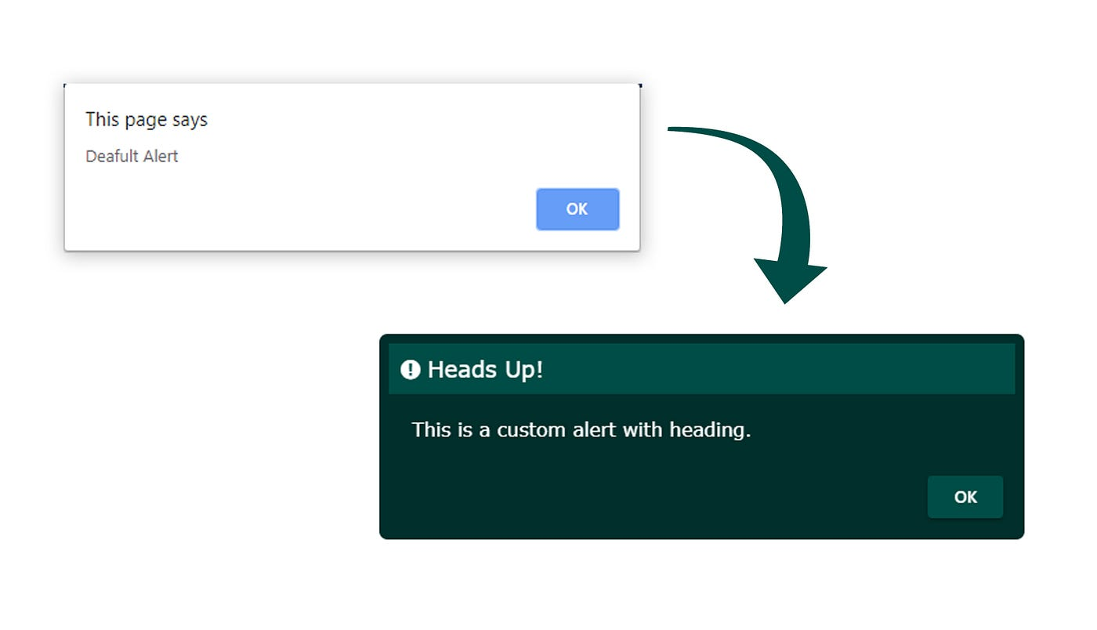
JavaScript Popup Boxes
JavaScript has three kind of popup boxes: Alert box, Confirm box, and Prompt box.
Alert Box
An alert box is often used if you want to make sure information comes through to the user.
When an alert box pops up, the user will have to click "OK" to proceed.

Slide 8
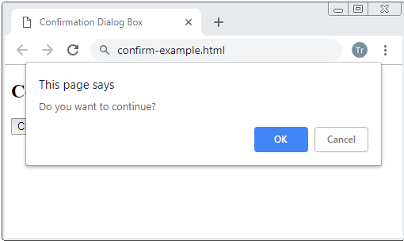
JavaScript Popup Boxes
Confirm Box
A confirm box is often used if you want the user to verify or accept something.
When a confirm box pops up, the user will have to click either "OK" or "Cancel" to proceed.
If the user clicks "OK", the box returns true. If the user clicks "Cancel", the box returns false.

Slide 9
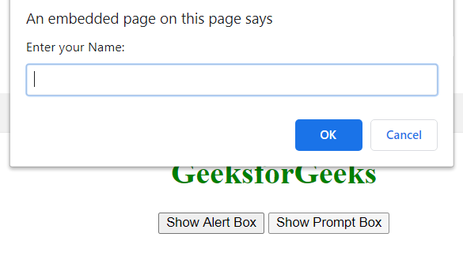
JavaScript Popup Boxes
Prompt Box :
A prompt box is often used if you want the user to input a value before entering a page.
When a prompt box pops up, the user will have to click either "OK" or "Cancel" to proceed after entering an input value.
If the user clicks "OK" the box returns the input value. If the user clicks "Cancel" the box returns null.

Slide 10

DOM(Document Object Model)
In JavaScript, the DOM (Document Object Model) is a programming interface for web documents. It represents the structure of a document as a tree-like model where each node is an object representing a part of the document, such as elements, attributes, and text.
When a web page is loaded, the browser creates a Document Object Model of the page.
The HTML DOM model is constructed as a tree of Objects:

Slide 11
DOM Manipulation
JavaScript can change all the HTML elements in the page
JavaScript can change all the HTML attributes in the page
JavaScript can change all the CSS styles in the page
JavaScript can remove existing HTML elements and attributes
JavaScript can add new HTML elements and attributes
JavaScript can react to all existing HTML events in the page
JavaScript can create new HTML events in the page

Slide 12
DOM Methods
Methods used to target HTML elements in JavaScript file
getElementById(id): This method allows you to retrieve an element from the document by its unique id.
getElementsByClassName(className): This method returns a collection of all elements in the document with a specified class name.
getElementsByTagName(tagName): Returns a collection of elements with the specified tag name.
querySelector(selector): Returns the first element that matches a specified CSS selector.
querySelectorAll(selector): Returns a NodeList of all elements that match a specified CSS selector.

Slide 13
Changing HTML Elements
Property | Description
element.innerHTML = new html content | Change the inner HTML of an element
element.attribute = new value | Change the attribute value of an HTML element
element.style.property = new style | Change the style of an HTML element
element.setAttribute(attribute, value) | Change the attribute value of an HTML element

Slide 14
Adding and Deleting Elements
Method | Description
document.createElement(element) | Create an HTML element
document.removeChild(element) | Remove an HTML element
document.appendChild(element) | Add an HTML element
document.replaceChild(new, old) | Replace an HTML element
document.write(text) | Write into the HTML output stream

Slide 15
DOM Event Listener
The addEventListener() method attaches an event handler to the specified element
The first parameter is the type of the event (like "click" or "mousedown" or any other HTML DOM Event.)
The second parameter is the function we want to call when the event occurs.
Ex:
  element.addEventListener("click", function(){
  alert("Hello World!");
  });

Slide 16
DOM Events
Event: An action performed by the user on the webpage is known as an event
A JavaScript can be executed when an event occurs, like when a user clicks on an HTML element.
  Click
  Mouseover
  Contaxmenu
  Doubleclick
  Keypress
  Submit
  onchange

Slide 17
Event Propagation
Event propagation refers to the way events travel through the DOM tree. When an event occurs on an element, it can trigger event handlers not only on that element but also on its parent elements, all the way up to the root of the document. There are two phases of event propagation:
Capturing Phase: The event travels from the root of the DOM tree down to the target element.
Bubbling Phase: The event then bubbles up from the target element back to the root.
event.stopPropagation(): This method prevents further propagation of the current event. It stops the event from bubbling up the DOM tree or from capturing down the tree

Slide 18
JSON(Java Script Object Notation
It is format of storing and transporting data.
It is used when the data is sent form the server to web page
It is a popular data format for developers because of its human readable text, light weight which requires less coding and faster process
Example: [
{“fname”:”Ram”,”lname”:”Patil”},
{“fname”:”Raj”,”lname”:”smith”},
{“fname”:”Ashish”,”lname”:”gouda”}
]

Slide 19
Syntax of JSON
Data is in Key value pairs
Data is separated by ‘,’
Curly braces holds objects
[ ]---holds array
In JavaScript, there are two main methods used to work with JSON (JavaScript Object Notation):
1.JSON.Stringify() : used to convert normal object to JSON format
2.JSON.parse(): Used to convert JSON format of data to normal object

Slide 20
Time delays
setTimeOut() and setInterval() are two functions in js allows to schedule tasks to be executed at later time. Used for animations, polling data from server and other asynchronous tasks.
setTimeOut() :
Runs the code with time delay
Syntax : window.setTimeOut( function , delay ) ;
function: The function you want to execute.
delay: The amount of time (in milliseconds) before the function is executed

Slide 21
Time delays
setInterval() :
The function similar to setTimeOut, but it schedules a function to be executed repeatedly at specified interval.
Syntax : window.setInterval( function , delay ) ;
function: The function you want to execute.
delay: The amount of time (in milliseconds) before the function is executed
createTimeOut() and createInterval()
cancel a setTimeout, you use clearTimeout
cancel a setTimeout, you use clearTimeout

Slide 22
Promises
Promises in JavaScript are a powerful way to work with asynchronous code. They provide a clean and more readable syntax for handling operations that may take an unknown amount of time to complete, such as fetching data from a server or reading a file.
A promise represents the eventual result of an asynchronous operation. It can be in one of three states:
Pending: Initial state, neither fulfilled nor rejected.
Fulfilled: Meaning the operation completed successfully.
Rejected: Meaning the operation failed.

Slide 23
Syntax to create promise
const myPromise = new Promise((resolve, reject) => {
// Asynchronous operation, e.g., fetching data from a server.
if (/* operation successful */) {
resolve('Success data'); // Resolve if successful.
} else {
reject('Error message'); // Reject if there's an error.
}
});

Slide 24
Consuming a Promise:
Then() : It will executed when the promise will in resolved state
Catch() : It will get executed when the promise is in rejected state
Finally() : It will execute always means promise is in resolve , reject or in pending state

Slide 25
Async and await
"async and await make promises easier to write"
async makes a function return a Promise
await makes a function wait for a Promise
Async : The async keyword is used to define a function that returns a promise. It allows you to write
Await : The await keyword is used inside an async function to wait for a Promise to settle (either resolve or reject). It can only be used inside an async function

