Slide 1
BDUI
Backend Driven User Interface
No name, no date, no nothing

Slide 2
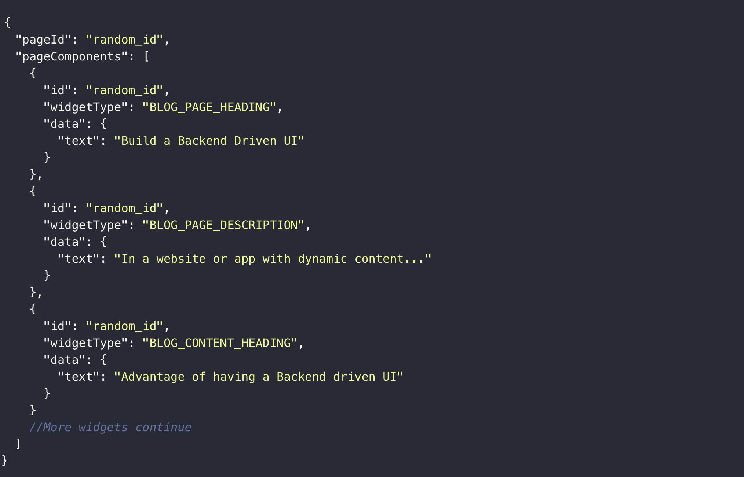

Slide 3
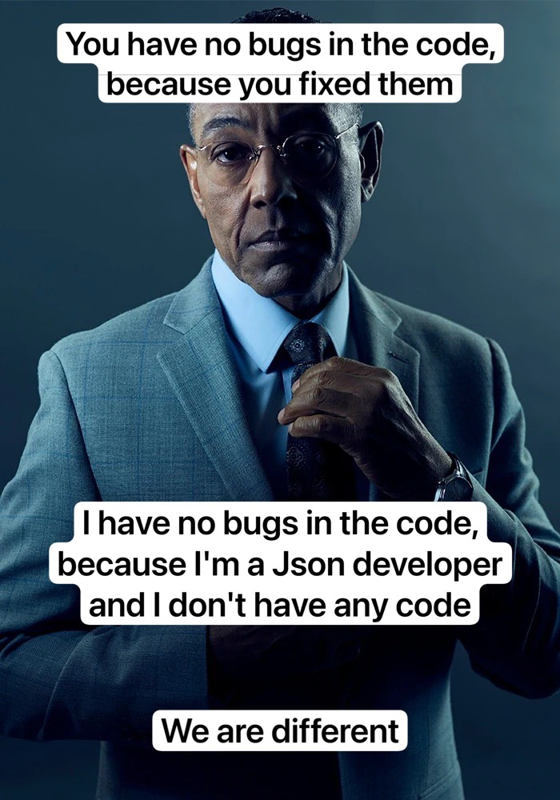
Why BDUI?
Time-to-market
Multiplatform
No need to wait for App Review & Updates

Slide 4
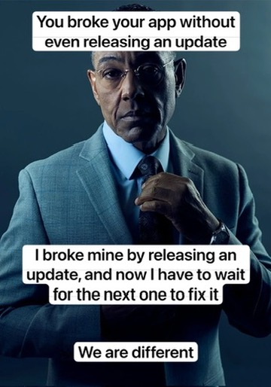
Why avoid BDUI?
Old version support
Redistribution of tasks towards the backend
Costs
Not suitable for all features
Releases

Slide 5
This slide can’t be loaded due to a server error

