Slide 1

Pingu the ping-list-bot

Slide 2
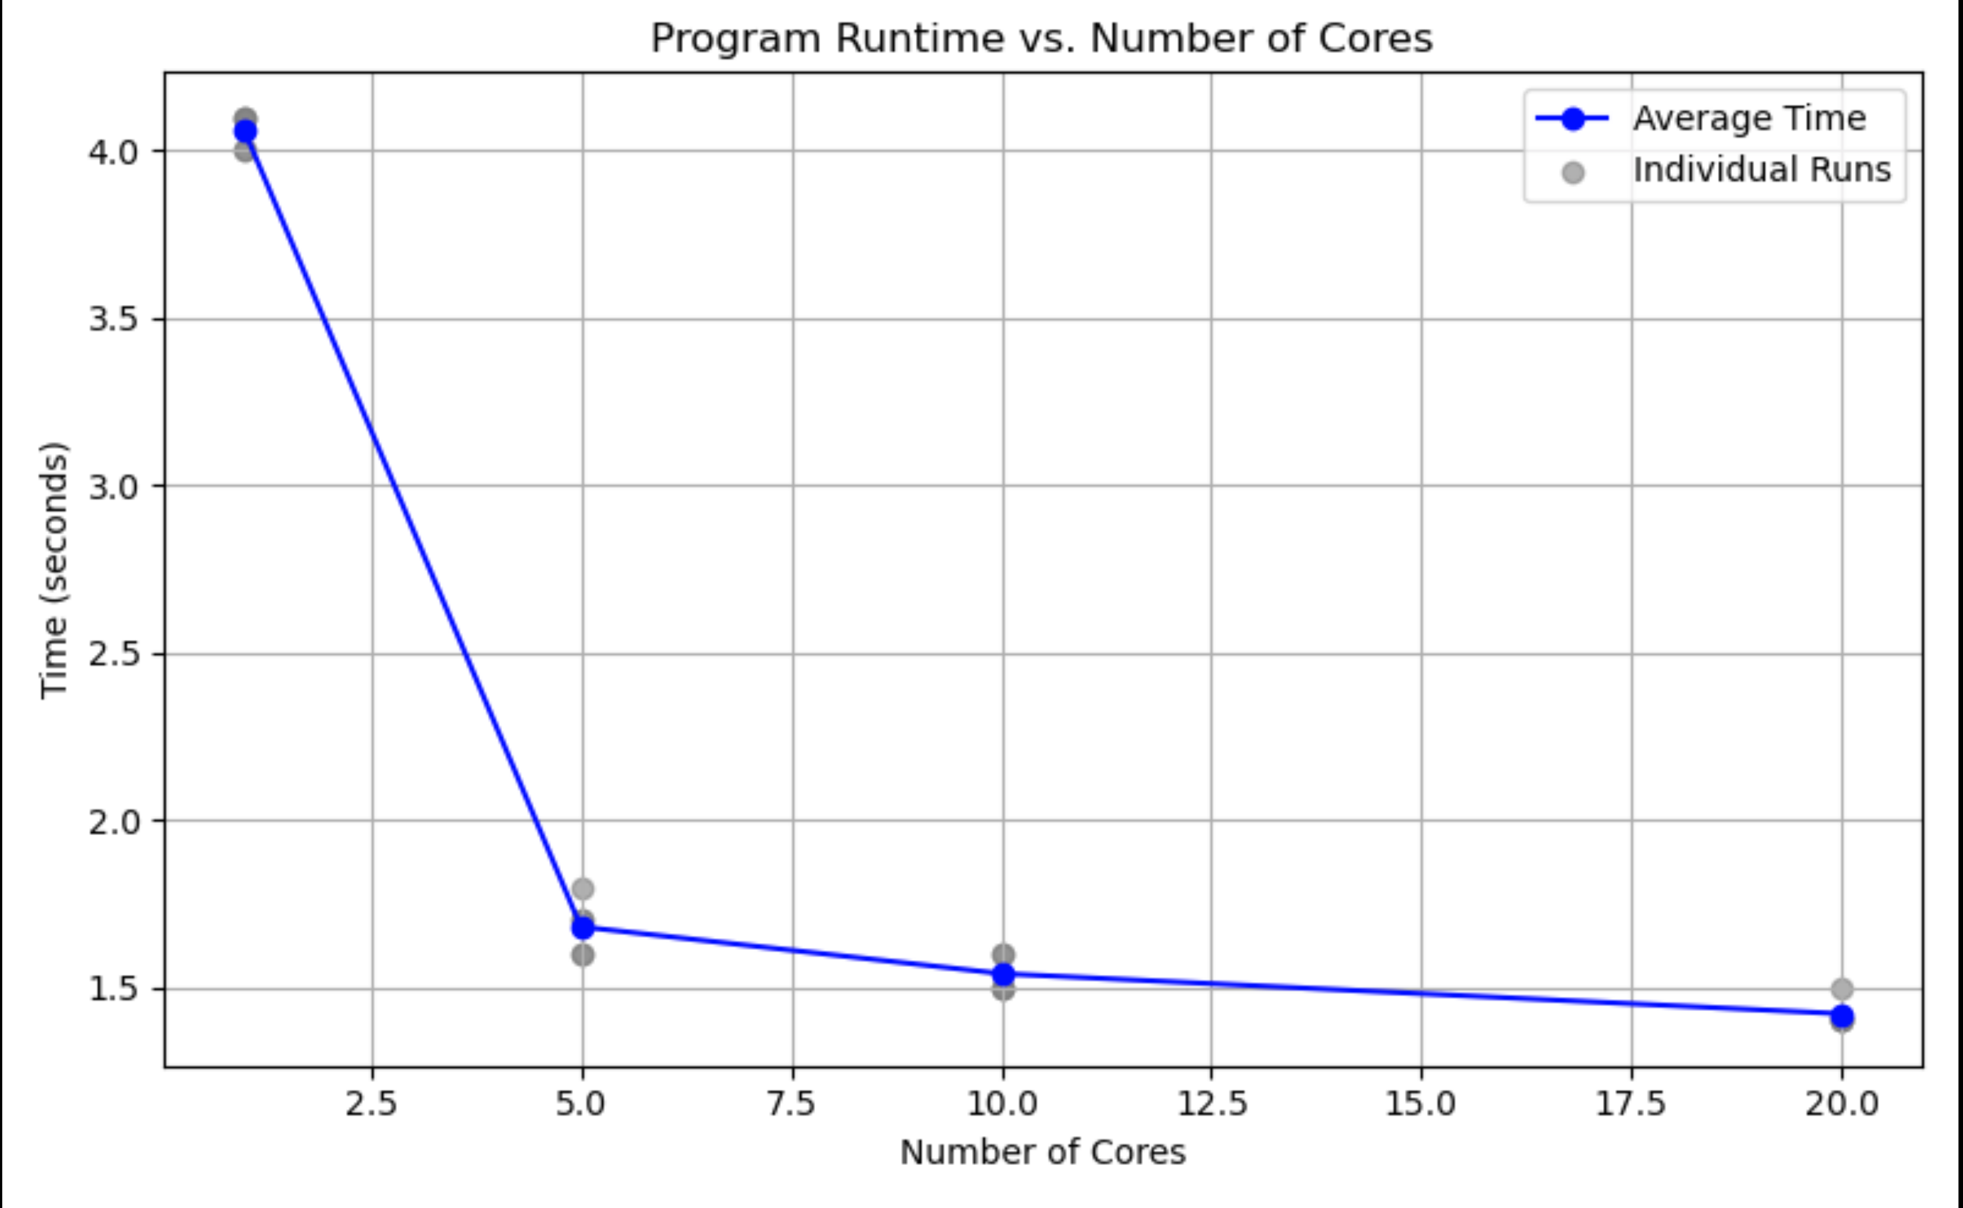
Metrics

