Slide 1
Analysis Sentiment and Topic Modelling
This analysis aims to provide deeper insights into customer perceptions and experiences of the services provided by British Airways.
In this analysis, we have collected and analyzed hundreds of customer reviews online. We used natural language processing technology to identify the main sentiments in the reviews, whether they were positive, negative or neutral. In addition, we also applied topic modeling to find the main themes that were frequently discussed by customers.

Slide 2
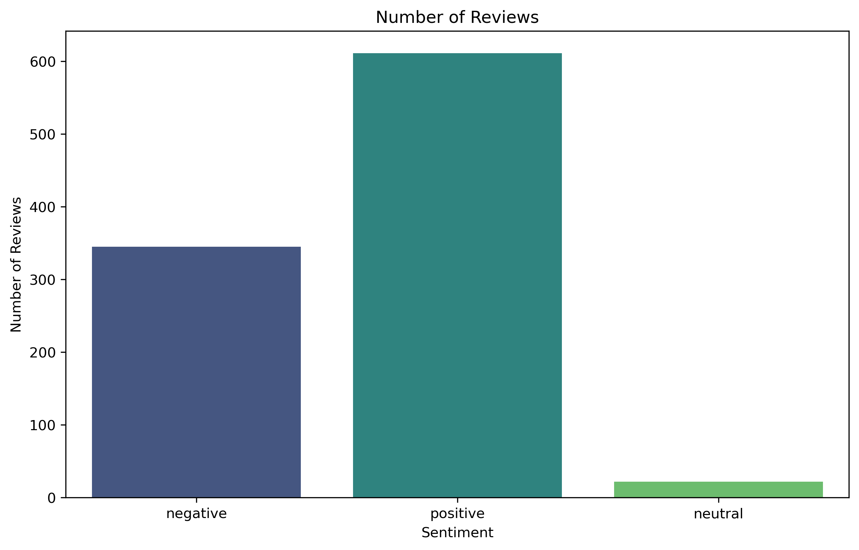
Sentiment Distribution
From the results of the processing that has been done. It can be seen that positive sentiment is indeed higher than negative and neutral. However, from these results, the negative sentiment is also quite high, about half of the positive sentiment, which indicates that there are still many complaints from customers.
Recommendation:
1. Proactively handle customer complaints

Slide 3
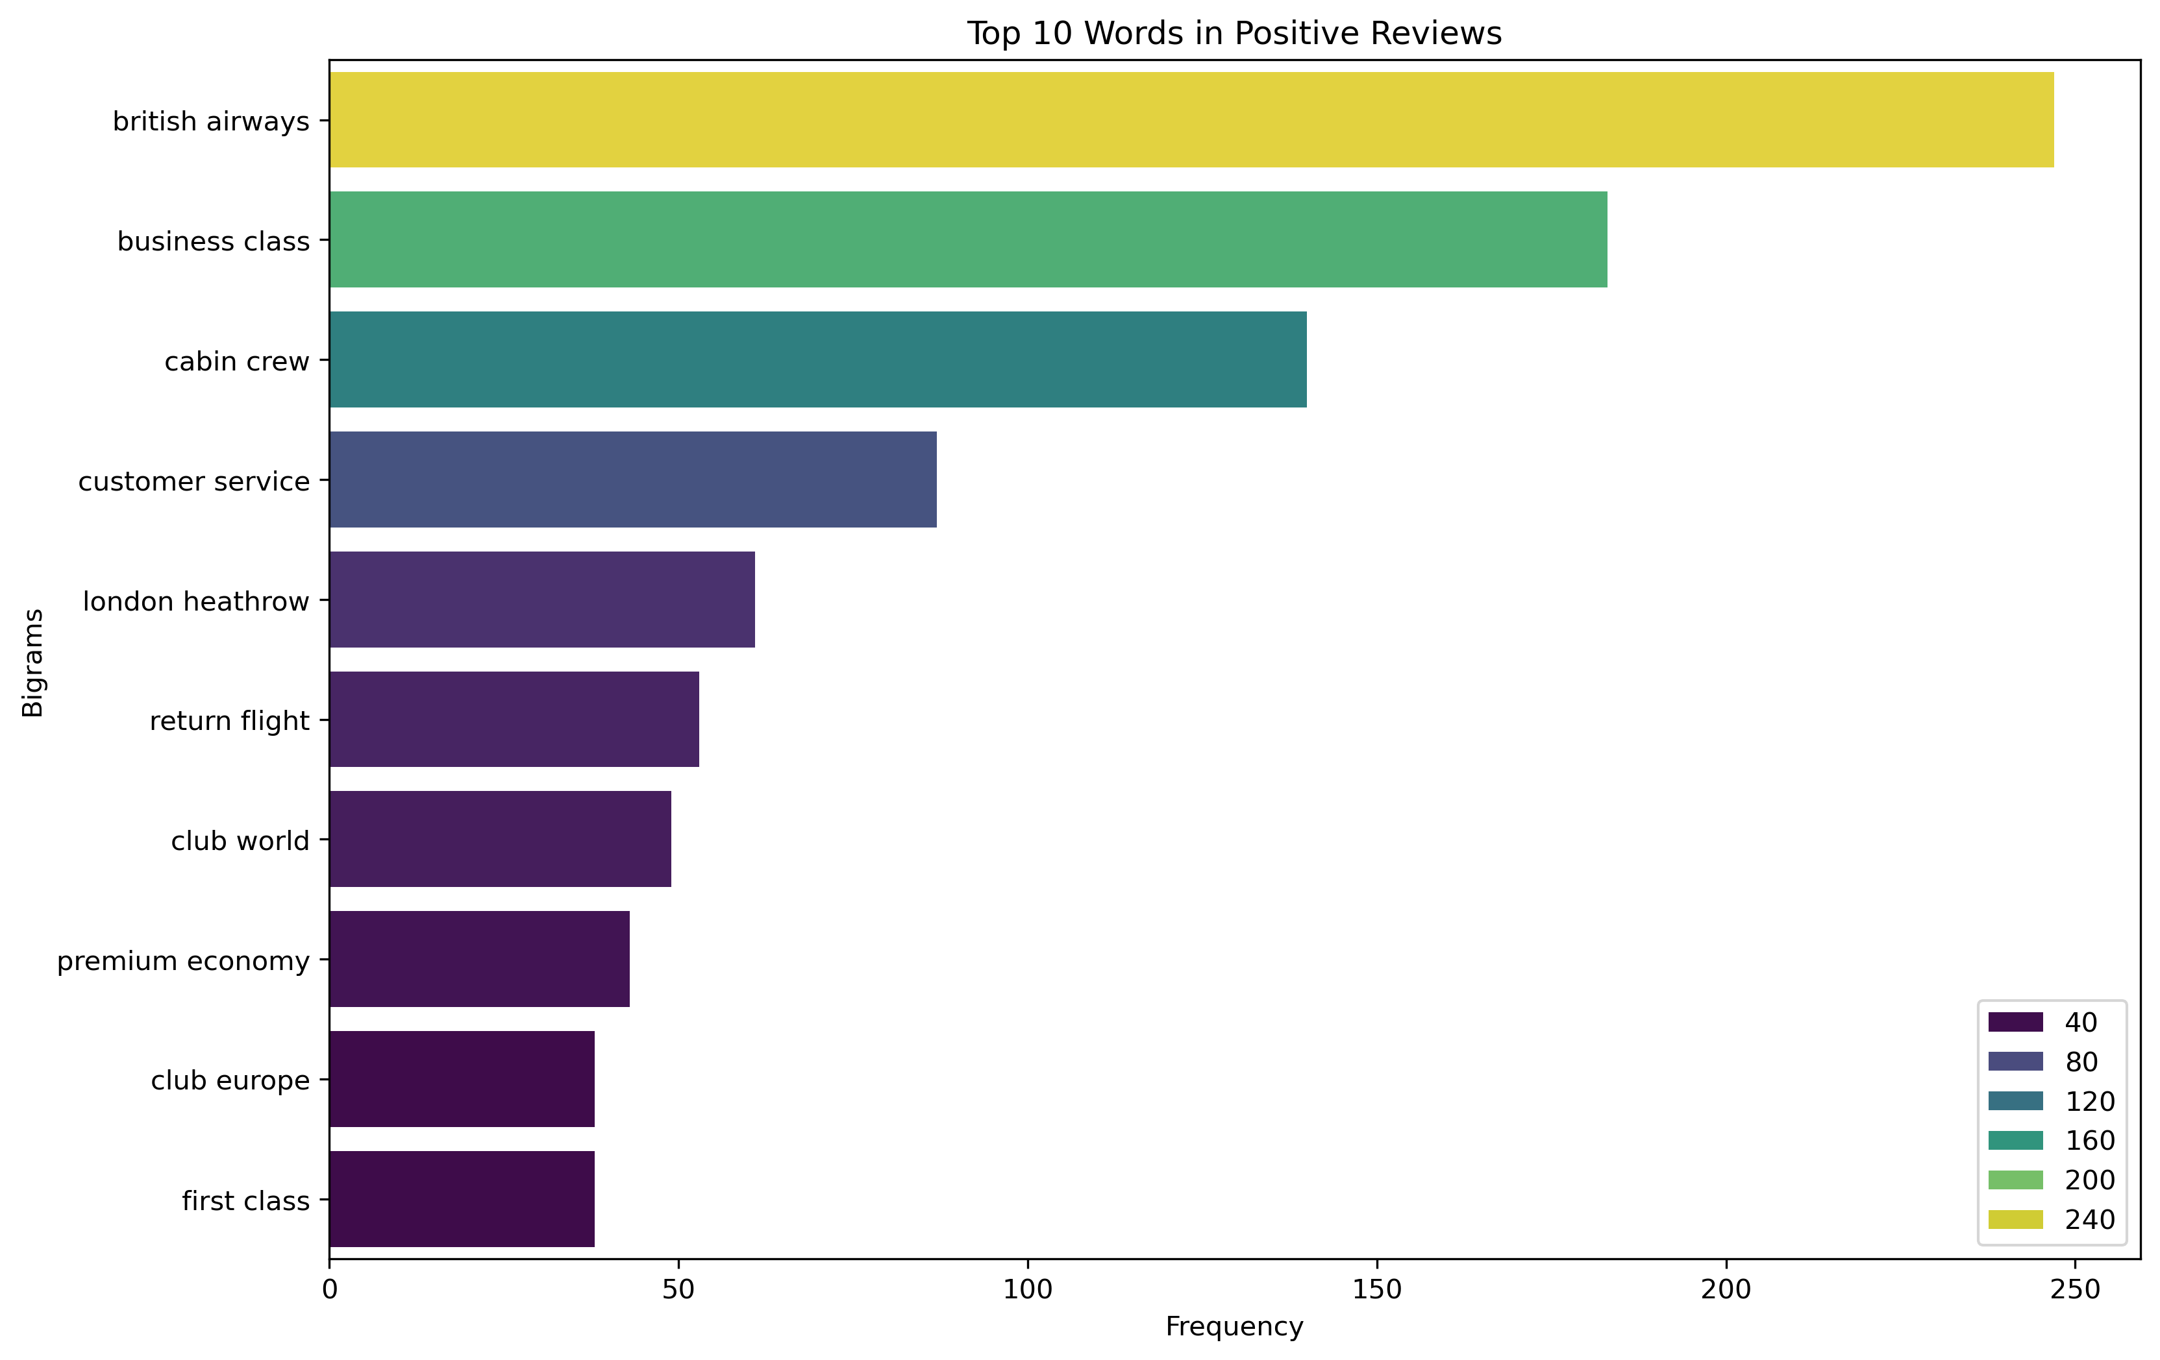
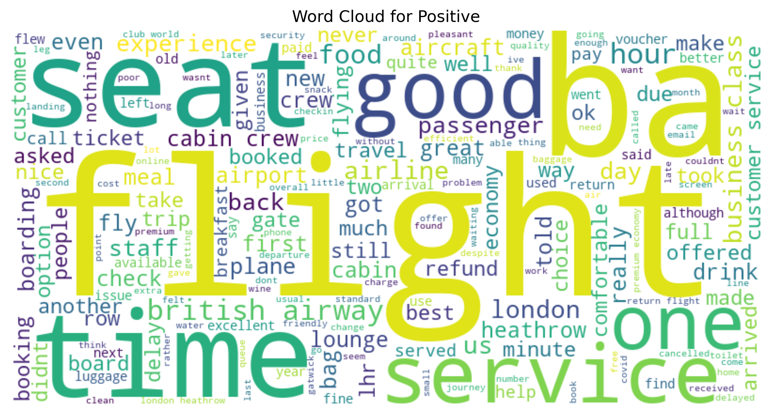
Sentiment Positive
Dari analisis yang telah dilakukan didapat beberapa kata positive yang sering dibahas oleh pelanggan: Business Class, Cabin Crew, Customer Service.
Recommendation: 1. Meningkatkan kualitas pada business class di British airways
2. Mempertahankan kinerja cabin crew
3. Customer Service yang selalu ditingkatkan.

Slide 4
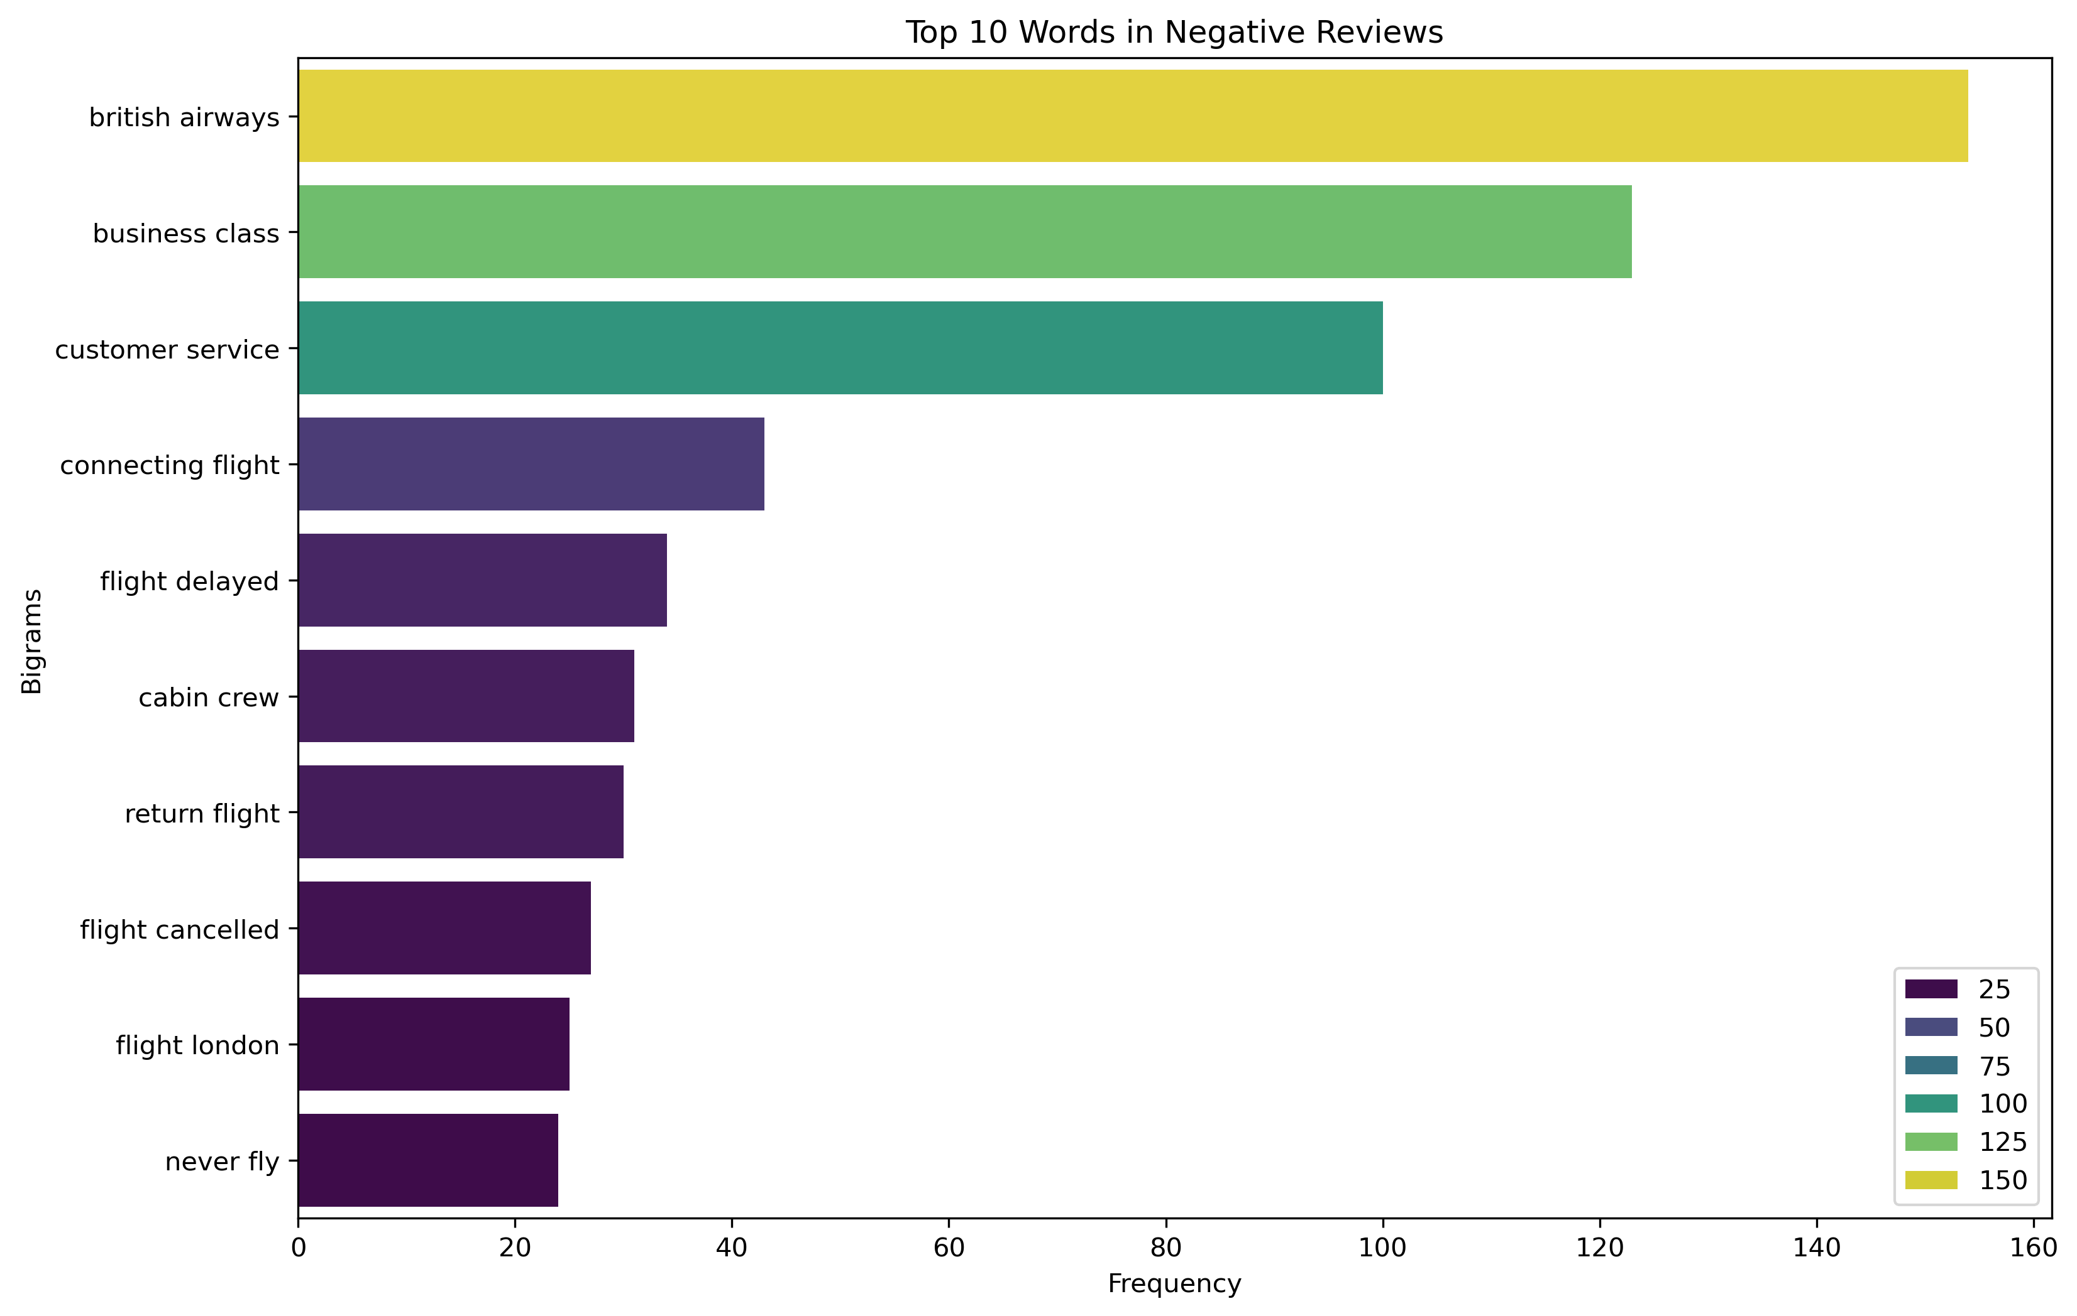
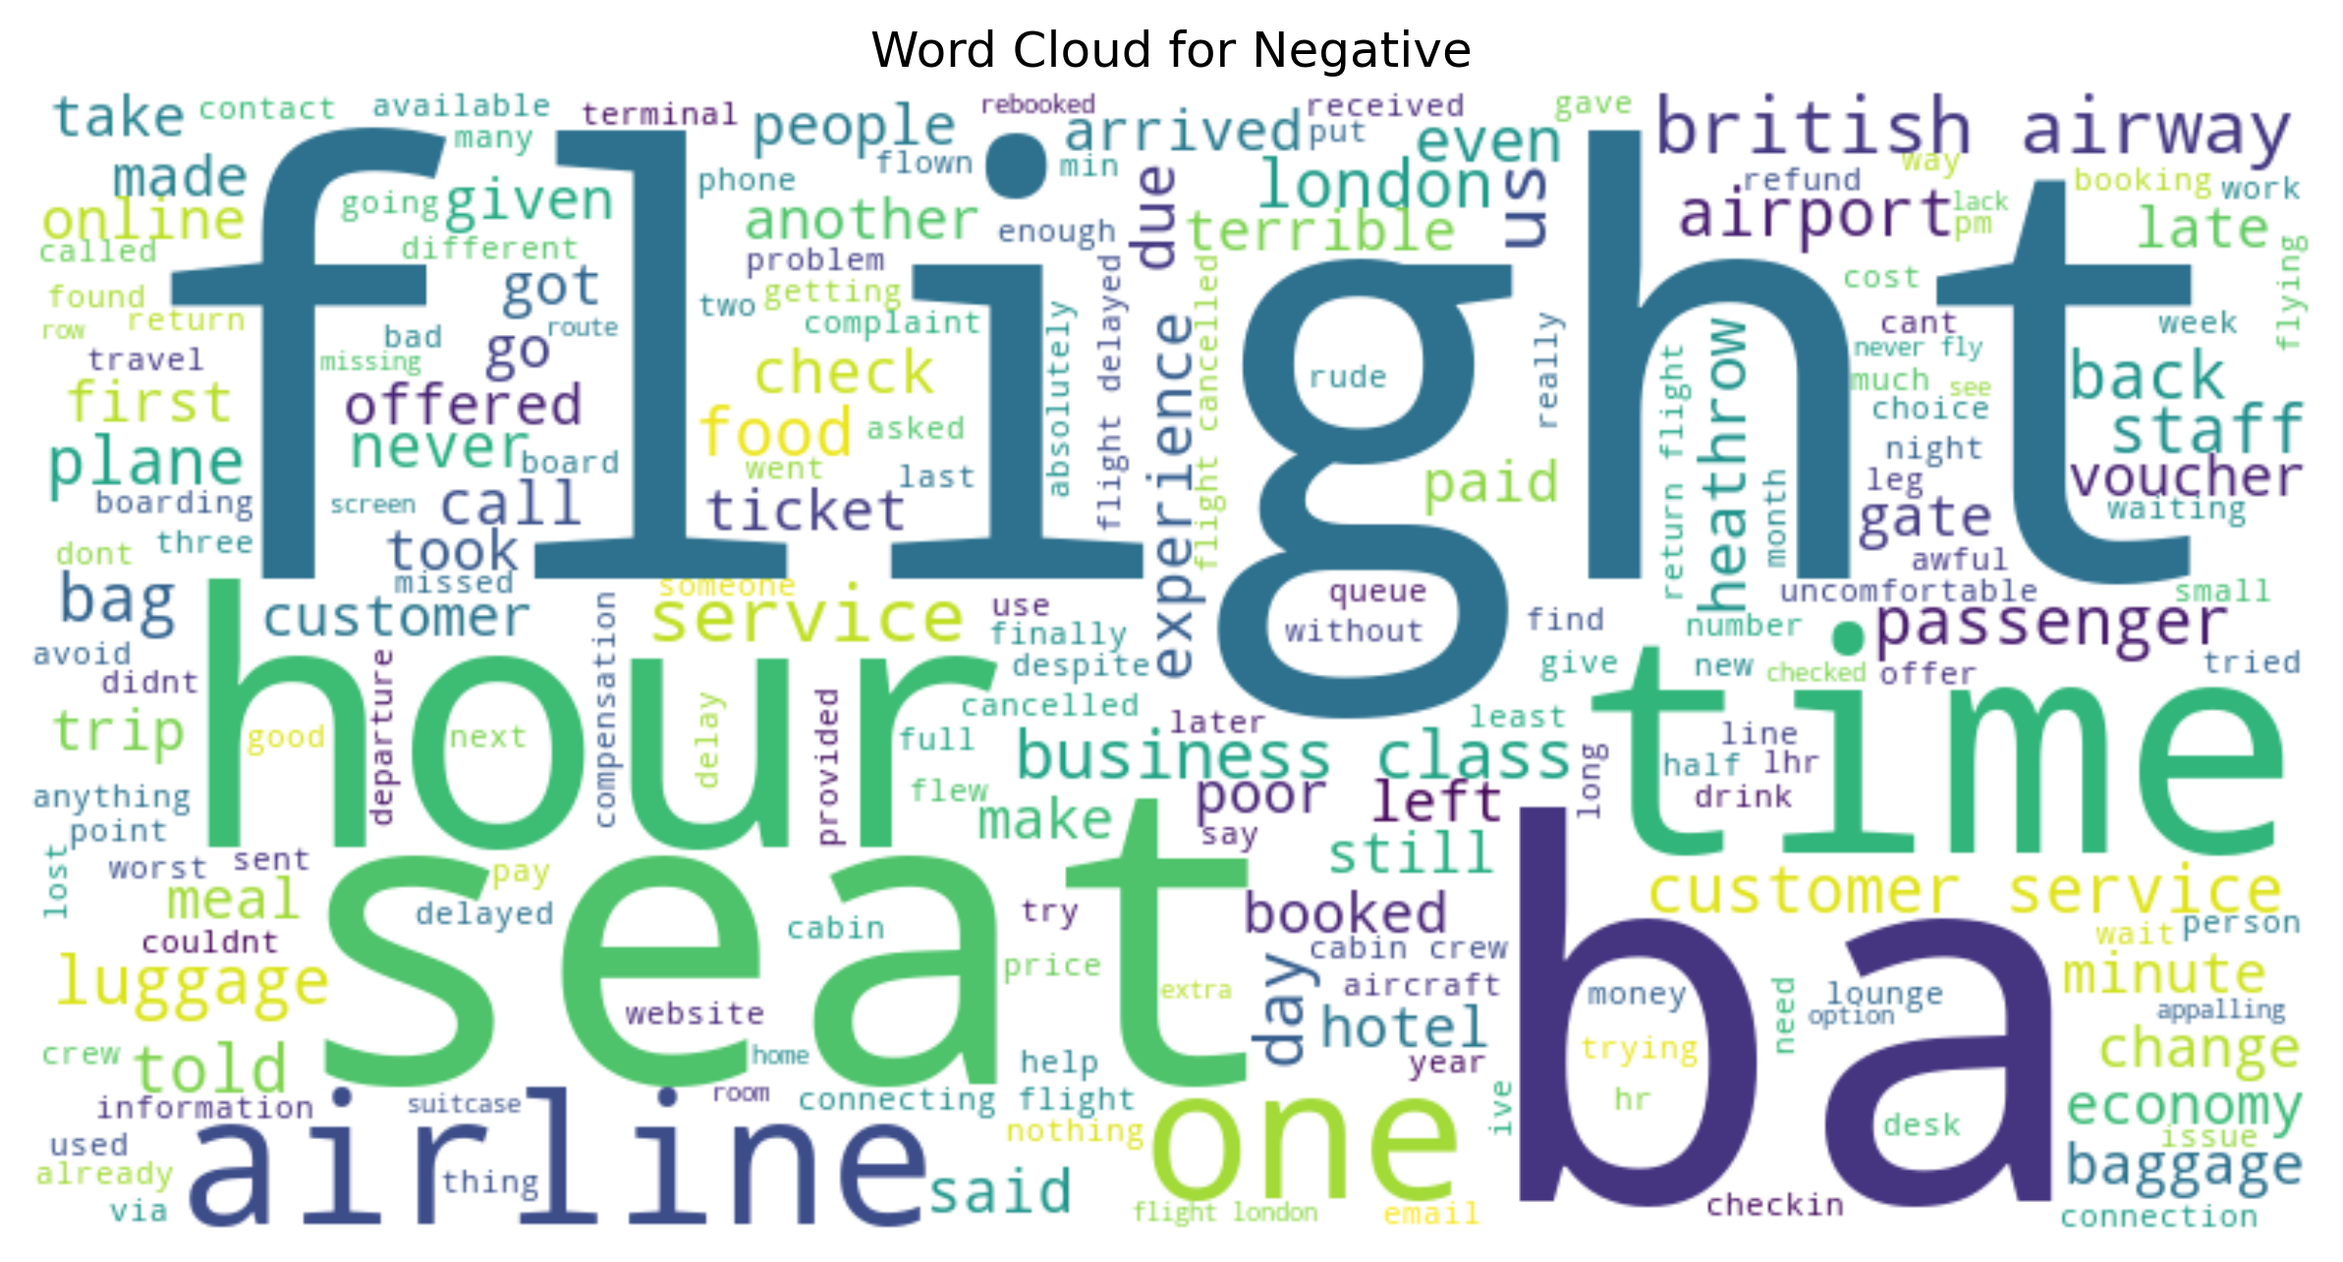
Sentiment Negative
From the analysis that has been done, several negative words are often discussed by customers: Flight Delayed, Customer Service
Recommendation: 1. Take action or improvement to minimize flight delayed.
2. Improve Customer Service performance.

Slide 5
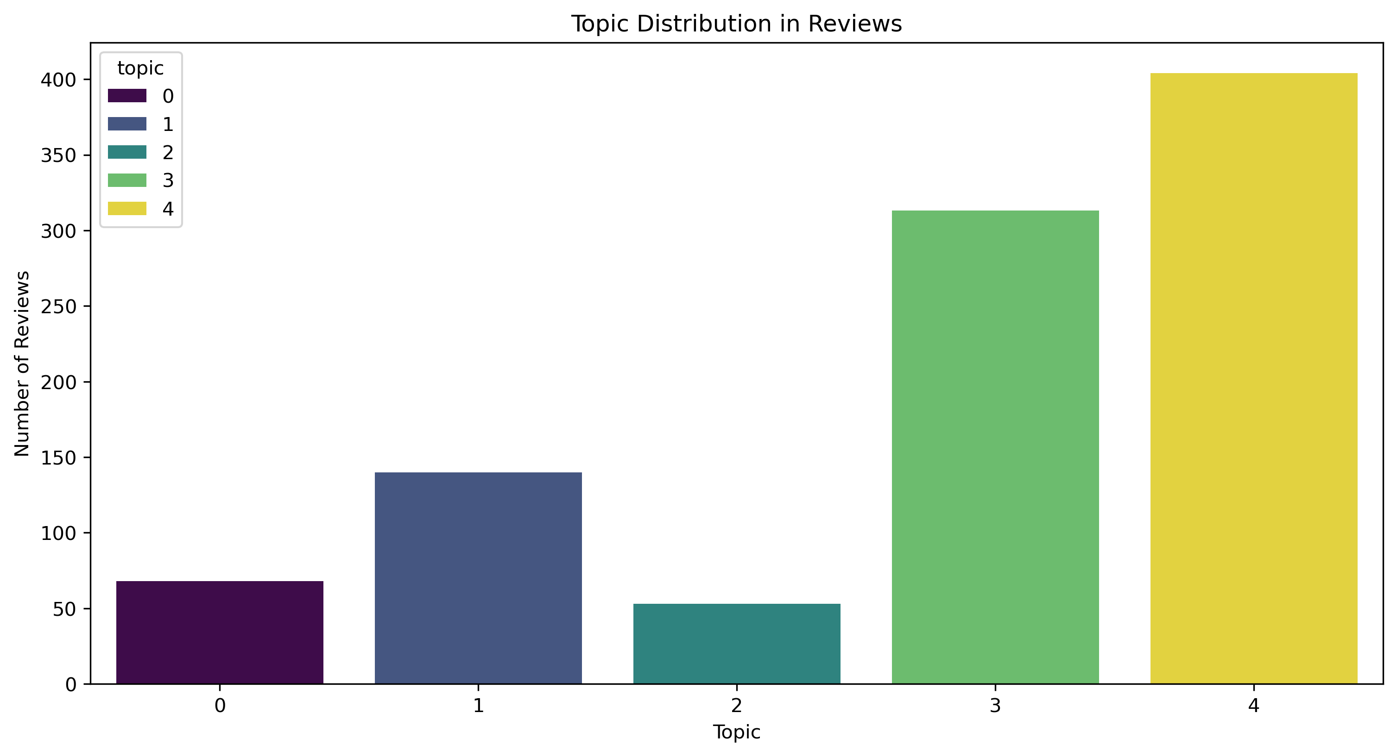
Topic Distribution
Topic 0: Class and business
Topic 1: Seating and service
Topic 2: Cabin and flight crew
Topic 3: quality and food
Topic 4: General and airline services
From the results of the analysis conducted: Topic 4, 3, and 1 are the most frequently discussed topics by customers.
Recommendation: 1. Improve or maintain the quality of services and food provided by British airways.
2. Improve or add new experiences to improve the quality of service and seating.

