Slide 1

Database Connectivity
Example Walk through

Slide 2
Class DB_Connector member Vars.
//create the connection string that holds the database information
private string serverName;
private uint port;
private string dbname;
private string UID;
private string password;
private MySqlConnectionStringBuilder connString = new MySqlConnectionStringBuilder();
private MySqlConnection conn;

Slide 3
DB_Connector Constructor
public DB_Connector(String serverName, uint port, string dbname, string UID, string password)
{
this.serverName = serverName;
this.port = port;
this.dbname = dbname;
this.UID = UID;
this.password = password;
connString.Server = this.serverName;
connString.Port = this.port;
connString.UserID = this.UID;
connString.Password = this.password;
connString.Database = this.dbname;
conn = new MySqlConnection(connString.ToString());
}

Slide 4
DB_Connector methods
public MySqlConnection getConnection()
{
return this.conn;
}
public void Open_Connection()
{
this.conn.Open();
}
public void close_connection()
{
this.conn.Close();
}

Slide 5
Query Class
class Query
{
MySqlCommand command;
string sqlQuery;
public Query()
{
command = new MySqlCommand();
sqlQuery = null;
}
public Query(string queryText)
{
sqlQuery = queryText;
command = new MySqlCommand(sqlQuery);
}

Slide 6
Query Run Query
public void RunQuery(DB_Connector conn, String query)
{
conn.Open_Connection();
MySqlCommand cmd = conn.getConnection().CreateCommand();
cmd.CommandText = query;
MySqlDataReader reader = cmd.ExecuteReader();
while (reader.Read())
{
string row = "";
for (int i = 0; i < reader.FieldCount; i++)
row += reader.GetValue(i).ToString() + ", ";
Console.WriteLine(row);
}
conn.close_connection();
}

Slide 7
Demo
static void Main(string[] args)
{
DB_Connector connect = new DB_Connector("localhost", 3306, "tpch", "root", "!Software_Engineer77");
try{
Query q = new Query();
Query q1 = new Query();
Console.WriteLine("Query 1:");
Console.WriteLine();
q.RunQuery(connect, "SHOW TABLES");
Console.WriteLine();
Console.WriteLine("Query 2:");
q1.RunQuery(connect, "SELECT * FROM NATION");
Console.WriteLine();

Slide 8
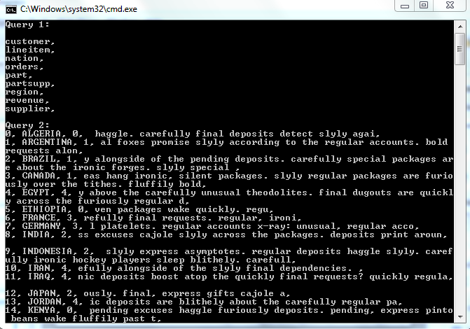
output

