Slide 1
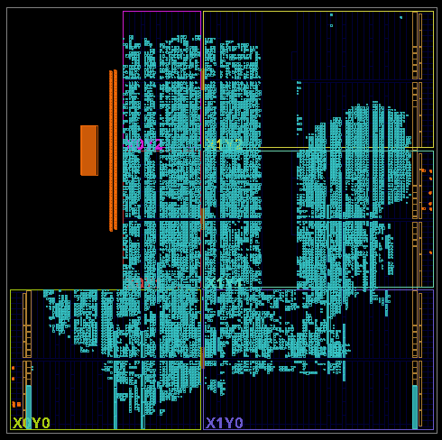
SoundSight
Zynq-7020
PL + PS / PYNQ
三维声源定位与身份许可双轴跟随
真实FPGA实现视图
RGB触摸屏 定向拾音 三维定位 声纹识别 双轴跟随
内部预写稿 · 2026-10-31
学校／团队署名及印刷尺寸待确认
01 应用价值
02 系统与设计
03 关键结果
将声音方向、说话人验证与双轴指向结合，为设备提供本地声学感知与交互能力。三维定位输出方位角和俯仰角，不估计声源距离。
四麦正四面体阵列 · 标称边长40 mm
声纹前端离线优化
40.55%
平均耗时减少
PL 连续数据处理
AXI
特征 / PCM
PS Linux / PYNQ
会议与教学
四麦采集
FFT / PHAT / IFFT
六对相关特征与PCM
三维C求解与方向筛选
说话人评分与时限许可
模式及动作管理
面向发言位置变化的场景，辅助拾音方向调整，减少反复手动对准。
两段录音各10.912 s，板端顺序处理，不含加载。
新旧评分相同；网络推理耗时基本不变。
本结果不代表在线端到端加速。 [E1]
机器人与交互终端
为“转向发声者”提供方向信息；声纹许可模式增加目标用户的授权条件。
RGB触摸屏
交互与状态
定向拾音
DAS延迟叠加
双轴跟随
PL PWM与保护
声纹双轴现场测试
功能框图：虚线表示待完成整机接合验证的路径。
声纹当前使用单麦PCM，未证实接入DAS输出。
项目 | 第1轮 | 第2轮
运行时长 / s | 32.159 | 27.254
消费定位帧 | 3012 | 2552
双轴命令提交 | 117 | 94
运行故障值 | 0 | 0
旧结果淘汰 | 0 | 1
RGB触摸屏独立操作
通过FPC连接显示与触摸，选择模式、配置参数、查看状态。整机交互待实证。
核心设计贡献
连续采集与计算解耦
PL处理连续数据，PS完成求解、识别与交互。
整机与触摸屏实拍
有界队列与结果保新
待补正面／斜45°照片与真实界面
淘汰旧READY，保护LOCKED帧，抑制旧角度驱动。
试验门限0.45，许可10 s。用户确认出现跟随。
命令提交不代表机械到位；第二轮有1次序号间隙。
两轮短测不构成识别准确率或长稳结论。 [E2]
应用收益以标定、识别可靠性与长稳验证为前提。
分层跟随许可
两种自动模式分开；默认不开轴，方向与STOP保护独立。
下一步：补齐三维误差、身份对照与实麦拾音效果。
声纹时限许可不等于多人身份与方向绑定。CAM++、Silero及厂商IP归原作者。E1/E2原始证据索引见备注。
Notes:
SoundSight bilingual poster, internal draft. Facts current as read on 2026-10-31. No new hardware or EDA execution.
E1: document/evidence/ps-speaker-live-opt-20261025/board-opt1-bench-user.log and board-opt1-bench.json. Two reused recordings, 10.912 s each. Mean front-end times calculated from both rows per variant. Loading excluded; fixed-order sequential board benchmark, not concurrent capture. Network time essentially unchanged. Scores unchanged. No general recognition-accuracy claim.
E2: document/evidence/speaker-dual-axis-20261030/board-tests.zip, logs/speaker-3d-20211118-232743-532522.json and logs/speaker-3d-20211118-233002-942132.json. Values from elapsed_seconds and stats. Runtime fault excludes the intentional STOP tail. User-observed tracking from the archive README. Board date is stale (2021); receipt date 2026-10-30. Threshold 0.45 is experimental, TTL 10 s. One old READY result dropped in Run 2. Motion commands are not independent mechanical arrivals.
Original FPGA image: project/reports/ps_3d/latest_result/user-export/imp_schematic.png, copied unchanged. It is a physical implementation view, not a logical schematic or device photograph. No claim of complete timing closure: current servo_vertical_pwm output timing is incomplete.
Architecture: document/main-architecture.md; software/tetra3d/README.md; document/requirements/report-poster-master-guide.md. Diagram is an authored functional explanation, not a tool-exported block design. Direction-only localization; far-field dominant-source model. RGB display/touch uses FPC as the final product scope, integration evidence pending. DAS reference implementation exists; microphone integration/gain and use as speaker input are unverified.
Modes: follow-sound follows direction only; speaker and run --axes require a permit. Motion defaults off. Manual calibration is independent. A permit from prior audio does not bind current direction to that same person.
Pending evidence and public identity/print decisions: document/posters/verification-checklist.md, V01–V03 and P04–P10. CAM++/Silero/vendor IP belong to their respective authors. Project contribution is system integration, scheduling and implementation optimization, not invention of those algorithms.

