Slide 1
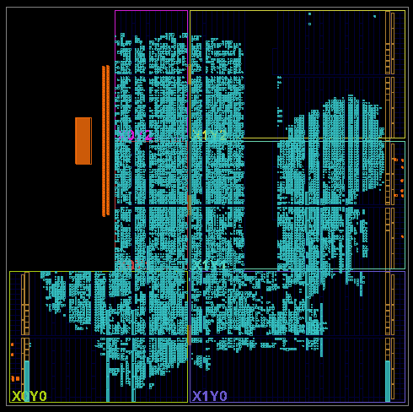
SoundSight
Zynq-7020
PL + PS / PYNQ
3D Sound Localization and Speaker-Gated Pan–Tilt Tracking
Actual FPGA implementation
RGB touchscreen Directional audio 3D localization Speaker verification Pan–tilt tracking
INTERNAL DRAFT · 2026-10-31
Affiliation, team credits and print size to confirm
01 Application value
02 System and design
03 Key results
SoundSight combines sound direction, speaker verification and pan–tilt control for local acoustic interaction. Localization estimates azimuth and elevation, not source distance.
Four-mic tetrahedral array · 40 mm nominal edge
Offline speech front-end optimization
40.55%
less processing time
PL Stream processing
AXI
Features / PCM
PS Linux / PYNQ
Meetings and classrooms
Mic acquisition
FFT / PHAT / IFFT
Six pair features / PCM
3D C solver and filtering
Speaker scores / permits
Modes and motion
Directional audio could reduce manual aiming as speakers move or take turns.
Two 10.912 s recordings, sequential board benchmark.
Loading excluded. Scores unchanged; inference time
essentially unchanged. Not an online end-to-end gain. [E1]
Robots and interactive devices
Direction estimates support turning toward a voice. Speaker-gated mode adds authorization for an enrolled user.
RGB touchscreen
Controls and status
Directional audio
Delay-and-sum
Pan–tilt tracking
PL PWM guards
Speaker-gated pan–tilt field tests
Functional diagram. Dashed paths await integration validation.
Speaker input is currently single-mic PCM, not verified DAS output.
Metric | Run 1 | Run 2
Duration / s | 32.159 | 27.254
Frames consumed | 3012 | 2552
Motion commands | 117 | 94
Runtime fault value | 0 | 0
Old results dropped | 0 | 1
Standalone RGB touchscreen
FPC display and touch for modes, settings and status. Integration awaits evidence.
Core design contributions
Decoupled acquisition and processing
PL handles streams; PS runs estimation, verification and UI.
Device and touchscreen photos
Bounded queues and fresh results
Original front / 45° views and interface needed
Drop old READY results, protect LOCKED frames and reject stale angles.
Trial threshold 0.45; permit 10 s. User observed tracking.
Commands do not prove arrival; Run 2 has one sequence gap.
Short trials do not establish accuracy or long-term stability. [E2]
Benefits depend on calibration, reliable verification
and sustained operation.
Layered motion permission
Separate tracking modes; axes default off. Direction and STOP guards remain.
Next: measure 3D error, identity rejection and directional audio.
A time-limited permit does not bind a person to a direction in a multi-speaker scene. CAM++, Silero and vendor IP retain their attribution. Sources: notes.
Notes:
SoundSight bilingual poster, internal draft. Facts current as read on 2026-10-31. No new hardware or EDA execution.
E1: document/evidence/ps-speaker-live-opt-20261025/board-opt1-bench-user.log and board-opt1-bench.json. Two reused recordings, 10.912 s each. Mean front-end times calculated from both rows per variant. Loading excluded; fixed-order sequential board benchmark, not concurrent capture. Network time essentially unchanged. Scores unchanged. No general recognition-accuracy claim.
E2: document/evidence/speaker-dual-axis-20261030/board-tests.zip, logs/speaker-3d-20211118-232743-532522.json and logs/speaker-3d-20211118-233002-942132.json. Values from elapsed_seconds and stats. Runtime fault excludes the intentional STOP tail. User-observed tracking from the archive README. Board date is stale (2021); receipt date 2026-10-30. Threshold 0.45 is experimental, TTL 10 s. One old READY result dropped in Run 2. Motion commands are not independent mechanical arrivals.
Original FPGA image: project/reports/ps_3d/latest_result/user-export/imp_schematic.png, copied unchanged. It is a physical implementation view, not a logical schematic or device photograph. No claim of complete timing closure: current servo_vertical_pwm output timing is incomplete.
Architecture: document/main-architecture.md; software/tetra3d/README.md; document/requirements/report-poster-master-guide.md. Diagram is an authored functional explanation, not a tool-exported block design. Direction-only localization; far-field dominant-source model. RGB display/touch uses FPC as the final product scope, integration evidence pending. DAS reference implementation exists; microphone integration/gain and use as speaker input are unverified.
Modes: follow-sound follows direction only; speaker and run --axes require a permit. Motion defaults off. Manual calibration is independent. A permit from prior audio does not bind current direction to that same person.
Pending evidence and public identity/print decisions: document/posters/verification-checklist.md, V01–V03 and P04–P10. CAM++/Silero/vendor IP belong to their respective authors. Project contribution is system integration, scheduling and implementation optimization, not invention of those algorithms.

