Slide 1
Gen AI
Quality Applications
How to use AI like an Engineer!

Slide 2





My Background
Medical Device
Started out in Research
Majority in Design Quality
Process Development
Semiconductor
Data Management
Current:
Data Engineering
Software Engineering
ML Engineering
Data Architect
Gen AI Solution Architect

Slide 3
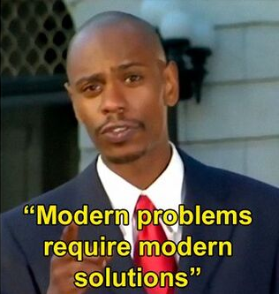
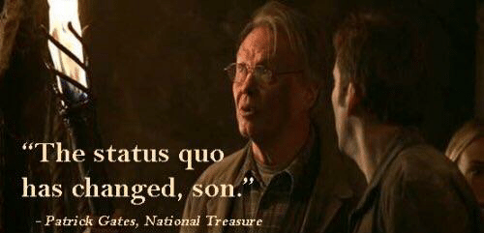


Goals
01
02
03
04

Slide 4
Goals
01
02
03
04
Status Quo
Modern Problems Modern Solutions
Manual Labor and Excel Macros
What can Gen AI actually do?
Live Coding Session
Simulating a Quality Engineer
Interactive session with take home examples
Novel Use Cases in Quality Roles

Slide 5
01
Status Quo
How we do our
jobs today

Slide 6
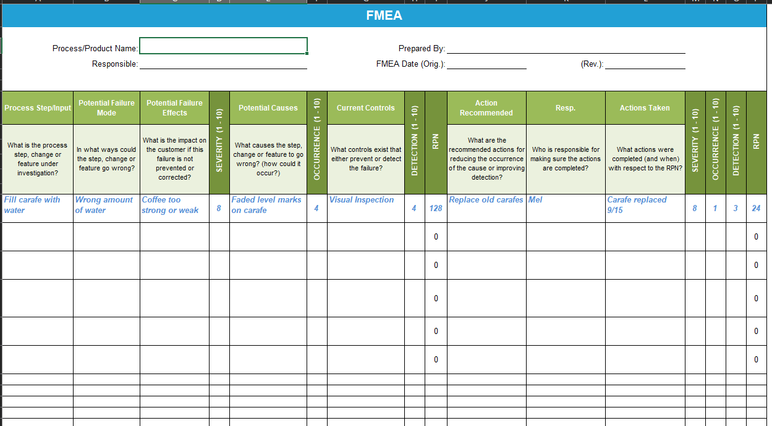
Designing FMEA’s
These documents are often time consuming efforts done in silos and then collaborated on for final approvals.

Slide 7
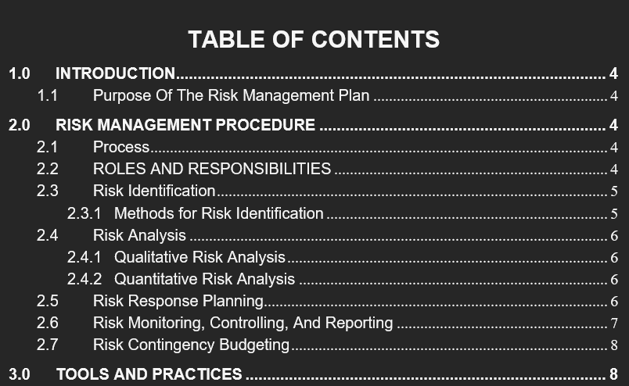
Risk Management
Although these documents look fairly similar across DHF’s they are a crucial piece of each Product’s Documentation

Slide 8
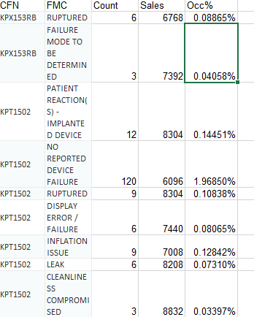
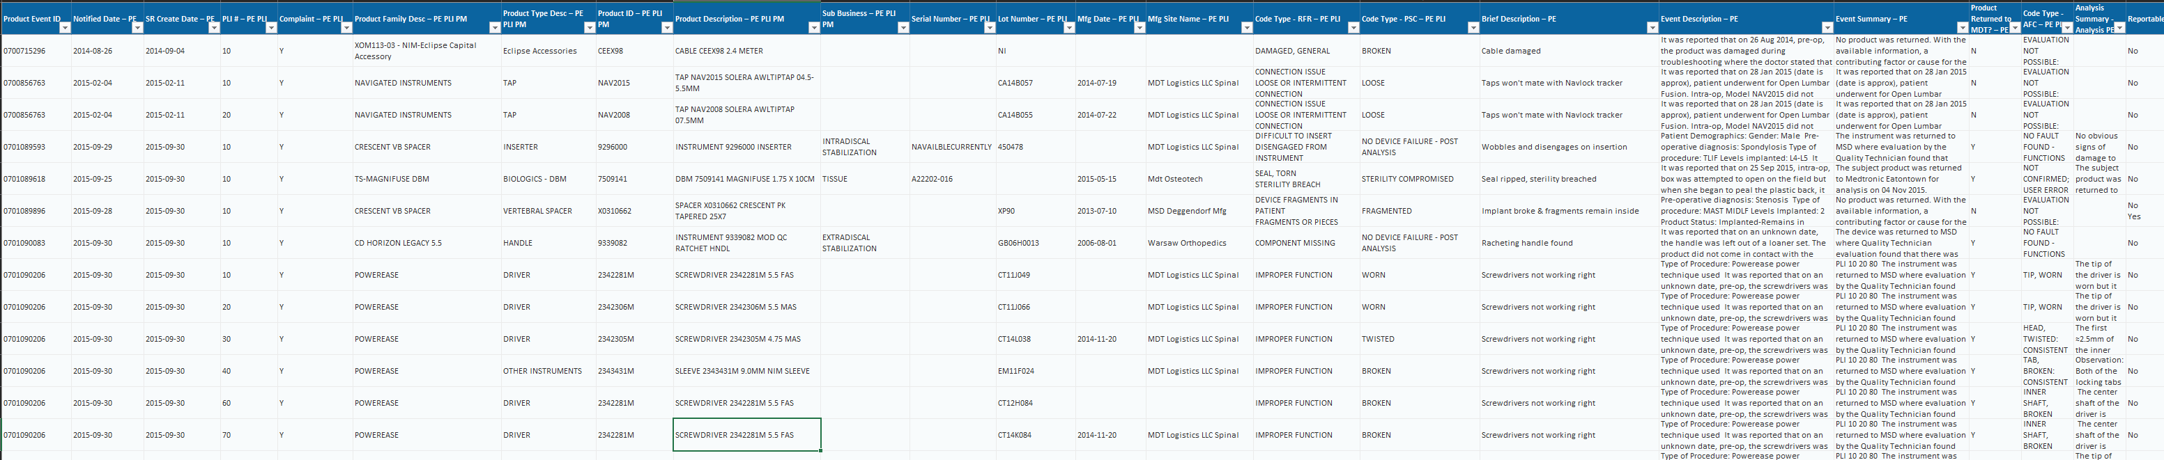
Post-Market Analysis
Post-Market Data is infamous for being some of the most overwhelming data to analyze. This data requires a large team and a lot of time to analyze fully.

Slide 9
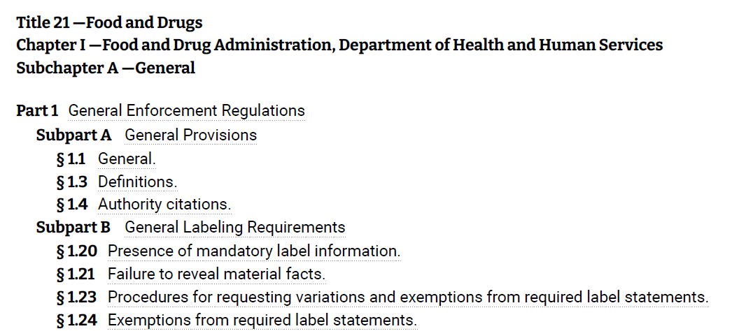
Regulation Overload
For fields such as Medical Device the extremely difficult to read and search documentation provided by the U.S. federal Govt. can be difficult to wade through

Slide 10
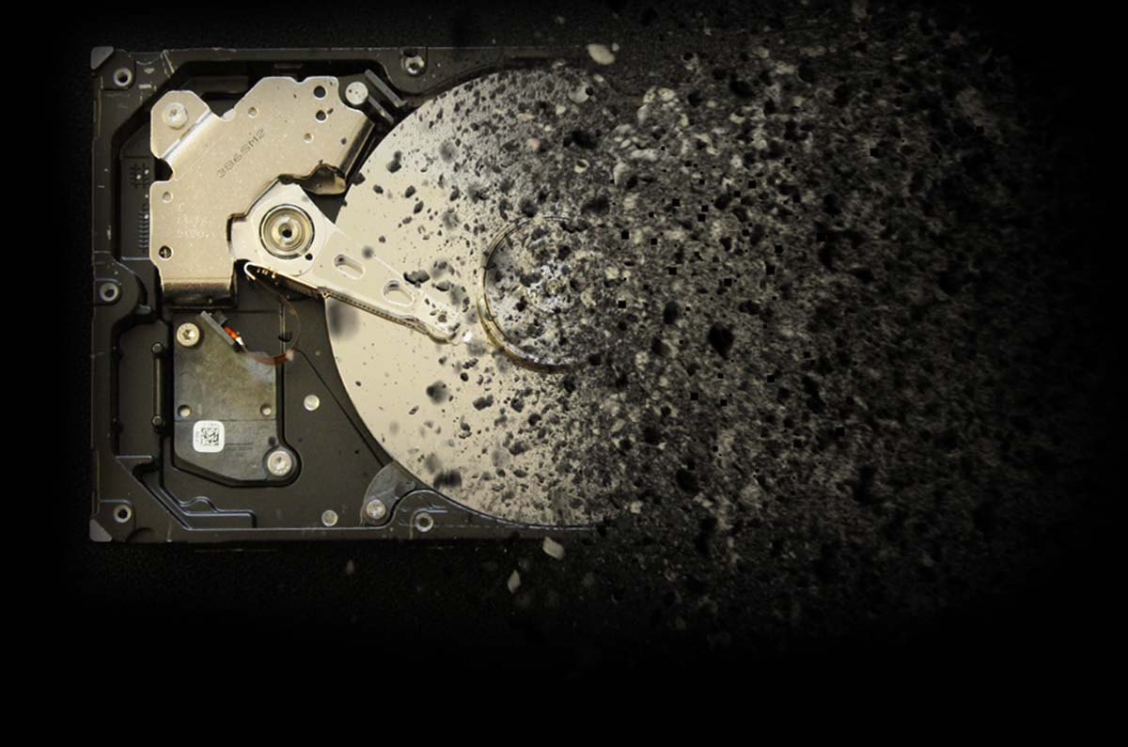
The Hard Truth
These manual processes can cripple project timelines.
This intensive process requires large investment and dedication.
The cost of skipping steps in this process can literally mean life or death.

Slide 11
Modernization

Slide 12
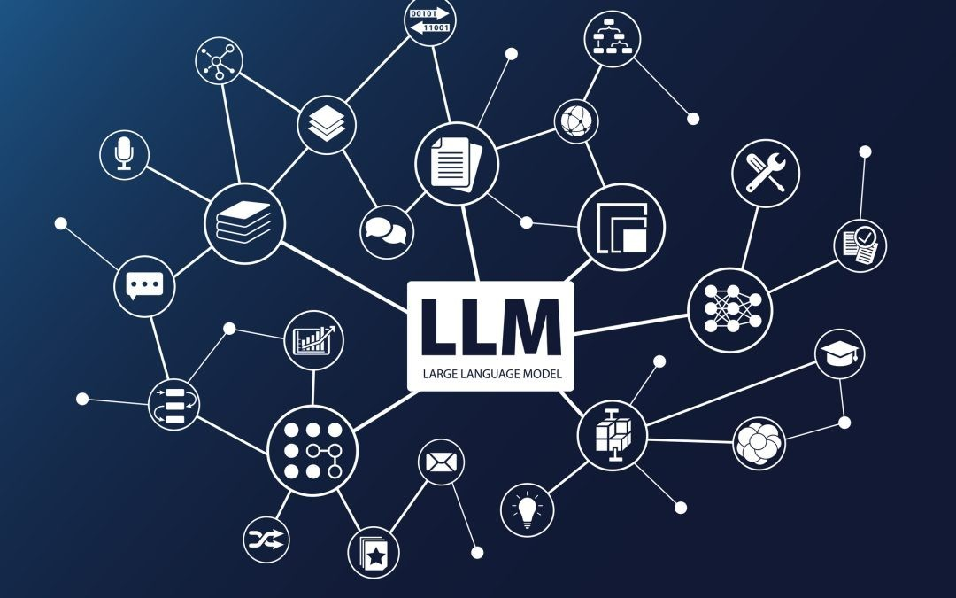
The Breakthrough of LLM’s
Google
Transformers
OpenAI
ChatGPT
2013 “Efficient Estimation of Word Representations in Vector Space”
2017 “Attention is all you need”
2020 GPT-3 debuts to the public.
2023 LLaMa becomes Open Source

Slide 13
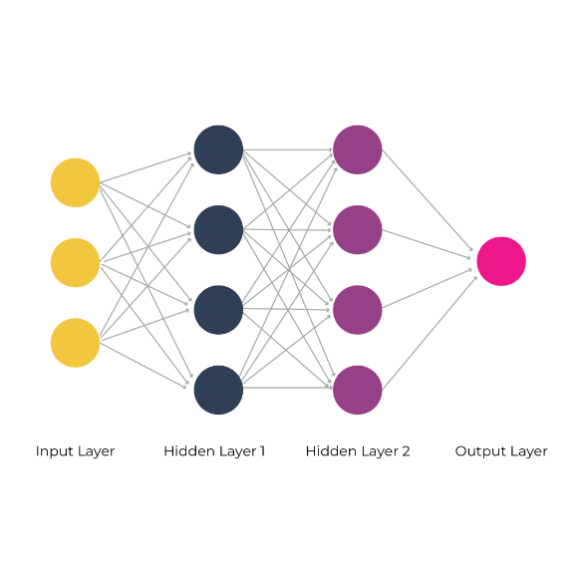
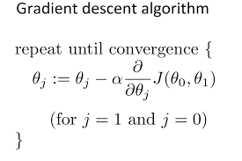
Neural Networks
Training Data
or
Text Input
Answers from the Model
Lots of Math
Hidden Layers With Parameters

Slide 14
1,760,000,000
Number of Parameters in GPT-4

Slide 15
$691,775,000
For 25,000 NVIDIA Tesla A100 GPU’s

Slide 16
62,319 MWh
The amount of electricity needed to Power Massachusetts for 1 day in the Summer

Slide 17
Cost of Gen AI API’s
GPT-3
GPT-3.5
GPT-4
$0.002
$0.004
$0.12
$0.008
$0.064
$3.84
“Davinci”
Max Tokens
4096
“Turbo”
Max Tokens
16000
“Top Dawg”
Max Tokens
32000

Slide 18


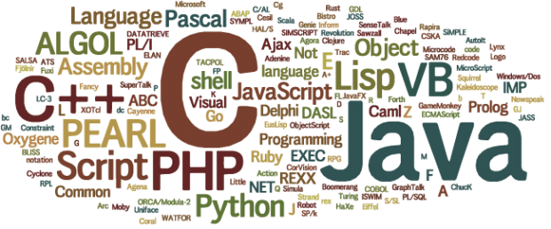
How to use Gen AI
LangChain
Cloud
Other
A Python package for AI Tools
Approachable for beginners
Endlessly customizable
Large Community of Developers
Current Leader in Gen AI Space
Accessible everywhere
“Infinitely” scalable
“Infinite” long term storage
Code, low-code, and no-code
Hybrid cloud and on-prem options
Azure, AWS, Google, IBM, etc.
Multiple coding languages
Low-code, no-code solutions
OpenAI, HuggingFace, API’s
GPU serving
Self-hosted models

Slide 19
—Cyberdyne Systems Series 800 Model 101 “Terminator”
“The system goes online August 4th, 1997. Human decisions are removed from strategic defense. Skynet begins to learn at a geometric rate. It becomes self-aware at 2:14 a.m. Eastern time, August 29th.”

Slide 20
Simulating A Quality Engineer

Slide 21
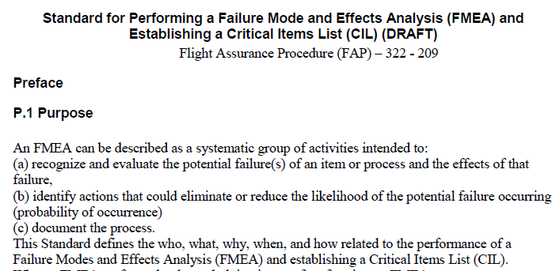
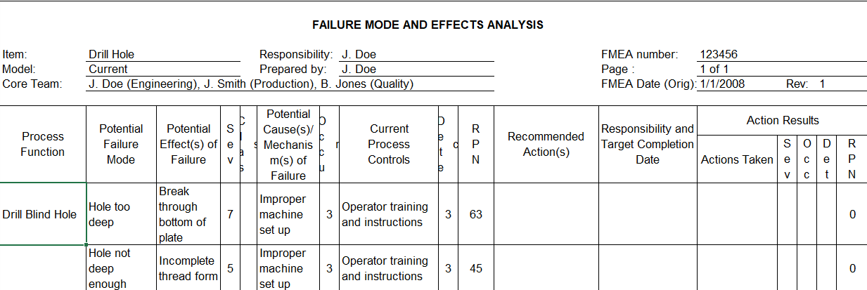
FMEA Risk Generator
Provide Guidance on how to generate the FMEA
Make a first pass on risk numbers
Generate some mitigation activities from previous work

Slide 22
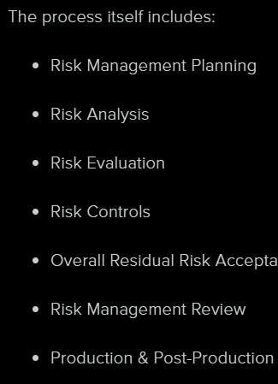
Risk Management Writer
Provide a template for how to format a RMR
Provide sample RMR’s for persona and flow guidance
Provide new data to incorporate into the draft
Use this data to write a first draft and spend time proofing not writing

Slide 23
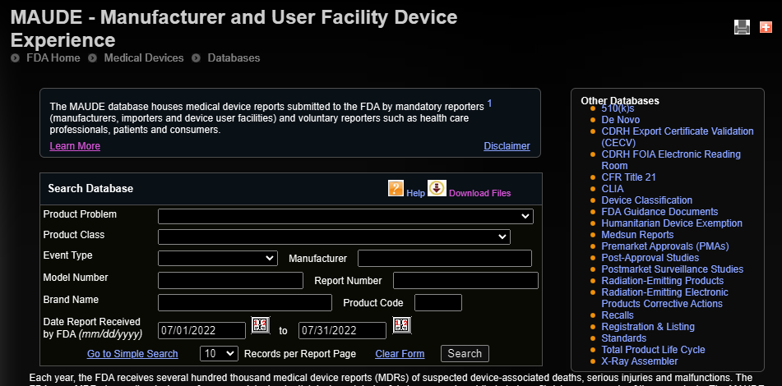
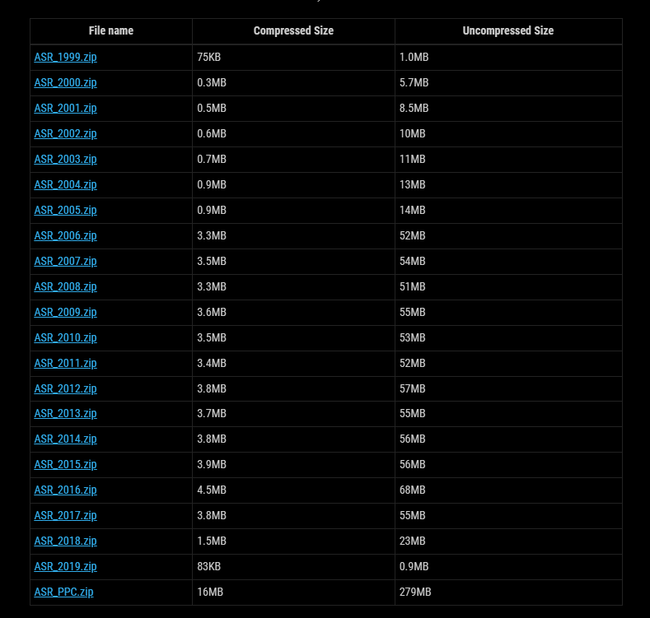
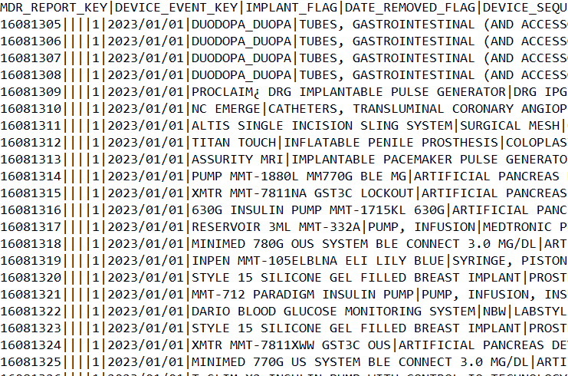
Post Market Analyzer
FDA Failure database online can be manually searched (Millions of Records a Year).
Collect this data and process it to make a personal database for searching
Use this database to generate graphs and analyses on similar devices

Slide 24
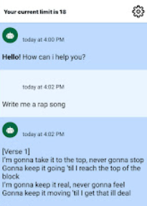
Regulation Chatbot
New and Old QE’s need to review the regs and answer complex questions or find related documents
Search features can show keywords but often miss answering the question asked completely

Slide 25
Live From Sunny California!

Slide 26
Links to GitHub and Collab
For Offline Content:
https://github.com/Tophurkey

Slide 27
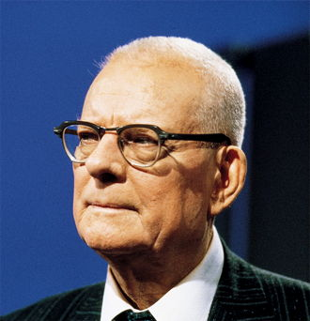
Final Thoughts…
Dr. W. Edwards Deming
“In God we trust, all others bring data.”

Slide 28

A Word From Our Sponsor…
Donate
Advocate
Communicate
ShelbyStrong.org

Slide 29
THANKS !
Do you have any questions?
christopher.gehrmann@gmail.com

