Slide 1
SASS by: Khushali Vagadia

Slide 2
Introduction
Syntactically Awesome Style Sheets
CSS preprocessor
Write code in one language and then compile it into CSS
Expanded CSS by having features such as variables, mixins, inheritence, nesting
Two syntax options:
  SCSS
  Indented

Slide 3
Compilers
Paid:
  Codekit
  Prepros App
  Mixture
  Compass.App
Free:
  Koala
  Scout
  Crunch
Online:
  sass meister

Slide 4
Output Styles
Nested
#first {
background-color: #00FFFF;
color: #C0C0C0; }
#first p {
width: 10em; }
.highlight {
text-decoration: underline;
font-size: 5em;
background-color: #FFFF00; }
Expanded
#first {
background-color: #00FFFF;
color: #C0C0C0;
}
#first p {
width: 10em;
}
.highlight {
text-decoration: underline;
font-size: 5em;
background-color: #FFFF00;
}

Slide 5
Output Styles (Contd...)
Compact
#first { background-color: #00FFFF; color: #C0C0C0; }
#first p { width: 10em; }
.highlight { text-decoration: underline; font-size: 5em; background-color: #FFFF00; }
Compressed
#first{background-color:#00FFFF;color:#C0C0C0}
#first p{width:10em}.highlight{text-decoration:underline;font-size:5em;background-color:#FFFF00}
Command: sass --watch style.scss:style.css --style compressed

Slide 6
Variables
Unlike CSS it supports variables
Scope
!global
!default

Slide 7
Example 1
SCSS file
$primaryColor: #eeaa00;
body {
$primaryColor: #ccc;
background: $primaryColor;
}
p {
color: $primaryColor;
}

Slide 8
Example2(global)
$primaryColor: #eeccff;
body {
$primaryColor: #ccc !global;
background: $primaryColor;
}
p {
color: $primaryColor;
}

Slide 9
Example 3(Default)
$firstValue: 62.5%;
$firstValue: 24px !default;
body {
font-size: $firstValue;
}

Slide 10
Operators
With variables and values
Can not be used with mix value (eg. 100%-50px)
Operators available: +, -, *, /, %, ==, !=.

Slide 11
Example 4(Math)
$container-width: 100%;
.div1 {
width: $container-width;
}
.div2 {
width: $container-width / 4;
}

Slide 12
@-rules and directives
@import | It is used to import the sass or scss files. It directly takes the filename to import.
@media | It is used to set style rule to different media types.
@extend | It specifies and shares the rules and relationships between selectors.
@at-root | It is specified as a collection of nested rules which is able to make style block at root of the document.
@debug | This directive is used to detect the errors and display the SassScript expression values to the standard error output stream.
@warn | This directive is used to get cautionary advice about the problem. It displays the SassScript expression values to the standard error output stream.
@error | This directive is used to display the SassScript expression value as fatal error.

Slide 13
Example 5 (@import)
reset.scss
html,
body,
ul,
ol {
margin: 0;
padding: 0;
}
CSS:
html, body, ul, ol {
margin: 0;
padding: 0;
}
body {
font: 100% Helvetica, sans-serif;
background-color: #efefef;
}
base.scss
@import 'reset';
body {
font: 100% Helvetica, sans-serif;
background-color: #efefef;
}

Slide 14
Example 6 (@media)
h2{
color: violet;
}
.style{
width: 500px;
@media screen and (orientation: portrait){
width:200px;
margin-left: 80px;
}
}

Slide 15
Inheritence
Example 7 (@extend)
%input-style {
font-size: 14px;
}
input {
@extend %input-style;
color: blue;
}

Slide 16
Example 8 (@at-root)
h2{
color: blue;
background-color: pink;
@at-root {
.style{
font-size: 20px;
font-style: bold;
color: violet;
}
}
}

Slide 17
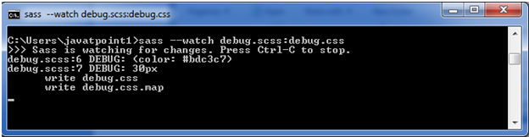
Example 9 (@debug)
$font-sizes: 10px + 20px;
$style: (
color: #bdc3c7
);
.container{
@debug $style;
@debug $font-sizes;
}

Slide 18
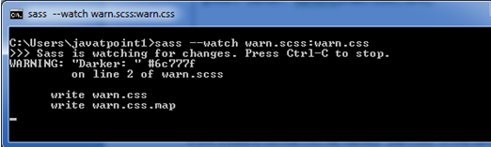
Example 10 (@warn)
$main-color: #bdc3c7;
@warn "Darker: " darken($main-color, 30%);
Can be turned off by using --quiet or the : quiet Sass option

Slide 19
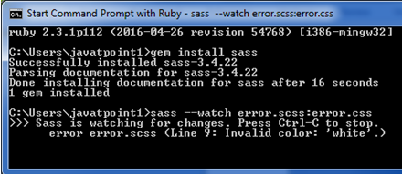
Example 11 (@error)
$colors: (
blue: #c0392b,
black: #2980b9,
);
@function style-variation($style) {
@if map-has-key($colors, $style) {
@return map-get($colors, $style);
}
@error "Invalid color: '#{$style}'.";
}
.container {
style: style-variation(white);
}

Slide 20
Control directives and expressions if() function
Syntax: if( expression, value1, value2 )
Example 12
h2{
color: if( 1 + 1 == 3 , green , red);
}

Slide 21
Control directives and expressions
@if and @else if directive
p {
@if 1 + 1 == 2 { border: 1px solid; }
@if 5 < 3 { border: 2px dotted; }
@if null { border: 3px double; }
}
$type: monster;
p {
@if $type == ocean {
color: blue;
} @else if $type == matador {
color: red;
} @else if $type == monster {
color: green;
} @else {
color: black;
}
}

Slide 22
Control directives and expressions
@for directive Example 13
With through:
@for $i from 1 through 4 {
.p#{$i} { padding-left : $i * 10px; }
}
With to:
@for $i from 1 to 4 {
.p#{$i} { padding-left : $i * 10px; }
}

Slide 23
Control directives and expressions
@each directive
Syntax: @each $var1, $var2, $var3 ... in <list>
Example 14
@each $color, $border in (aqua, dotted),
(red, solid),
(green, double){
.#{$color} {
background-color : $color;
border: $border;
}
}

Slide 24
Control directives and expressions
@while directive
Example 15
$i: 100;
@while $i > 20 {
.paddding-#{$i} { padding-left: 1px * $i; }
$i: $i - 20;
}

Slide 25
Mixins and include
Mixins facilitates you to make groups of CSS declarations that you want to reuse repeatedly on your site
You can even pass the value according to your need to make the mixin more flexible

Slide 26
Mixins and include
Defining and including
Example 16
$font-base: 12px;
@mixin sample {
font-size: $font-base;
}
.div1 {
@include sample;
}

Slide 27
Mixins
Arguments
Example 16 (contd.)
@mixin headline ($color, $size) {
color: $color;
font-size: $size;
}
h1 {
@include headline(green, 12px);
}
Another way with fixed argument:
@mixin headline($size, $color: red) {
color: $color;
font-size: $size;
}
h1 {
@include headline(12px);
}
h2 {
@include headline(12px, blue);
}

Slide 28
Passing content block to mixin Example 17
@mixin respond-to($value) {
@if $value == a {
.a { @content; }
}
@else if $value == b {
.b { @content; }
}
@else if $value == c {
.c { @content; }
}
}
p {
float: left;
width: 300px;
@include respond-to(a) { float: none;
background-color: green;
width: 100px; }
@include respond-to(b) { float: none;
background-color: yellow;
width: 200px; }
@include respond-to(c) {background-color:red;
width: 300px; }
}

Slide 29
Functions
Example 18
@function remy($pxsize,$rembase) {
@return ($pxsize/$rembase)+rem;
}
h1 { font-size: remy(32);}
@function remy($pxsize,$rembase:16) {
@return ($pxsize/$rembase)+rem;
}
h3 { font-size: remy(32);}
p { font-size: remy(16,8);}

Slide 30
Functions
Many built in functions
  Color functions
  String functions
  Number functions
  List functions
  Map functions
  Selector functions
List of built-in functions

Slide 31
Differences
 | SASS | LESS
Runs on: | Ruby | JS
Way to represent variables: | $ | @
Loops: | Allowed for various data | Only for numeric data
Nesting | Allows nesting for individual properties | SASS is better

Slide 32
References
http://www.javatpoint.com/sass-tutorial
https://www.tutorialspoint.com/sass
https://scotch.io/tutorials/getting-started-with-sass
https://www.sitepoint.com/sass-basics-the-mixin-directive/
http://sass-lang.com/documentation/Sass/Script/Functions.html

Slide 33
Thank you. :)

