Slide 1

By Sushil Kotia

Slide 2
Introduction
LESS is a CSS pre-processor.
It extends the CSS language, adding features that allow variables, mixins & functions.
It provide many other techniques that allow you to make CSS that is more maintainable, themeable and reuseable.

Slide 3
Why to use LESS?
LESS keeps your code in modular way which is really important by making it readable and easily changeable.
Faster maintenance can be achieved by the use of LESS variables.
LESS is an agile tool that sorts out the problem of code redundancy.
LESS provides the use of operations that makes coding faster and saves time.

Slide 4
Installation of LESS
Step 1 : Before installing LESS, we need to install NodeJs into our system.
Step 2 : After that, install LESS on the server via NPM (Node package manager).
Run the following command into the command prompt to install LESS :
npm install -g less

Slide 5
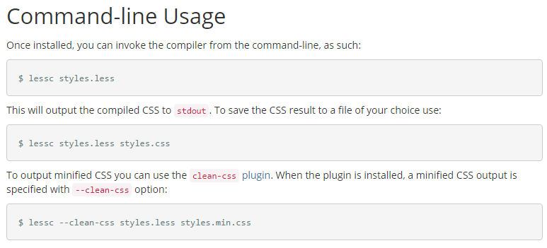
Command-line Usage

Slide 6
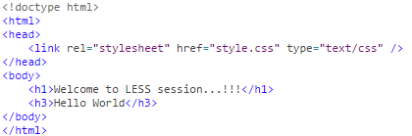
Basic Example of how this works :-
First create a file demo.html .
demo.html
Next, let's create a file style.less .

Slide 7
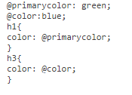
Basic Example of how this works :-
Next, let's create a file style.less .
style.less
Both the files, .html and .less should be created inside the folder nodejs.

Slide 8
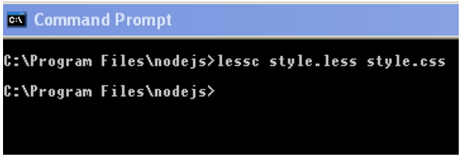
Basic Example of how this works :-
Compile style.less file to style.css by using the following command:
lessc style.less style.css
Example:

Slide 9

Basic Example of how this works :-
When you run the above command, it will create style.css file automatically.
Whenever you change the LESS file, it's necessary to run the above command in the cmd and then the style.css file will get updated.
The style.css file will have following code when you run the above command:
style.css

Slide 10

Basic Example of how this works :-
And Finally we will get output into our browser like this :
Output

Slide 11
WHAT CAN HAPPEN ON SAVE ?
Since LESS is a preprocessor, it has to be compiled into CSS before it can be used.
During this process, you can insert your own tasks to happen at the same time.
Some of this are :
  Checks for errors
  Autoprefixes for older browsers
  Combines (concats) all files into one
  Minify the code

Slide 12
Various Compiler of LESS :-
There are various methods for compiling LESS into CSS. These are as under :
  Gulp
  Command-line with Rhino
  Client Side Compile
  Via Sublime
  With Grunt
  SimpLess
  WinLess
  CodeKit

Slide 13
Using Winless Online Compiler :
Winless Online Compiler

Slide 14
Nesting in LESS
Nesting let’s you do more and write less.
Nesting allows you to cascade your CSS properties with inheriting children.

Slide 15
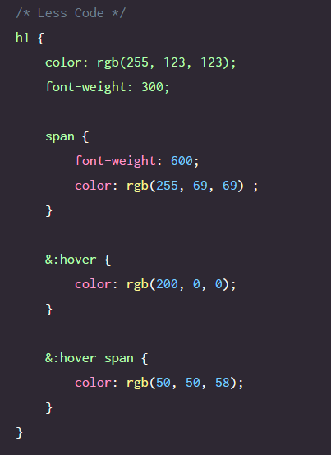
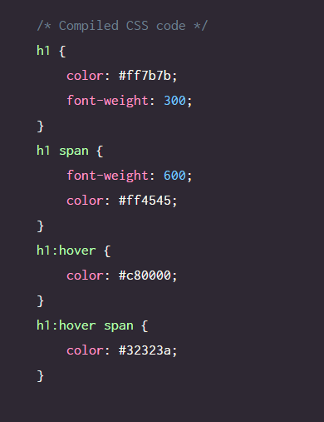
Example : Nesting in LESS
.LESS
.CSS

Slide 16
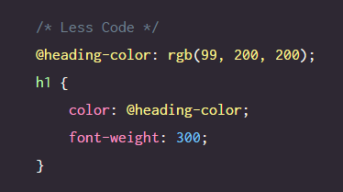
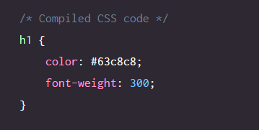
Variables in LESS
We can use variables in LESS with the preceding symbol ‘@’ followed by the variable name.
.LESS
.CSS

Slide 17
Importing in LESS
Importing works similar to regular CSS importing.
With CSS, you don’t want to do too many imports for performance reasons.
With LESS, it’s beneficial to treat them like includes.
Some of the benefits:
  Easier to collaborate with others.
  Variables are shared across imports.
  Creates a modular and dry approach to front-end development.

Slide 18
Importing in LESS
You can import .less files, and all the variables and mixins in them will be made available to the main file.
The .less extension is optional, so both of these are valid:
@import "lib.less";
@import "lib";
If you want to import a CSS file, and don't want LESS to process it, just use the .css extension:
@import "lib.css";

Slide 19
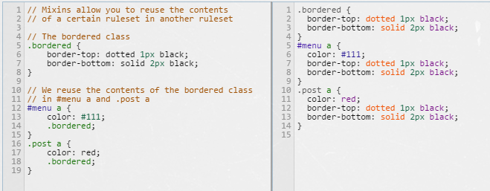
Mixins in LESS
.LESS
.CSS

Slide 20
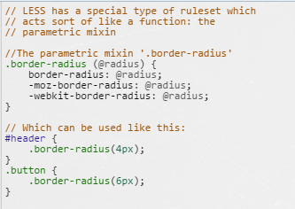
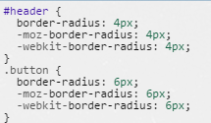
Parametric (Function) Mixins in LESS
Parametric Mixins with @radius as a parameter.
.LESS
.CSS

Slide 21
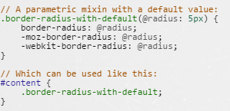

Parametric (Function) Mixins in LESS
Parametric Mixins with @radius as a parameter with default value 5px.
.LESS
.CSS

Slide 22
Mixins in LESS
Existing Libraries of Mixins :-
LESS Hat
LESS Element

Slide 23
Operations in LESS
Operations bring math and calculations to your CSS.
You can do operations on the following data types:
  A Number
  A Color
  A variable

Slide 24
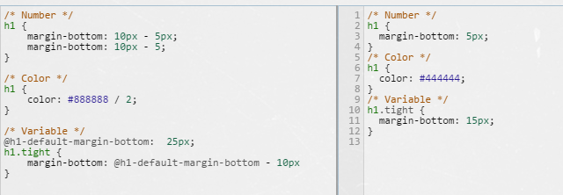
Example : Operations in LESS
.LESS
.CSS

Slide 25
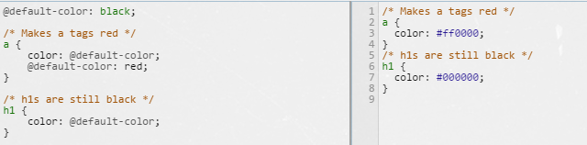
Scope in LESS
Scope is a way of saying that you can override variables on a per class basis without messing up all your global variable settings.
.LESS
.CSS

Slide 26
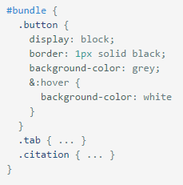

Namespace in LESS
Sometimes, we want to group our mixins, for organizational purposes, or just to offer some encapsulation we use namespace.
Example : #bundle is use as a Namespace
.LESS
Now if we want to mixin the .button class in our #header a, we can do:
.CSS

Slide 27
Namespace in LESS
Note that variables declared within a namespace will be scoped to that namespace only and will not be available outside of the scope via the same syntax that you would use to reference a mixin (#Namespace > .mixin-name).
So, for example, you can't do the following: (#Namespace > @this-will-not-work).

Slide 28
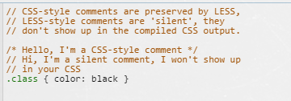

Comments in LESS
.LESS
.CSS

Slide 29
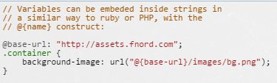

URL in LESS
.LESS
.CSS

Slide 30

Escaping in LESS
Sometimes you might need to output a CSS value which is either not valid CSS syntax, or uses propriatery syntax which LESS doesn't recognize.
To output such value, we place it inside a string prefixed with “ ~ ”, for example:
.LESS
.CSS

Slide 31
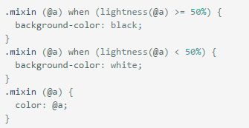
Guards in LESS
Guards are useful when you want to match on expressions.
Consider an example :-
.LESS

Slide 32

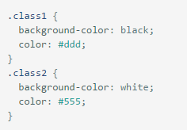
Guards in LESS
Now , if we use following code :-
.LESS
We get following output code:-
.CSS

Slide 33
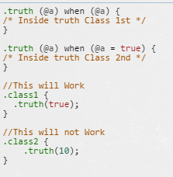

Guards Comparision Operators in LESS
The full list of comparison operators usable in guards are: >, >=, =, =<, <.
The keyword true is the only truthy value, making these two mixins equivalent:
.LESS
.CSS

Slide 34


Guards Logical Operators in LESS
Use the ‘and’ keyword to combine guards:
You can emulate the 'or’ operator by separating guards with a comma ‘,’ .
If any of the guards evaluate to true, it's considered a match:
Use the ‘not’ keyword to negate conditions:

Slide 35
Loops in LESS
In LESS a mixin can call itself.
Such recursive mixins, when combined with Guard Expressions and Pattern Matching, can be used to create various iterative/loop structures.

Slide 36
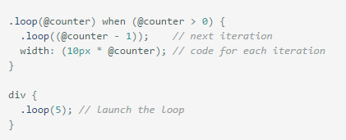
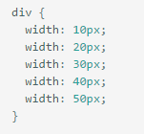
Example : Loops in LESS
.LESS
.CSS

Slide 37
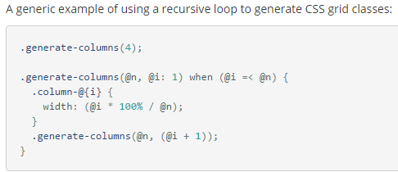
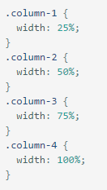
Example : Loops in LESS
.LESS
.CSS

Slide 38
Merge in LESS
The merge feature allows for aggregating values from multiple properties into a comma or space separated list under a single property.

Slide 39
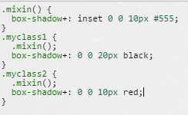

Example : Merge in LESS
.LESS
.CSS

Slide 40
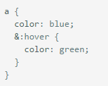
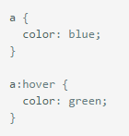
Parent Selectors in LESS
The ‘&’ operator represents the parent selectors of a nested rule.
.LESS
.CSS

Slide 41
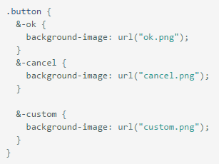
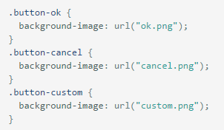
Example : Parent Selector in LESS
For example another typical use of the & is to produce repetitive class names:
.LESS
.CSS

Slide 42
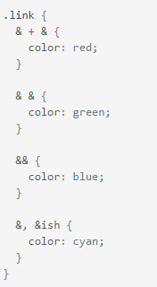
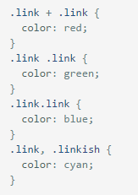
Example : Parent Selector in LESS
Multiple ‘&’ example :
.LESS
.CSS

Slide 43
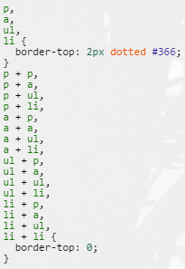
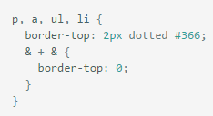
Example : Parent Selector in LESS
Combinatorial Explosion :
  ‘&’ can also be used to generate every possible permutation of selectors in a comma separated list.
.CSS
.LESS

Slide 44
Math Functions in LESS :-
Math functions includes methods which are used for performing numeric operations such as round, square root, power value, modulus, percentage etc.

Slide 45
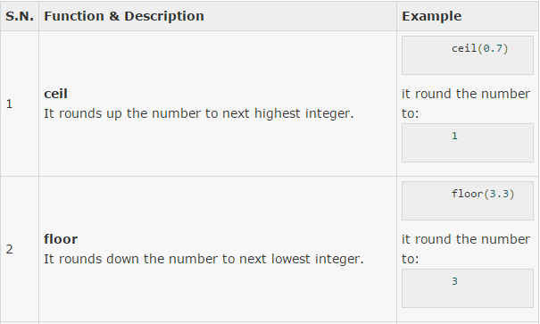
Examples : Math Functions in LESS

Slide 46
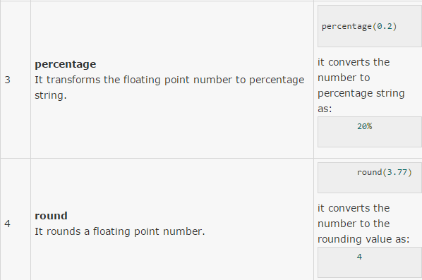
Examples : Math Functions in LESS

Slide 47
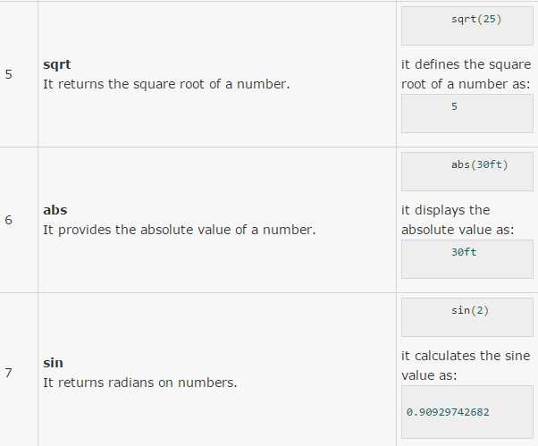
Examples : Math Functions in LESS

Slide 48
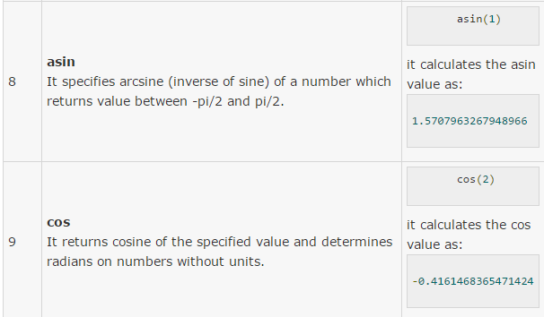
Examples : Math Functions in LESS

Slide 49
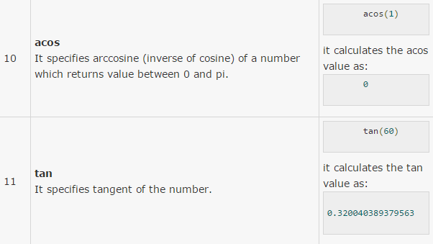
Examples : Math Functions in LESS

Slide 50
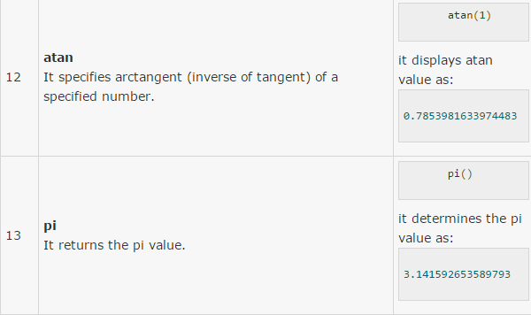
Examples : Math Functions in LESS

Slide 51
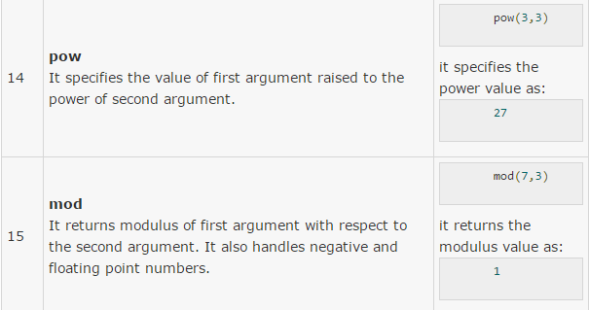
Examples : Math Functions in LESS

Slide 52
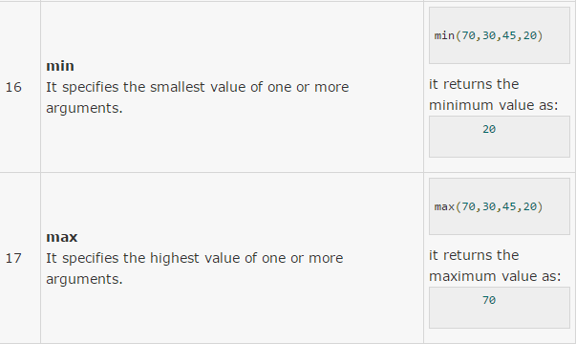
Examples : Math Functions in LESS

Slide 53
Color functions in LESS
Lighten (variable_name , Percentage)
  e.g lighten (@color , 20%)
Darken (variable_name , Percentage)
Saturate (variable_name , Percentage)
Desaturate (variable_name , Percentage)
Fadein (variable_name , Percentage)
Fadeout (variable_name , Percentage)
Spin (variable_name , Degree)
  e.g spin (@color , 10)
  e.g spin (@color , -10)

Slide 54
Color functions in LESS
We can also extract the color information like :-
  @hue: hue(@color);
  @saturation: saturation(@color);
  @lightness: lightness(@color);
Which is useful if you want to create a new colour using one or more properties from the old colour.
Create @new-color with @color's hue, and its own saturation and lightness.
  @new-colour: lighten(hue(@color), 45%, 90%);

Slide 55
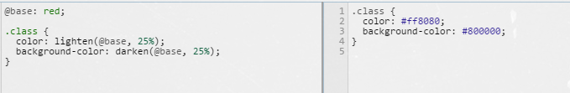
Example : Color functions in LESS
.LESS
.CSS

Slide 56
List functions in LESS
Length :-
  It will take a comma or space separated list of values as parameter and returns an integer representing the number of elements in a list.

Slide 57
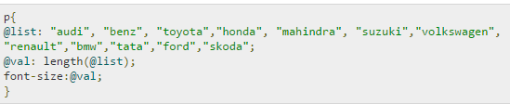

Example :- Length function in LESS
.LESS
.CSS

Slide 58
List functions in LESS
Extract :-
  It will return the value at a specified position in a list.
  It takes list as parameter.

Slide 59
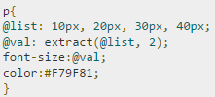

Example :- Extract function in LESS
.LESS
.CSS

Slide 60
Type Checking Functions in LESS
If you want to match mixins based on value type, you can use the ‘is’ functions:
  iscolor
  isnumber
  isstring
  iskeyword
  isurl
If you want to check if a value is in a specific unit in addition to being a number, you may use one of:
  ispixel
  ispercentage
  isem
  isunit

Slide 61

Example : Type Checking function

Slide 62
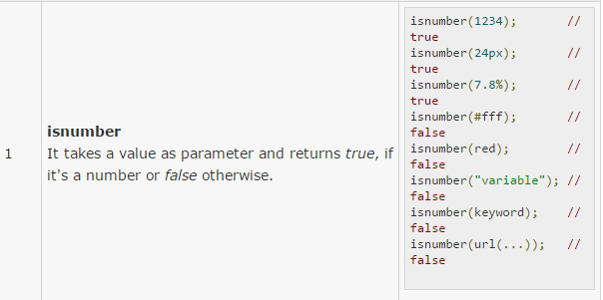
Examples: Type functions in LESS

Slide 63
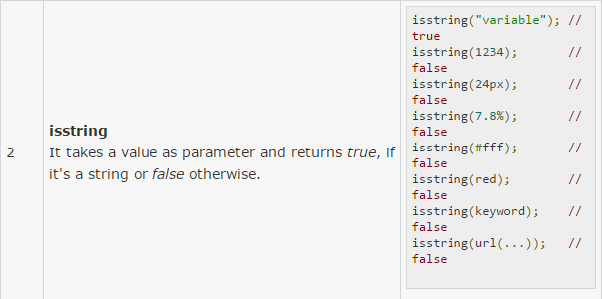
Examples: Type functions in LESS

Slide 64
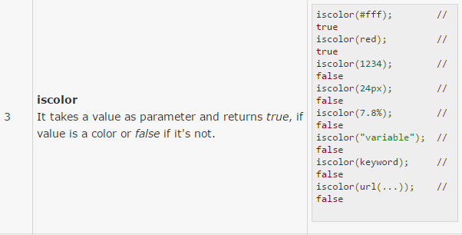
Examples: Type functions in LESS

Slide 65
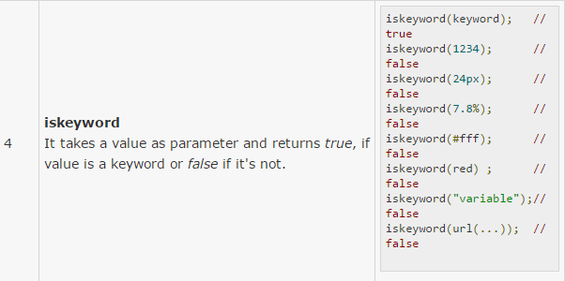
Examples: Type functions in LESS

Slide 66
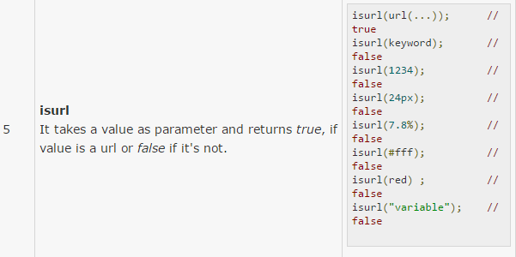
Examples: Type functions in LESS

Slide 67
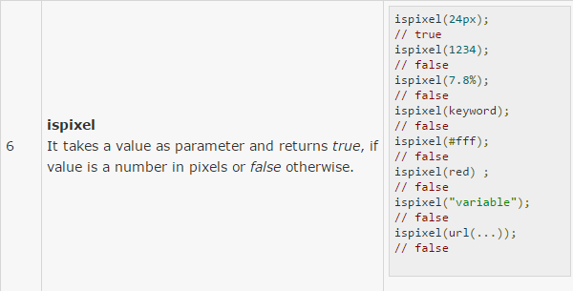
Examples: Type functions in LESS

Slide 68

Examples: Type functions in LESS

Slide 69

Examples: Type functions in LESS

Slide 70

Examples: Type functions in LESS

Slide 71

Examples: Type functions in LESS

Slide 72
MISC functions in LESS
Color :- It is a string which represents colors.
.LESS
.CSS
.style{
color:(#fe2700)
};
.style {
color: #fe2700;
}

Slide 73
MISC functions in LESS
Image-size :- It is used to examine the dimension of the image from the file.
.LESS
.CSS
body{
background-image:url("startup.jpg");
image-size:image-size("startup.jpg");
}
body {
background-image: url("startup.jpg");
image-size: 1200px 800px;
}

Slide 74
MISC functions in LESS
Image-width :- It examines the width of the image from the file.
.LESS
.CSS
body{
background-image:url("startup.jpg");
width:image-width("startup.jpg");
}
body {
background-image: url("startup.jpg");
width: 1200px;
}

Slide 75
MISC functions in LESS
Image-height :- It examines the height of the image from the file.
.LESS
.CSS
body{
background-image:url("startup.jpg");
height:image-height("startup.jpg");
}
body {
background-image: url("startup.jpg");
height: 800px;
}

Slide 76
MISC functions in LESS
Convert :- A number is converted from one unit to another.
.LESS
.CSS
body{
meter:convert(10cm, mm);
time:convert(3s, "ms");
no-unit:convert(5, mm);
}
body {
meter: 100mm;
time: 3000ms;
no-unit: 5;
}

Slide 77

2015 Survey
Source: 2015 Survey from ashleynolan.co.uk
Disclaimer: These are just responses from a small portion of developers.

Slide 78
References :
http://winless.org/online-less-compiler
http://lesscss.org/features/
https://scotch.io/tutorials/getting-started-with-less
https://www.tutorialspoint.com/less
Thank You

