Slide 1
Communicating To POS Terminal
Project

Slide 2
First , I am going to talk about this project state please.
I developed Communicating Program to a credit card reader 8 months ago
That time, I worked hourly for 3 months so I completed this project
Protocal is complex so I meet a lot of difficulty but I resolved these problems
I can show you that this program works correctly.
And I have to work on your computer remotely
My source project will be on your computer and I will debug and run on it
So I think such this.
Before main working, I will show you that my program works correctly with a credit card reader.
And You can confirm this.
At this state, I want to be payed 70% of total.
The reason is that communicating module is completed aleady and we have to make interface from your .net application to my module.
If there is my program, any developers can complete it.
So I think it’s same as 70% completed
I believe you understand for this please.
Next then, I can develop on your computer for extra part with your developer.
From that time, I want to work hourly for some days until finishing this project being payed 30%.
Please Let me know how about my opinion.
And let me know your good idea please.

Slide 3
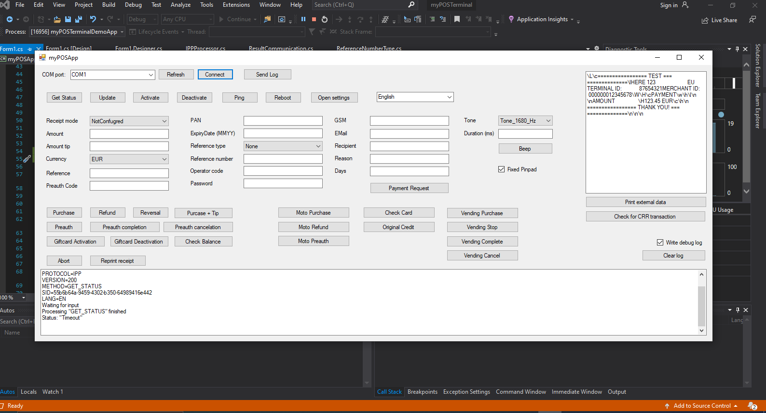
This is current project

Slide 4
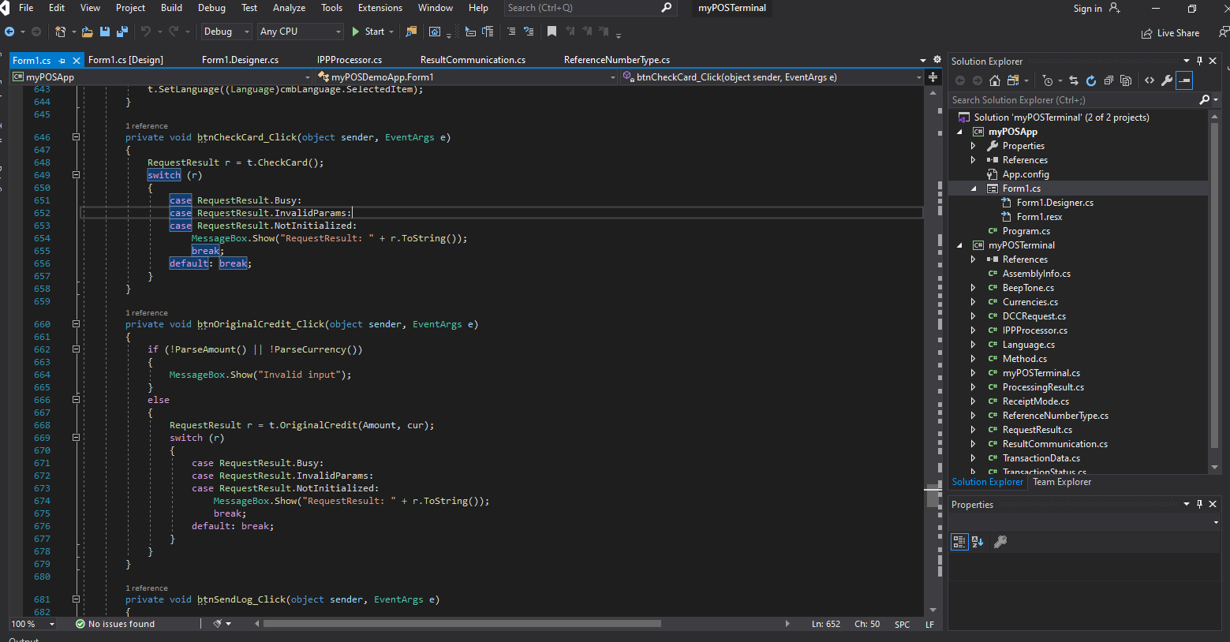

Slide 5
Finally If you are sure for me and also I am sure, I want to chat easy way on skype .
Let me know your skype id please.
Now I am glad to meet good client as I wont.
I want upfront if you can .
I will try offering excellent result.

