Slide 1
Finding Shortest Path

Slide 2
This is a table that save
x,y coordinates of every site
create table FUMAR_SITES (
SiteNumber int primary key nonclustered,
SiteName nvarchar(100),
XCoordinate int check (XCoordinate between -100 and 100),
YCoordinate int check (YCoordinate between -100 and 100)
)
Go

Slide 3
This is a procedure that generate
random numbers of site (easy)
create procedure GENERATE_N_FUMAR_SITES (@siteCount AS DECIMAL)
as begin
delete from FUMAR_SITES
insert into FUMAR_SITES select 0, 'Original Position', 0, 0
declare @siteNumber int
set @siteNumber = 1
while @siteNumber <= @siteCount begin
insert into FUMAR_SITES
select @siteNumber, 'Site #' + convert(nvarchar, @siteNumber),
100 - floor(rand()*200), 100 - floor(rand()*200)
set @siteNumber = @siteNumber + 1
end
end
go

Slide 4
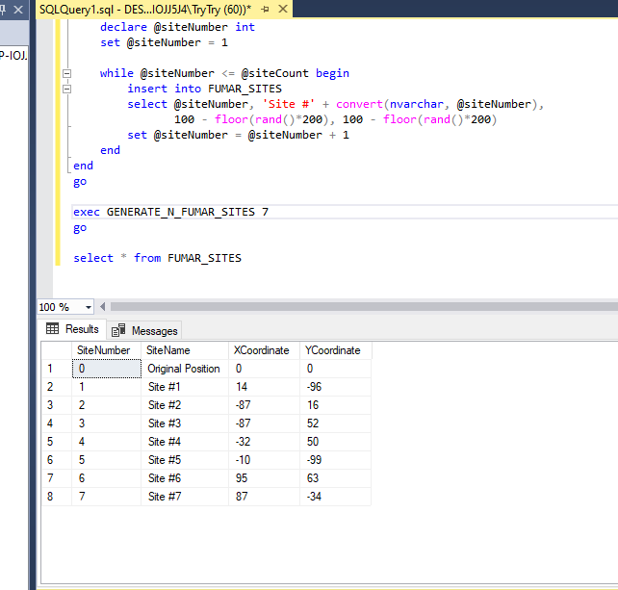

Slide 5
This is a View that shows
distance between two sites.
I used SQRT() function
create view FUMAR_PATHS (StartSite, EndSite, Distance) as
select a.SiteNumber as StartSite , -- start site
b.SiteNumber as EndSite , -- end site
SQRT(
(a.XCoordinate - b.XCoordinate) *
(a.XCoordinate - b.XCoordinate) +
(a.YCoordinate - b.YCoordinate) *
(a.YCoordinate - b.YCoordinate)
) as Distance -- formula
from FUMAR_SITES a INNER JOIN FUMAR_SITES b
ON b.SiteNumber <> a.SiteNumber -- between two points each other
go

Slide 6
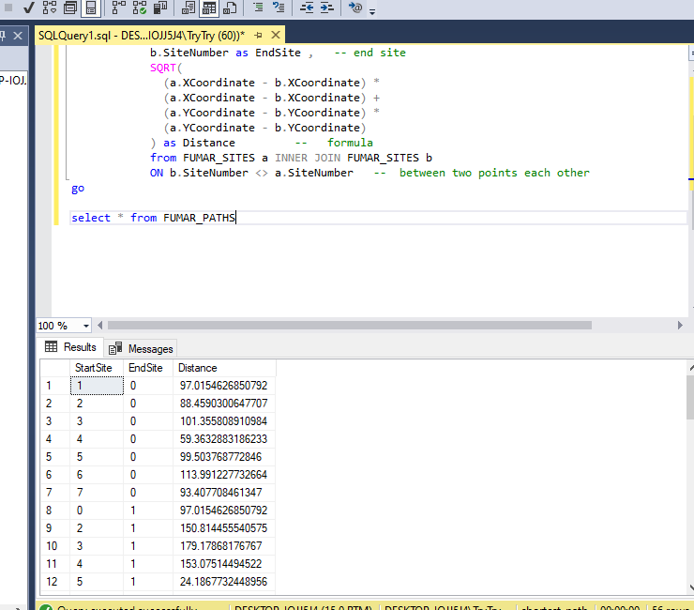

Slide 7
GET_SHORTEST_N_FUMAR_PATH
procedure
CREATE TABLE #site_counter
(
site_path_index int NULL,
site_number int NULL,
);
CREATE TABLE #nodeestimate
(
paths varchar(MAX) NULL,
distance float NULL,
);
In this part,
Temperative tables
are created.
This tables are used
for saving
Temperative data

Slide 8
This is the part that
Generates temporary
Sitenumbers for loop.
1,2,3,4,5,6
1,2,3,4,6,5
1,2,3,5,4,6
1,2,3,5,6,4
. . .
SELECT @site_count = COUNT(*)
FROM FUMAR_SITES WHERE SiteNumber <> 0
declare @loopNumber int
set @loopNumber = 1
while @loopNumber <= @site_count begin
insert into #site_counter(site_path_index,
site_number) VALUES(@loopNumber,1)
set @loopNumber = @loopNumber + 1
end

Slide 9
This is the part that
Calculates distances
Of all possible paths
And save into
#nodeestimate
table
WHILE @site_count * @site_count > @loopNumber BEGIN
. . . . . .
END

Slide 10
This is the part that
increases temporary
Sitenumbers for loop.
1,2,3,4,5,6
1,2,3,4,6,1
1,2,3,5,6,2
1,2,3,5,6,3
. . .
while @loopNumber2 <= @site_count begin
declare @temp_site int
SELECT @temp_site = site_number FROM #site_counter
WHERE site_path_index = @loopNumber2
. . . . .
set @loopNumber2 = @loopNumber2 + 1
end

Slide 11
This is the part that
Skip if there are same
Sites in one path
SET @loopNumber2 = 0
SELECT @loopNumber2 = site_number
FROM #site_counter Group By site_number
having COUNT(*) > 1
IF @loopNumber2 > 0
BEGIN
CONTINUE;
END

Slide 12
This is the part that
Calculates distance
From start site
To end site with
One path
while @loopNumber3 <= @site_count begin
SELECT @end_site_num = site_number
FROM #site_counter
WHERE site_path_index = @loopNumber3
. . .
set @loopNumber3 = @loopNumber3 + 1
end

Slide 13
And It is saved
In #nodeestimate
Table
INSERT INTO #nodeestimate(paths,distance)
VALUES(@path_str,@distance_sum)

Slide 14
Finally, shortest path
Is selected
By MIN() function
In #nodeestimate
table
select distance Distance,
DATEDIFF(millisecond, @start_time,@end_time)
ExecTime,
paths ThePath
FROM #nodeestimate
WHERE distance = (SELECT MIN(distance)
FROM #nodeestimate);

Slide 15
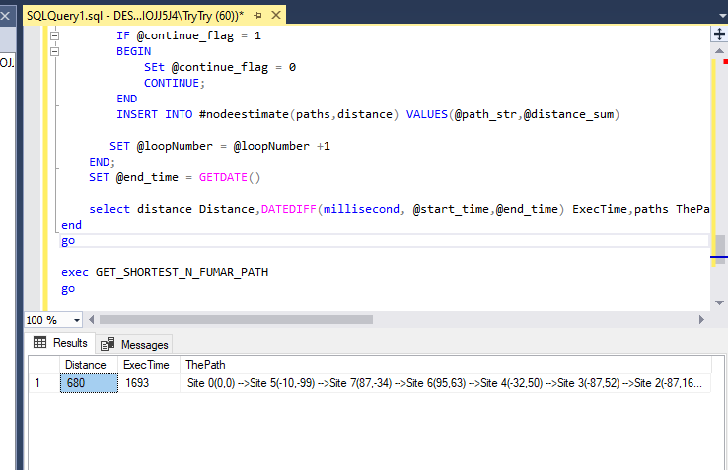

Slide 16
Thank you!

