Slide 1
CSC 361: Artificial Intelligence
Constraint Satisfaction Problems

Slide 2
Definition of CSP
Standard search problem:
A state is a "black box“ – any data structure that supports successor function, heuristic function and goal test.
CSP:
A state is defined by variables X_{i} with values from domains D_{i.} Goal test is a set of constraints specifying allowable combinations of values for variables.
The CSP formalism allows for more powerful algorithms than standard search algorithms.

Slide 3
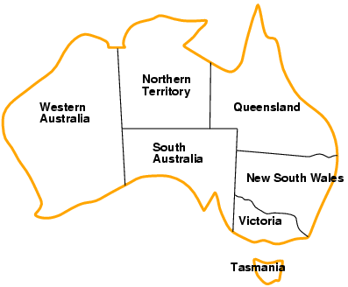
Example: map-coloring
Variables: {WA, NT, Q, NSW, V, SA, T}
Domains: D_{i} = {red, green, blue}
Constraints: adjacent regions must have different colors:
Example WA ≠ NT,
or (WA,NT) in {(red,green),(red,blue),(green,red), (green,blue),(blue,red),(blue,green)}

Slide 4
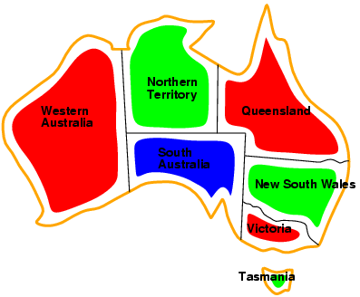
Example: map-coloring
Solutions are complete and consistent assignments. Complete assignment: all variables are assigned.
Consistent assignment: no constraint is violated.
Example: {WA = red, NT = green,Q = red,NSW = green,V = red,SA = blue,T = green}

Slide 5
Varieties of CSP
Variables can be:
Discrete:
Finite domain: the domain size is a finite number d. If we have n variables then we have d^{n} possible assignments.
Example : Boolean CSP.
Infinite domains: integer, strings etc.
Example: Job scheduling (start/end day).
Continuous:
Example: scheduling (start/end time): Scheduling for Hubble Space Telescope observations.
Can be solved using continuous optimization methods. For example linear programming.
We are concerned with discrete CSP.

Slide 6
Varieties of CSP
Constraints can be:
Unary: apply to one variable.
Example: SA ≠ green.
Binary: relate two variables.
Example: SA ≠ WA.
N-ary (or higher-order) constraints: involve 3 or more variables.
Example: Sudoku.
A CSP with n-ary constraints can always be transformed to a CSP with binary constraints → We focus on binary CSP (they may contain of course unary constraints).

Slide 7
Constraint graph
A binary CSP can be represented by a constraint graph: nodes are variables, arcs are constraints
NT
Q
WA
NSW
SA
V
T

Slide 8
Examples of CSP
Assignment problems.
Example: who teaches what class.
Timetabling problems.
Example: which class is offered when and where?
Transportation scheduling.
Factory scheduling.
Notice that many real-world problems involve real-valued variables.

Slide 9
Solving CSPs
Trivial approach:
Complete state formulation:
Path is irrelevant, so can also use complete-state formulation.
Initial state: Start with a random complete assignment (we allow for inconsistent assignments).
Actions: Change the values of one variable.
Goal test: Obtaining a consistent assignment.
We have d^{n} states.

Slide 10
Solving CSPs
Trivial approach:
Incremental formulation:
Initial state: Start with the empty assignment { }.
Actions: At each step, assign a value to an unassigned variable that does not conflict with current assignment (we do not allow inconsistent assignments)
→ fail if no legal assignments.
Goal test: the current assignment is complete.
Every solution appears at depth n with n variables → use depth-first search.
b = (n - L ) d at depth L, hence n! · d^{n} states !!

Slide 11
Backtracking search
Variable assignments are commutative:
[ WA = red then NT = green ] is the same as [ NT = green then WA = red ]
Only need to consider assignments to a single variable at each node → b = d and there are d^{n} states:
This is reasonable, since we have d^{n} assignments.
Depth-first search for CSPs with single-variable assignments is called backtracking search.
Backtracking search is the basic uninformed algorithm for CSPs: Can solve n-queens for n ≈ 25.

Slide 12
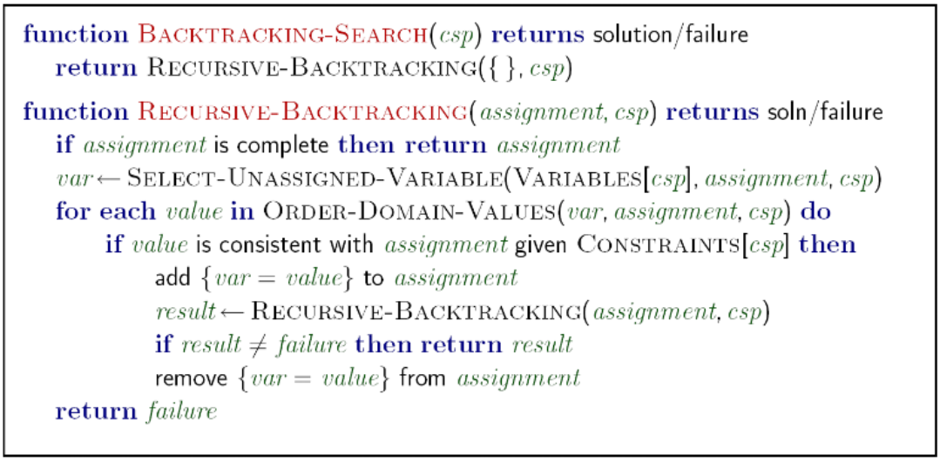
Backtracking Algorithm

Slide 13

Backtracking example

Slide 14
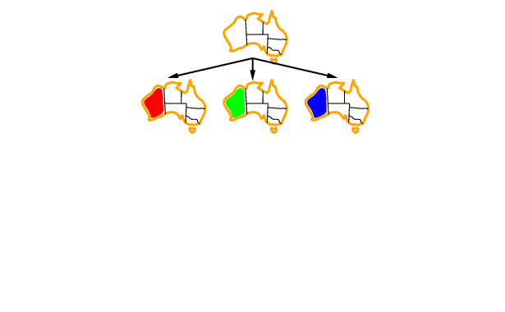
Backtracking example

Slide 15
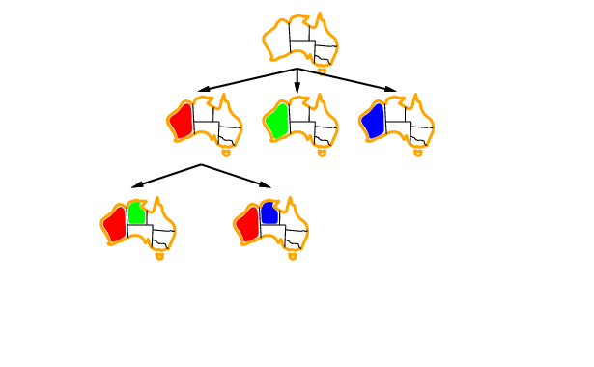
Backtracking example

Slide 16
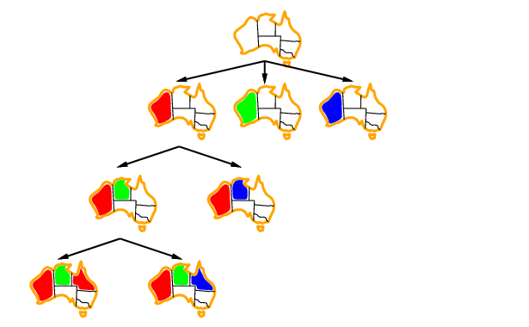
Backtracking example

Slide 17
Backtracking example (4-queens)
 |  |  | Δ
 |  |  | Δ
 |  | Δ
 |  |  | Δ
 |  | Δ
 |  |  | Δ
 |  | Δ
 |  |  | Δ
 |  | Δ
 | Δ
 |  |  | Δ
 |  | Δ
 |  |  | Δ
 | Δ
 |  | Δ
Δ
 |  |  | Δ
 | Δ

Slide 18
Solving CSPs
So far, CSP looks like any standard search problem. However, unlike standard search problems, we can do two things in CSP:
Search: try a value and check whether it leads to a solution:
Example: color WA = red, then NT = red and so on.
Infer: deduce the values of some variables from other variables.
Example : If we choose WA= red, then all neighbors can not be red because the two states are neighbors → violation of constraints. The neighbors can only be green or blue.
Solving a CSP in practice consists in interleaving search and inference.

Slide 19
Inference
The explicit representation of constraints allows us to reduce the domain of variables.
Example: WA= red → NT can only be green or blue.
Inference helps reduce the number of possibilities to explore.
Sometimes inference alone can solve the problem completely !
Different types of inference:
Node consistency.
Forward checking.
Arc consistency.
Higher order consistency: path consistency and k-consistency (not covered in this course)

Slide 20
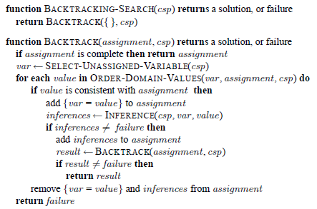
Backtracking with inference

Slide 21
Node consistency
Applicable when there are unary constraints on the variable.
This is a trivial form of inference, where we keep only the values that satisfy the constraints on the variable.
Example: WA ≠ green → the domain of WA becomes {red, blue}.
Node consistency is usually run as a preprocessing step before searching.

Slide 22
Forward checking
When we assign a variable X, we look at each unassigned variable, Y, connected to X and delete from Y’s domain any value inconsistent with X’s assignment.
If forward checking detects an inconsistency, then the current assignment is not valid.
Forward checking is used during search, and when an inconsistency is detected, the algorithm backtracks immediately without exploring the rest of tree.

Slide 23
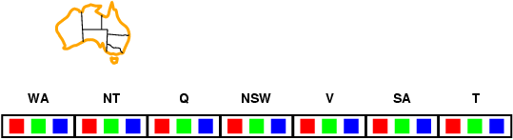
Backtracking with forward checking

Slide 24
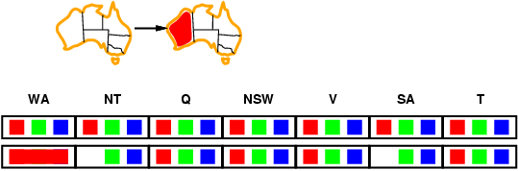
Backtracking with forward checking

Slide 25
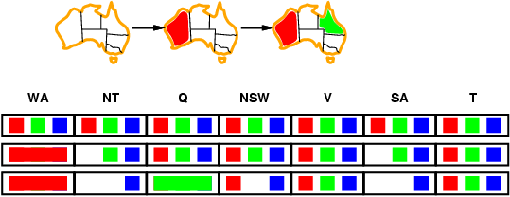
Backtracking with forward checking

Slide 26
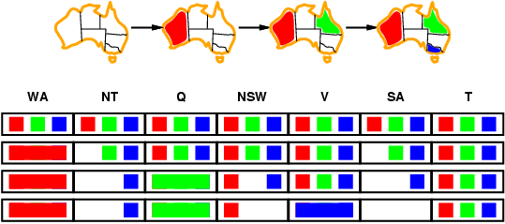
Backtracking with forward checking
SA can not be assigned →inconsistency

Slide 27
Arc consistency
Apply forward checking recursively.
Constraints are treated as directed arcs.
A constraint between X and Y is then seen as two arcs: X →Y and Y→X.
An arc X→Y is consistent if for every value of X there is a value of Y that satisfies the constraint .
Remarks:
If X→Y is consistent, Y→X is not necessarily consistent!
Arc consistency does not detect every possible inconsistency!!

Slide 28
Arc consistency
Arc consistency can be run:
During the search, or
As a preprocessing step before the search.
When used during the search, we start with the arcs ending at the newly assigned variable.
If a inconsistency is detected, the algorithms backtracks immediately.
Arc consistency detects more inconsistencies than forward checking.
Search with arc consistency inference at each step is called Maintaining Arc Consistency (MAC)
When used as a preprocessing step, we start with all the arcs of the CSP.
If an inconsistency is detected, the CSP is not solvable at all.
The AC-3 algorithm is the most widely used algorithm for arc consistency.

Slide 29
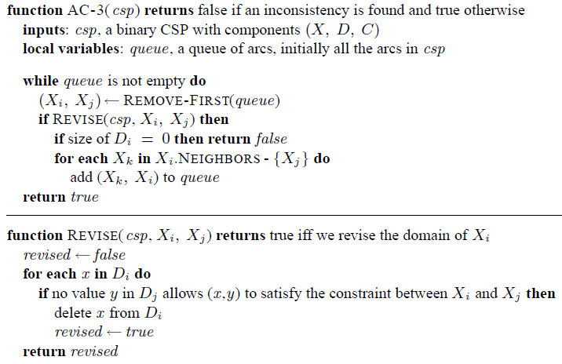
Arc consistency (preprocessing version)

Slide 30
Arc consistency
Sometimes are consitency alone can solve a CSP.
Example:
A
{1,2,3}
≠
>
C
B
{1,2,3}
{1,2,3}
<

Slide 31
Search in CSP
In standard search problems we used domain specific knowledge (heuristic functions) to improve the search.
In CSP, we can improve the search without domain –specific knowledge. We use general heuristic:
Which variable should be assigned next?
In what order should its values be tried?

Slide 32
Search in CSP

Slide 33

Variable choice
For variable, we choose the most constraining ones.
Minimum remaining values (MRV) heuristic:
Choose the variable with the fewest legal values.

Slide 34

Variable choice
Maximum degree heuristic:
choose the variable with the most constraints on remaining variable.
Tie-breaker among MRV variables.

Slide 35
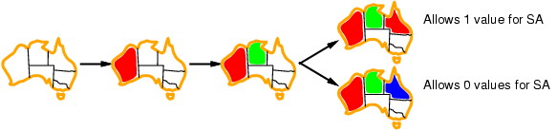
Values choice
For values, we choose the least constraining value:
the one that rules out the fewest values in the remaining variables.

Slide 36
Variable choice vs. values choice
Why for variables we choose the most constraining, whereas for values we choose the least constraining ?
Because, we need to assign all variables. If we can not assign a variable, it is better to know it early and save effort.
However, we need only one value for each variable to solve the CSP, so it is better to try the values that are more likely to work.

Slide 37
Local search for CSPs
The path to the solution is unimportant, so we can apply local search!
Hill-climbing, simulated annealing typically work with “complete" states, i.e., all variables assigned.
To apply to CSPs:
allow states with unsatisfied constraints
operators reassign variable values
Objective function: f(state) = total number of violated constraints
Variable selection:
randomly select any conflicted variable
Value selection:
choose value that violates the fewest constraints
called the min-conflicts heuristic

Slide 38
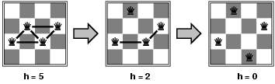
Example: 4-Queens
States: 4 queens in 4 columns (4⁴ = 256 states)
Actions: move queen in column
Goal test: no attacks
Evaluation: h(n) = number of attacks
Hill-climbing can solve even the million-queens problem in an average of 50 steps.

Slide 39
Summary
CSPs are a special kind of problems:
states defined by values of a fixed set of variables
goal test defined by constraints on variable values
Backtracking = depth-first search with one variable assigned per node.
In CSP we can do search + inference.
Inference is deducing the values of some variables from the constraints and the values of other variables.
Variable ordering and value selection heuristics help significantly.
Iterative min-conflicts is usually effective in practice

