Slide 1
How to prepare a presentation

Slide 2
Know your audience
Who would be there?
  Experts in your field
  Not expert in your field
  Students
  Non experts
  Examiners

Slide 3
Know your audience
Keep in mind
  They might be tired
  They can read
  They are thinking “Why should I listen?”
  Non-experts will tune off within 2 minutes
  Experts after 5 minutes
How to catch their attention?

Slide 4
How to catch their attention?
Start the talk with easy to understand examples
State your contribution/results early and in simple terms
Illustrate your idea with images, animations and diagrams

Slide 5
At the end of the presentation
The audience should be able to understand what the problem was and why it was important.
The audience should be able to understand your solution and how it is different/better than others

Slide 6
Where were you?
People will get lost during your talk, even those who are listening
  Show the outline in the beginning of the presentation
  Divide the presentation into sections
  Display the main steps of your approach
  Use visual clue to highlight where you are in the process of explaining your approach.

Slide 7
The skeleton
What is the problem
Motivation and goals
Relevant state of the art
Your approach/contribution.
Explain the evaluation and the results
Summarize what you just said and what you want to do next

Slide 8
Related work
Be familiar with all related work
Don’t list each paper you read
Mainly talk about results that are immediately related to what you did
Do not add references at the end of the presentation

Slide 9
Technical details: yes / no?
Select what you need to present
Use examples
  If you are running out of time remove the general case not the example
Present specific aspect that show the main part of your approach
Don’t fill up your slides with lots of equations
Prepare back-up slides to answer questions. Leave them at the end of the presentation

Slide 10
Preparing the presentation
Write clear sentences
Avoid spelling/grammar mistakes
Use animations/ images / diagrams
Use colors to emphasize some points but limit to 2 or 3
Be consistent in the choice and the use of color font size/type etc
Number your slides

Slide 11
Slide layout - Bad
This page contains too many words for a presentation slide. It is not written in point form, making it difficult both for your audience to read and for you to present each point. Although there are exactly the same number of points on this slide as the previous slide, it looks much more complicated. In short, your audience will spend too much time trying to read this paragraph instead of listening to you.

Slide 12
Slide layout – Good
Show one point at a time:
  Will help audience concentrate on what you are saying
  Will prevent audience from reading ahead
  Will help you keep your presentation focused

Slide 13
Fonts - Good
Use a decent font size
Use different size fonts for main points and secondary points
  this font is 24-point, the main point font is 32-point, and the title font is 44-point
Use a standard font like Times New Roman or Arial

Slide 14
Fonts - Bad
If you use a small font, your audience won’t be able to read what you have written
CAPITALIZE ONLY WHEN NECESSARY. IT IS DIFFICULT TO READ
Don’t use a complicated font

Slide 15
Color - Good
Use font color that contrasts sharply with the background
    Blue font on white background
Use color to reinforce the logic of your structure
    Ex: light blue title and dark blue text
Use color to emphasize a point
    But only use this occasionally

Slide 16
Color - Bad
Using a font color that does not contrast with the background color is hard to read
Using color for decoration is distracting and annoying.
Using a different color for each point is unnecessary
    Same for secondary points
Trying to be creative can also be bad

Slide 17
Background - Good
Use backgrounds such as this one that are attractive but simple
Use backgrounds which are light
Use the same background consistently throughout your presentation

Slide 18

Background – Bad
Avoid backgrounds that are distracting or difficult to read from
Always be consistent with the background that you use

Slide 19
Graphs - Good
Use graphs rather than just charts and words
  Data in graphs is easier to comprehend & retain than is raw data
  Trends are easier to visualize in graph form
Always title your graphs

Slide 20
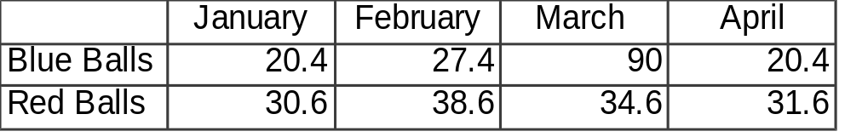
Graphs - Bad

Slide 21
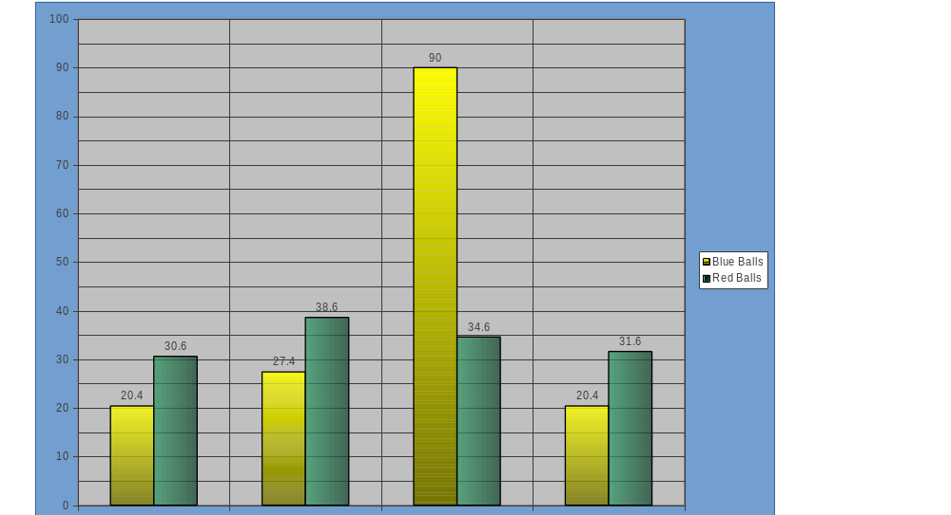
Graphs - Bad

Slide 22
Graphs - Bad
Minor gridlines are unnecessary
Font is too small
Colors are illogical
Title is missing
Shading is distracting

Slide 23
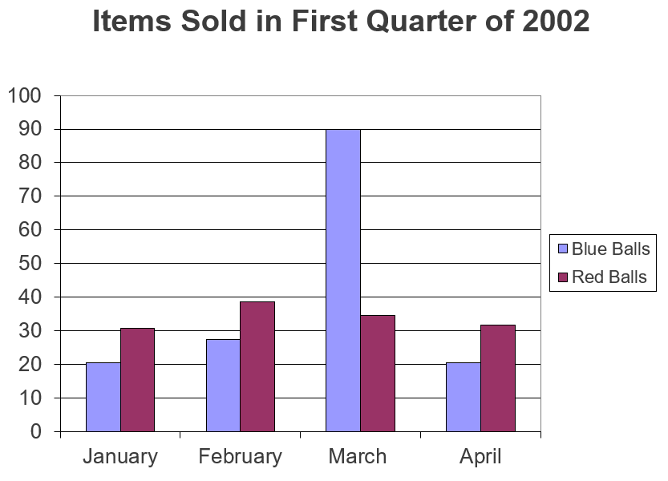
Graphs - Good

Slide 24
Preparing the presentation
Prepare the slides in advance (one week before the presentation)
Show them to friends
When you think you are done read them again
Check all animations

Slide 25
Preparing the presentation
Practice, practice, practice
  Practice in front of a mirror
  Give a practice talk to a general audience
  Give a practice talk to an audience of expert
  Time your presentation
Have backups (bring a copy of your presentation with you).

Slide 26
Delivering the talk
Be enthusiastic! If you aren’t why should the audience be?
Make eye contact with the audience
Point at the screen not the computer
Do not read directly from the PPT or your notes

Slide 27
Delivering the talk
Memorize the first couple of slides in case you go blank
Finish on time
Do not skip slides. It is really annoying to see someone doing that.

Slide 28
Handling questions
Different types of questions– handle accordingly
  Need clarification
  Suggest something
  Test you understanding
Anticipate questions (prepare additional slides)

Slide 29
Handling questions
Do not return the question to the examiner or ask him/her if there is a better way to do something.
Do not interrupt the examiner when he/she is talking.

Slide 30
How can I get better?
Practice every chance you can
Observe others
  Steal good presentation ideas
  Notice all the things that turned you off
Seek comments from friends and mentors
Remember that a good presentation will leave a good impression on your work.

