Slide 1
Web Search

Slide 2
1.Web Search Engines
amount of information on the web is growing rapidly
Year | Search Engines | Index Size (web pages)
1994 | World Wide Web Worm | 110.000
1997 | WebCrawler | 2-100 million
2017 | Google | over a billion
as well as the number of new users
Year | Search Engines | Average Number of Queries per Day
1994 | World Wide Web Worm | 1500
1997 | Altavista | 20 million
2017 | Google | hundreds of millions

Slide 3
2. Goal of Google
To address problems of quality and scalability, introduced by scaling search engine technology to such extraordinary numbers.

Slide 4
3. How Google achieves scalability
It is designed to scale well to extremely large data sets.
It makes efficient use of storage space to store the index.
Its data structures are optimized for fast and efficient access.

Slide 5
4. How Google achieves quality
It makes use of the hypertextual information. In
particular it utilizes:
the link structure of the web to calculate a quality ranking for each web page (PageRank)
anchor text to improve search results
other features such as proximity and visual presentation details (e.g. font size)

Slide 6
5. PageRank
It is a measure of a web page’s citation importance that corresponds well with people’s subjective idea of importance.
We assume page A has pages T1..Tn which point to it (i.e., are citations). The parameter d is a damping factor which can be set between 0 and 1 (usually set to 0.85). The damping factor basically says that a page cannot vote another page to be as equally important as it is. Also C(A) is defined as the number of links going out of page A. The PageRank of A is given as follows:
PR(A) = (1 - d) + d (PR(T1)/C(T1) + … + PR(Tn)/C(Tn))

Slide 7
6. Anchor Text
Most search engines associate the text of a link with the page that the link is on. In addition, Google associates it with the page the link points to.
Anchors:
often provide more accurate descriptions of web pages than the pages themselves
may exist for documents which cannot be indexed by a text-based search engine, such as images, programs and databases. This makes it possible to return web pages which have not actually been crawled.

Slide 8
Related Work
Information Retrieval
Diffreences Between the Web and Well controlled collections

Slide 9
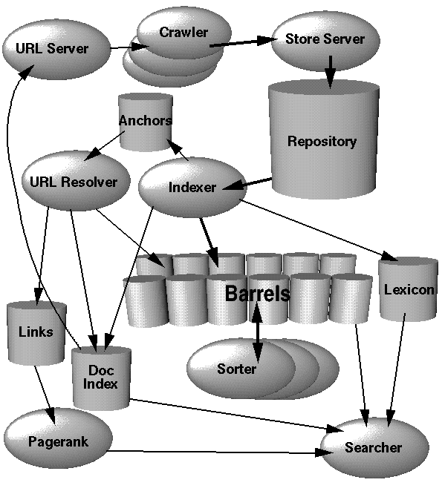
7. Google Architecture
URL Server
- sends lists of URLs to crawlers
Crawler
- downloads web pages
Store Server
- compresses & stores web pages
into the repository
Indexer
- reads the repository &
uncompresses the documents
- parses the documents
- creates forward index
- parses out the links
URL Resolver
- converts relative URLs to
absolute URLs and then to docIDs
- generates a database of links
- puts the anchor text into the barrels

Slide 10



8. Major Data Structures
BigFiles
virtual files spanning multiple file
systems which are
addressable by
64 bit integers
Repository
Document Index
Lexicon

Slide 11
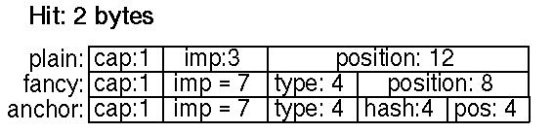
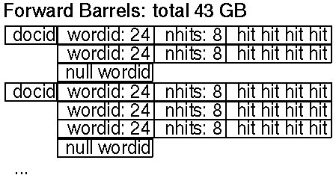
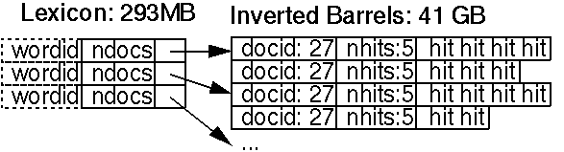
8. Major Data Structures
Hit Lists
Forward Index
Inverted Index

Slide 12
9. Major Operations
Crawling
Crawling is the most fragile application since it involves interacting with hundreds of thousands of web servers and various name servers which are all beyond the control of the system

Slide 13
9. Major Operations
Indexing
Parsing
Indexing Documents into
  Barrels.
Sorting

Slide 14
10. Google Query Evaluation
Parse the query.
Convert words into wordIDs.
Seek to the start of the doclist in the short barrel for every word.
Scan through the doclists until there is a document that matches all the search terms.
Compute the rank of that document for the query.
If we are in the short barrels and at the end of any doclist, seek to the start of the doclist in the full barrel for every word and go to step 4.
If we are not at the end of any doclist go to step 4.
Sort the documents that have matched by rank and return the top k.

Slide 15
11. Major Operations
Searching
The Ranking System
Feedback

Slide 16
9. Conclusions
Future Work
High Quality Search
Scalable Architecture
A Research Tool

Slide 17
11. Results and Performance
Query: bill clinton
http://www.whitehouse.gov/
100.00% (no date) (0K)
http://www.whitehouse.gov/
Office of the President
99.67% (Dec 23 1996) (2K)
http://www.whitehouse.gov/WH/EOP/OP/html/OP_Home.html
Welcome To The White House
99.98% (Nov 09 1997) (5K)
http://www.whitehouse.gov/WH/Welcome.html
Send Electronic Mail to the President
99.86% (Jul 14 1997) (5K)
http://www.whitehouse.gov/WH/Mail/html/Mail_President.html
mailto:president@whitehouse.gov
99.98%
mailto:President@whitehouse.gov
99.27%
The "Unofficial" Bill Clinton
94.06% (Nov 11 1997) (14K)
http://zpub.com/un/un-bc.html
Bill Clinton Meets The Shrinks
86.27% (Jun 29 1997) (63K)
http://zpub.com/un/un-bc9.html

