Slide 1
CST8219 C++ programming
Extra material
Using Nana C++ Library

Slide 2
Today’s Topics
How to compile Nana
Integrating Nana into your project
Laying out widgets & callbacks

Slide 3
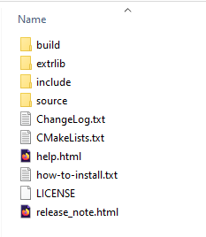
Nana
Nana is an open-source project which provides classes for implementing a graphical user interface.
It is available here: http://nanapro.org/en-us/.
If you click on the Download button, it should
download a zip file. If you unzip the folder,
you should see this:
Click on the “build” folder, and then on “vc19”
From there, click on nana.sln

Slide 4
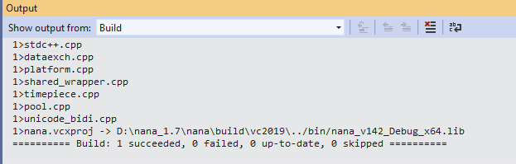
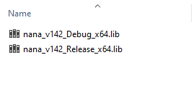
Nana solution file
This project creates a library, not a program. That means there is nothing to run or debug. You should just build this project. (ctrl+shift+b). When it finishes, you should see this:
This means it built a debug library
You should switch the build to
“Release” and build it again.
The output says that from the folder, go up one folder and look in the “bin” directory and see the libraries:

Slide 5
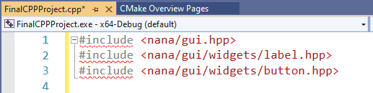
Start your final project
From Visual Studio, create a new CMake project.
Look at the main webpage for the Nana project. There should be code for a “Hello Nana c++ library” example project. Copy that source code and paste it over what visual studio generated: cout << “Hello CMake”;
You should see some errors in the .cpp file:
The problem is that Visual Studio can’t
find those files to include. You must tell
Visual Studio where those files are located. Look at where you unzipped the nana libray

Slide 6
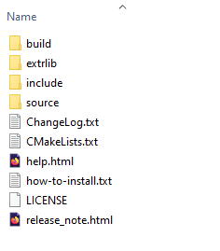
Additional includes directories
Normally software libraries have an “include” directory where they put their header files. Look at the Nana folder to find it
If you look in the “include” directory, there is a
Folder called “nana”, which also has a “gui” folder.
That’s what visual studio can’t find here:

Slide 7
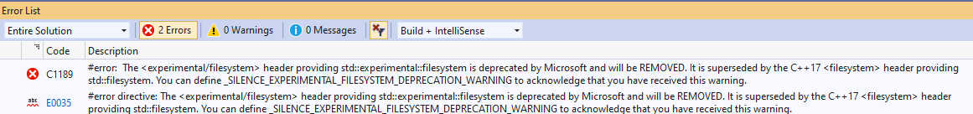
Cmake include directory
To tell visual studio to look in another folder to find include files, add this line to CMake after the “add_executable” line:
Now the errors should be fixed. If you try to build your final project, you should see this next error:
The solution is to define a build variable

Slide 8
Define variables
In CMakeLists.txt, add this line. It defines a compiler variable:
Now your project should compile fine but have linker errors:
You must include the .lib files that you compiled on slide 4. To do that, add this line but don’t include the .lib ending:
Make sure the target matches your executable target name

Slide 9
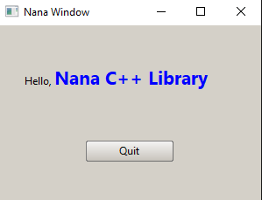
Where to find libraries
You must tell Visual Studio where to find these .lib files. The command for that in CmakeLists.txt is:
target_link_directories(FinalCPPProject PUBLIC "d:\\nana_1.7.4\\nana\\build\\bin")
Now it should compile without any more errors. You need to supply:
Where the .h files are found
Where the .lib files are found
Which .lib files to link
Now run the program and you
should see this:

Slide 10

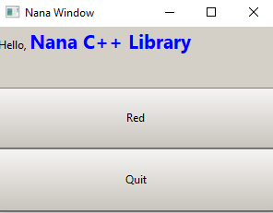
How to lay out buttons
Find the line fm.div( “vert …..); Now change that line to:
fm.div(“vert <AA>< ><BB>”); //This creates 3 slots
You should see that there is an empty row between the label and button
Create a third button in the code:
In the empty row, add a name: <AA><RED><BB>
Then in the form, add redBtn to the row “RED”:

Slide 11
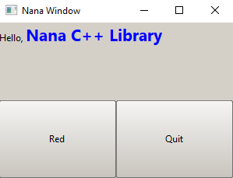
How to lay out buttons
Now change that line to:
fm.div(“vert <AA>< >”); There are 2 rows.
In the empty second row, add 2 items: <AA> < <RED> < BB > >
Now there are only 2 rows, but the second row is divided into 2:

Slide 12
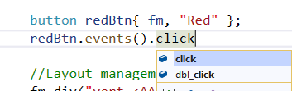

Adding mouse events to button
To add a mouse click listener, add this code to redBtn:
The .events() function returns a collection of all the events. After that, you can set what to do when a mouse is clicked:
If you want to listen for double-click, then write dbl_click instead of click:
To change a button background colour, type:
The numbers are from 0 – 255, for red, green, and blue components.

Slide 13
Changing colour
To make a colour look like it lights up, set the other colours to 50%. For instance, for red to light up, change the colour from:
color(255, 0, 0) to color(255, 128, 128)

Slide 14


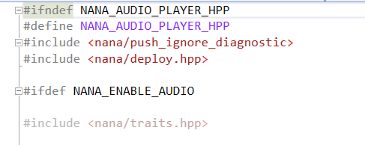
Play audio
Nana also has classes for playing .wav files:
You have to include the following files:
You will still get compile errors that the audio namespace isn’t part of nana. Look at the file player.hpp:
It says #ifdef NANA_ENABLE_AUDIO

Slide 15
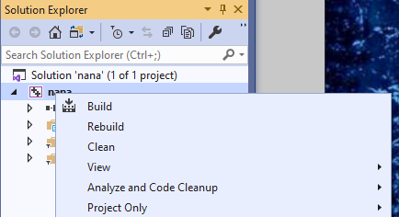
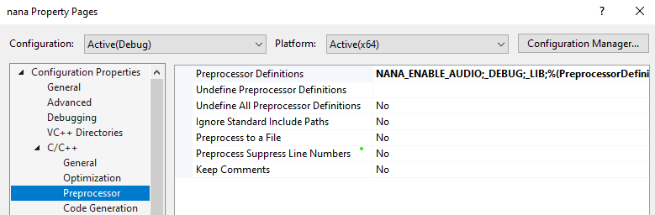
Rebuild libraries
Now if you compile, you will get linker errors about the nana audio player functions. That’s because the Nana .lib files were compiled without the NANA_ENABLE_AUDIO flag. Go back to the visual studio that has the nana project. Right-click on the top-most folder in the project view. At the bottom of the menu, select properties.
Add NANA_ENABLE_AUDIO

Slide 16
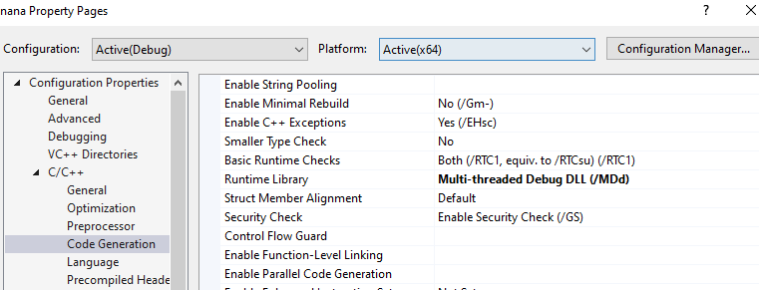
Rebuild libraries
While you have the properties window open, you should change the library’s code generation to “Multi-Threaded Debug dll so that it matches your project’s settings as well:

Slide 17

Define variable
You must tell the compiler to include audio code in your project. In CMakeLists.txt, add this:
Now when you click on a button,
tell the player object to play the file:
It won’t work yet because the .wav file isn’t in the right directory. The .wav files have to be in the same directory as your .exe file. Add the wave files in: \out\build\x64-Debug (default)
Now your button should play sounds

Slide 18


Timers
You’ll need to time how long the user is taking to click on a button. Nana has a timer object that can help you:
The milliseconds constructor tells the number of milliseconds to wait.
There is also an .elapse( ) function that takes a lambda function for what to do if you reach the end time:
The .start() function starts the timer. There is a .reset() function that restarts the timer and there is a .stop() function that stops the timer.

