Slide 1
User Manual

Slide 2
Explanation Expression()

Slide 3
1.Analyzing expression in Expression()
1)normalize expression
if input string isn’t normalized, we have to normalize it.
for example: 2 * 3+ 4 *(5 -1) – 1* 5 ->
2 * 3 + 4 * ( 5 – 1 ) – 1 * 5
String operations[] = {"(",")","+","-","*","/"};
String normalizeString = s;
for(int i=0;i<operations.length;i++)
{
String operation = operations[i];
normalizeString = normalizeString.replace(operation," "+operation+" ");
normalizeString = normalizeString.replace(" "," ");
}
normalizeString = normalizeString.trim();

Slide 4
2.Construct Expression Tree (processExpression())
This function is a recursive function. e.g. 3 * 2 + ( 2 – 1 )
void processExpression(String exp, BNode<String> node, boolean isLeft);
Param1(exp): expression sub string. e.g. 3 * 2
Param2(node): root of sub tree for splitting exp
e.g. + node
3 * 2 ( 2 – 1 )
Param3(isLeft): position of exp in sub tree if node == null , no meaning
e.g. isLeft=true -> 3 * 2, isLeft = false -> ( 2 – 1 )

Slide 5
Step 1: check full bracket pair
//step1 : check (expression)
boolean closedWithBracket = false;
if(exp.charAt(0) == '(')
{
int bracketCount = 1;
for(int i=1;i< exp.length();i++)
{
if(exp.charAt(i) == '(')
{
bracketCount++;
}
if(exp.charAt(i) == ')')
{
bracketCount--;
}
if(bracketCount == 0)
{
if( i == exp.length()-1)
{
closedWithBracket = true;
}
break;
}
}
}
//return without bracket
if(closedWithBracket)
{
this.processExpression(exp.substring(2, exp.length()-2),
node, isLeft);
return;
}
In this step, check if exp includes full bracket pair.
e.g. ( 3 * 2 – ( 2 – 1) + 4 )
if check is true
return exp without full bracket pair.
e.g. 3 * 2 – ( 2 – 1) + 4

Slide 6
Step 2: if expression is leaf, retrun at this point
//step 2 : if exp is leaf, return this only
if(!exp.contains(" ") && node != null)
{
if(isLeft)
{
BNode<String> newNode = new BNode<String>(exp,node,null,null);
node.setLeft(newNode);
}
else
{
BNode<String> newNode = new BNode<String>(exp,node,null,null);
node.setRight(newNode);
}
return;
}
e.g. if expression is 3 and isLeft=true, it becomes left leaf of param node.
and return at this point.
+ node
3 2

Slide 7
Step 3:analyze expression in order with + -, * /
int matchedBracket = 0;
for(int loopIndex = 0;loopIndex < 2;loopIndex++)
{
String operation1 = "+";
String operation2 = "-";
if(loopIndex == 1)
{
operation1 = "*";
operation2 = "/";
}
matchedBracket = 0;
step 4:
}
e.g. with + or -
+
3 * 2 ( 2 – 1 )
If no + -, with * or /
/
3 * 2 ( 2 – 1 )

Slide 8
Step 4: analyze expression
matchedBracket variable:
2 * 4 – ( 3 – 1 ) / 2 <- expression
0 0 0 0 1 1 1 1 0 0 0 <- matchedBracket state
when matchedBracket is 0 only, can split by using with + -, * /
// check bracket pair
if(exps[i].equals(")"))
{
matchedBracket++;
}
if(exps[i].equals("("))
{
matchedBracket--;
}

Slide 9
Step 5: splits expression to two parts
String left = "";
String right = "";
//get left expression
for(int j = 0;j<i;j++)
{
if(j == 0)
{
left += exps[j];
}
else
{
left += " "+exps[j];
}
}
//get right expression
for(int j = i+1;j<exps.length;j++)
{
if(j == i+1)
{
right += exps[j];
}
else{
right += " "+exps[j];
}
}
In this step, splits one expression to two parts.
e.g. 3 * 2 – ( 2 + 5 ) ->
left: 3 * 2
right: ( 2 + 5 )

Slide 10
Step 6: set new node to param node
BNode<String> newNode = null;
//root node
if(node == null)
{
try {
this.addRoot(exps[i]);
} catch (Exception ex) {
ex.printStackTrace();
}
newNode = (BNode<String>)this.root();
}
//left node
else if(isLeft)
{
newNode = new BNode<String>(exps[i],node,null,null);
node.setLeft(newNode);
}
//right node
else
{
newNode = new BNode<String>(exps[i],node,null,null);
node.setRight(newNode);
}
If param node is null, set new node to root node
If isLeft is true, set new node to left node of param node
If isLeft is false, set new node to right node of param node

Slide 11
Step 7: call recursive functon with left and right expression
In this step, analyze separated expressions with recursive function.
first, analyze left expression.
and next, analyze right expression
this.processExpression(left, newNode, true);
this.processExpression(right, newNode, false);

Slide 12
Final Flow
+
call
3 * 2 – ( 2 – 1) + 4
call
_
4
3 * 2 – ( 2 – 1)
call
_
call
3 * 2
*
2 - 1
3
2
2
1

Slide 13
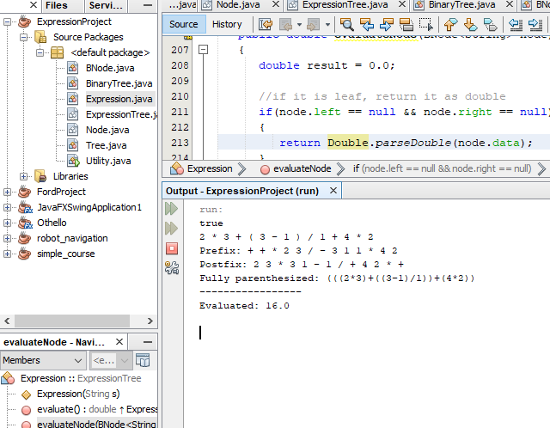

Slide 14
Explanation getFullyExpression ()

Slide 15
Get Full expression from node tree
//if it is leaf, return it
if(node.left == null && node.right == null)
{
return node.data;
}
//left expression
String left = this.getFullyExpression(node.left);
//right expression
String right = this.getFullyExpression(node.right);
//sum of left and right
return "("+left+node.data+right+")";
If node is leaf, return its data
Get left expression of node
Get right expression of node
Get sum of left exp + node data + right exp
In here, node data is a operation of +, -, * , /

Slide 16
Explanation getFullyExpression ()

Slide 17
Evaluate expression with node tree
if(node.left == null && node.right == null)
{
return Double.parseDouble(node.data);
}
//left value of node
double left = this.evaluateNode(node.left);
//right value of node
double right = this.evaluateNode(node.right);
//calculate with left and right
if(node.data.equals("+"))
{
result = left + right;
}
else if(node.data.equals("-"))
{
result = left - right;
}
else if(node.data.equals("*"))
{
result = left * right;
}
else if(node.data.equals("/"))
{
result = left / right;
}
return result;
If param node is leaf, return node value itself
Evaluate left expression of node
Evaluate right expression of node
Evaluate with left, right and operation
Result = left + opreraion + right

Slide 18
Technology

Slide 19
Analizing expression technology
Example expression: (3 * 2 – 6) / ( 4 -1 ) + 4 * 2
priority of operation : () * / + -
in here one expression, I will name thease chunk.- (3 * 2 – 6) , ( 4 -1 ) ,4,2
- I splitted expression with following method.
1.with + or - , from last I repeated it until not having + or -
(3 * 2 – 6) / ( 4 -1 ) + 4 * 2
so I can get sub expressions without +,- (it means with chunks)
2.with * or / , from last
(3 * 2 – 6) / ( 4 -1 )
4 * 2
3.if expression encolosed with bracket pair, remove it
(3 * 2 - 6) -> 3 * 2 - 6

Slide 20
Construct recursive function
I decided recursive function following above.
In each analyze method, expression type is same.
So I can call recursive function for analyzing expression

