Slide 1
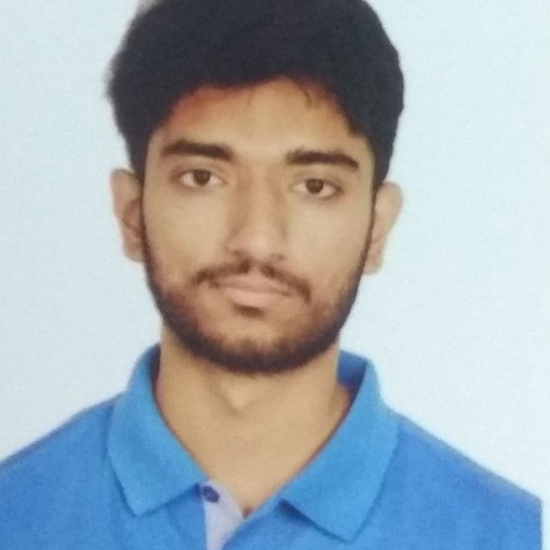





About
Undergraduate Student of Computer Science & Engineering discipline at Khulna University of Engineering & Technology (KUET). Interested in problem solving, designing and developing. Looking to build a career that enhances my skills and is challenging at the same time.
Projects
Md Sakib Hasan
Alaap – A Chatting Application | Link
Built with Android (java) , Firebase Cloud Messaging, FireStore Database
Library Management System| Link
Web Project built HTML, CSS,C#, JavaScript and ASP.net
Cardiac Recorder| Link
Android Project built in a collaborative manner
Library Management Database Project| Link
Database Project built with Oracle SQL
Digital Smart Meter| Link
Peripheral Project built with Arduino
+88 01846303458
sakibhasantopu646@gmail.com
Chalkfarid, Colony, Bogura Sadar, Bogura-5800, Bangladesh
Topu646
Md Sakib Hasan
Technical Skills
EDUCATION
Front End | HTML, CSS, Javascript
Back End | Java, Python, C++, Asp.net, C#
Developer Tools | Git, Pycharm, Android Studio, VSCode, Vim
App Development | Java, Flutter
MS Office and Document Processing | MS Word, Powerpoint, Excel
BSc. In Computer Science & Engineering| 2019 -
Khulna University of Engineering & Technology, Khulna
Result: CGPA 3.61 out of 4.00 (After 3-2)
Higher Secondary Certificate | 2019
Govt. Azizul Haque College, Bogura
Result: GPA 5.00 out of 5.00
Secondary School Certificate | 2017
Bogra Zilla School, Bogura
Result: GPA 5.00 out of 5.00
SKILL HIGHLIGHTS
Project management
Strong decision maker
Complex problem solver
Creative design
Innovative
Service-focused
References
Mr. X | Professor, Department of Computer Science & Engineering, KUET
Mr. Y | Assistant Professor, Department of Computer Science & Engineering, KUET

