Slide 1
Decoding Hotel Bookings: EDA and Visuals
Presented by Moslim Eldawi

Slide 2
Statement
Cancellation
Correlation
Loyalty
Seasons
Insights
agenda

Slide 3
Turning Data into Revenue Growth
My analysis of 30,000 + hotel bookings reveals surprising patterns in cancellations, revenue opportunities, and customer loyalty. Let's explore how data can help boost profits and reduce losses.

Slide 4
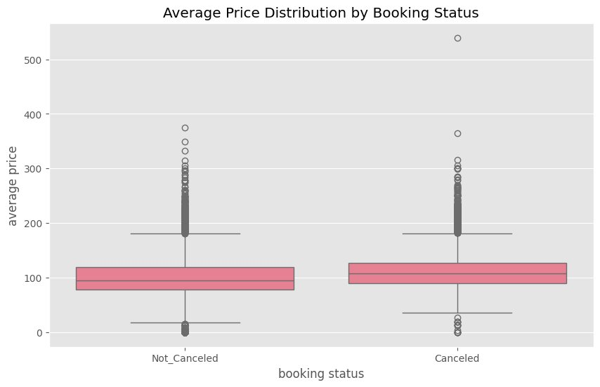
Cancellation Problem
Why 30% of Bookings Disappear"
Nearly one-third of all reservations get canceled, costing significant revenue. The biggest culprits? Guests who book far in advance (47 days on average) and those paying higher room rates. Premium Room Type 4 sees the most cancellations at 38%, suggesting we need better strategies for these valuable bookings.
Fig. 1.1
Higher or lower price doesn’t seem to influence whether someone cancels or not.
.

Slide 5
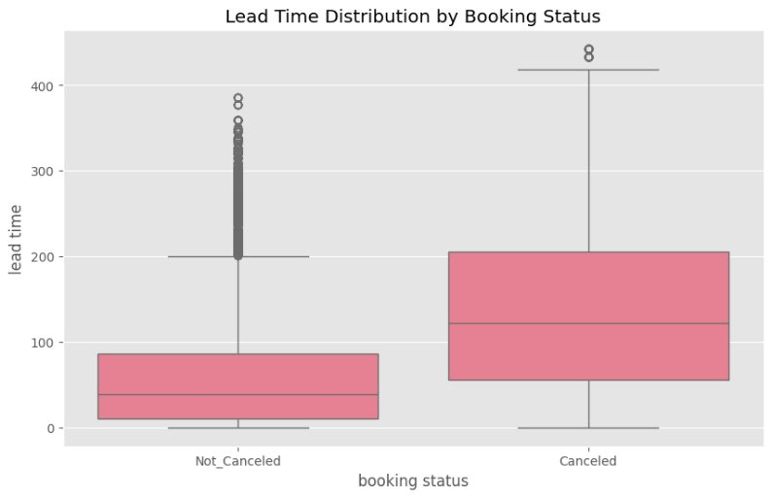
Fig. 1.2
This boxplot, displaying the distribution of data of booking status in relation to price, shows that guests who book way in advance are more likely to cancel

Slide 6
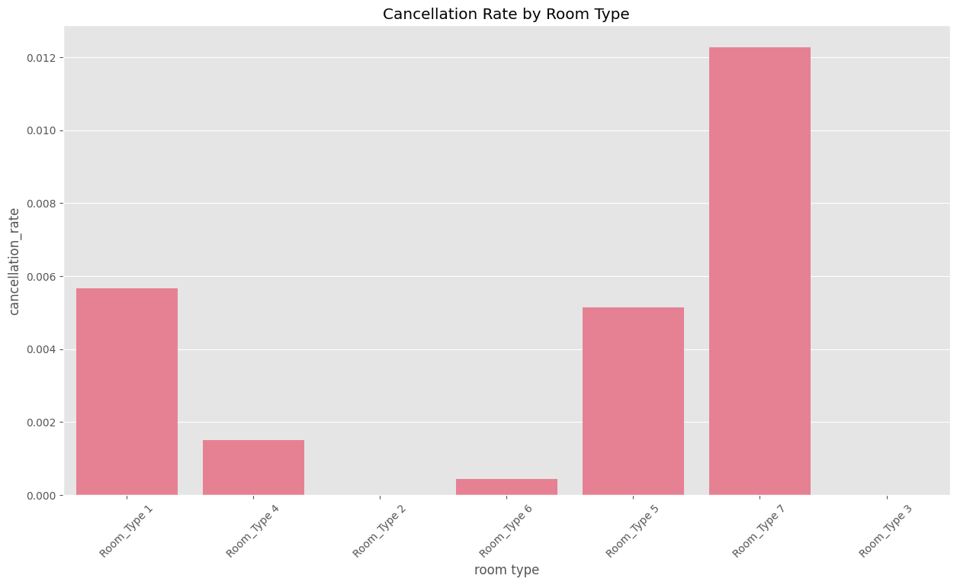
Fig. 1.3
Room 7 stands out with the highest cancellation rate, followed closely by Room 1 and Room 5.
This could indicate an issue with the room or another underlying reason.

Slide 7
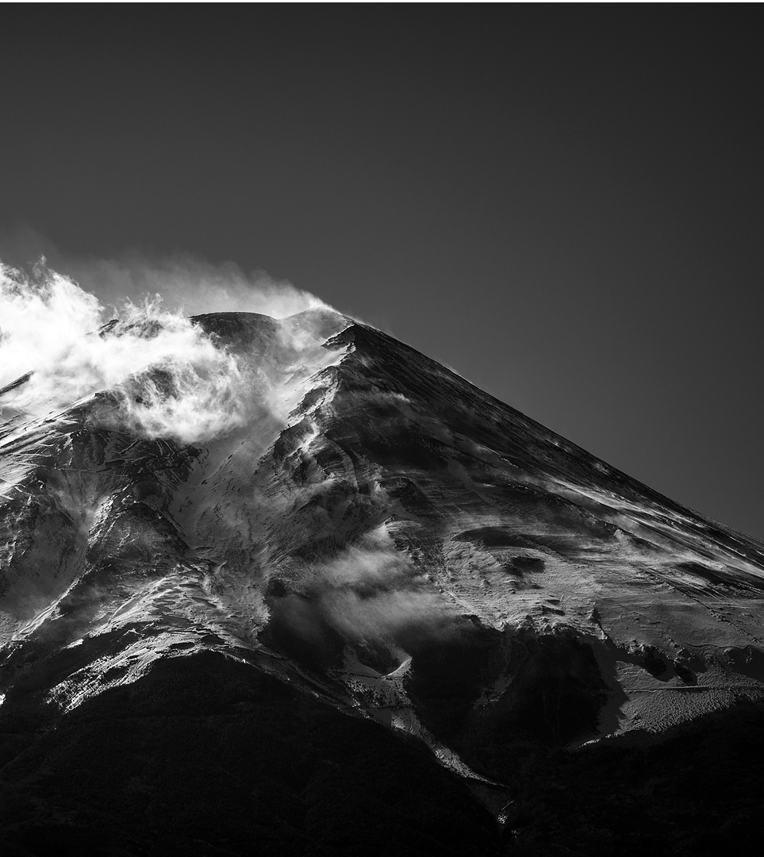
CORRELATION ANALYSIS

Slide 8
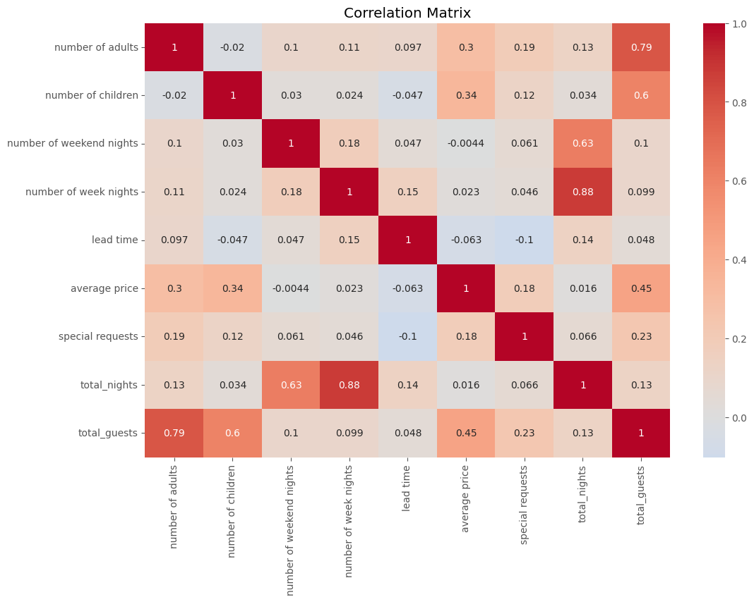
CORRELATION MATRIX
Fig. 2.1
Each cell at the intersection of a row and a column contains a correlation coefficient. This number ranges from -1 to +1.
KEY INSIGHTS
1- average price and number of children (0.34): Moderate positive correlation. Similar reasoning to adults, more children can also increase the overall price
.
2- special requests and lead time (-0.1): Weak negative correlation. This might indicate that people who book further in advance tend to have slightly fewer special requests

Slide 9

Loyalty Advantage
Repeat Guests Cancel 30% Less
Only 18% of our bookings come from repeat customers, but these loyal guests cancel just 22% of the time versus 32% for first-timers. Imagine the impact if we could double our repeat guests through a simple loyalty program with room upgrades or dining perks.

Slide 10
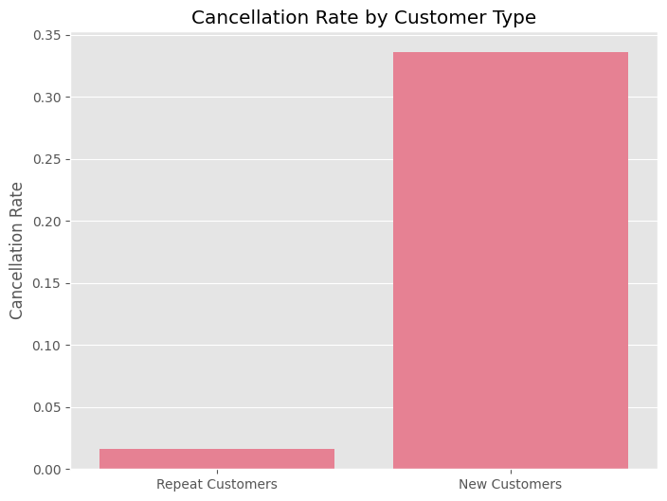
Quote
Cancellation rate by customer type.
Fig. 3.1
The most striking insight is that New Customers have a drastically higher cancellation rate compared to Repeat Customers.
The cancellation rate for New Customers is approximately 0.34 (or 34%).
The cancellation rate for Repeat Customers is very low, approximately 0.015 (or 1.5%).

Slide 11
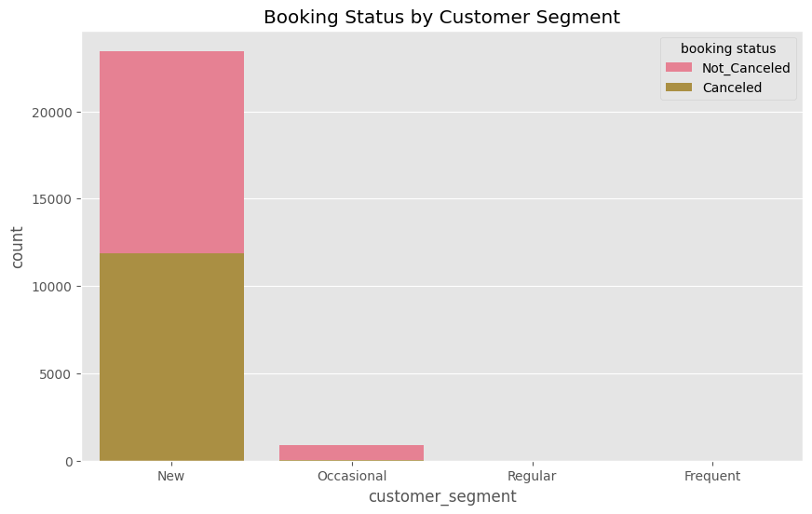
Quote
BOOKING by customer type.
Fig. 3.2
This chart highlights that the hotel primarily caters to "New" customers, and this segment is the main source of both confirmed bookings and, critically, cancellations. The other customer segments ("Occasional", "Regular", "Frequent") have a very low representation in the booking data.

Slide 12
February's Risk, October's Reward
Our data shows clear seasonal patterns - February suffers the highest cancellation rates (33%) while October brings our highest occupancy (9.8% of annual bookings). This suggests we should offer non-refundable winter deals and create premium autumn packages to maximize revenue.
Seasonal Opportunities

Slide 13
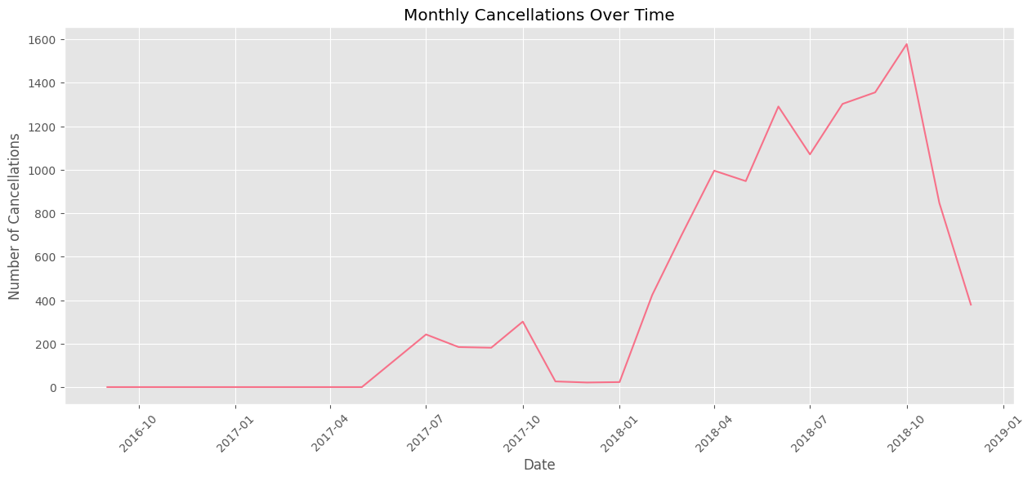
Monthly Cancellations Over Time
Fig. 4.1
The hotel experienced a significant and escalating problem with cancellations throughout 2018, reaching its peak towards the end of that year before a sharp decline. The period before 2018 had very low cancellation volumes. This data would be crucial for a hotel to investigate the causes of the surge in cancellations during 2018.

Slide 14
KEY INSIGHTS
 | INSIGHT 1 | INSIGHT 2
FEATURE
Overall Cancellation Rate | 32.78%
Most Popular Room Type | Room_Type 1
Canceled bookings | -80.32 more days lead time on average | $10.66 lower on average
Most Common Booking Channel | Online
Month with Highest Cancellations | 10 / OCTOBER (1880 cancellations)

Slide 15

Thank you
MOSLIM TAMER ELDAWI
Moslimtamer@gmail.com

