Slide 1
Task 2
Submitted by: Mohamed Elshamy Malak Abdelmonem John Shoukry

Slide 2
Introduction
This is a data for a hotel That shows us the Booking if its canceled or not

Slide 3
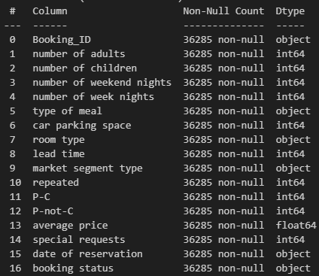
Data Loading & Initial Inspection

Slide 4
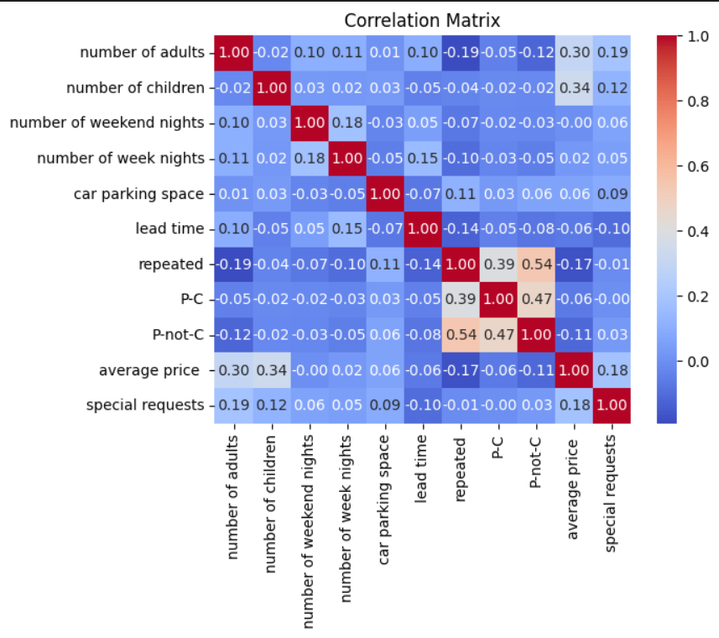
Checking Multicollinearity

Slide 5


Renaming Columns for Clarity

Slide 6
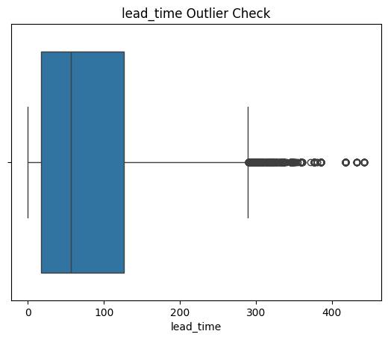
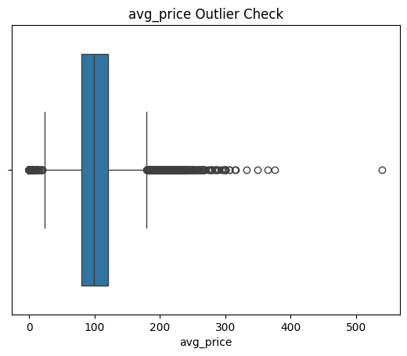
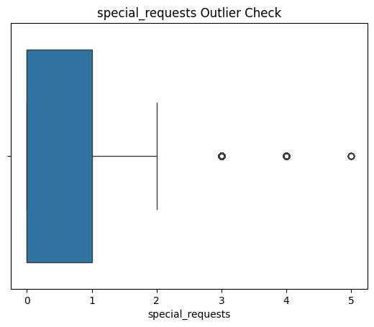
Outlier Detection & Visualization

Slide 7
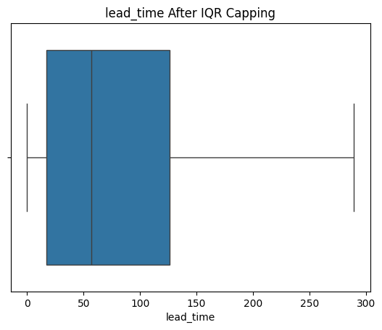
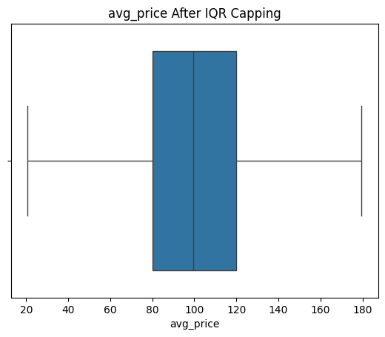
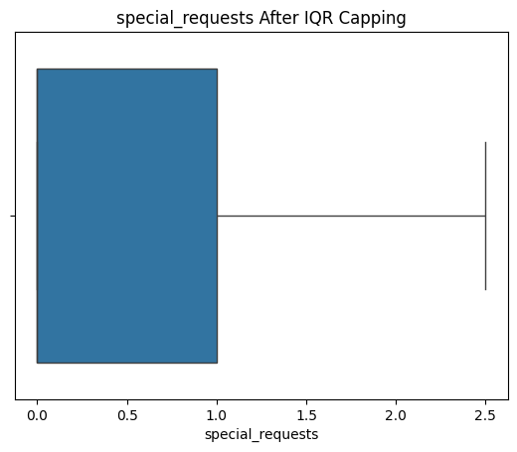
Outlier Handling (IQR Capping)

Slide 8
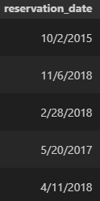
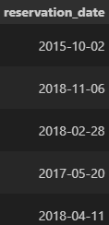
Date Transformation And Unnecessary Features removal

Slide 9
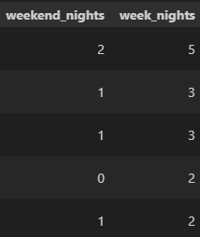

Feature Engineering

Slide 10
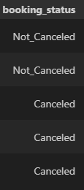
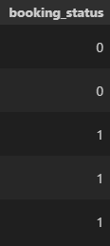
Target Encoding

Slide 11
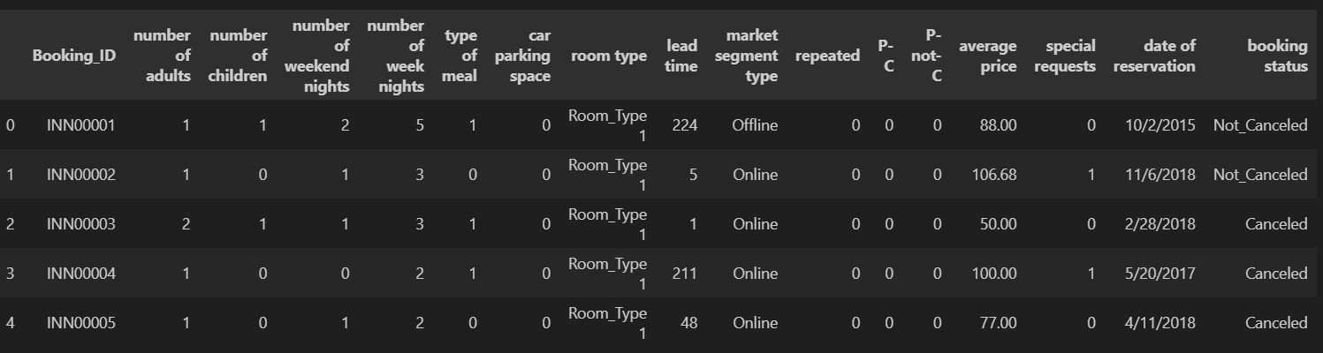
Categorical Feature Transformation
Assuming Meal types are ordered by Price

Slide 12
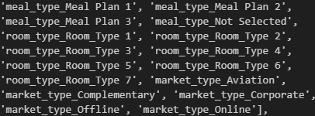
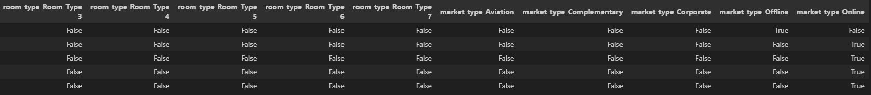
Categorical Feature Transformation

Slide 13
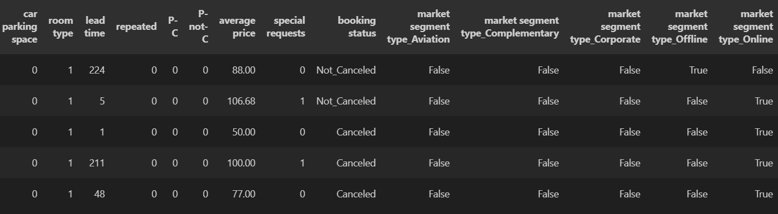
Categorical Feature Transformation

Slide 14
Thank You

