Slide 1
Model Building Trips Dataset
Soha Ashraf Eltokhy
Eslam Ebrahim khalil

Slide 2
Dataset Description:
User_ID: A unique number for each user.
User Name: The user's name.
Driver Name: The driver's name.
Car Condition: Whether the car is in good or bad condition.
Weather: The weather condition winter, windy, sunny.
Traffic Conditions: Whether traffic is congested or normal.
Key: A unique number for each trip
Fare Amount: The trip fare.
Pickup Datetime: The time when the passenger requested.
Pickup Longitude & Latitude: The (passenger’s location.
Drop-off Longitude & Latitude: The destination location, where the passenger was dropped off.
Passenger Count: The number of passengers in the car.
JFK, EWR, LGA Distance: The distance between the pickup location and these airports.
SOL Distance: The distance from the Statue of Liberty.
Distance: The trip distance.
Bearing: The trip direction from start to end, measured in angles.

Slide 3
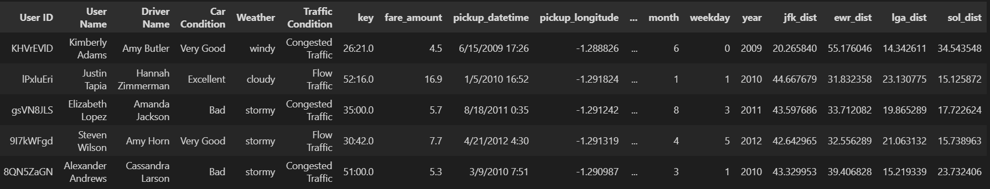
Dataset Overview:
Figure: Sample of the Dataset.

Slide 4
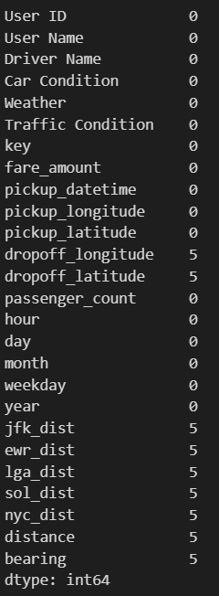
Data Cleaning and Preprocessing:
There is no duplicated values.
There is missing values in: ‘jfk_dist’, ‘ewr_dist’, ‘lga_dist’, ‘nyc_dist’, ‘distance’, ‘bearing’ columns.
Converting to ‘pickup_datetime’ to datetime data type.
Divide 'pickup_datetime’ to ‘month’, ‘day’, ‘weekday’, ‘hour’, and ‘year’.

Slide 5
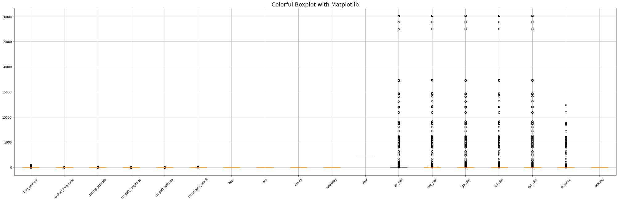
Dealing with Outliers:

Slide 6
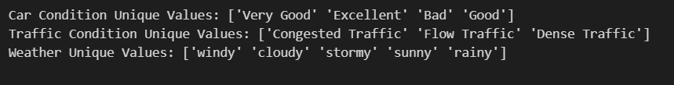
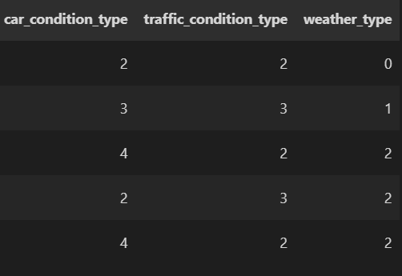
Data Encoding:
Categorical Columns Encoded:
- ‘Car Condition’.
- ‘Traffic Condition’
- ‘Weather’

Slide 7
Used Models:
Linear Regression.
Random Forest Regressor.
Train-Test Split : 80/20

Slide 8
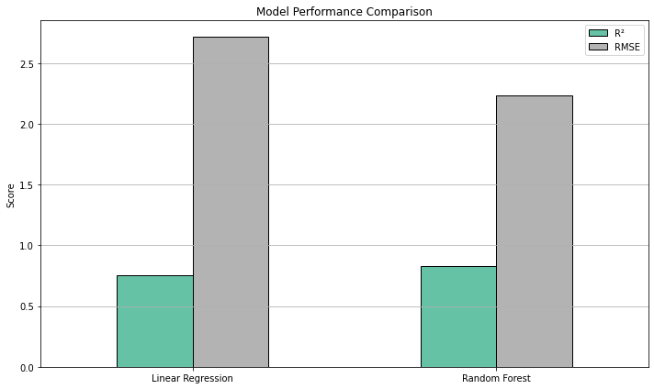
Model Comparison:

Slide 9
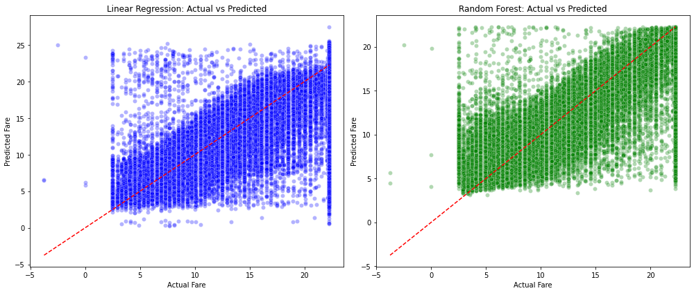
Model Comparison:

Slide 10
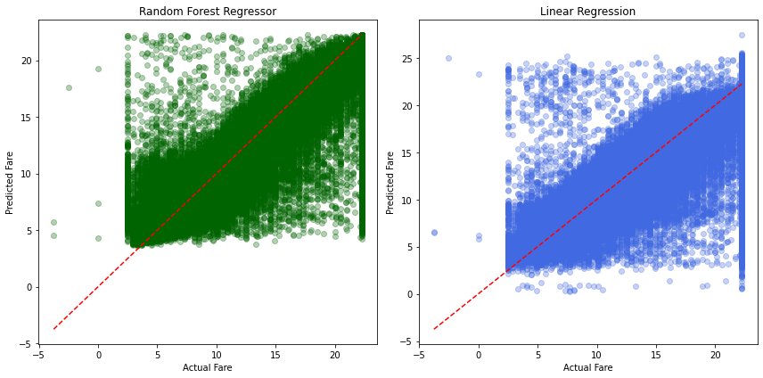
After Applying Hyperparameter for Random Forest regressor

Slide 11
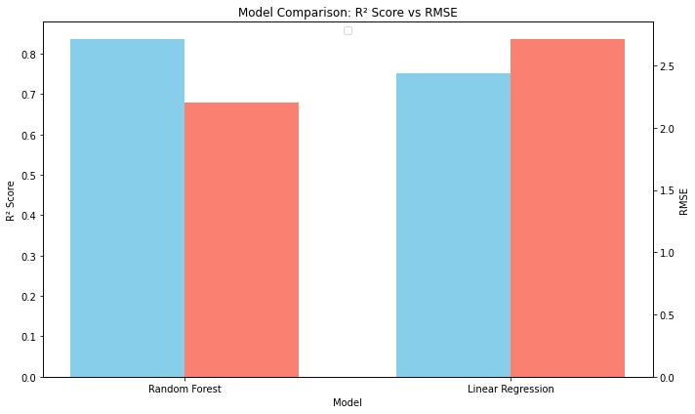
After Applying Hyperparameter for Random Forest regressor

Slide 12
Result:
Hyperparameter tuning significantly improved Random Forest’s performance, it led to:
Better generalization (higher R²).
More accurate predictions (lower RMSE).

Slide 13
THANK YOU

