Slide 1
Remaining Useful Life Prediction

Slide 2
Outline
Maintenance Strategies Comparison
Applications
Experiment Structure
Data Preprocessing
Modeling
Conclusion & Future Work

Slide 3

Maintenance Strategies Comparison
Fail
Corrective Maintenance (CM)
Maintenance after failure
Fail
Preventive Maintenance (PM)
Regular Maintenance
Find anomaly
Fail
Condition Based Maintenance (CBM)
Maintenance before failure
(Not consider RUL)
Find anomaly
Fail
Predictive Maintenance (PdM)
Maintenance before failure
(Consider RUL)
Source: Ran, Y., Zhou, X., Lin, P., Wen, Y., & Deng, R. (2019). A survey of predictive maintenance: Systems, purposes and approaches. ArXiv preprint ArXiv:1912.07383.
Use ML/DL model to predict RUL to maintenance at the most appropriate time.

Slide 4
Maintenance Strategies Comparison
Strategy | Benefits | Challenges | When to use?
CM | Maximum capacity utilization No maintenance cost | Unexpected downtime Potential damage to equipment Higher maintenance cost | Repetitive, standard or non-critical equipment Lower maintenance costs after machine downtime
PM | Reduce equipment failure and unplanned downtime Lower maintenance cost | Anticipated rise in downtime Equipment in good condition is still maintained | Probability of failure increases with cycle time or usage time (mileage)
CBM | Immediate detection of equipment abnormalities and maintenance treatment to reduce unplanned downtime | IT infrastructure setup, including sensors on the device side and data and analysis systems on the back end | Very critical equipment
PdM | Comprehensive Device Health avoid run-to-failure Save the most cost | Including challenges and difficulties of CBM With front-end sensing and back-end data analysis, the factory operation system will be more complex | Cost-effective failure mode prediction through monitoring and data collection
Source: 李家岩、洪佑鑫（2022）。製造數據科學：邁向智慧製造與數位決策。新北市：前程文化。
Notes:
表13.1

Slide 5
Applications
Author | Year | Source | Paper Name | Problem | Methods | Application Field
Che, C. et al. | 2019 | Aerospace Science and Technology | Combining multiple deep learning algorithms for prognostic and health management of aircraft | PHM | PHM model combining DBN and LSTM is proposed for condition assessment, fault classification, sensor prediction, and RUL estimation of aircraft | Aircraft
Chen, C. et al. | 2019 | Procedia CIRP | Automobile maintenance prediction using deep learning with GIS data | PHM | Data-driven predictive maintenance framework Integration with data collected by GIS system DNN Model | Predictive Maintenance in Automobile Industry
Grosso, L. A. et al. | 2020 | International Journal of Prognostics and Health Management | Development of Data-driven PHM Solutions for Robot Hemming in Automotive Production Lines | PHM | Data-driven predictive maintenance framework Production line in-service PHM with LSTM ANN and particle filtering Wave Cycle Recognition | Production Line Related to Robot Hemming
Lim et al. | 2021 | IEEE | Prognostics and Health Management of Wafer Chemical-Mechanical Polishing System using Autoencoder | PHM | Autoencoder | Semiconductor Manufacturing
PHM is widely used in highly automated manufacturing fields such as aviation industry, automobile industry, semiconductor, etc.

Slide 6
Experiment Structure
Data Exploratory
Data Preprocessing
Visualization
Data Cleaning
Feature Engineering
Feature Scaling
Stratified Sampling
Histogram
Line Chart
Modeling
Evaluation
BiLSTM
MAE

Slide 7
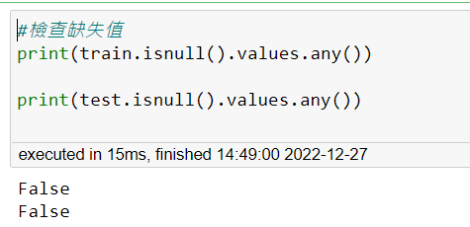
Data Preprocessing—Check Missing Values

Slide 8
Data Preprocessing—Drop Redundant Columns
The following columns are dropped because they contain the same value.
'setting1, 'setting2', 'setting3', 'setting4', 'setting5', 'setting6', 'setting7', 'setting10', 's4', 's8', 's18', 's24', 's26', 's27'

Slide 9
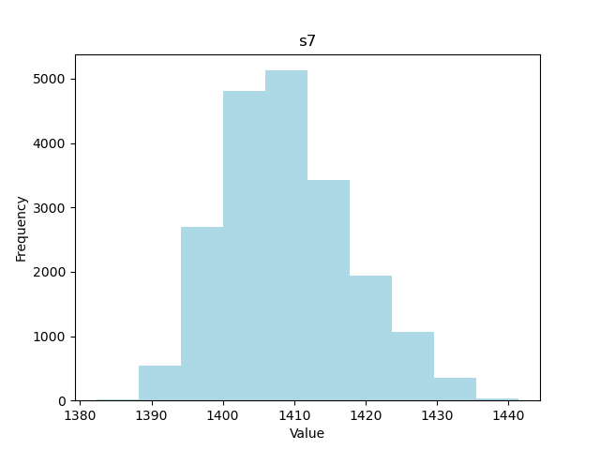
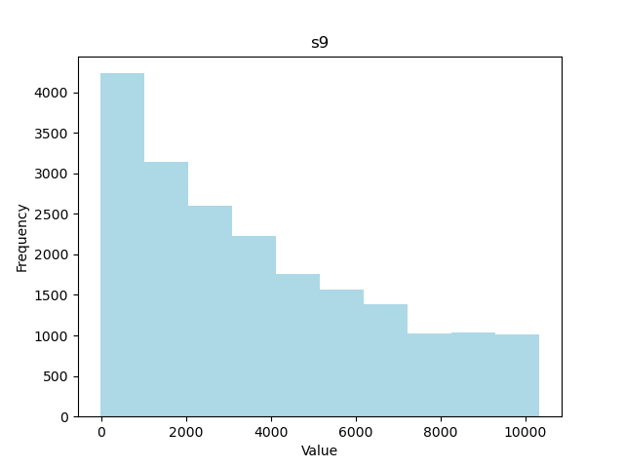
Data Preprocessing—Normalization
By plotting histogram, we can find 2 different kind of distributions.
For data distribution similar as normal distribution, we use Z-Score scaler. We use Min-Max scaler for the rest features.

Slide 10
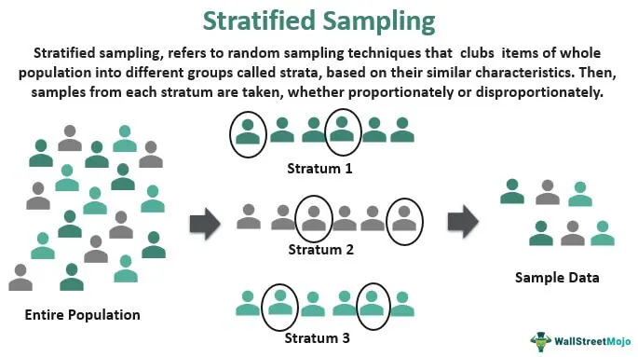
Data Preprocessing—Stratified Sampling
In dataset, they are 97 machines, if we only split training and validation randomly, the model might only learn some machines.
Stratified sampling means split training and validation set by machines, which can guarantee the model can learn every machine’s pattern.
Source: https://www.wallstreetmojo.com/stratified-sampling/

Slide 11
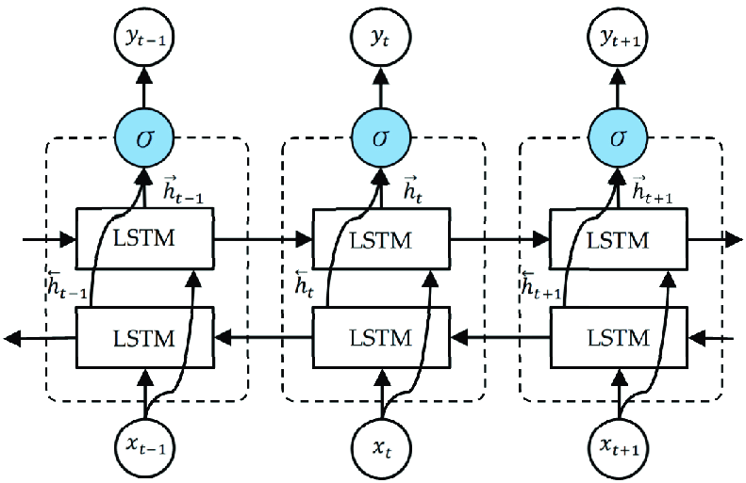
Modeling—Bidirectional LSTM
Source：https://www.researchgate.net/figure/The-unfolded-architecture-of-Bidirectional-LSTM-BiLSTM-with-three-consecutive-steps_fig2_344751031

Slide 12
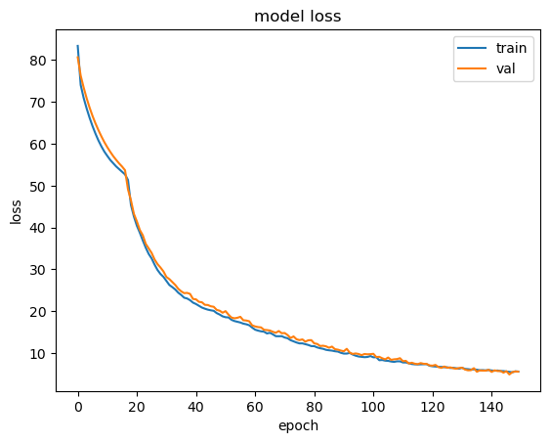
Modeling—Parameters
Time Window=31
Layers=4 (units=128, 86, 86, and 1)
Set dropout=0.2 in every layer
Learning Rate=0.001
Loss Function=Mean Absolute Error
Optimizer=Adam
Batch Size=512

Slide 13
Conclusion & Future Work
Conclusion
Current data processing method can fit training and validation dataset well, but in testing set, the performance dropped. Maybe can try to add padding so that can increase the time window size.
Future Work
Add padding

Slide 14
Thanks for Listening！

