Slide 1
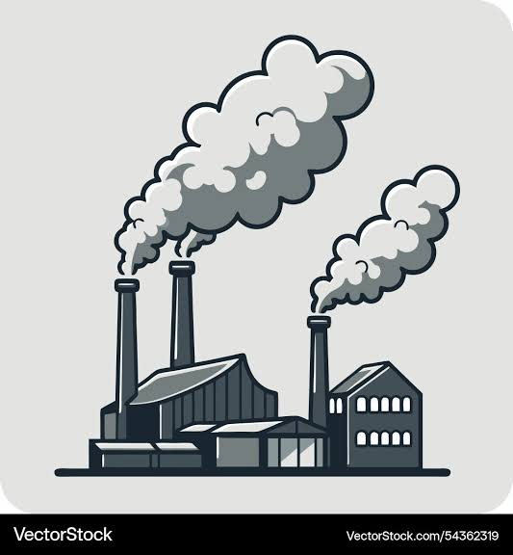
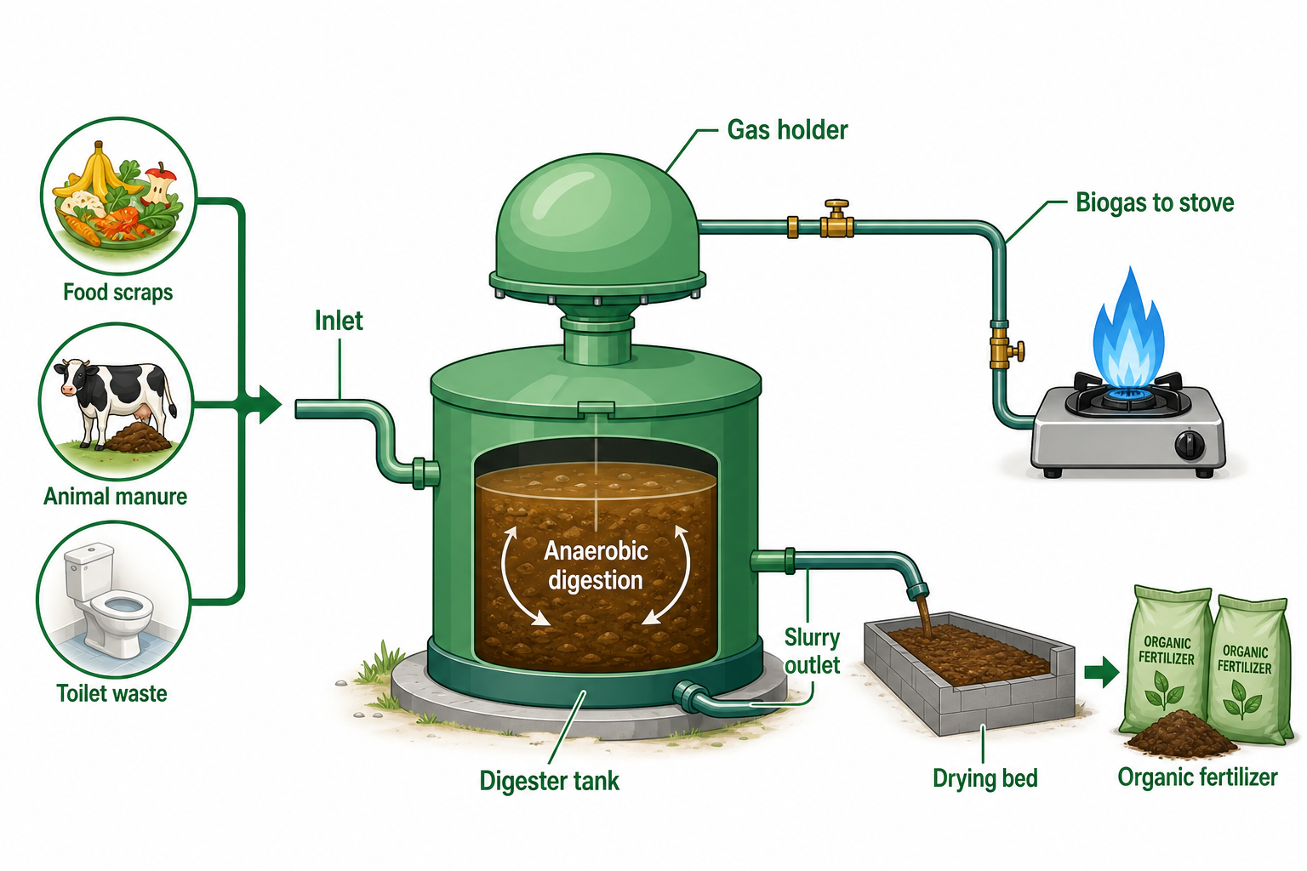
BIOCLEAN · SCHOOL & COMMUNITY INNOVATION
BIOCLEAN SMART
BIOGAS SYSTEM
(BSBS)
Combating Air Pollution in Schools and Communities in Enugu State
Creating a healthy environment for better learning and healthier living.
PRESENTED BY
Chinwuba Chinwendu Jennifer
Head Girl · Federal Government College, Enugu
WASTE → ENERGY

Slide 2
INTRODUCTION
02
Meet the Presenter & the Issue
Our school and our community breathe air that is harming us — and I have designed a fix.
THE PRESENTER
Chinwuba Chinwendu Jennifer
Head Girl · Federal Government College, Enugu
IN THE HOSTELS
Sewage and open dumps release ammonia (NH₃) and hydrogen sulphide (H₂S) — students report drowsiness and nausea.
As Head Girl, I work with our Green Club, the school management and the P.T.A. to make our campus a healthier, cleaner place to learn — and to give our community a model it can copy.
ON CAMPUS
Waste is burned on the premises; the smoke makes some classrooms hard to breathe in.
IN THE COMMUNITY
Homes rely on charcoal, firewood and generators — releasing carbon monoxide (CO) and other pollutants.
This entry presents my proposed solution: the Bioclean Smart Biogas System (BSBS).
BIOCLEAN SMART BIOGAS SYSTEM · BSBS

Slide 3
PROBLEM STATEMENT
03
A Problem We Breathe Every Day
Air pollution means harmful substances released into the air in quantities that damage health and climate — PM2.5 & PM10, CO, SO₂, NO₂, ozone and methane. The WHO reports about 6.7 million premature deaths from air pollution every year.
1
Toxic gas from sewage & dumps
2
Smoke from burning waste
Ammonia (NH₃) and hydrogen sulphide (H₂S) build up around the hostels; students report drowsiness and nausea.
Waste is burned on campus. Students inhale the smoke — some no longer enter classes because they cannot breathe comfortably.
3
Charcoal, firewood & generators
4
Failing sewage systems
In the community, CO from burning fuel binds to the blood’s haemoglobin and cuts off oxygen — a risk of severe illness or death.
Broken septic tanks and leaking sewage pipes release odour and harmful gases into the neighbourhood.
Every day, 300 students live with the fumes — and families lose health, income and productive time to the same problem.
BIOCLEAN SMART BIOGAS SYSTEM · BSBS

Slide 4
PROPOSED SOLUTION · 1 OF 3
04
What Is the Bioclean Smart Biogas System?
BSBS is a modular biogas system that converts the organic waste our school and community already produce — from toilets, kitchens and livestock — into clean cooking energy and organic fertiliser, through anaerobic digestion.
THE CORE CONCEPT
ORGANIC WASTE
ANAEROBIC DIGESTION
CLEAN BIOGAS
COOKING ENERGY
+ organic fertiliser from the residue
Stop the smoke
Collected waste is digested, not burned — ending open burning on campus.
Replace dirty fuel
Clean biogas for cooking (and later generators) instead of LPG, firewood, charcoal or diesel.
Turn problem into asset
The same waste and sewage that pollute our air become our energy and our fertiliser.
A BSBS digester: waste goes in — clean energy and fertiliser come out.
BIOCLEAN SMART BIOGAS SYSTEM · BSBS

Slide 5
PROPOSED SOLUTION · 2 OF 3
05
How the System Works
1
Waste collection
2
Pre-treatment
3
Anaerobic digestion
4
Gas collection
Inlet from toilets, kitchens & livestock; mobile tank and farm hopper.
Pre-filter & mixing tank remove plastics and sand; waste is mixed with water for the microbes.
Modular digester with accelerated microbes & temperature control — gas in 7 days, not 30.
Outlet pipes and the gas-passage network carry raw biogas out of the digester.
5
Purification
6
Storage
7
Distribution & use
8
Residue handling
Water scrubber & H₂S filter remove water vapour and toxic hydrogen sulphide.
Clean biogas is held in low-pressure gas storage bags.
HDPE pipeline runs to the kitchen or generator point via the converter kit.
Slurry outlet & drying bed turn the residue into organic fertiliser.
Usable gas in as little as 7 days. Gas pressure and temperature are watched continuously by IoT sensors, AI and a mobile app — with alerts sent straight to the operator.
BIOCLEAN SMART BIOGAS SYSTEM · BSBS

Slide 6
PROPOSED SOLUTION · 3 OF 3
06
What Makes BSBS Innovative?
7 DAYS
SAFE GAS
SMART
Accelerated digestion
Biogas purification
IoT + AI monitoring
Enhanced microbial action plus temperature control cuts gas production from about 30 days to about 7.
A water scrubber and H₂S filter remove vapour and toxic hydrogen sulphide — giving gas safe for cooking.
Sensors track gas pressure and temperature continuously; the mobile app raises automatic alerts.
ZERO WASTE
WASTE → ENERGY
SCALABLE
Residue → fertiliser
Our own waste fuels us
Modular by design
Slurry is dried on a drying bed into organic fertiliser — nothing from the cycle is wasted.
Cooking energy comes from the school’s own organic waste — not imported LPG, petrol, firewood or charcoal.
A modular digester with mobile collection means the same design can be replicated in other schools and homes.
Innovation in one sentence: BSBS turns our biggest problem — waste and polluted air — into our biggest asset: clean energy, cleaner air and fertiliser.
BIOCLEAN SMART BIOGAS SYSTEM · BSBS

Slide 7
TARGET AUDIENCE
07
Who Benefits — and How
WHO BENEFITS
WHERE THE IMPACT LANDS
Students
Health
Less smoke, smog and sewage gas in and around the buildings
Breathable hostels & classrooms; fewer fumes
Learning
Classrooms students can actually breathe in
The school
Cleaner campus; savings on LPG & waste removal
Energy access
Reliable cooking energy; less dependence on LPG, petrol & firewood
Families & households
Waste management
Waste is collected and digested — not burned or dumped
Clean, affordable cooking fuel instead of charcoal & firewood
Agriculture
Fertiliser that helps farmers cultivate more and harvest more
Farmers
Organic fertiliser from the digester residue
Employment
Work for skilled residents in installation, operation & maintenance
Wider community
Environment
Methane captured instead of released; less firewood, cleaner air
Less smoke & odour; skills and jobs for residents
BIOCLEAN SMART BIOGAS SYSTEM · BSBS

Slide 8
IMPLEMENTATION
08
Steps for Implementation — Proposed Pilot
1 · IMPLEMENTATION STEPS
2 · PEOPLE & MENTORSHIP
1
Approvals & site prep — permits, safety review, pilot site (hostel / refectory area)
10 Green Club students — day-to-day pilot operations
2
Procurement — order the equipment & materials (panel 3)
2 juniors — trained every year for continuity
3
Installation — engineers & plumbing team fit digester, scrubber, storage & piping
Engineers · plumbing · safety specialists — installation & testing
4
Inoculation & safety testing — microbes added; gas quality & safety checked
Labourers — site & construction support
5
Commissioning — run the first 7-day gas cycle; hand over to the Green Club
Mentorship — technical guidance from the engineers & partners; leadership support from school management & the P.T.A.
3 · MATERIALS & EQUIPMENT
4 · FINANCIAL COMMITMENT
Modular digester unit
Inlet plumbing + tank
Pre-filter + mixing tank
Equipment & materials
₦50,000
Installation & labour — engineers, plumbing, safety, labourers
₦50,000
Scrubber + H₂S filter
Gas storage bags
HDPE pipe + converter kit
₦50,000
Contingency, permits, microbes & app monitoring
Slurry outlet + drying bed
Microbes (inoculant)
IoT sensors + mobile app
TOTAL ₦150,000 · within the ₦200,000 limit
PROPOSED PILOT TIMELINE · 8 WEEKS
Wks 1–2 · Approvals & procurement
Wks 3–4 · Installation
Wk 5 · Inoculation & safety testing
Wks 6–7 · First 7-day gas cycle
Wk 8 · Handover to Green Club
BIOCLEAN SMART BIOGAS SYSTEM · BSBS

Slide 9
EXPECTED OUTCOMES
09
What We Expect — and How We Sustain It
OBSERVED TODAY
EXPECTED FROM THE PILOT
SCALE & SUSTAINABILITY
Students in hostels report drowsiness & nausea (NH₃, H₂S)
PROJECTED — TO BE MEASURED
Full-school model projects ₦1.88m net benefit per year, 17-month payback
Biogas cooking in the pilot area — no LPG or firewood needed
Waste is burned on campus; smoke in classrooms
Projected 5-year savings: ₦6.75m — for labs, infrastructure & scholarships
Zero open burning of collected waste → less smoke & odour
Homes depend on charcoal, firewood & generators
Sustained by the Green Club (10 students) with 2 juniors trained for continuity
Usable gas within the 7-day digestion cycle
≈ ₦1.56m wasted every year on waste & fuel
Organic fertiliser produced on the drying bed
Replicable: modular design + trained team → other schools & communities
Gas pressure & temperature logged by sensors + app
Creates work for skilled residents in installation & operation
Honest by design: every figure above is a projection, not a result — the pilot’s sensor data will prove what actually happens.
BIOCLEAN SMART BIOGAS SYSTEM · BSBS

Slide 10
CALL TO ACTION
Let’s Breathe Clean Air Together
THE PROBLEM
THE SOLUTION
THE IMPACT
THE OPPORTUNITY
Fumes, smoke and no clean energy in our school and community
BSBS: waste → anaerobic digestion → biogas → clean energy + fertiliser
Healthier students, cleaner air, fertiliser for farmers, new skills
An 8-week pilot with a confirmed ₦150,000 budget — within the ₦200,000 limit
Fund this pilot — and watch a federal college in Enugu turn its waste into clean energy.
From Waste to Wealth. From Problem to Power. This is not just a project — it is my legacy.
THANK YOU
Chinwuba Chinwendu Jennifer · Head Girl · Federal Government College, Enugu
WASTE → ENERGY

