Slide 1
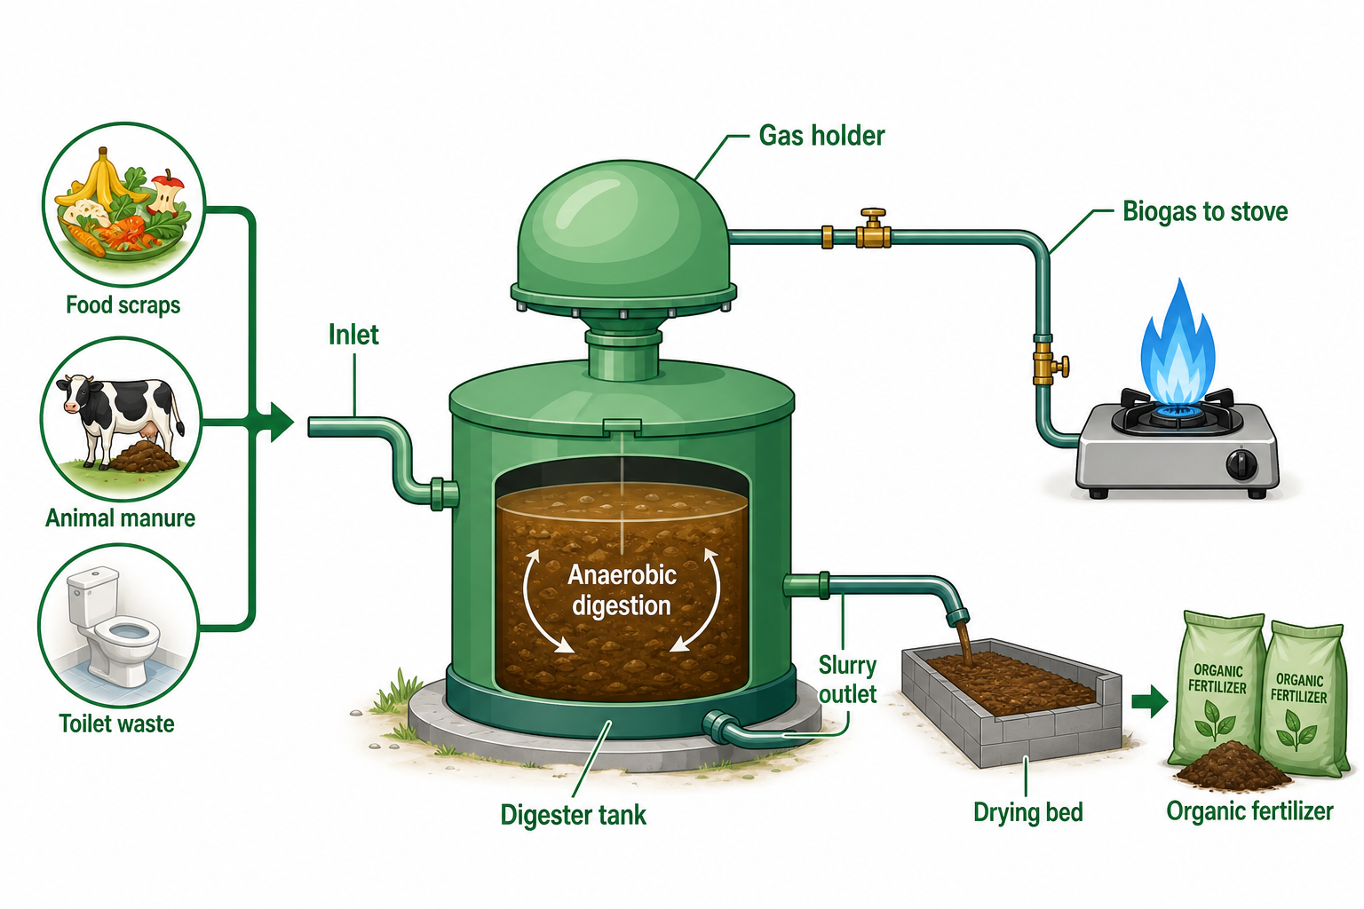
BIOCLEAN · SCHOOL & COMMUNITY INNOVATION
BIOCLEAN SMART
BIOGAS SYSTEM
(BSBS)
Combating Air Pollution in Schools and Communities in
Enugu State
Creating a healthy environment for better learning and healthier living.
Presented by
Chinwuba Chinwendu Jennifer
Head Girl · Federal Government College, Enugu
WASTE → ENERGY

Slide 2
THE PROBLEM
02
Introduction to Air Pollution
Air pollution is the release of substances into the atmosphere in quantities which can be harmful to human health and can cause modification in our climate, leading to an imbalance in nature.
Major pollutants
01 PM2.5 & PM10
Tiny dust particles from vehicles and generators. The most dangerous because they travel deep into our lungs.
02 Carbon Monoxide (CO)
From the incomplete burning of fuel such as coal, firewood, diesel and petrol.
03 Sulphur Dioxide (SO₂)
Released from gas flaring and diesel combustion.
04 Nitrogen Dioxide (NO₂)
A reddish-brown gas emitted from vehicle engines, generators and gas-flaring industries.
05 Ground-level Ozone (O₃)
A major part of smog; formed when sunlight reacts with other pollutants.
06 Methane (CH₄)
A colourless, odourless gas from sewage, decomposing waste and gas flaring; reacts with sunlight to form smog.
WHO reports that about 6.7 million premature deaths every year are caused by air pollution.
BIOCLEAN SMART BIOGAS SYSTEM · BSBS

Slide 3
THE LOCAL EVIDENCE
03
Current Situation in My School
Most days in my school — especially within the hostels — my fellow students complain of drowsiness and nausea. This is due to the presence of ammonia (NH₃) and hydrogen sulphide (H₂S) gas from sewage and open dumps.
What students experience daily
Drowsiness & nausea — Reported especially within the hostels, linked to gases from sewage and open dumps.
Smoke from burning waste — Students feel uncomfortable inhaling smoke when waste is burned on the premises.
Unbreathable classrooms — Some students no longer enter classes because they cannot breathe comfortably.
Clean air is not a luxury — it is a learning condition.
BIOCLEAN SMART BIOGAS SYSTEM · BSBS

Slide 4
THE LOCAL CONTEXT
04
My Community Challenge
Nowadays, most homes in my community utilise charcoal, stoves and generators for cooking and powering their houses. As we all know, coal burns in a limited supply of air to release carbon monoxide (CO), a colourless and odourless gas which, when inhaled excessively, accumulates in the body and reacts with the haemoglobin of our blooad to form carboxyhaemoglobin. This cuts down the level of oxygen delivered in the body, leading to severe cardiovascular issues or even death.
Furthermore, most houses in my community still use poor sewage systems. These include broken septic tanks and leaking sewage pipes, which cause air pollution.
THE COMMUNITY NEED
Safer waste handling + cleaner energy + better sanitation → healthier, more productive homes and schools.
BIOCLEAN SMART BIOGAS SYSTEM · BSBS

Slide 5
THE IMPACT
05
The Effects of Air Pollution in Our Schools and Communities
01 Health effects
Air pollution affects our health through diseases like asthma, pneumonia and lung cancer. Families are exposed to serious, long-term health risks.
02 Academic effects
Students find it difficult to learn in polluted environments, leading to poor grades by the end of the term or session. Teachers may also lose interest in teaching, causing poor educational outcomes.
03 Economic effects
Families spend their income on treatment and medical expenses, reducing money available for other needs. Workers also lose productive days to sickness.
04 Social effects
Air pollution reduces interaction among people, who fear stepping out to inhale smoke, smog or bad odour. Students face embarrassment and stigma over fears of airborne disease.
BIOCLEAN SMART BIOGAS SYSTEM · BSBS

Slide 6
THE SCIENCE
06
The Research and Science Behind the Innovation: Bioclean Smart Biogas System (BSBS)
What is biogas?
Biogas is a renewable fuel produced when microorganisms break down organic waste without oxygen.
The process
Organic Waste
→
Anaerobic Digestion
→
Biogas
→
Clean Energy
How the system works
Stages | Components | Functions
Inlet plumbing | Waste collection system from toilets, kitchens and livestock farms; a mobile tank and farm hopper. | Plumbing from hostels, classrooms and refectory kitchens.
Pre-treatment | Pre-filter and mixing tank. | Removes plastics and sand; mixes waste with water for the microbes.
Process | Modular digestion, accelerated microbe action and temperature control. | 7-day gas production instead of 30 days.
BIOCLEAN SMART BIOGAS SYSTEM · BSBS

Slide 7
THE PEOPLE
07
Key Metrics & Sustainability and Leadership Plan
Stages | Components | Functions
Equipments And Materials | ₦1,870,000 | 70%.
Installation and labour- Engineers, Plumbing, Safety testing, Labourers. | ₦580,000 | 21%
Contingency and setup permits, Microbes, App monitoring, | ₦230,000 | 7-day gas production instead of 30 days.
Total CAPEX | ₦2,650,000 | 100%
Key metrics
Funding Strategy
Stages | Components
William National Head Girl Price | ₦1,000,000
School Management and P.T.A + CSR Patners. | ₦1,650,000
Total | ₦2,650,000
BIOCLEAN SMART BIOGAS SYSTEM · BSBS

Slide 8
THE BUSINESS CASE
08
Financial Viability and Sustainability
Annual net benefit to school
₦1,880,000
How we make / save money
Sustainability and leadership plan
₦1,860,000 Savings
As the Head Girl of my college, I will sustain this innovation by:
01 Organise 10 reliable students from our Green Club to manage its operations.
02 Train two (2) juniors for continuity.
03 Enhance scalability so more models can be replicated in other schools and communities.
No LPG and no waste-truck fees.
₦320,000 Revenue
Organic fertilisers and carbon credits.
₦80,000 Running cost
Maintenance and microbes.
₦1,880,000 Net gain every year
5-year savings
₦6,750,000 for our labs, infrastructure and scholarships.
Reported annual net benefit.
Motto
This investment pays for itself in 17 months and generates savings for 15 years.
17
Months payback
71%
Year-1 ROI
BIOCLEAN SMART BIOGAS SYSTEM · BSBS

Slide 9
THE SOLUTION
09
How My Smart Bioclean Biogas System (BSBS) Combats Air Pollution
BEFORE
Waste burning → Smoke → Air pollution → Health problems
AFTER
Waste collection → Biogas production → Clean energy → Cleaner environment
Health
Biogas burns clean and releases no smoke into the atmosphere, reducing health risks from firewood, charcoal and generator fumes.
Economic
Biogas comes from decomposing organic materials, so My BSBS is affordable for families and schools. A 5m³ model in each home brings a net benefit of ₦1,880,000, The utilization of biogas would minimize the use of petrol and cooking gas which may not be affordable for most families, Moreover my BSBS would create emplyment opportunities for skilled residents who are willing to work
Agricultural
The residue left behind after the prodcution is collected by the slurry outlet and dried on the drying bed beforeit can be supplyed to farmers. This will therefore encourage farmers to cultivate more in order to yield bountiful harvests thereby fostering agriculture in our community and beyond
Social
Student will nto have to feel isolated or stigmatised because our environment will provide everyone with clean air, People will not have to stay indoors always because of polluted air, with My BSBS installed in every home, there will be a decrease in air pollutions
Environmental
Another exciting benefit of BSBSis that it traps methane (a greenhouse gas) and a major contributor to climate change. Moreover it provides a clean, renewable alternative to firewood and charcoal.
BIOCLEAN SMART BIOGAS SYSTEM · BSBS

Slide 10
THANK YOU
10
Conclusion and Gratitude
Bioclean Smart Biogas System (BSBS) — From Waste to Wealth: From Problem to Power.
01 The problem is real
300 students suffer daily from gas fumes; waste causes bad odour and ₦1.56m is wasted every year.
02 The solution works
Biogas turns our biggest problem into our biggest asset: clean cooking, clean hostels, plus ₦1.8m net gain every year.
03 The plan is ready
₦2.65m total cost: ₦1m from WILAN, ₦1.65m from partners; 17-month payback and 15 years of impact.
04 The leadership is here
With the BSBS Green Club and annual training, this impact will outlive me and inspire other schools in Enugu.
Invest ₦1,000,000 in me today. In return, LILAN gets a national model of student-led climate action that saves money, saves the planet and saves lives.
This is not just a project — this is my legacy.
Let’s Breathe In Clean Air together.
Thank you, WILAN, for this opportunity to change my school, community, nation, continent and the whole world.
BIOCLEAN SMART BIOGAS SYSTEM · BSBS

