Slide 1

MINDMATE
MindMate
One small step
toward a better day.
A calm, private wellbeing companion for young people.
CHECK IN → TAKE ONE SMALL STEP → REFLECT → FIND SUPPORT
Team: team mindmate
MINDMATE
Notes:
Introduce MindMate as a calm, private wellbeing companion for young people. The product helps users check in, take one small step, reflect, and find support.

Slide 2
PROBLEM STATEMENT
Many people need help before they know where to start
Nearly 150 million people in Africa — including about 105 million in Nigeria — are reported to face mental-health challenges. Verify this statistic before submission.
HARD TO NAME IT
HARD TO KNOW WHAT TO DO
HARD TO FIND SUPPORT
People may feel bad without knowing what is affecting them.
Too many options can make the first step harder.
When self-guided help is not enough, the right person can be hard to find.
Start with awareness
Make one small move
Know where to go next
MindMate closes the gap between “I need help” and “What do I do next?”
MINDMATE
Notes:
The problem is the gap between needing help and knowing what to do next. The headline statistic must have a verified source before final submission.

Slide 3
THE SOLUTION
From a difficult moment to one next step
MindMate helps users check in, reflect, act, and connect.
NOTICE
ACT
Name what is happening before deciding what to do.
Choose one small action. If it does not help, try another.
Start with awareness
Start small
TALK
CONNECT
Use guided conversation without pretending to be a clinician.
Move to trusted, professional, or emergency help when needed.
Talk it through safely
Know where to go next
MINDMATE
Notes:
MindMate helps users check in, reflect, act, and connect. It is a guided pathway rather than a collection of unrelated features.

Slide 4
SAFETY BY DESIGN
Helpful support, with clear boundaries
MindMate supports the user without pretending to replace human care.
01 / SUPPORT
02 / RISK
03 / LIMITS
MindMate listens, reflects what the user shares, and offers one practical next step.
When urgent help may be needed, MindMate points the user toward Emergency Support.
MindMate does not diagnose, replace professional care, or act outside the user’s control.
Support first. Then guide.
A clear route to help
Clear limits. User control.
Supportive by design. Honest about its limits.
MINDMATE
Notes:
MindMate supports reflection and practical next steps, but does not replace professional care. When risk appears, it points the user to Emergency Support.

Slide 5
THE DIFFERENCE
MindMate brings the support journey together
It connects the check-in, the next step, the conversation, and the route to human help.
CHECK-IN
OTHER APPROACHES
MINDMATE
A mood score may not explain what to do next.
Turns the check-in into a useful starting point.
Check in → know what to try
TOOLS
OTHER APPROACHES
MINDMATE
A long list of exercises can create more choice, not more clarity.
Offers one manageable action at a time.
Less choice → clearer action
SUPPORT
OTHER APPROACHES
MINDMATE
Self-guided tools can leave the user alone when more help is needed.
Keeps trusted and emergency support visible.
Self-guided → human support
MindMate is built around the journey, not just one feature.
MINDMATE
Notes:
This slide explains MindMate’s integrated journey without making unsupported claims about named competitors.

Slide 6
PRODUCT READINESS
Built, tested, and ready to show
MindMate is running on Android and Web, with the main user journeys checked from check-in through support.
ANDROID RELEASE
WEB RELEASE
MAIN JOURNEYS CHECKED
An installable Android build is ready for demonstration and use.
A live Web version makes MindMate easy to access and share.
The core features, safety behaviour, and layouts have been tested.
Ready to install
Easy to try and share
Built and tested
The point: MindMate is more than an idea — it is ready to demonstrate.
MINDMATE
Notes:
Explain product readiness in plain language: an installable Android build, a live Web release, and tested core journeys.

Slide 7
BUSINESS MODEL
A free core, with paid features later
MindMate can stay accessible while a premium plan supports future sustainability.
FREE ACCESS
MINDMATE PLUS
EXAMPLE SCENARIO
BASIC MINDMATE
PLANNED FEATURES
FUTURE INCOME
• Check-ins + reflection
• Basic next-step guidance
• Journaling + wellbeing tools
• Support routes
• Guided routines
• Progress tools
• Additional wellbeing content
• Future features to validate
₦10,000 per year × 500 paid users
= ₦5,000,000 projected annual income
→
→
DEMO UNLOCK ONLY — NO REAL PAYMENT IS PROCESSED · FIGURE IS A FUTURE PROJECTION
MINDMATE
Notes:
The freemium unlock is simulated for the demo; no real payment is processed. The ₦10,000 annual price and 500 paid users are an illustrative future scenario, not current revenue. The team should validate the price, conversion rate, and paid features before presenting them as a final business plan.

Slide 8
COMPETITION FINANCES
Where the projected revenue comes from
Figures shown for the competition budget. Verify the records before submission.
SOURCE
BASIS
CALCULATION
TOTAL (₦)
Shares
₦500 each
₦500 × 100
50,000
Sponsorship
1 sponsor
1 × ₦200,000
200,000
Sales of confectioneries
₦100 each
₦100 × 500
50,000
TOTAL REVENUE
₦50,000 + ₦200,000 + ₦50,000
300,000
PROJECTED TOTAL REVENUE: ₦300,000
PROJECTION — VERIFY FIGURES BEFORE SUBMISSION
MINDMATE
Notes:
This slide shows the full revenue calculation: shares are ₦500 times 100, sponsorship is one sponsor at ₦200,000, and confectioneries are ₦100 times 500. The total is ₦300,000. Treat it as projected until the records are verified.

Slide 9
EXPENDITURE STATEMENT
How the projected funds are used
A clear cost breakdown makes the financial story easier for judges to follow.
EXPENDITURE
AMOUNT (₦)
FINANCIAL SUMMARY
App development
100,000
Internet / data
10,000
Total revenue
₦300,000
Board
9,000
Total expenses
₦217,000
Contingency
30,000
Transport
30,000
Projected profit / surplus
₦83,000
Stationery
20,000
₦300,000 − ₦217,000 = ₦83,000
Printing paper
10,000
TOTAL EXPENSES
217,000
ILLUSTRATIVE / PROJECTED
MINDMATE
Notes:
The total is ₦217,000. If revenue is projected at ₦300,000, the projected surplus is ₦83,000. Do not call this actual profit unless the revenue and expenses are verified. The figures should be checked against the team’s records before submission.

Slide 10
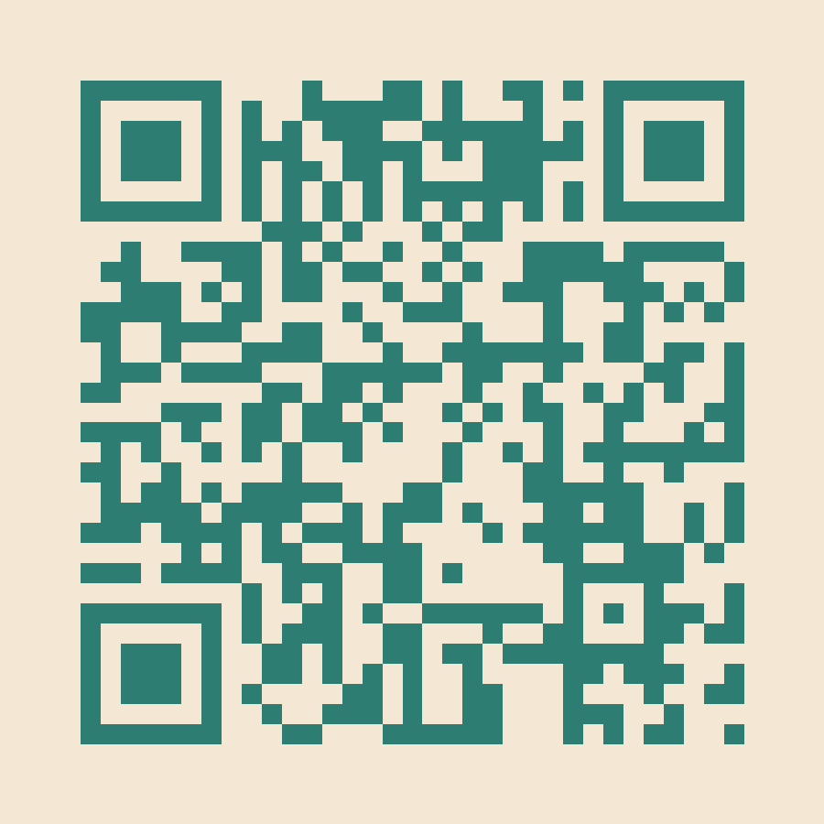
MindMate
Make the next safe step feel possible.
CHECK IN → TAKE ONE SMALL STEP → REFLECT → CONNECT
https://mindmate-app-fcf2d.web.app
Scan the QR code to try the live Web release.
Thank you
MINDMATE
Notes:
Close with the product promise and invite the judges to try the live Web release.

