Slide 1
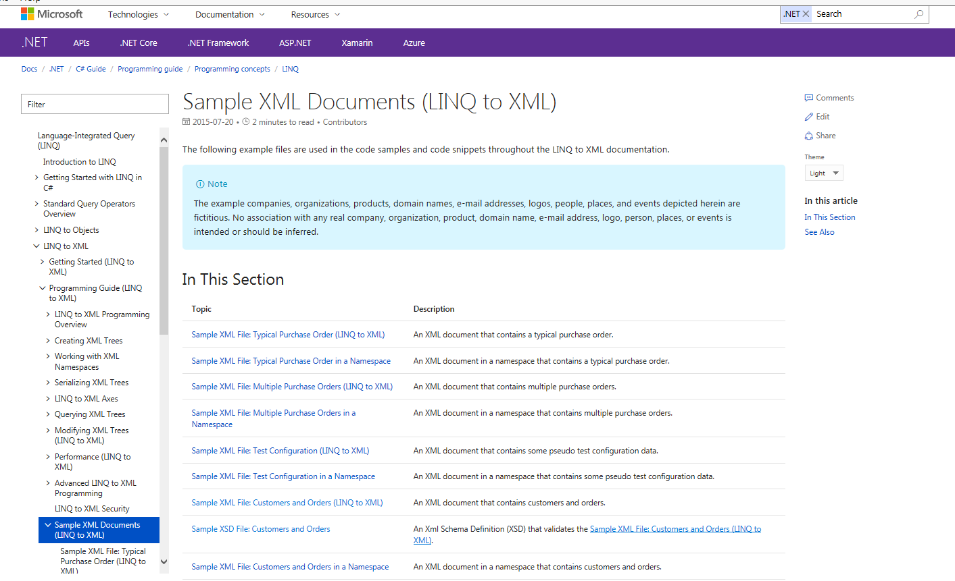
Real World Example
Example taken from Microsoft
XSD and XML data
Notes:
Screenshot of
https://docs.microsoft.com/en-us/dotnet/csharp/programming-guide/concepts/linq/sample-xml-documents-linq-to-xml

Slide 2
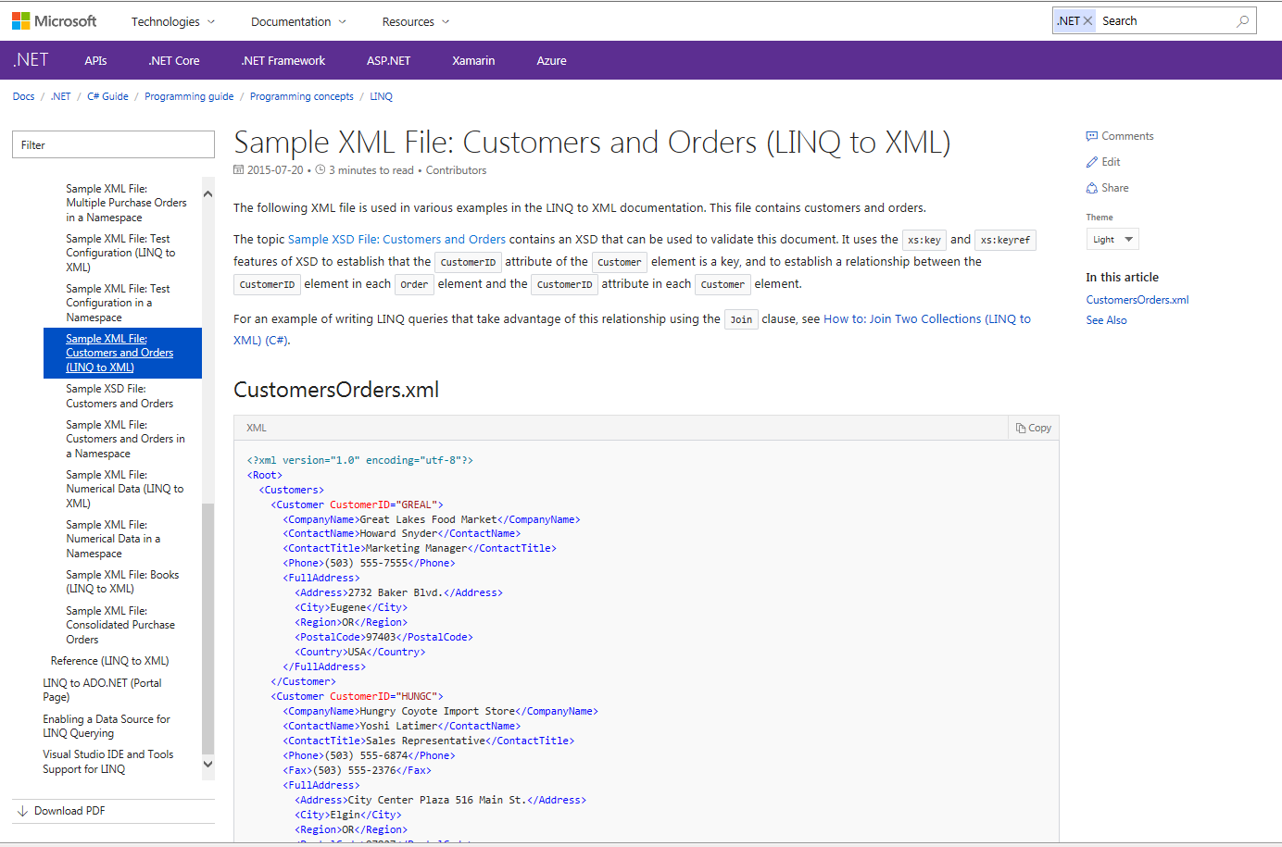
Customers Orders XML
Notes:
CustomersOrders.XML taken from
https://msdn.microsoft.com/en-us/library/bb387025.aspx
And
https://docs.microsoft.com/en-us/dotnet/csharp/programming-guide/concepts/linq/sample-xml-file-customers-and-orders-linq-to-xml-2

Slide 3
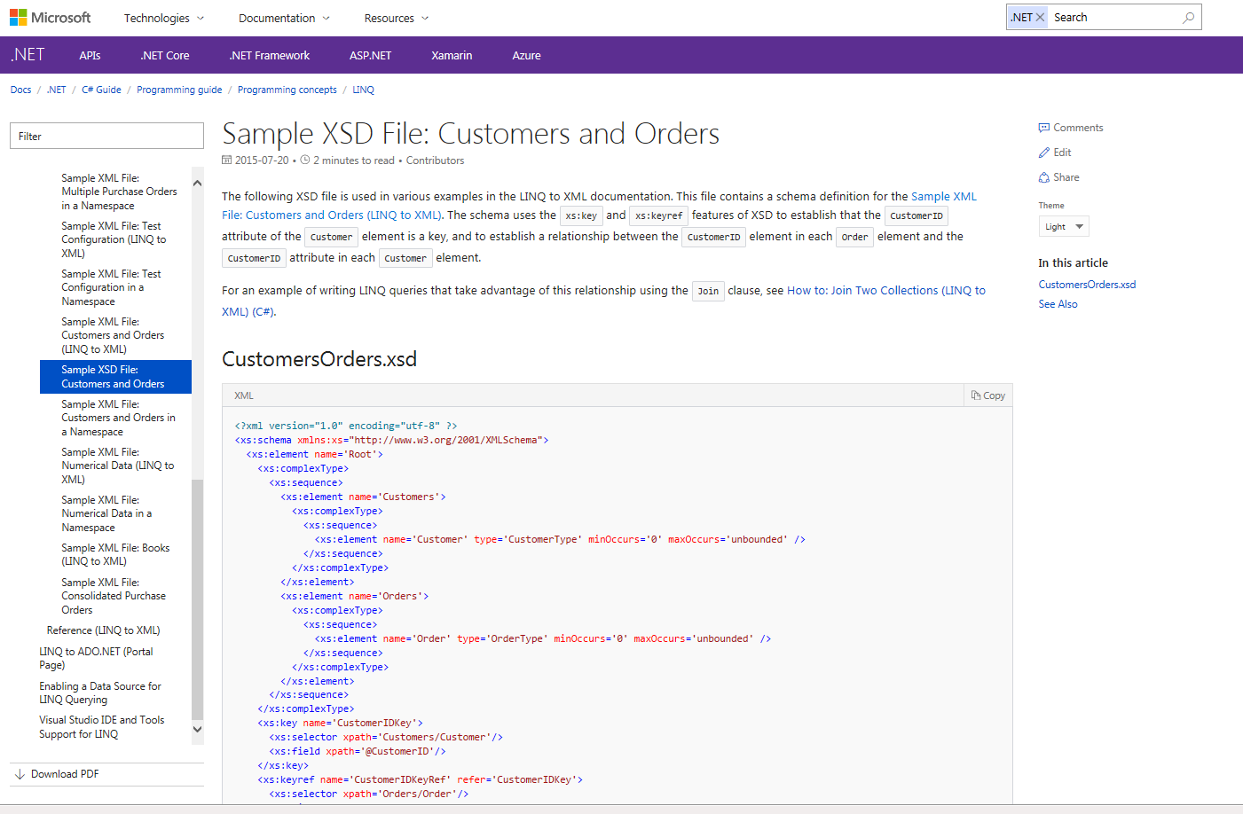
Customers Orders XSD
Notes:
CustomersOrders.XSD taken from
https://msdn.microsoft.com/en-us/library/bb675181.aspx
And
https://docs.microsoft.com/en-us/dotnet/csharp/programming-guide/concepts/linq/sample-xsd-file-customers-and-orders1

Slide 4
Customers Orders SUT
new customer (xml)
SUT
updated report (xml)
new order (xml)

Slide 5
Customers Orders SUT
Whenever inputs are received, an updated report will be send shortly there after
A report contains all received customers and orders

Slide 6
Customer Orders TorXakis data types
TYPEDEF Report ::= Report { customers :: List_Customer
; orders :: List_Order }
ENDDEF
TYPEDEF List_Customer ::=
Nil_Customer
| Cstr_Customer { head :: Customer; tail :: List_Customer }
ENDDEF
TYPEDEF List_Order ::=
Nil_Order
| Cstr_Order { head :: Order; tail :: List_Order }
ENDDEF

Slide 7
Customer Orders TorXakis data types
TYPEDEF Customer ::= Customer { companyName :: String
; contactName :: String
; contactTitle :: String
; phone :: String
; fax :: Conditional_string
; fullAddress :: Address
; customerID :: Int }
ENDDEF
TYPEDEF Address ::= Address { address :: String
; city :: String
; region :: String
; postalCode :: String
; country :: String }
ENDDEF

Slide 8
Customer Orders TorXakis data types
TYPEDEF Order ::= Order { customerID :: Int
; employeeID :: Int
; orderDate :: Int
; requiredDate :: Int
; shipInfo :: ShipInfo }
ENDDEF
TYPEDEF ShipInfo ::= ShipInfo { shipVia :: Int
; freight :: Int
; shipName :: String
; shipAddress :: String
; shipCity :: String
; shipRegion :: String
; shipPostalCode :: String
; shipCountry :: String
; shippedDate :: Conditional_dateTime }
ENDDEF

Slide 9
Customer Orders TorXakis functions
FUNCDEF isValid_Report ( t :: Report ) :: Bool ::=
isValid_List_Customer(customers(t), 0, Absent_Int)
/\ isValid_List_Order(orders(t), 0, Absent_Int)
/\ uniqueCustomerIDs(customers(t))
/\ validCustomerIDsInOrders(orders(t),customers(t))
ENDDEF
FUNCDEF uniqueCustomerIDs ( x :: List_Customer ) :: Bool ::=
IF isNil_Customer (x)
THEN True
ELSE not(containsCustomerID(customerID(head (x)), tail(x)))
/\ uniqueCustomerIDs(tail(x))
FI
ENDDEF

Slide 10
Customer Orders TorXakis functions
FUNCDEF containsCustomerID ( cid :: Int; x :: List_Customer ) :: Bool ::=
IF isNil_Customer (x)
THEN False
ELSE IF customerID(head (x)) == cid
THEN True
ELSE containsCustomerID (cid, tail(x))
FI
FI
ENDDEF
FUNCDEF validCustomerIDsInOrders ( o :: List_Order; c :: List_Customer ) :: Bool ::=
IF isNil_Order (o)
THEN True
ELSE containsCustomerID(customerID(head(o)), c)
/\ validCustomerIDsInOrders (tail(o), c)
FI
ENDDEF

Slide 11
Customers Orders - ProcDefs
PROCDEF bufferedOutput [ IReport, OReport :: Report ] (queue :: ReportList) ::=
IReport ? r >-> bufferedOutput [ IReport, OReport ] (add (r , queue))
##
[[ isCstr_Report (queue) ]] =>> OReport ! head(queue) >-> bufferedOutput [ IReport, OReport ] (tail(queue))
ENDDEF
PROCDEF handle [ Customer :: Customer; Order :: Order; Report :: Report ]
(cs :: List_Customer; os :: List_Order; changed :: Bool) EXIT ::=
[[ changed ]] =>> ( Report ! Report ( cs, os )
>-> handle [Customer , Order , Report ] ( cs , os , False)
)
##
( Customer ? c [[ isValid_Customer(c) /\ not ( containsCustomerID ( customerID ( c ) , cs ) ) ]]
>-> handle [Customer, Order, Report] ( Cstr_Customer ( c, cs ), os , True )
)
##
( Order ? o [[ isValid_Order(o) /\ containsCustomerID ( customerID(o), cs ) ]]
>-> handle [Customer, Order, Report] ( cs, Cstr_Order ( o, os ) , True )
)
ENDDEF

Slide 12
Customer Orders ModelDef
MODELDEF Model ::=
CHAN IN Customer, Order
CHAN OUT Report
BEHAVIOUR
HIDE [ HReport :: Report ] IN
handle [ Customer, Order, HReport ] ( Nil_Customer, Nil_Order, True )
|[ HReport ]|
bufferedOutput [ HReport, Report ] (Nil_Report)
NI
ENDDEF

Slide 13
Customer Orders - Connect to SUT
CHANDEF Chans ::= Customer :: Customer
; Order :: Order
; Report :: Report
ENDDEF
CNECTDEF Sut ::=
CLIENTSOCK
CHAN OUT Customer HOST "localhost" PORT 7890
ENCODE Customer ? c -> ! toXml(c)
CHAN OUT Order HOST "localhost" PORT 7891
ENCODE Order ? o -> ! toXml(o)
CHAN IN Report HOST "localhost" PORT 7892
DECODE Report ! fromXml(s) <- ? s
ENDDEF

