Slide 1
7. Topology sort (30)
A company has a product, and the production of the product has many steps. The manufacturing process of the product is divided into several works, some of which must wait for the completion of the pre-work before proceeding.
The work in the same order shall be given priority to with the smallest number.
Please output the work sequence of the company‘s product production process. If there is a cycle, output “not exist”.
( Input )
Read file (input_1.txt)
For each test data, the first line contains two integers J, R.
─ J indicates the number of the works. ( No. 1~J，1≦J≦1000 )
─ R indicates the number of relationships between works.
( 1≦R≦J*(J-1)/2 )
Next R lines are relationships, each line contain two integers x, y:
─ x and y indicate that must complete work x before work y.
( Output )
For each test data, output the work sequences and use a space to separate each work in the same sequence.
( Sample input )
5 6
1 2
1 3
2 3
2 4
3 5
5 4
( Sample output )
1 2 3 5 4

Slide 2
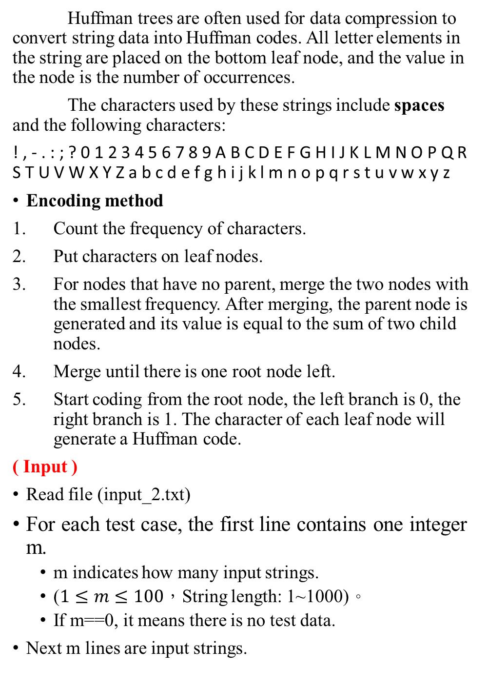
8. Huffman code (30)
Huffman trees are often used for data compression to convert string data into Huffman codes. All letter elements in the string are placed on the bottom leaf node, and the value in the node is the number of occurrences.
The characters used by these strings include spaces and the following characters:
! , - . : ; ? 0 1 2 3 4 5 6 7 8 9 A B C D E F G H I J K L M N O P Q R S T U V W X Y Z a b c d e f g h i j k l m n o p q r s t u v w x y z
Encoding method
Count the frequency of characters.
Put characters on leaf nodes.
For nodes that have no parent, merge the two nodes with the smallest frequency. After merging, the parent node is generated and its value is equal to the sum of two child nodes.
Merge until there is one root node left.
Start coding from the root node, the left branch is 0, the right branch is 1. The character of each leaf node will generate a Huffman code.
( Input )
Read file (input_2.txt)
For each test case, the first line contains one integer m.
m indicates how many input strings.
($1≤m≤100$，String length: 1~1000)。
If m==0, it means there is no test data.
Next m lines are input strings.

Slide 3
( Output )
For each test data, output a line containing the total length of the input string.
( Sample input )
1
Huffmannn
2
Hello!
oH He lolo
0
( Sample output )
22
40

Slide 4
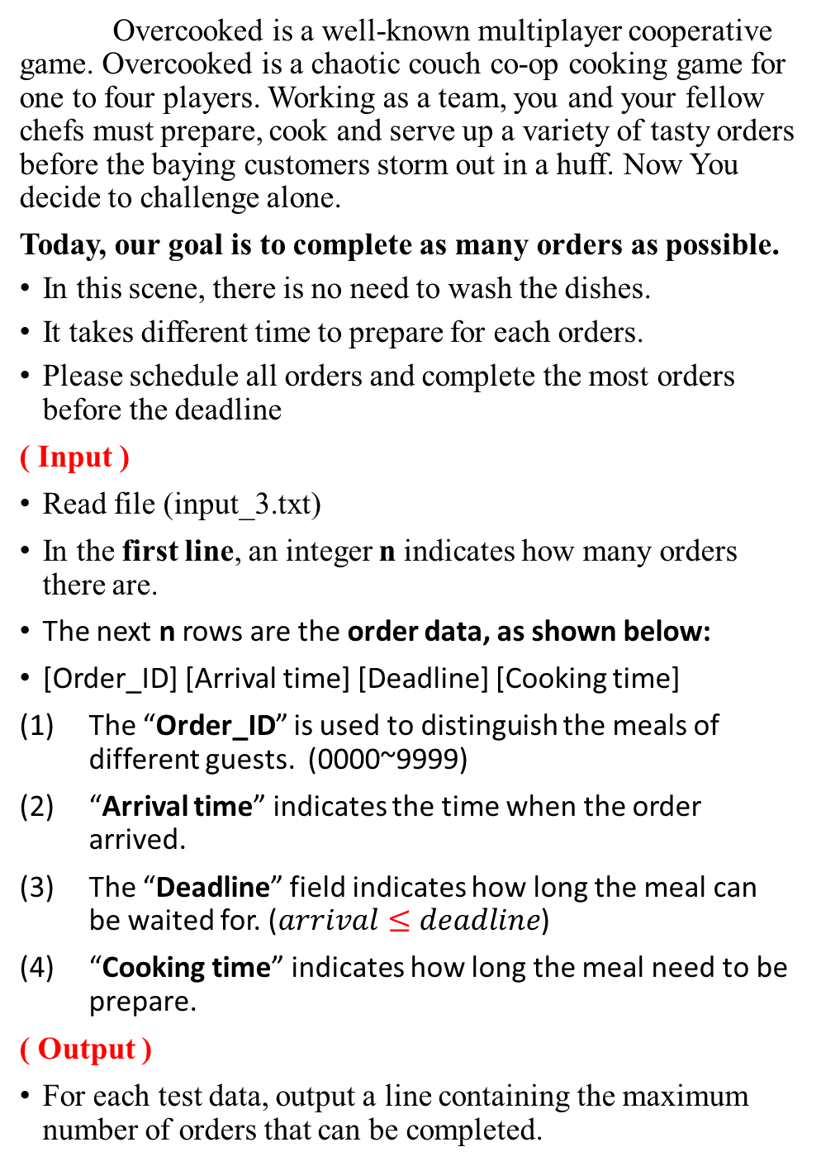
9. Overcooked (40)
Overcooked is a well-known multiplayer cooperative game. Overcooked is a chaotic couch co-op cooking game for one to four players. Working as a team, you and your fellow chefs must prepare, cook and serve up a variety of tasty orders before the baying customers storm out in a huff. Now You decide to challenge alone.
Today, our goal is to complete as many orders as possible.
In this scene, there is no need to wash the dishes.
It takes different time to prepare for each orders.
Please schedule all orders and complete the most orders before the deadline
( Input )
Read file (input_3.txt)
In the first line, an integer n indicates how many orders there are.
The next n rows are the order data, as shown below:
[Order_ID] [Arrival time] [Deadline] [Cooking time]
The “Order_ID” is used to distinguish the meals of different guests. (0000~9999)
“Arrival time” indicates the time when the order arrived.
The “Deadline” field indicates how long the meal can be waited for. ($arrival≤deadline$)
“Cooking time” indicates how long the meal need to be prepare.
( Output )
For each test data, output a line containing the maximum number of orders that can be completed.

Slide 5
( Sample input )
5
1001 0 5 2
1002 1 6 3
1003 2 11 3
1004 3 5 2
1005 4 8 3
( Sample output )
4

