Slide 1
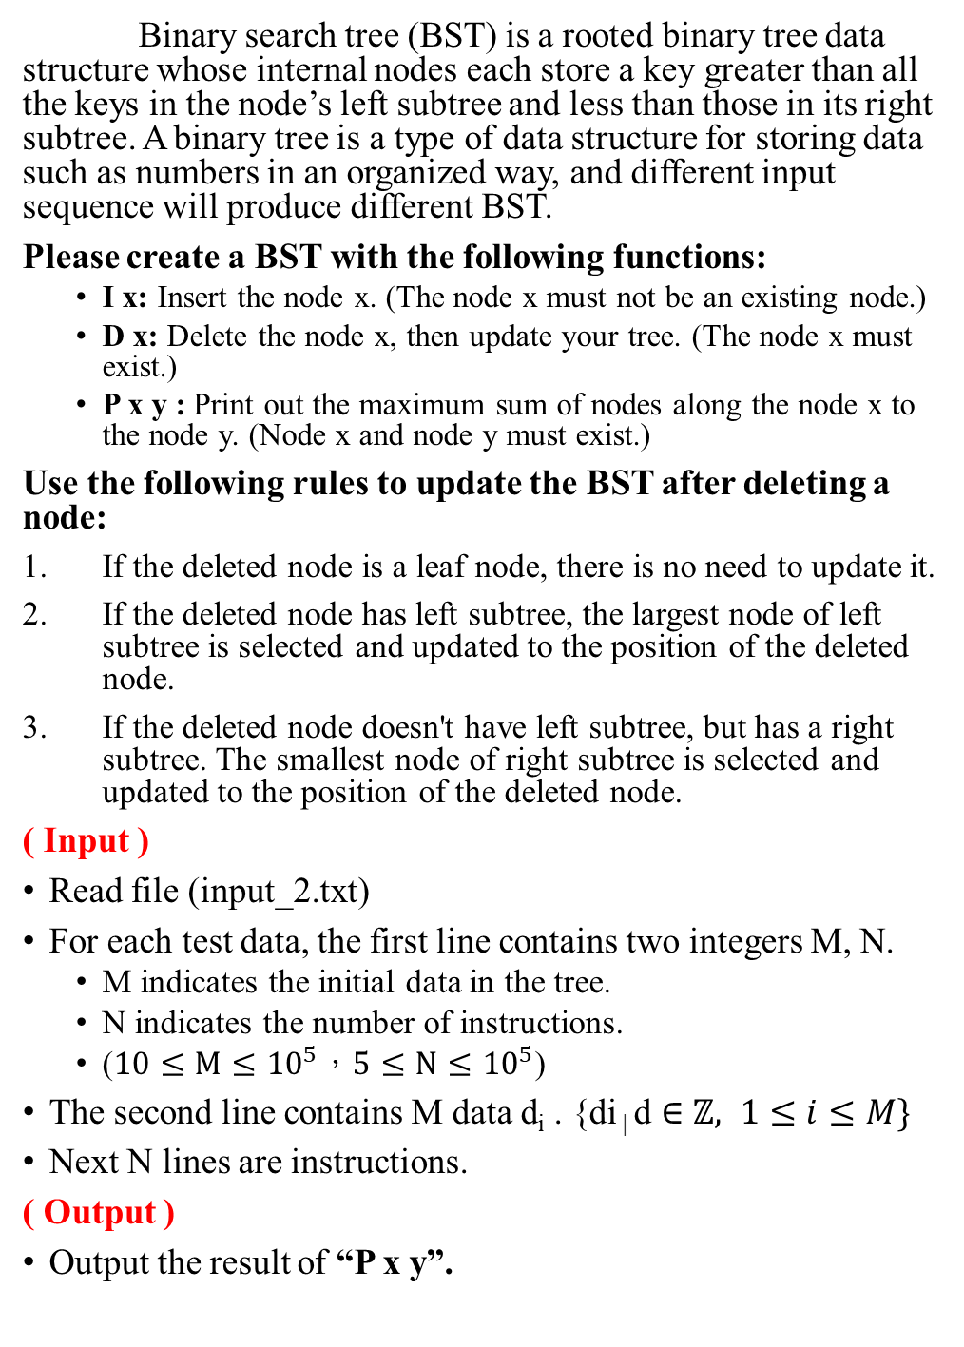
1. Binary search tree (30)
Binary search tree (BST) is a rooted binary tree data structure whose internal nodes each store a key greater than all the keys in the node’s left subtree and less than those in its right subtree. A binary tree is a type of data structure for storing data such as numbers in an organized way, and different input sequence will produce different BST.
Please create a BST with the following functions:
I x: Insert the node x. (The node x must not be an existing node.)
D x: Delete the node x, then update your tree. (The node x must exist.)
P x y : Print out the maximum sum of nodes along the node x to the node y. (Node x and node y must exist.)
Use the following rules to update the BST after deleting a node:
If the deleted node is a leaf node, there is no need to update it.
If the deleted node has left subtree, the largest node of left subtree is selected and updated to the position of the deleted node.
If the deleted node doesn't have left subtree, but has a right subtree. The smallest node of right subtree is selected and updated to the position of the deleted node.
( Input )
Read file (input_2.txt)
For each test data, the first line contains two integers M, N.
M indicates the initial data in the tree.
N indicates the number of instructions.
($10≤M≤{10}^{5}，5≤N≤{10}^{5}$)
The second line contains M data d_{i} . $\text{\{}\text{di}\text{ | }\text{d}∈ℤ, 1≤i≤M\}$
Next N lines are instructions.
( Output )
Output the result of “P x y”.

Slide 2
( Sample input )
10 3
6 4 2 5 8 1 3 7 9 10
I 100
D 2
P 1 7
( Sample output )
26

Slide 3
2. Preorder expression (30)
The standard way of writing expressions is known as infix notation. We have used this notation for all of the expressions written thus far. Although infix notation is the most common way of writing expressions, it is not the one used by computers to calculate expressions. Instead computers typically use prefix to calculate expressions.
Please use stack to do the preorder conversion
Operands only contain English letters.
Uppercase and lowercase letters are different.
Priority of operators:
1. ( )
2. * % /
3. + -
4. > <
5. & ^ |
( Input )
Read file (input_2.txt)
The first line contains a integer N.
N indicates the number of input strings.
Next N lines are input strings. ( length ≤ 100 )
( Output )
For each test data, output a line containing the preorder of each expressions.
( Sample input )
3
A+B*C
A|B*(C+D)
A%b&(C/z)>p*X

Slide 4
( Sample output )
+A*BC
|A*B+CD
&%Ab>/Cz*pX

Slide 5
3. Paint the plane (40)
Given a plane that has been designed but not painted, and a list of paints which contains the inventory and prices of various paints. Please paint this plane with the least cost.
However, coloring must comply with certain rules:
1. A block can only have one color, and it must be filled.
2. Adjacent blocks cannot use the same color.
3. The area of the block indicates how much paint is needed for coloring. (It costs one inventory per unit area)
( Input )
Read file (input_3.txt)
For each test data, the first line contains two integers N, E, L :
─ N indicates how many blocks the plane is divided into. (1~N，1≦N≦5000)
─ E indicates how many edges indicate whether the blocks are connected. ( 1 ≦ E ≦ N*(N-1)/2 )
─ L indicates how many items are in the list.
Next N lines are the area size of each block, separated by spaces.
Next E lines are the connection relationship between blocks.
─ each line contains two integers u and v, indicating the blocks at both ends of the edge.
After the map data is over, M rows of list data are followed, each row contains three variables a, b, c:
─ a indicates the color of the paint, and the color is represented by a letter plus a number. ([a-z][0-9], e.g. a1, b2)
─ b indicates the inventory of the paint.
─ c indicates the price of the paint.

Slide 6
( Output )
For each test data, output a line containing the minimum coloring cost of the plane.
( Sample input )
5 8 6
16 16 36 16 16
1 2
1 3
1 4
2 3
2 5
3 4
3 5
4 5
a1 100 25
a2 100 20
b1 10 5
b2 16 10
c1 20 12
c2 36 15
( Sample output )
1532

