Slide 1
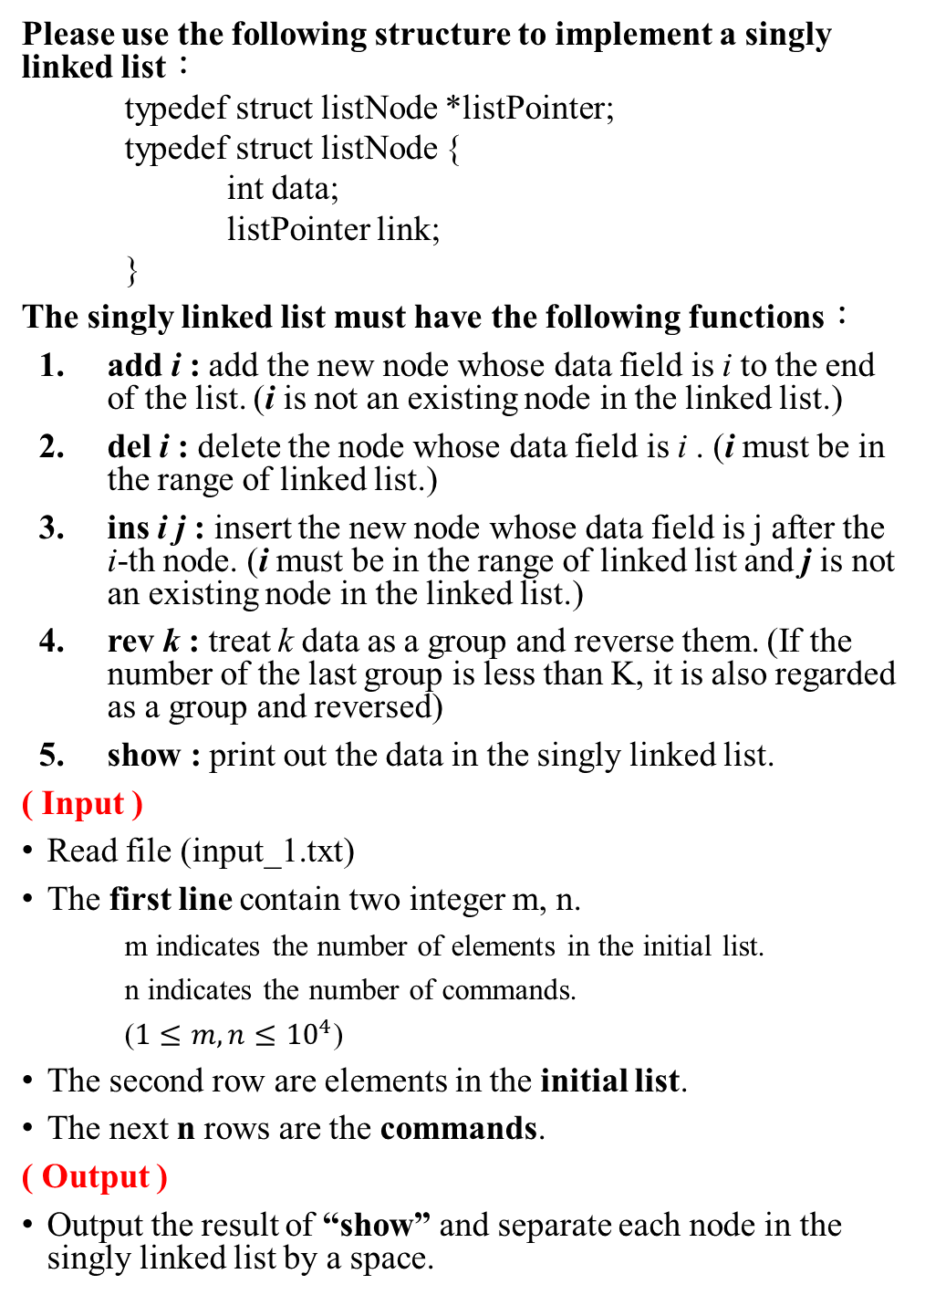
4. Singly linked list (30)
Please use the following structure to implement a singly linked list：
typedef struct listNode *listPointer;
typedef struct listNode {
int data;
listPointer link;
}
The singly linked list must have the following functions：
add i : add the new node whose data field is i to the end of the list. (i is not an existing node in the linked list.)
del i : delete the node whose data field is i . (i must be in the range of linked list.)
ins i j : insert the new node whose data field is j after the i-th node. (i must be in the range of linked list and j is not an existing node in the linked list.)
rev k : treat k data as a group and reverse them. (If the number of the last group is less than K, it is also regarded as a group and reversed)
show : print out the data in the singly linked list.
( Input )
Read file (input_1.txt)
The first line contain two integer m, n.
m indicates the number of elements in the initial list.
n indicates the number of commands.
($1≤m,n≤{10}^{4}$)
The second row are elements in the initial list.
The next n rows are the commands.
( Output )
Output the result of “show” and separate each node in the singly linked list by a space.

Slide 2
( Sample input )
6 6
1 2 3 4 5 6
add 9
add 8
rev 3
del 1
ins 3 11
show
( Sample output )
2 1 6 11 5 4 8 9

Slide 3
5. Logistics center (30)
You are the boss of a logistics company, and you come to a new area to expand your business territory. You want to find a good location to set up a logistics center, please select the location with the lowest total transportation cost based on the estimated order demand.
The cost depends on the total path length from the logistics center to the distribution locations.
Assuming that the driver must return to the logistics center for each shipment to deliver the next order, and cannot deliver multiple orders at the same time.
( Input )
Read file (input_1.txt)
For each test data, the first line contains two integers N, M.
─ N indicates the place where shipment may be required (1~N，1≦N≦10000)
─ M indicates the number of locations with order requirements (1≦M≦N)
Then N-1 edges represent the path and cost between locations:
─ Each edge contains three variables u, v, p
─ u and v indicate the locations at both ends of the path (1≦u≦N, 1≦v≦N)
─ p indicates the path length (1≦p≦500)
Next M lines are orders, each line contains two integers s, t:
─ s indicates the place where the order is requested (1≦s≦N)
─ t indicates the number of orders requested (1≦t≦500)
( Output )
For each test data, output a line containing the total cost of all orders on the first line.
The next line, output the location suitable for logistics center.

Slide 4
( Sample input )
5 3
1 2 10
2 3 20
3 4 30
4 5 30
1 10
2 10
5 20
( Sample output )
3400
2 3 4 5

Slide 5
6. Over the mountains (40)
Today, a special force comes to the battlefield. In order to retain their energy, they must take the most energy-saving route to reach some tactical locations. Given a bitmap, please find the path with the least energy consumption and follow the rules below:
1. The energy will be consumed depends on the height difference between the next step and the current step.
2. Eight directions of movement: north, northeast, east, southeast, south, southwest, west, and northwest.
3. All destinations must be visited once, and there is no restriction on the order.
( Input )
Read file (input_3.txt)
The first line contains two integers d and n:
d: how many destinations to be visited (1 ≤ d ≤ 5 )
n: indicates the size of the map. ( 5 ≤ n ≤ 100 )
The second line contains two integers x and y indicate the starting point.
The following d lines are the destination coordinates (d_{x},d_{y}).
Then, the next n lines are the map data (each line contains n elements).
( Output )
For each test data, output a line containing the total cost. (energy consumption)

Slide 6
( Sample input )
1 5
0 0
4 4
1 1 1 1 1
2 2 2 2 2
3 3 3 3 3
4 4 4 4 4
6 5 6 5 5
( Sample output )
4

