Slide 1
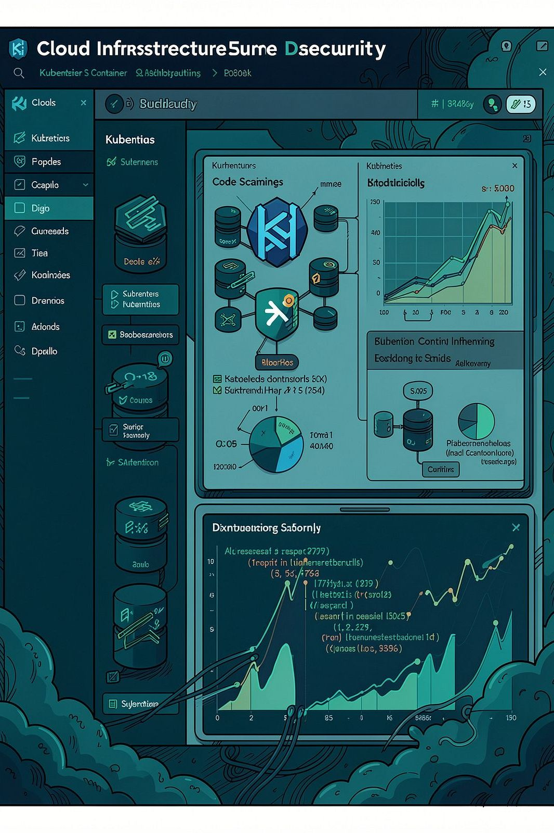
Benchmarking Cloud-Native
Misconfiguration Scanners
A controlled comparison of Checkov, Trivy and Kubescape
Honours research presentation
University of Johannesburg
Notes:
Source: final-d08.pdf, title slide and project framing.

Slide 2

Why scanner results are difficult to compare
The same artifact can produce incompatible evidence
Different rule IDs
Equivalent findings use scanner-specific names, so matching by identifier alone fails.
Different JSON structures
Raw alert totals do not prove that a scanner found the issue that the case was built to test.
A fair comparison needs labelled ground truth and one common evaluation method.
02
Notes:
Sources: final-d08.pdf, problem statement; README.md.txt, benchmark purpose and workflow.

Slide 3
Controlled benchmark design
Ground truth is defined before scanner performance is evaluated
60
160
3
deliberately insecure
use cases
applicable scanner-case
results
artifact families
20 Kubernetes YAML
20 Dockerfiles
20 Helm charts
Checkov · Trivy · Kubescape
Kubescape is not applicable to Dockerfiles
03
Notes:
Source: results/comparison/benchmark-comparison.json. Counts: 60 cases, 20 per artifact family, 160 applicable scanner-case results.

Slide 4
Evaluation pipeline
Every scanner follows the same traceable path
1
2
3
4
5
Raw output
Normalise
Match
Measure
Report
Keep the scanner's original JSON
Convert findings to one schema
Map rule IDs to ground truth
Calculate TP, FP, FN and scores
Create per-case and combined evidence
Strict matching treats findings without a ground-truth mapping as false positives for that controlled case.
04
Notes:
Source: README.md.txt and pipeline scripts. Stages: raw evidence, normalisation, ground-truth matching, metrics and reporting.

Slide 5
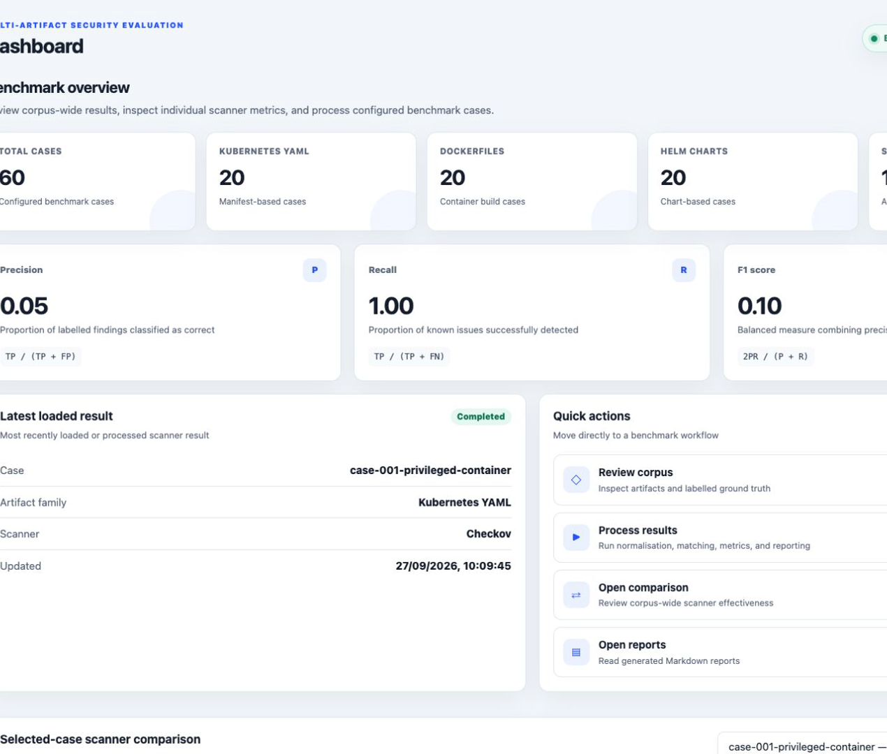
Live prototype
A complete user journey from one labelled case to the corpus-wide comparison
Corpus
Process
Inspect outputs
Compare
The demonstration follows case-001-privileged-container across all three scanners.
05
Notes:
Source: local Scanner Benchmark frontend and live dashboard state.

Slide 6

Major findings
Results from this controlled corpus
Trivy has the strongest overall balance
Dockerfiles produce the highest family scores. Helm produces the lowest because additional unmapped findings reduce precision.
06
Notes:
Source: results/comparison/benchmark-comparison.json. Overall micro F1: Checkov 31.97%, Trivy 42.92%, Kubescape 17.74%. Trivy Dockerfile micro F1 94.74%; Trivy Helm micro F1 27.03%.

